Slide 1
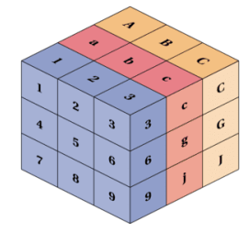
TensorFlow Tutorial for Beginners
Part-III
Notes:
1

Slide 2
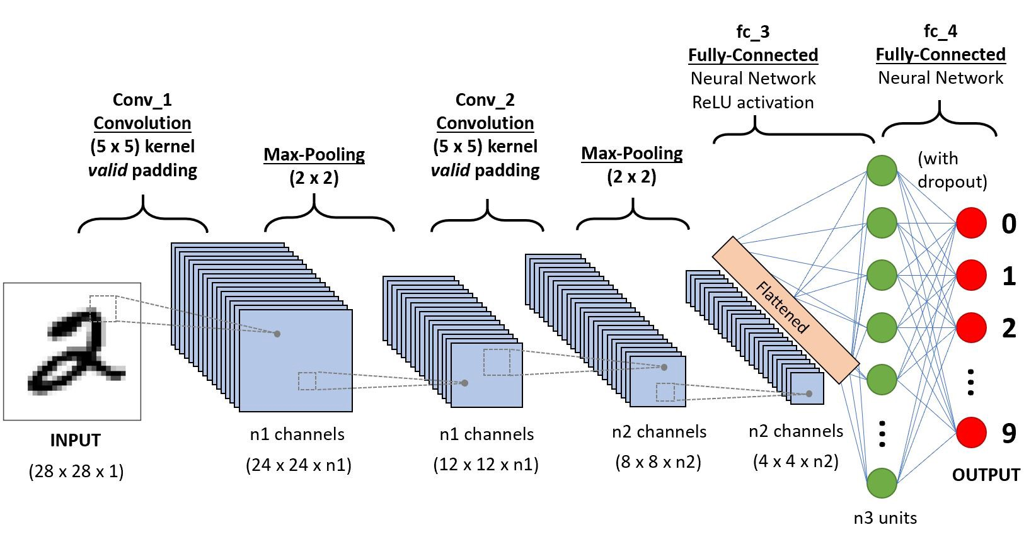
Convolutional Neural Networks
Notes:
2

