Slide 1

PROJECT PRESENTATION
ON
“Data Science Assisting Crisis Management ”
Presented by: Team SMRT Analytics
Shreya Khedekar
Muskan Shaikh
Richa Sirwani
Tithi Choudhary
Guide
“Dr. Meenakshi Thalor”

Slide 2
IMPLEMENTATION
The web application works in four stages to assist the user in decision making during a global pandemic.
Different pointers that help in decision making of the user have been mentioned below-
Growth of Pandemic (via per day confirmed, recovered and death counts)
Economically affected people(sector-wise)
Recovery Rate
Economical Dependencies
Impact of different phases of the lockdown

Slide 3
RESULTS OBTAINED
The web application is made user friendly and curated into a step
by step interface which assists the user in decision making during
pandemic like situations.

Slide 4
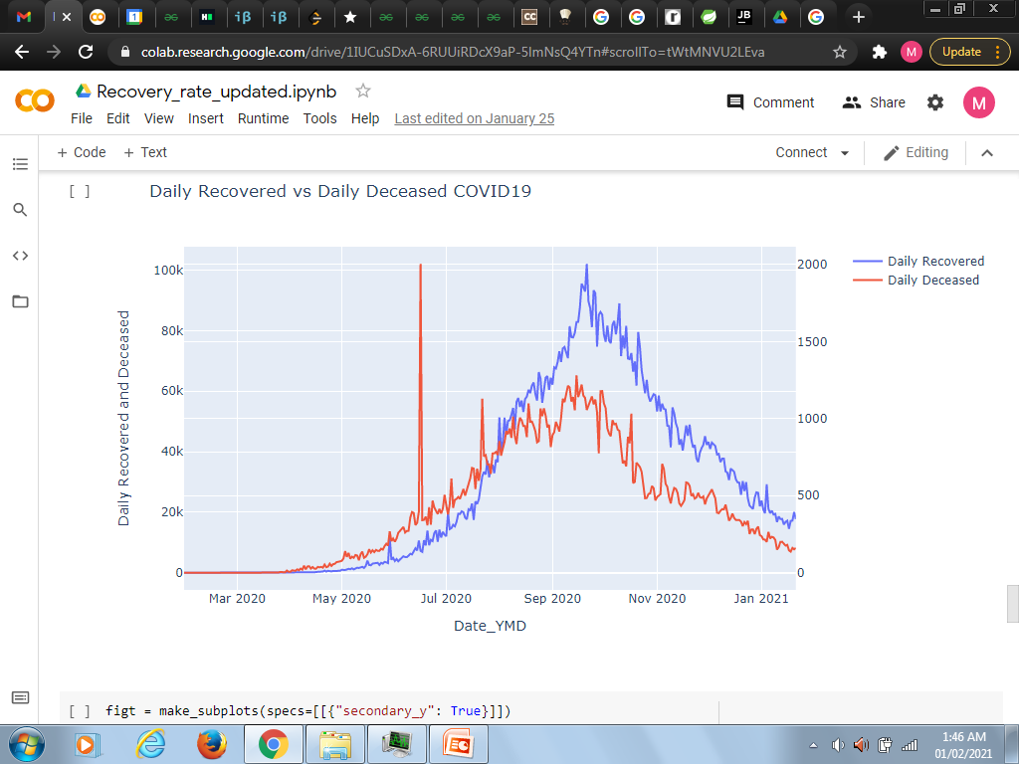
SCREEN 1
The first screen provides the user with insights into the current recovery rate .The data acquired on a daily basis is shown in the form of a graph based on recovery VS death rate.

Slide 5
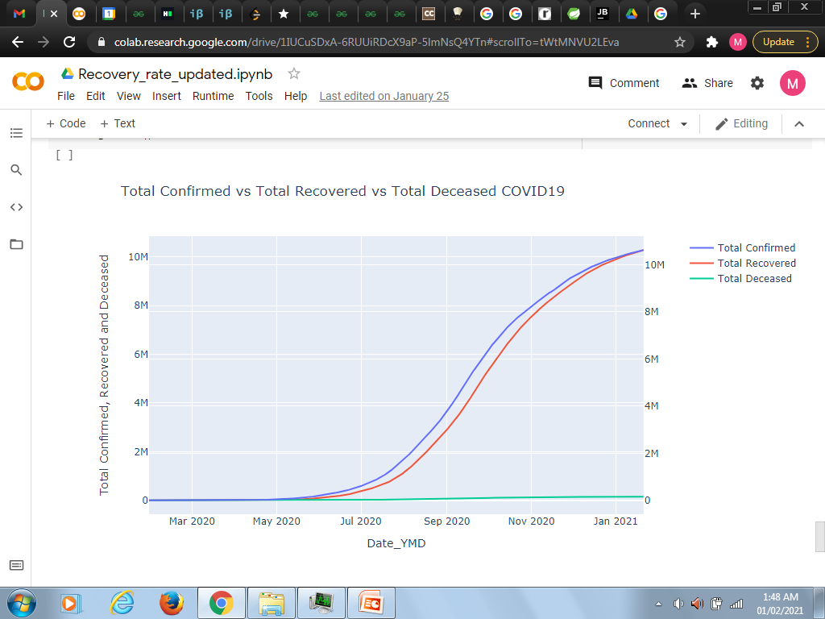
SCREEN 1
The second visual takes on the bigger picture providing an overall and detailed comparison between total number of confirmed ,recovered an deceased cases respectively .

Slide 6
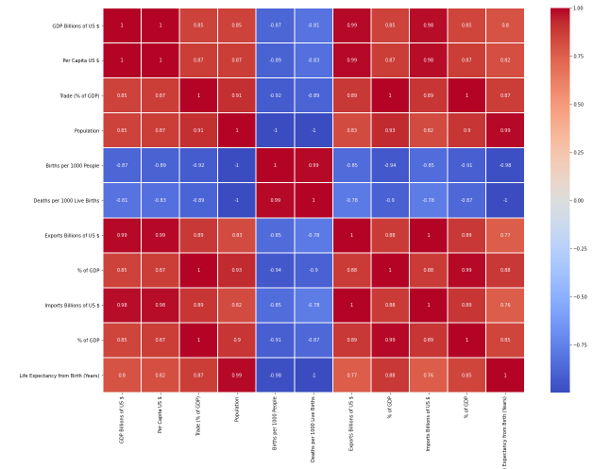
SCREEN 2
The heat map helped our system to work more efficiently. It helped the developer to choose between parameters that helped build a more reliable system for the user.

Slide 7
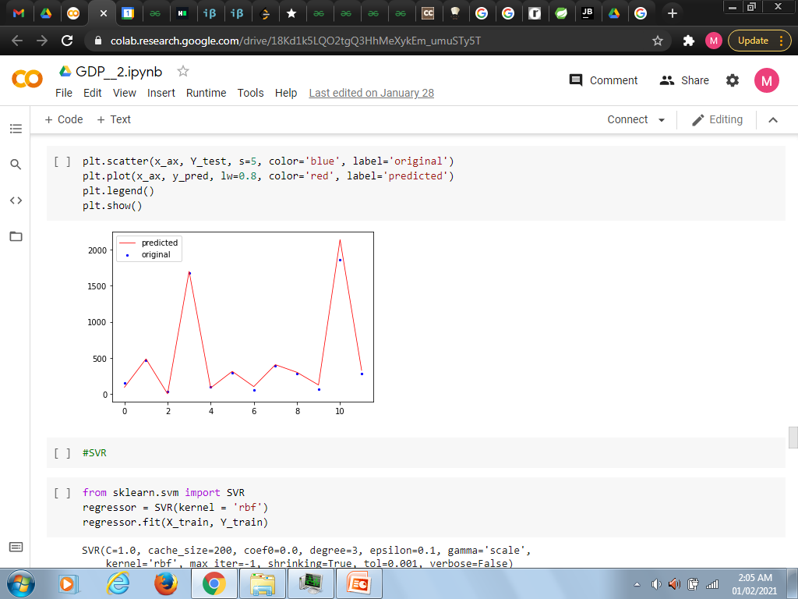
SCREEN 2
B. The screen shows pattern of the GDP of a country . There’s a comparison between the predicted and the current GDP.GDP being a major indicator of economic growth of a country, the following module allows us to check the trends in economic growth or fall in a particular situation.

Slide 8
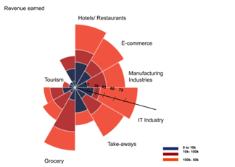
SCREEN 3
This screen showcases the impact of
the lockdown with the help of three
Factors-
Loss Calculation
Revenue rates- comparison between revenue rates during the lockdown in the business sector.
Time frame based economic impacts.

Slide 9

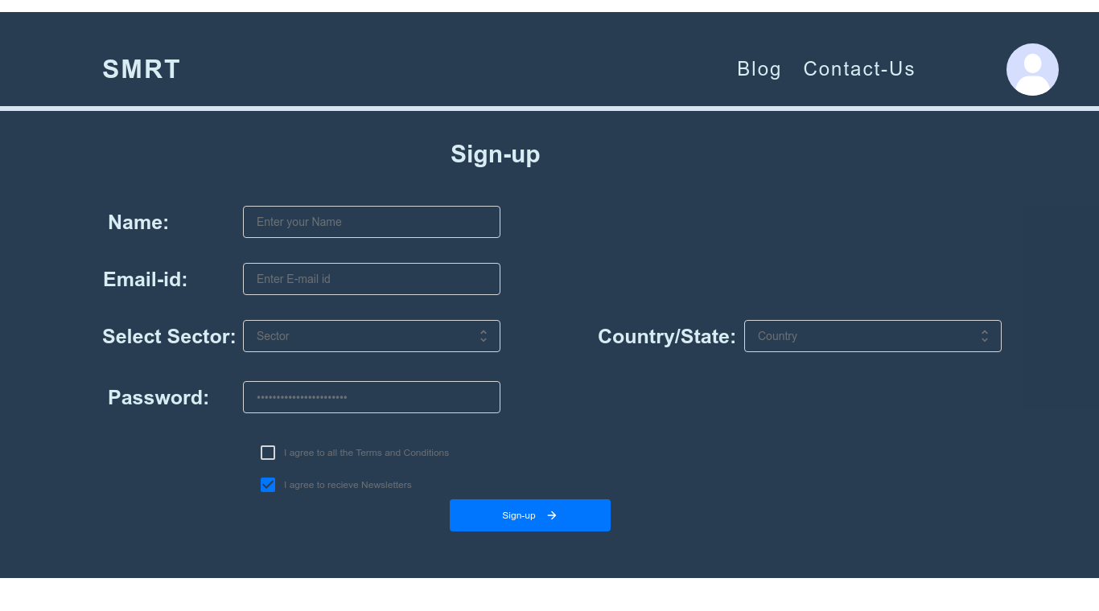
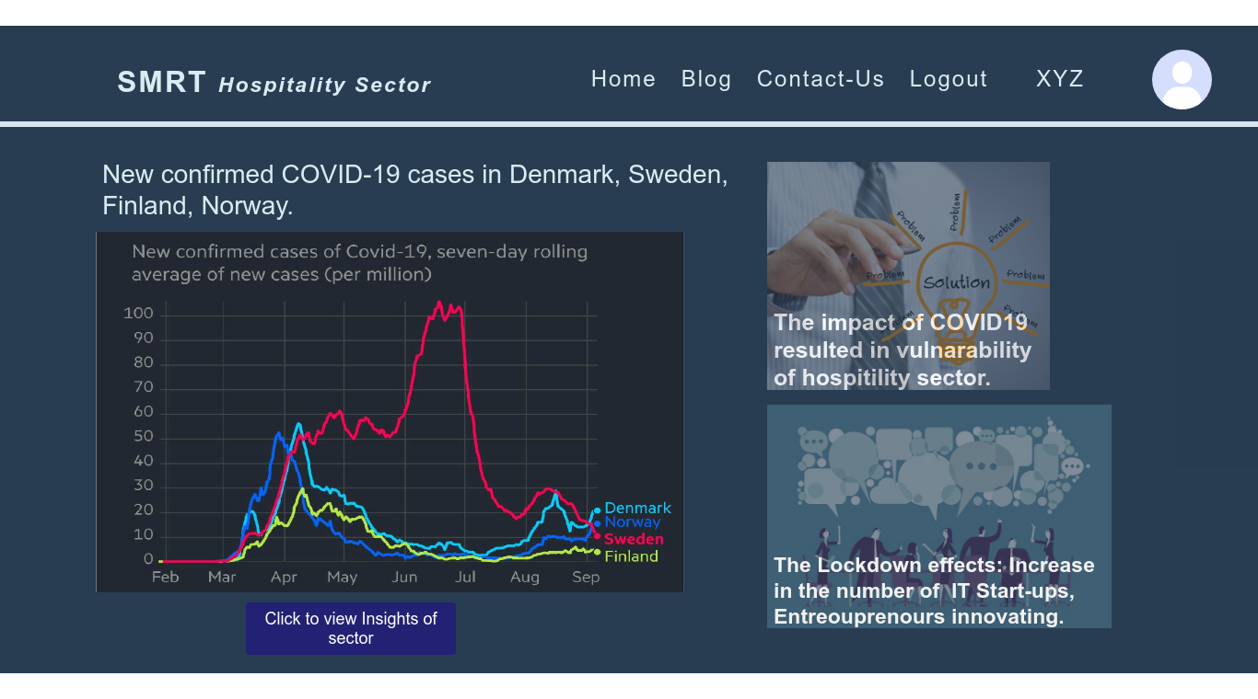
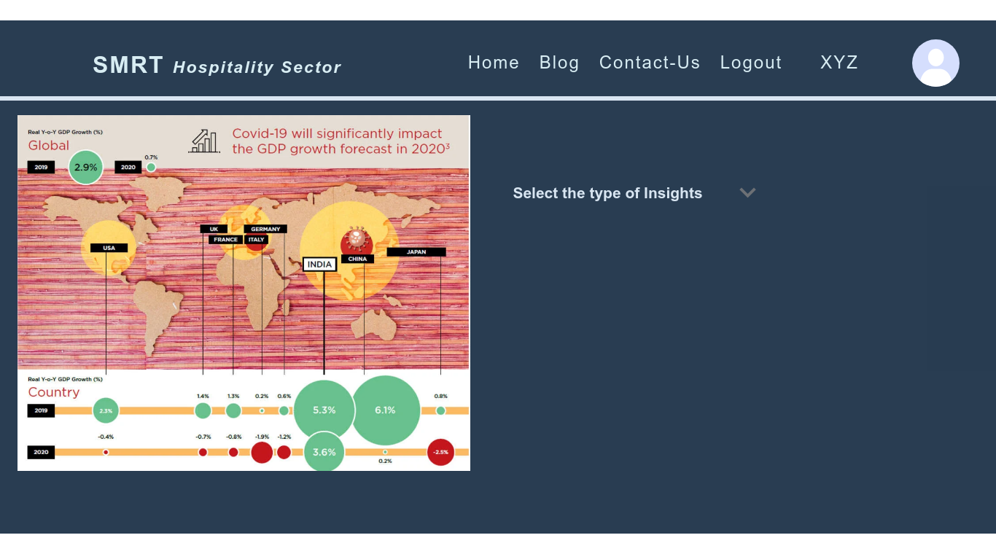
UI Screens

Slide 10
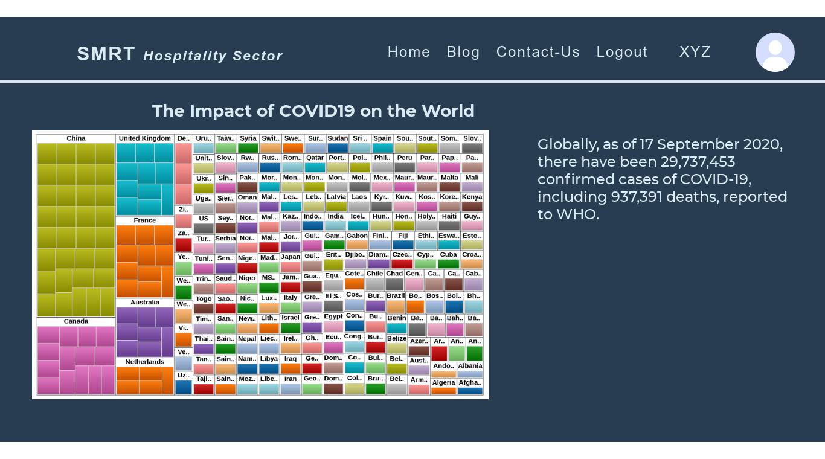
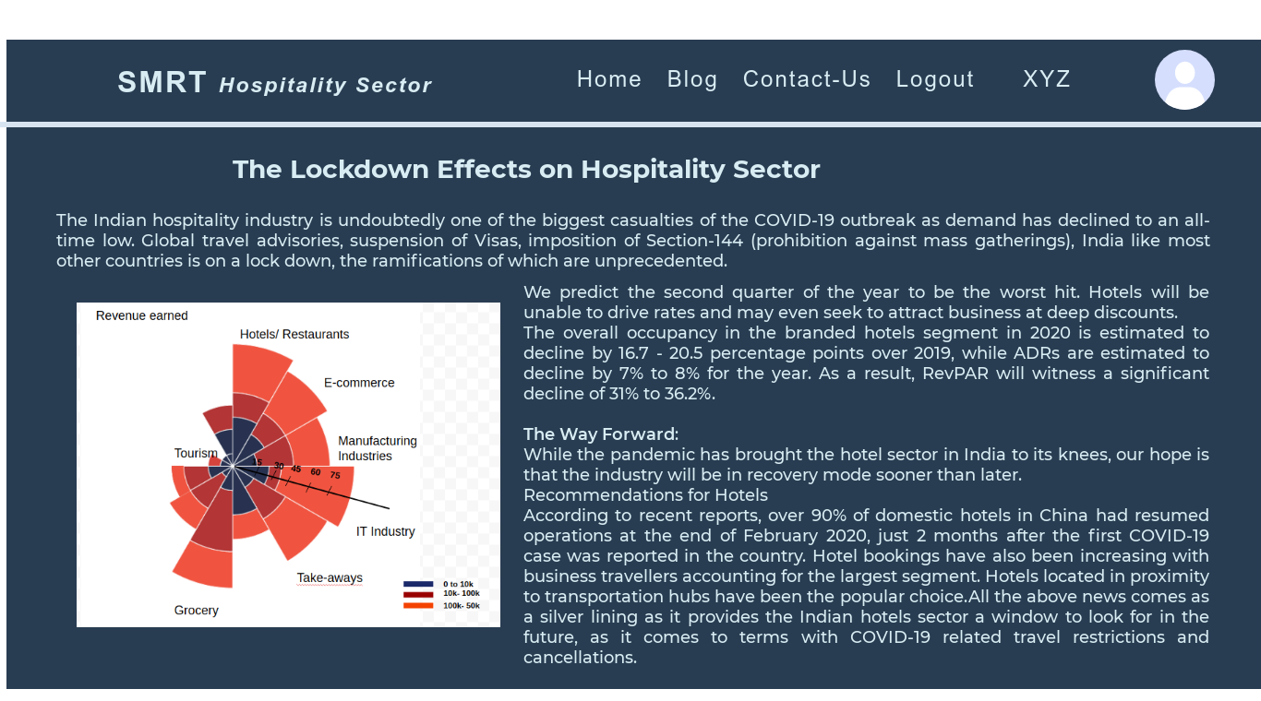
UI Screens

Slide 11
ALGORITHMS ,METHODOLOGIES
GDP Algorithm selection by GROOMS
Algorithms tested for GDP analysis and prediction along with their MSE and R2 scores are as follows:
S.No. | Algorithms | MSE | R2
1 | Linear Regression | 2261.878252 | 0.995431
2 | ElasticNet CV | 2310.806511 | 0.995332
3 | SGD Regressor | 3268.581138 | 0.993398
4 | Bayesian Ridge | 2320.479117 | 0.995313
5 | Lasso Lars | 2077.670415 | 0.995803
6 | ARD Regression | 1834.062541 | 0.996295
7 | Passive Aggressive Regressor | 6126.077982 | 0.987626
8 | TheilSen Regressor | 1822.249353 | 0.996319

Slide 12
For an algorithm to be best fit, the Mean Squared Error value should be lower and R2 value should be higher. Thus, from the table, it can be observed that TheilSen Regressor method satisfies the condition.
B. Progressive Mortality and Death Rate Calculation
Progressive Mortality Rate (PMR). In general, for any case/pandemic, Cwith an average recovery time period of P_{avg}, PMR can be computed as,
PMR = D_{C}x 100 ;
N_{Pavg}
D_{C} denotes the total number of death cases due to C disease and N_{Pavg} refers to a total number of infections before average recovery time period P_{avg}.
PRR = R_{C} x 100 ;
N_{Pavg}
where R_{C} refers to total number of recovered cases till date.

Slide 13
Conclusion
Using the available Raw Data we make sure it is worked on in a system which along with the application of Human Computer Interaction Fundamentals completes an analytical system that helps the user to make decisions on the basis of the results presented in the form of a series of info-graphic visuals on a interface that is designed keeping in mind the principles of UX(User Experience).

