Slide 1


YouTube Song Analysis
Prepared by
Aiswarya Lakshmi

Slide 2

OVERVIEW
This internship project focuses on analyzing YouTube song data using Tableau to uncover trends and patterns in performance, popularity, and user engagement.
Visualizations and reports generated will offer a deeper understanding of audience preferences and behaviors, helping optimize YouTube song content effectively.

Slide 3
PROBLEM STATEMENT
The goal of this project is to uncover factors influencing viewer behavior, such as optimal publishing times, content preferences, and engagement trends.
By creating insightful visualizations and reports, the project aims to provide actionable insights that enable content creators and stakeholders to optimize their YouTube song content effectively.

Slide 4

Dataset Description
1. video_id: Unique identifier for each YouTube video.
2. channelTitle: Title of the YouTube channel publishing the song.
3. title: Title of the YouTube song video.
4. description: Description provided for the YouTube song video.
5. tags: Tags associated with the YouTube song video.
6. publishedAt: Date and time when the YouTube song video was published.
7. viewCount: Number of views received by the YouTube song video.
8. likeCount: Number of likes received by the YouTube song video.
9. favoriteCount: Number of times the YouTube song video has been marked as a favorite.
10. commentCount: Number of comments posted on the YouTube song video.
11. duration: Duration of the YouTube song video.
12. definition: Video definition or quality (e.g., HD, SD).
13. caption: Availability of captions for the YouTube song video.

Slide 5
Project Objectives
1) Data Cleaning:
Checking for NULL VALUES:
Checking for null values in the dataset to ensure data completeness and accuracy.
Removed Rows having NULL values:
The column ‘Description’ have 2 null values.
Checked Datatype of all columns:
Changed datatype of column ‘Published_at’ to DateTime for accuracy.
Changed Column Names.
Changed some of the column names to standard formats.

Slide 6
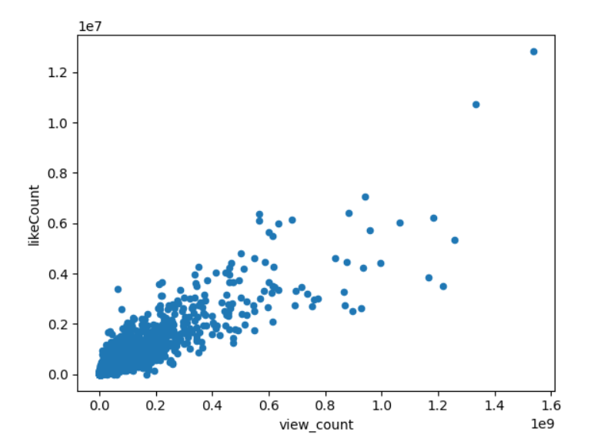
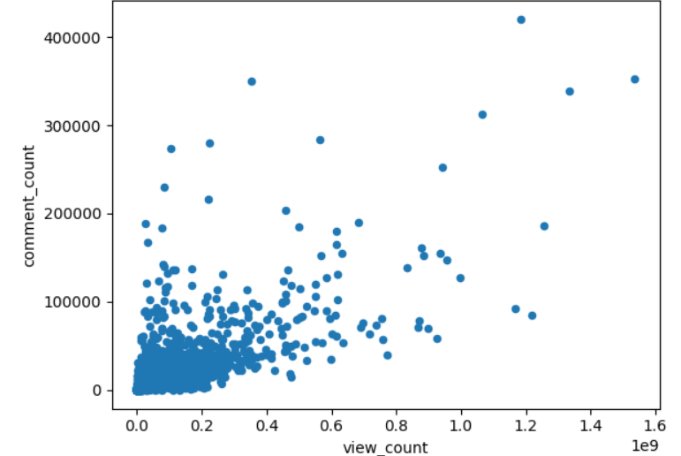
2) Exploratory Data Analysis (EDA):
Explore patterns and distributions in view counts, like counts, and comments

Slide 7
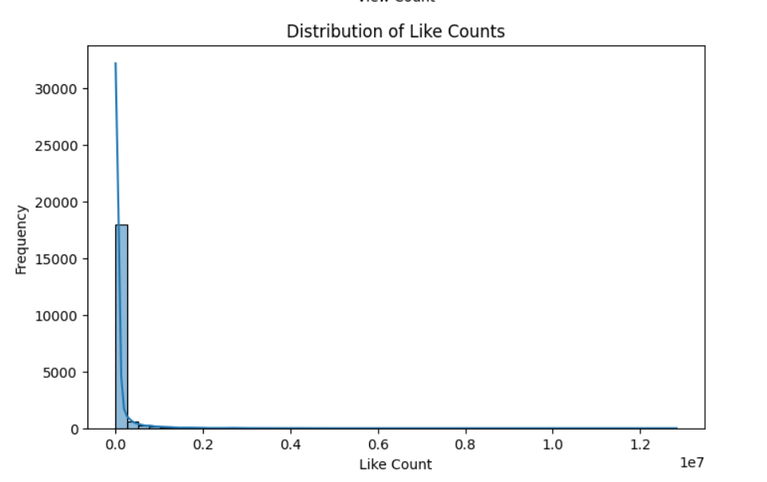
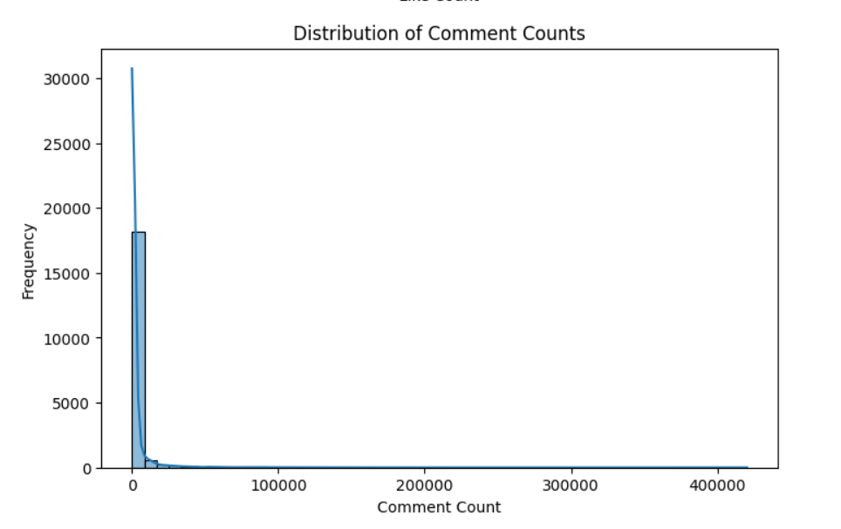
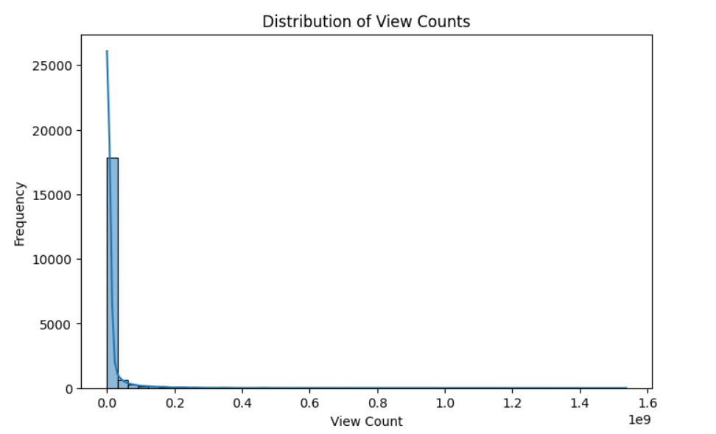
Identify trends in the popularity and engagement of YouTube song videos

Slide 8
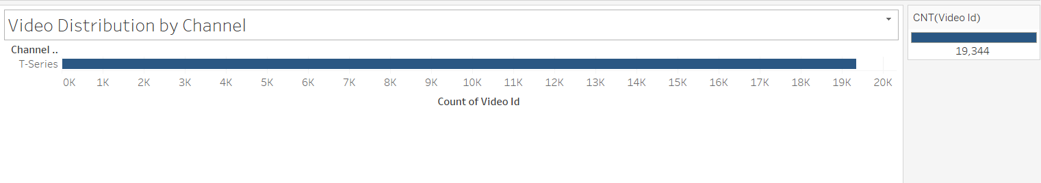
3. Content and Channel Analysis:
Analyze the distribution of videos across different channels.

Slide 9
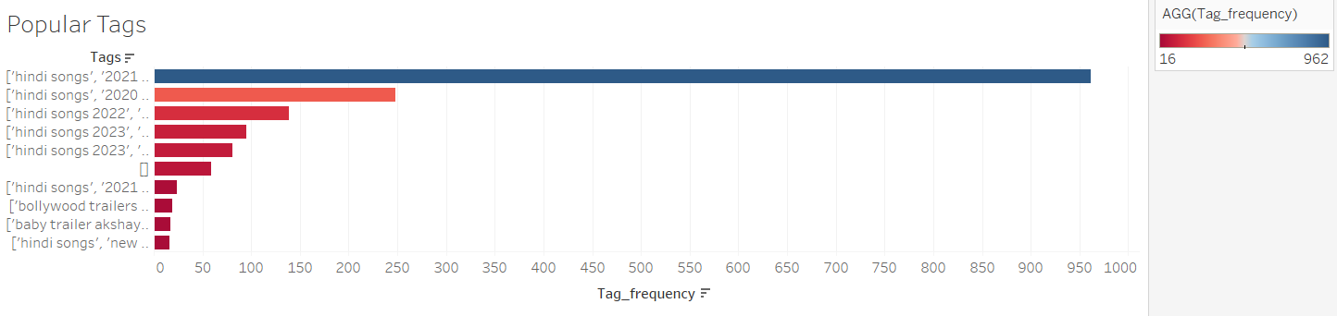
Identify popular tags and their correlation with view counts.

Slide 10
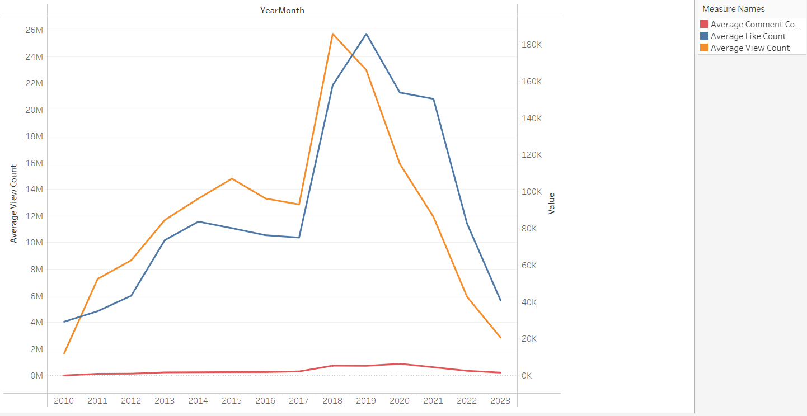
4. Temporal Trends:
Explore how YouTube song video metrics vary over time.

Slide 11
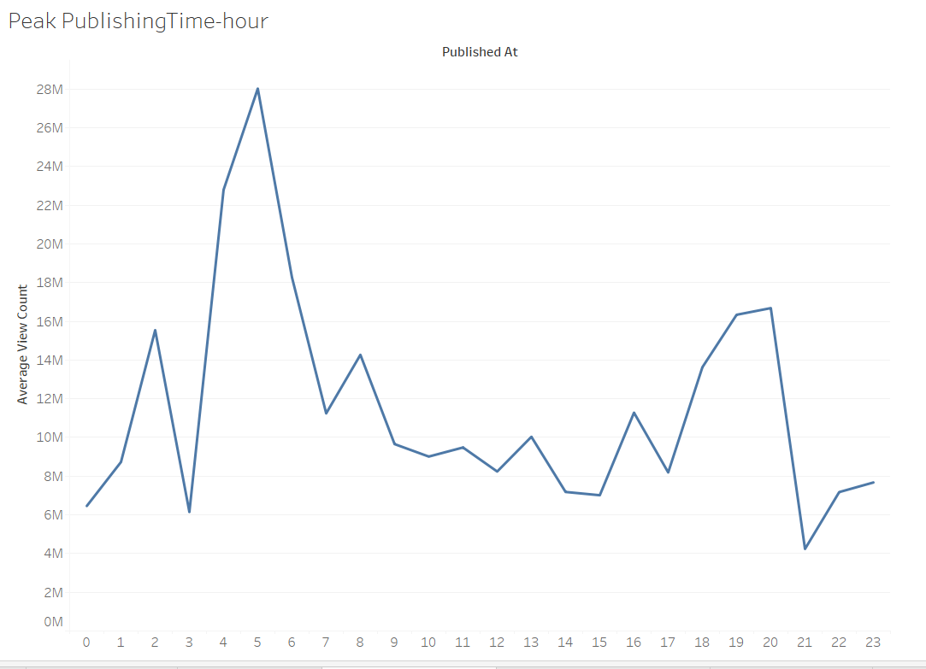
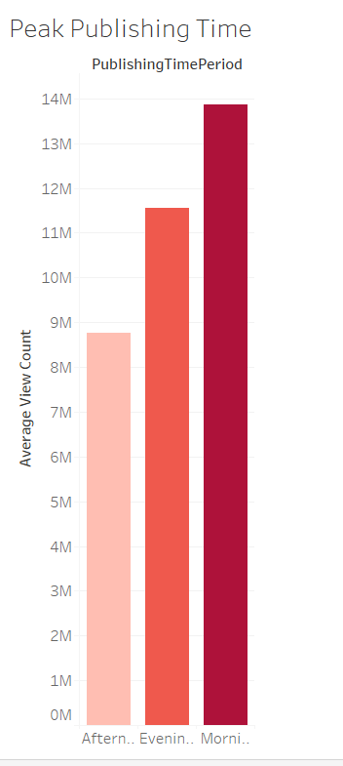
Identify peak publishing times and their impact on engagement.

Slide 12
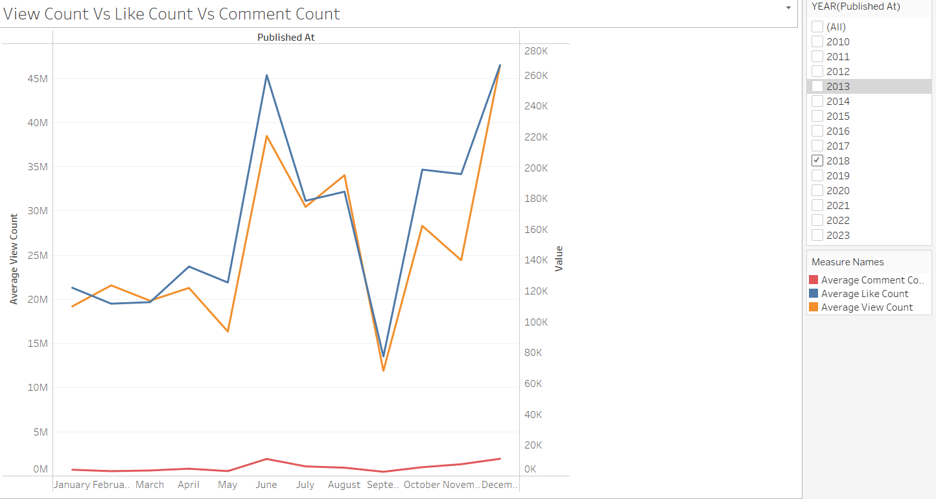
5. User Engagement Insights:
Investigate relationships between likes, comments, and views.

Slide 13
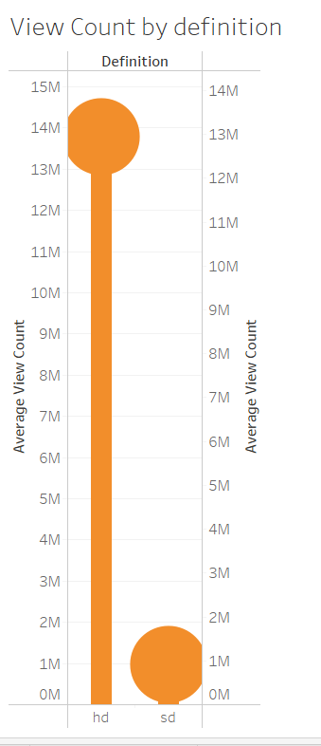
Factors influencing user engagement with YouTube song videos.

Slide 14
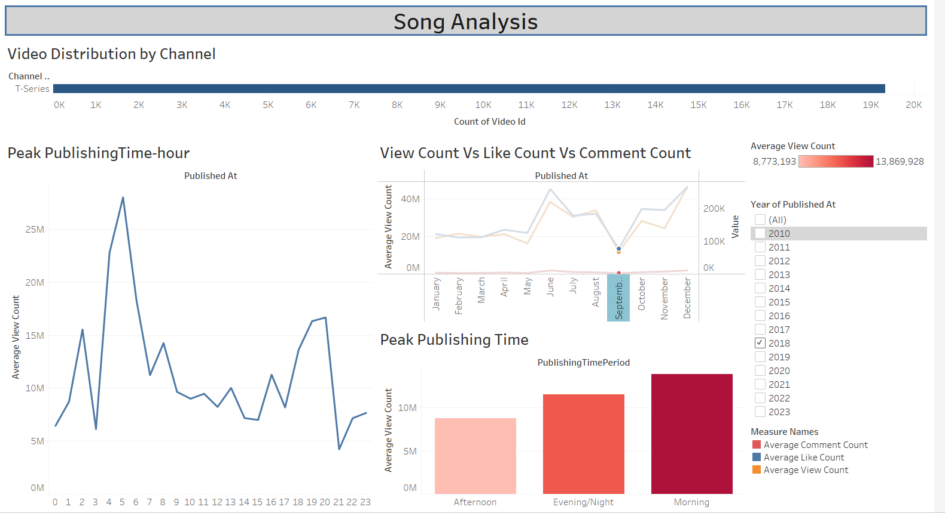
Dashboard View

Slide 15
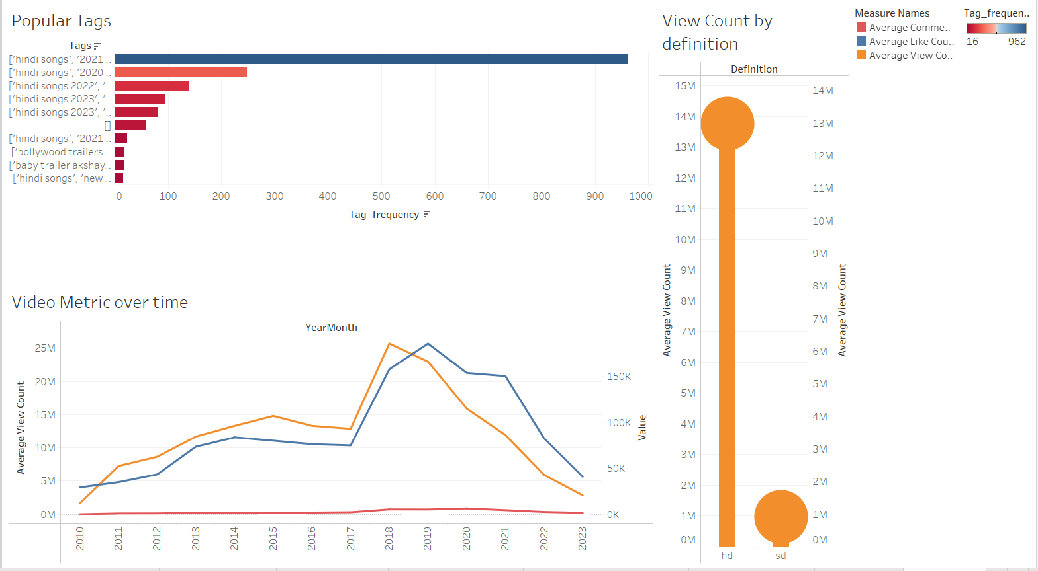
Dashboard view

Slide 16

Key Insights and Recommendations
Publishing Strategy:
Optimal Timing: Analyze data to identify peak times for publishing videos when your audience is most active. Consider scheduling uploads during these times to maximize initial views and engagement.
Analytics and Iteration:
Monitor Performance: Use YouTube Analytics to track metrics such as view counts, likes, comments, and watch time. Identify trends and patterns to understand what content resonates best with your audience.
SEO Optimization:
Keyword Optimization: Conduct keyword research to identify high-traffic keywords related to your content. Incorporate these keywords naturally into your titles, descriptions, and tags to improve SEO and visibility.

Slide 17

Conclusion
In conclusion, this project successfully leveraged Tableau to analyze YouTube song data, providing valuable insights into performance, popularity, and user engagement.
By identifying key trends and patterns, such as optimal publishing times and viewer preferences, we have equipped content creators and stakeholders with actionable strategies to enhance their YouTube song content. This analysis underscores the importance of continuous monitoring and adaptation in the dynamic landscape of digital content, ultimately aiming to maximize reach and viewer satisfaction.

