Slide 1

Prediction Market Value of Premiership Player
2017/2018 Season
(Group 15)

Slide 2


Slide 3

Group 15 members
Ibrahim
Samantha
Olayinka
Kunle
Majeed

Slide 4
Dataset Overview
The dataset was sourced from an online data repository kaggle.com
The dataset has 461 players and 17 features.
Aim
Build a model for estimating a player's market value.

Slide 5
Describing the Dataset
name: Name of the player
club: Club of the player
age : Age of the player
position : The usual position on the pitch
position_cat :
1 for attackers
2 for midfielders
3 for defenders
4 for goalkeepers
market_value : As on transfermrkt.com on July 20th, 2017
page_views : Average daily Wikipedia page views from September 1, 2016 to May 1, 2017
fpl_value : Value in Fantasy Premier League as on July 20th, 2017
fpl_sel : % of FPL players who have selected that player in their team
fpl_points : FPL points accumulated over the previous season

Slide 6
Describing the Dataset
region:
1 for England
2 for EU
3 for Americas
4 for Rest of World
nationality
new_foreign : Whether a new signing from a different league, for 2017/18 (till 20th July)
age_cat
club_id
big_club: Whether one of the Top 6 clubs
new_signing: Whether a new signing for 2017/18 (till 20th July)

Slide 7

Exploratory Data Analysis

Slide 8
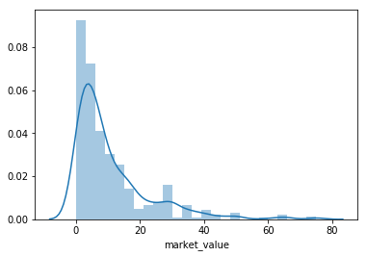
Market Value Distribution
Clearly not a normal distribution, but this was expected. Teams tend to have few elite players, and a large number of low + mid value players in their squads

Slide 9
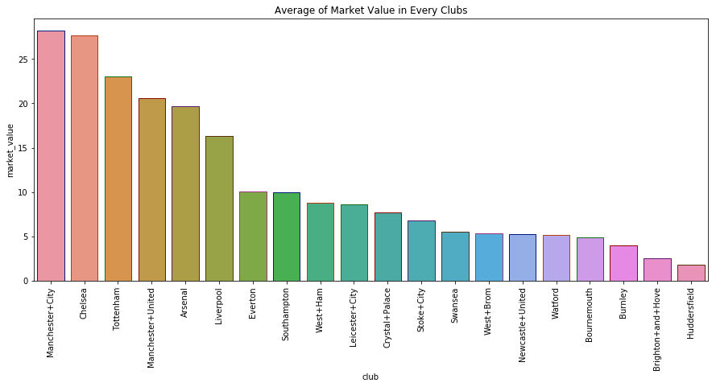
Average Market Value in Every Club

Slide 10
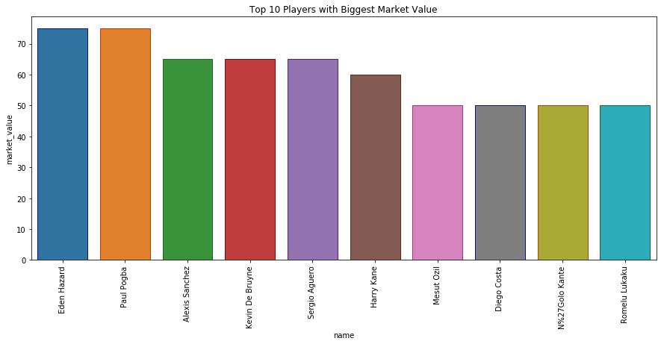
Top 10 Players with Biggest Market value

Slide 11
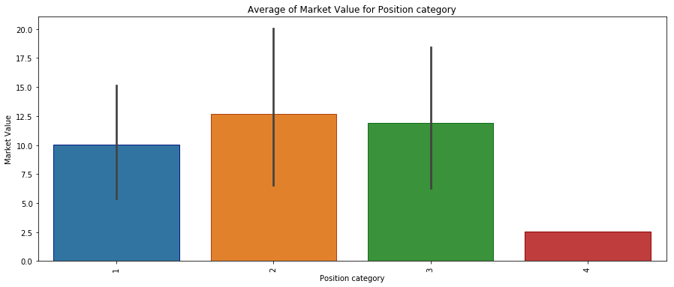
Average Market Value for Position
Attackers
Midfielders
Defenders
Goalkeepers

Slide 12
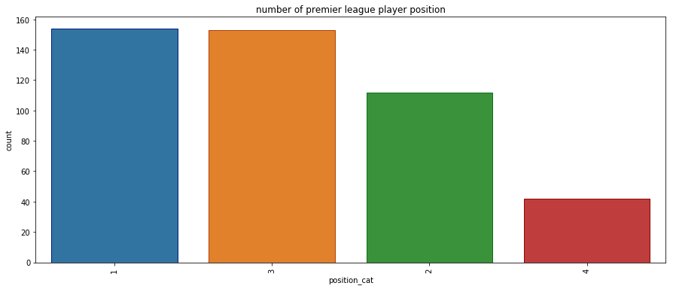
Number of Player Position
Attackers
Midfielders
Defenders
Goalkeepers

Slide 13
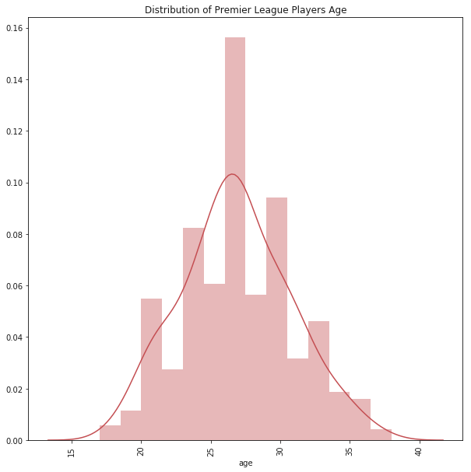
Players Age Distribution

Slide 14
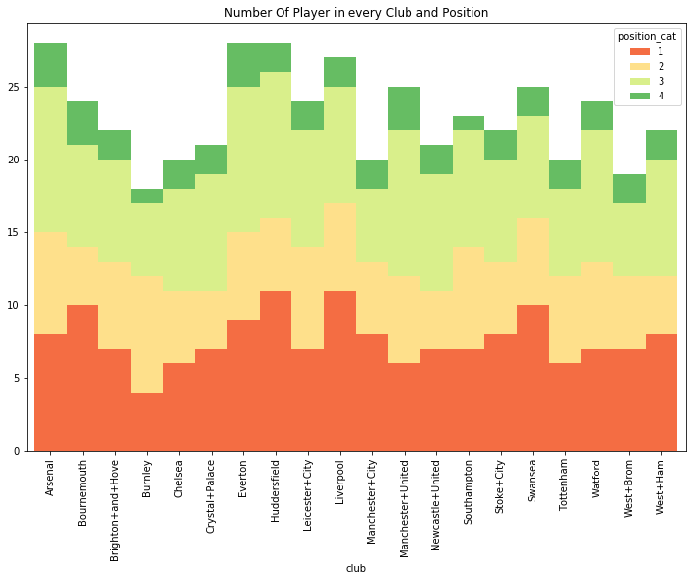
Number of Player in every club & Position

Slide 15
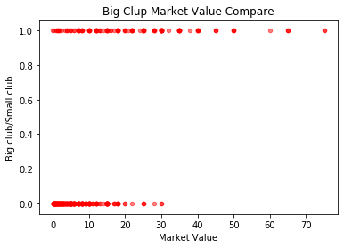
Big Market Value

Slide 16

Feature Selection

Slide 17
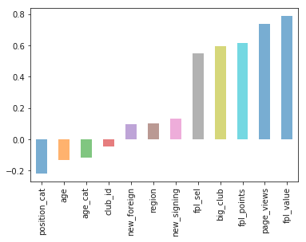
Feature Correlation

Slide 18
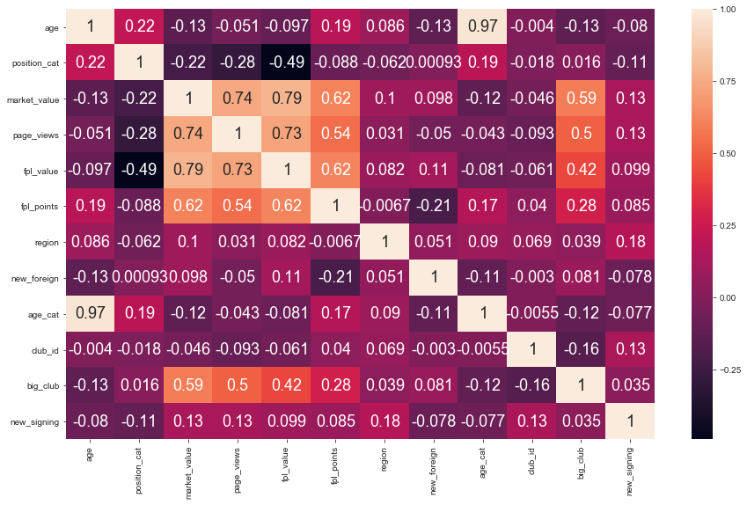
Feature Correlation Heatmap

Slide 19
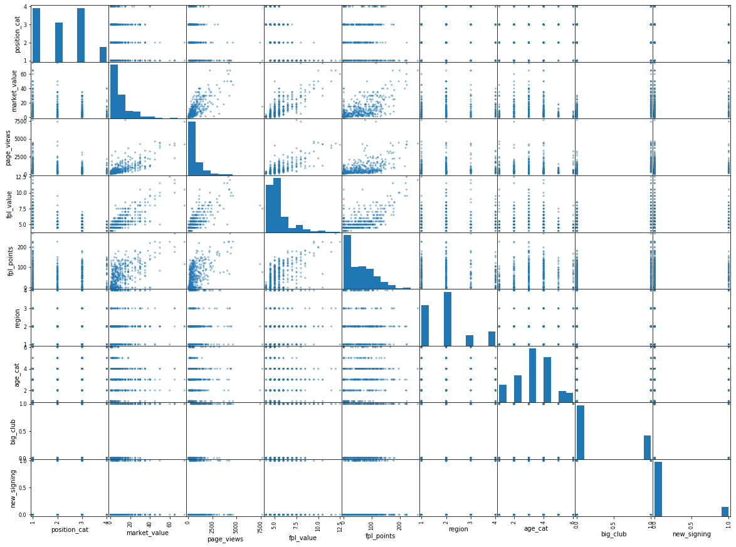
Feature Scatter Matrix

Slide 20
Selected Features For Model Building
After necessary Exploratory Data Science (EDA) and feature selection plots; we were convinced to build our models using the following features:
Position category
Page Views
Fpl Value
Fpl Points
Region
Age category
Big Club
New Signing

Slide 21
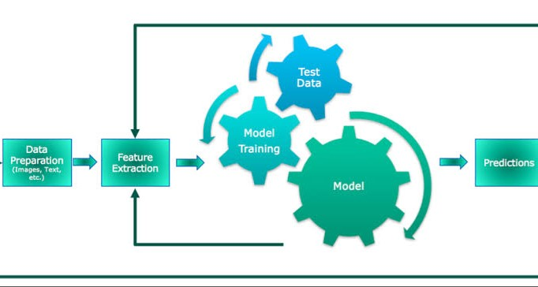
Model Building

Slide 22
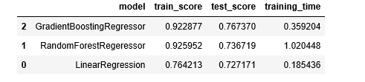
Model Results & Selection
The Gradient Boosting Regressor (GBR), Random Forest Regressor and Linear Regressor were implemented.

Slide 23
Recommendations
From the results of the models implemented. We recommend the following:
Based on the metrics used, the Gradient Boosting Regressor performed better, For example, it took GBR about 0.36 seconds to train the model.
Similarly, the GBR had an accuracy value of about 76.7% (the highest amongst the three models used)
We recommend the Gradient Boosting Regressor (GBR) which is an ensemble model; and thus, performs better than other regression model.

