Slide 1
TEAM KAPWEPWE
ANALYSING REVIEWS OF HOTELS AND RESTAURANTS IN NIGERIA TO DETERMINE CUSTOMER SENTIMENT

Slide 2
MEET THE TEAM
Orevaoghene Ahia - Mentor
Daniel Otulagun - Member
Olatunde Ogunboyejo - Member
Sarah Akinkunmi - Member

Slide 3
CONTENT
Introduction and Problem statement
Dataset description
Methodology/ Framework employed
Solution presentation
Summary

Slide 4
INTRODUCTION

Slide 5
INTRODUCTION
Choosing hotels and restaurants is a time-consuming process, often involving weeks of deliberation. To make informed decisions, prospective guests increasingly rely on online reviews, which sometimes contain huge volume of comments - some of which may be manipulated.

Slide 6
INTRODUCTION (contd.)
Our goal is to empower Nigerians in making better informed choices and help restaurants and hotels improve their services by leveraging guest feedback. This study's potential extends to diverse areas within the hospitality industry, such as tourism, travel, recreation, and entertainment.

Slide 7

DATASET DESCRIPTION

Slide 8
The data was scraped from TripAdvisor’s website, restricting our query to restaurants and hotels in Lagos, Nigeria.
Reviews on 155 restaurants and 110 hotels were obtained. In total, there were 8294 reviews for the restaurants and 10066 reviews for the hotels.
The full data dictionary for the restaurants is linked here and for the hotels is linked here.

Slide 9
After scraping all the files, they were merged in the command prompt before proceeding to cleaning
Since the header of each file was merged, we manually removed them from the merged files in Microsoft Excel.
We also converted the `visit_date` column for the restaurants and `stay_date` column for the hotels to date columns before proceeding to further cleaning in Google Colab.
CLEANING

Slide 10
The files were not readable at first, so we checked the character encoding and passed that into the pd.read_csv() function.
In Colab, we converted the author ratings to a 5-star system because each rating in the html file was recorded as “10, 20, 30, 40, or 50” (unavoidable due to the scraping).
Other cleaning steps we carried out were changing the character encoding of the `review_title` and `review_text` columns to UTF-8 and removing 'More' from the review_text column.
CLEANING
Notes:
'More' was mostly present in texts that were too long, so they were cut short on the TripAdvisor website. Unfortunately, it was not avoidable when scraping.

Slide 11
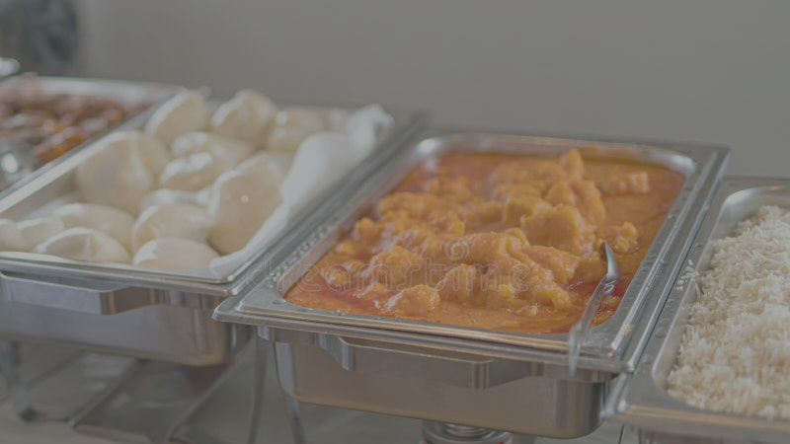
RESTAURANTS

Slide 12
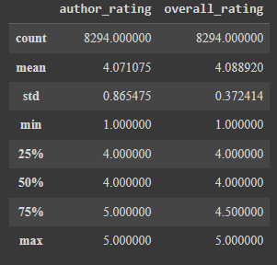
Getting the descriptive analysis of the `author_rating` and `overall_rating` columns ⇓
EDA

Slide 13
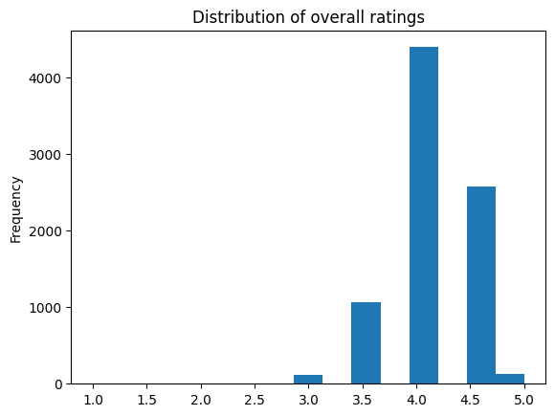
EDA
Notes:
The histogram shows a leftly skewed distribution with most of the scraped ratings being from 4.0 upwards. However, there are really few restaurants on TripAdvisor with lower than 3.0 ratings. Out of what was scraped, only 10 restaurants were rated negatively, 13 neutral and 132 positively

Slide 14
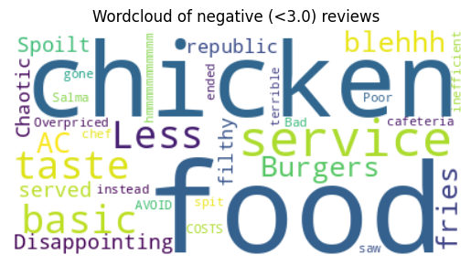
EDA
Notes:
“Chaotic", “Terrible”, "Spoilt", "Poor", "Basic", "Disappointing", "Overpriced" and "Inefficient" are some of the common words used for the negative ratings

Slide 15
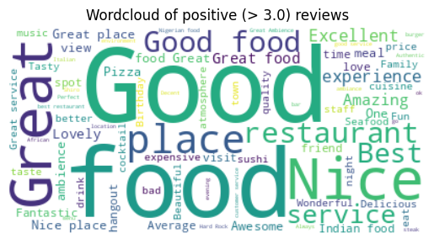
EDA
Notes:
It seems most of our visitors with positive ratings used "Good", "Great", "Best", "Beautiful", "Excellent", "Amazing", "Great service", “Lovely” and "Nice" in their review titles!

Slide 16
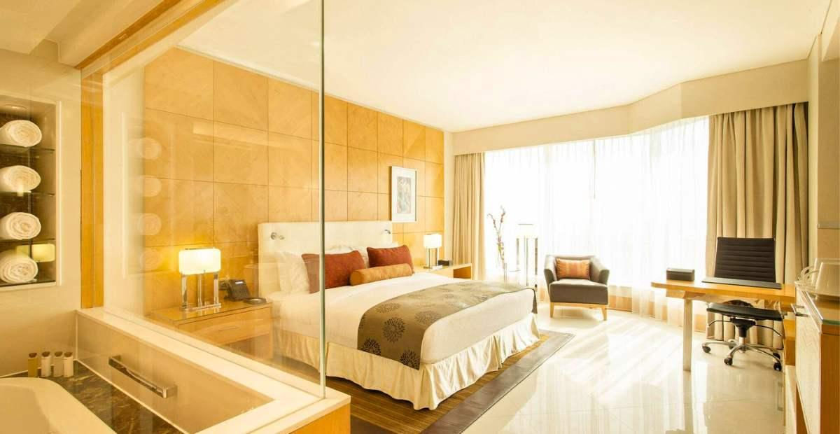
H O T E L S

Slide 17
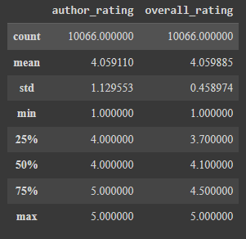
Getting the descriptive analysis of the `author_rating` and `overall_rating` columns ⇓
EDA

Slide 18
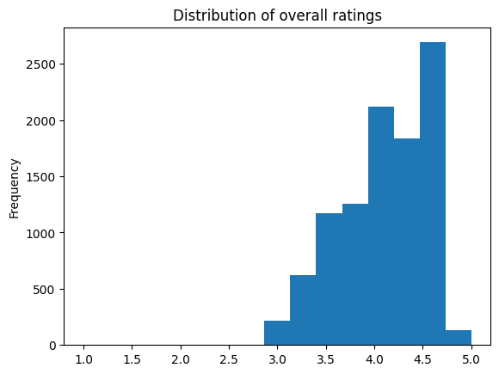
EDA
Notes:
The histogram shows a leftly skewed distribution with most of the scraped ratings being from 3.5 to 4.5. However, there are really few hotels on TripAdvisor with lower than 3.0 ratings.

Slide 19
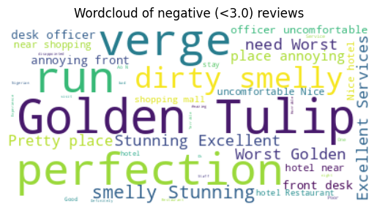
EDA
Notes:
"Uncomfortable", "Smelly", "Annoying", "Horrible", "Worst", are some of the common words used for the negative ratings. However, there are some anomalies like "Perfection, "Stunning", "Excellent Services". Perhaps, the author's selected the wrong stars.

Slide 20
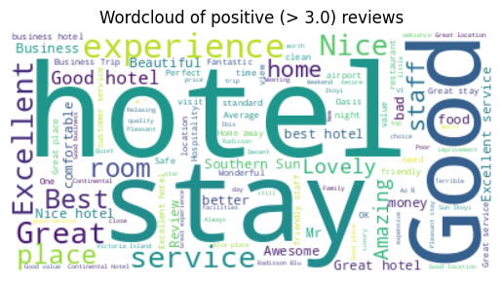
EDA
Notes:
It seems most of our visitors with positive ratings used "Good", "Great", "Awesome", "Fantastic", and "Excellent" in their review titles!

Slide 21
METHODOLOGY/ FRAMEWORK

Slide 22
After manually trying to calculate the TF-IDF and running into some issues, we went with using the VADER (Valence Aware Dictionary and sEntiment Reasoner) package which is attuned to social media language and used it for the sentiment analysis.
This package gives scores on the percentage of positive, neutral and negative words as well as the compound score. Using the threshold cited in the github docs, we were able to get the overall sentiment of each record.
FRAMEWORK

Slide 23
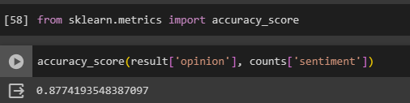
Thereafter, we grouped the records by the restaurant name and selected the sentiment. We chose the overall sentiment as the maximum between negative, neutral and positive counts.
Our restaurant model has an accuracy score of 87.7%.
FRAMEWORK

Slide 24
DEMO
https://lag-rest.streamlit.app/
https://lag-hotel.streamlit.app/

Slide 25
Summary

Slide 26
While there were some challenges faced such as:
Scraping reviews from Google. There are more restaurants reviewed with Google than TripAdvisor and also more people reviewing on Google, since TripAdvisor needs creating an account. This limited our scope to just TripAdvisor.
The sentiment analysis seemed more accurate with the review titles, because some of the review texts came off as sarcastic.
SUMMARY

Slide 27
VADER sentiment does not accurately detect sarcasm in Nigerian English as some of the obviously negative titles with sarcastic review texts were rated positive.
Deploying with Streamlit. Worked fine on local machine and then gave many issues during deployment.
SUMMARY

Slide 28
In all, there’s great potential for this project.
Ease of expansion into other domain areas in the hospitality and tourism industry.
Incorporating Nigerian English, pidgin and slangs to have higher accuracy on the sentiment analysis.
SUMMARY

