Slide 1
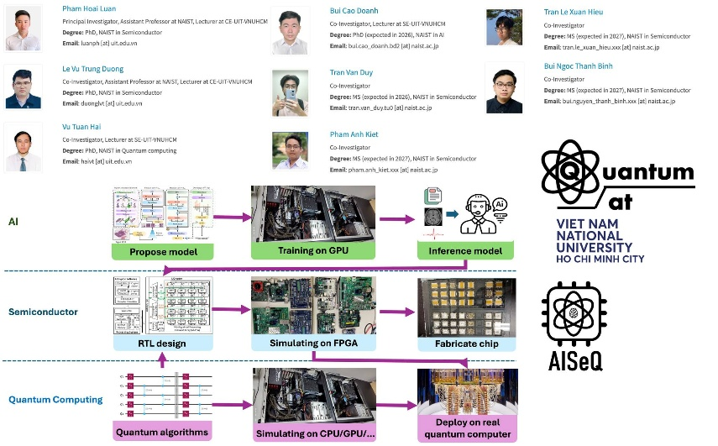

Slide 2
Accelerators for quantum computer
HCMUS, 15-Dec-2025
PhD. Vu Tuan Hai
Email: haivt@uit.edu.vn

Slide 3






Heart of quantum computers, we can not cover this part!
(3) Control and deploy on real quantum computers
(1) Deploy quantum programs at small scale
(2) Pass all test cases?
Then deploy on real quantum computers
Turn to ~ 0ºK
Cryogenic system
Quantum Emulator
(GPU/FPGA/ASIC)
Control
Quantum Processing Unit
Noise mitigation
We CAN cover this
Classical computer
(Your computer)
Control Electronics
(FPGA/ASIC)
We CAN cover this
Error correcting code device (FPGA/ASIC)
Quantum Computer

Slide 4
1.1. Quantum simulation approach
Table 1.1. My research’s contribution.
Note: △: Not implemented ○: Implemented/Available ◎: Improved
Approach | Device | Type | Theory analysis | Software design | Hardware design
Density matrix variant (state vector) [2] | FPGA ZCU102 | Emulator | ◎ | ○ | ◎
Wave function variant (state vector) [3] | FPGA ZCU102 | Emulator | ◎ | ○ | ◎
Extended stabilizer formalism [4] | GPU RTX4090 | Simulator | ◎ | ◎ | △
Tensor-network [5]
Decision diagram [6]
All related works are only focus on one of these aspects!
[2] Ali Javadi-Abhari,, et al. Quantum computing with Qiskit. arXiv preprint arXiv:2405.08810, 2024.
[3] Nguyen et al. Qsun: an open-source platform towards practical quantum machine learning applications. Machine Learning: Science and Technology, 3(1):015034, 2022.
[4] Andi Gu, Salvatore F. E. Oliviero, and Lorenzo Leone. Doped stabilizer states in many-body physics and where to find them. Phys. Rev. A, 110:062427, Dec 2024
[5] Feng Pan, Hanfeng Gu, Lvlin Kuang, Bing Liu, and Pan Zhang. Efficient quantum circuit simulation by tensor network methods on modern gpus. ACM Transactions on Quantum Computing, 5(4), November 2024.
[6] Thomas Grurl and et al. Arrays vs. Decision Diagrams: A Case Study on Quantum Circuit Simulators. In 2020 IEEE 50th International Symposium on Multiple-Valued Logic (ISMVL), pages 176–181, 2020.
Notes:
I summarized my research’s contribution in this slides.
There are a five major simulation approaches but I only focus on state-vector and stabilizer formalism (the first three row).
Each approach have its advantage and disadvantage in different context and different usecase.
Currently, many works accelerate the processing on quantum simulation, almost from software side.
but none of them improve both theory, software and hardware design at the same time.
While my work has been improve all three aspects. The state-vector approach is implemented on FPGA ZCU102, stabilizer formalism is just done on rtx4060.

Slide 5
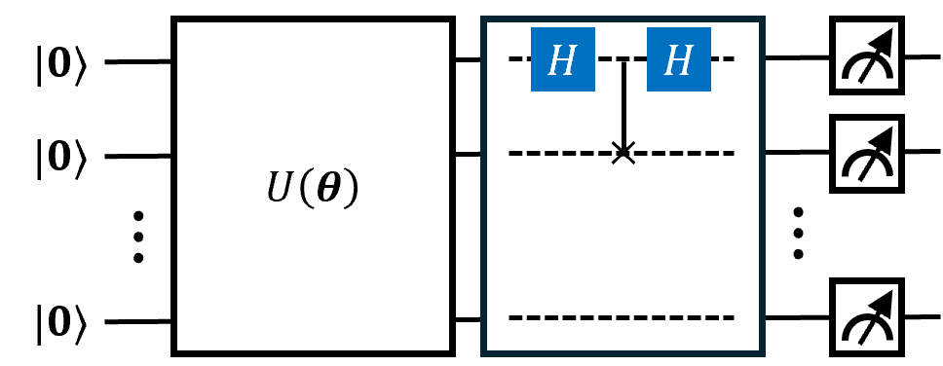
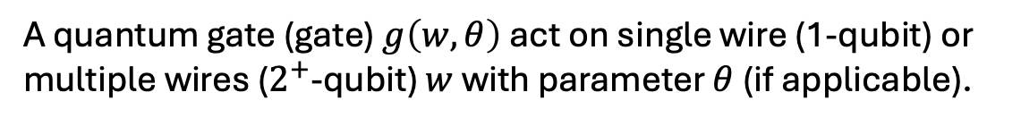
1.2. Quantum circuit model
Init state
Circuit/Operator
Gate
Decoder
Figure 1.1. A $n$ – qubit quantum circuit.
A quantum gate (gate) $g\left(w,θ\right)$ act on single wire (1-qubit) or multiple wires ($2^{+}$-qubit) $w$ with parameter $θ$ (if applicable).
Decoder (Observable) return the measurement values.
Notes:
The main model conducted during my thesis is the quantum circuit model.
Normally, the procedure is start with a initial state, then it is transformed by a series of unitary operator, then return the final or target state.
An unitary operator is composed from many gate, the gates are classified as one-qubit gate or multiple qubit gate, it also has the position on circuit and parameter if applicable.
In the other case, Instead of returning the whole target state, I can also take only a part of them through the observables or decoder, but in this thesis, I eliminate them.

Slide 6

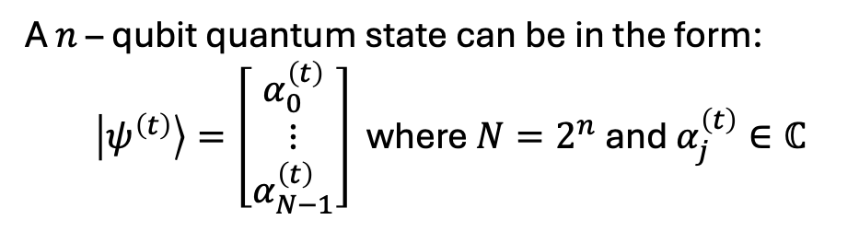




1.3. Representation of state & gate
A $n$ – qubit quantum state can be in the form:
  $\left|ψ^{\left(t\right)}\right\rangle =\left[\begin{matrix}α_{0}^{\left(t\right)} \\ ⋮ \\ α_{N−1}^{\left(t\right)}\end{matrix}\right]$ where $N=2^{n}$ and $α_{j}^{\left(t\right)}∈ℂ$
The number of amplitudes grows exponentially based on #Qubits
$$\left\|α_{j}^{\left(t\right)}\right\|≤1$$
A quantum gate update amplitudes $\left\{α_{j}^{\left(t\right)}\right\}$:
$$g\left(w,θ\right):\left\{α_{j}^{\left(t\right)}\right\}→\left\{α_{j}^{\left(t+1\right)}\right\}$$ | (1.1)
Traversing on a long vector
where $w$ and $θ$ are wires and parameter (if applicable).
Our target is to compute the evolved (final) state:
$$\left|ψ^{\left(m\right)}\right\rangle =U\left(θ\right)|ψ^{(0)}⟩$$ | (1.2)
Both $\left|ψ^{\left(t+1\right)}\right\rangle$ and $\left|ψ^{\left(t\right)}\right\rangle$ need to be saved at the same time
under unitary $U$. $U$ is composed from gates or sub-operators via tensor product/matrix multiplication
Notes:
The state, gate and operator presented in the last slide can be viewed as vector and matrix in the state-vector approach.
A state is simply a normalized vector which has dimensional two exponential of n where n is the number of qubits.
Because the length of state is only 1, so each element on state always has the norm less or equal 1.
The gate and operator is actually the matrix which has the element is the complex number.
A operator can be reconstructed by tensor multiplication between gates.
And when a operator acts on a state as Eq 1.2, it is equivalent to a matrix-vector multiplication.
But note that the dimensional of both state and operator increase exponentially based on the number of qubits.
Computing this term is a hard problem.

Slide 7
2. A wave-function based emulator (FQsun)
The wave-function approach is based on the representation in the last slides.
Challenges:
Efficient Memory Management: able to process large #Qubits
Flexible Quantum Gate Configuration: an adaptable gate configuration system is needed
Optimized Task Scheduling: the emulator requires an optimized scheduling mechanism to ensure continuous processing without latency.
Multi-Level Precision Support: supporting various precision levels allows the emulator to balance accuracy with resource usage
Notes:
In this section, we present how the equation 1.2 is emulated on ZCU102 following wave function variant. This emulator is called FQsun.
Challenge (a): Quantum emulation requires managing and processing large memory, especially as the #Qubits increases, which dramatically expands memory demands. Efficient data handling and minimized memory access times are crucial to achieving high processing speeds without excessive energy consumption.
Challenge (b): Different quantum algorithms rely on a variety of quantum gates, but many emulators are constrained by limited gate support. To effectively execute diverse algorithms, an adaptable gate configuration system is needed to facilitate a wide range of computations with minimal hardware reconfiguration.
Challenge (c): Quantum emulators must execute sequential calculations, where delays in one step can impact the entire system’s performance. To avoid bottlenecks, the emulator requires an optimized scheduling mechanism to ensure continuous processing without latency, thus maximizing resource utilization and computation speed.
Challenge (d) Quantum algorithms often demand different levels of numerical precision, from FX to FP, depending on application requirements. Supporting various precision levels allows the emulator to balance accuracy with resource usage, adapting performance to meet the specific needs of each quantum task while minimizing computational overhead.

Slide 8
2.1. Related works
Table 2.1. Surveyed results of related quantum simulators/emulators in the last five years.
(†) Depend on hardware resources (††) Estimated ONLY (†††) Best performance in 3-17 qubits.
Reference | Devices | Precision | #Qubits | Metrics
Qiskit | CPU/GPU/QPU | FP32,FP64 | (†) | Exe time
Pennylane | CPU/GPU | FP32,FP64 | (†) | Exe time
Analog-based emulator | UMC-180 nm CMOS analog | FP32 | 6-17 | Exe time, Power consumption
ZCVU9P-based emulator | Xilinx ZCVU9P | FX16 | 6 | Exe time, test accuracy
Alveo-based emulator | Alveo U250 | FP32 | 32 (††) | Exe time, resources utilization
Arria-based emulator | Arria 10AX115N4F45E3SG | FX16 | 32 (††) | Exe time, resources utilization, frequency
XCKU-based emulator | Xilinx XCKU114 | FX16 | 16 | Exe time, resources utilization
Stratix-based emulator | Altera Stratix EP1S80B956C6 | FX8, FX16 | 8 | Exe time, logic cell usage, frequency
This work (FQsun) | Xilinx ZCU102 | FX16/24/32, FP16/32 | 30 (†††) | Exe time, PDP, Fidelity, MSE, Power, Resources utilization
Universal simulator/emulator
Limited (Fixed) emulator
Notes:
As summarized in Table 2.1
Among existing quantum simulators, the most well-known include Qiskit, Pennylane, which are developed in Python. Other famous package can be found in my thesis.
From the quantum emulator’s side, analog-based emulators, introduced in [56], use CMOS analog circuits to represent real numbers naturally, which are suitable for simulating quantum states. Although analog circuits achieve higher energy efficiency, scalability, and speed than software, they face limitations when they only support a single algorithm with lower fidelity.
In contrast, FPGA-based emulators offer a more practical and developable approach while still achieving high speed and energy efficiency.

Slide 9
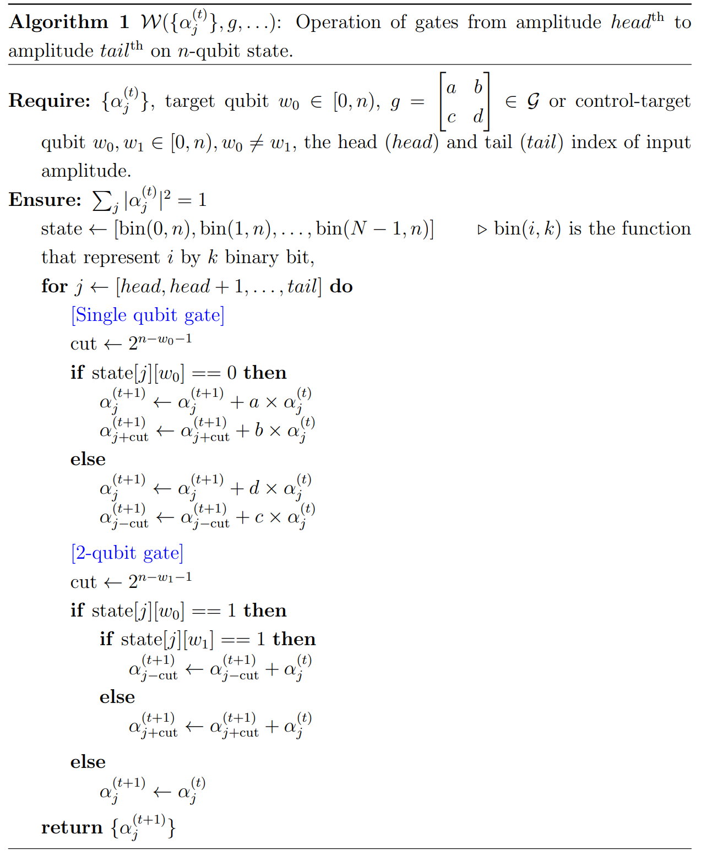
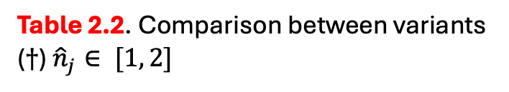
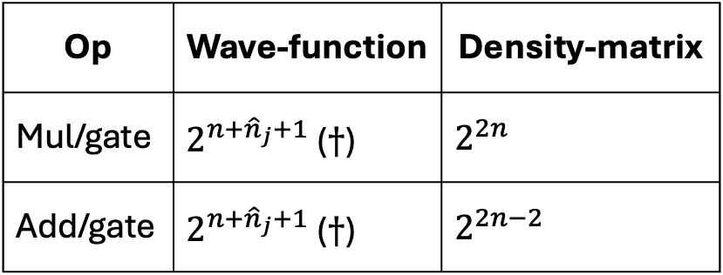
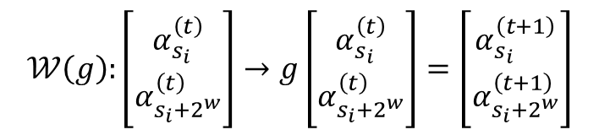
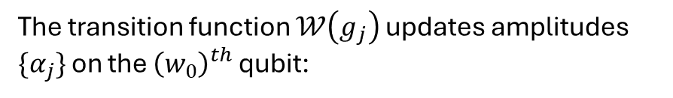
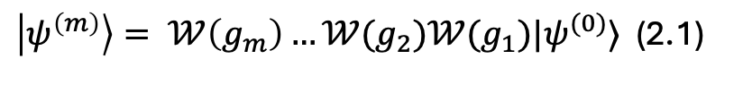
2.2. Algorithm
Table 2.2. Comparison between variants ($†$) ${\hat{n}}_{j}∈ [1, 2]$
Matrix-vector multiplication
Op | Wave-function | Density-matrix
Mul/gate | $2^{n+{\hat{n}}_{j}+1}$ ($†$) | $2^{2n}$
Add/gate | $2^{n+{\hat{n}}_{j}+1}$ ($†$) | $2^{2n−2}$
Depend on type
The final state is calculated through series of $𝒲$:
$\left|ψ^{\left(m\right)}\right\rangle = 𝒲\left(g_{m}\right)…𝒲(g_{2})𝒲(g_{1})|ψ^{(0)}⟩$ (2.1)
The transition function $𝒲\left(g_{j}\right)$ updates amplitudes $\{α_{j}\}$ on the ${\left(w_{0}\right)}^{th}$ qubit:
$$𝒲\left(g\right):\left[\begin{matrix}α_{s_{i}}^{\left(t\right)} \\ α_{s_{i}+2^{w}}^{\left(t\right)}\end{matrix}\right]→g\left[\begin{matrix}α_{s_{i}}^{\left(t\right)} \\ α_{s_{i}+2^{w}}^{\left(t\right)}\end{matrix}\right]=\left[\begin{matrix}α_{s_{i}}^{\left(t+1\right)} \\ α_{s_{i}+2^{w}}^{\left(t+1\right)}\end{matrix}\right]$$
(2.2)
Algorithm 2.1. The implementation of single- and multiple-qubit gates is unified into a common framework
Notes:
We can easily see that applying a operator on a n-qubit state has the complexity 2^2n because of the matrix-vector multiplcation.
Instead of that, we design an algorithm that only traverse on the state vector, the action will be design by quantum gate and the ooerator will not be constructed.
That help reduce both time and space complexity from 2^2n to 2^n.

Slide 10
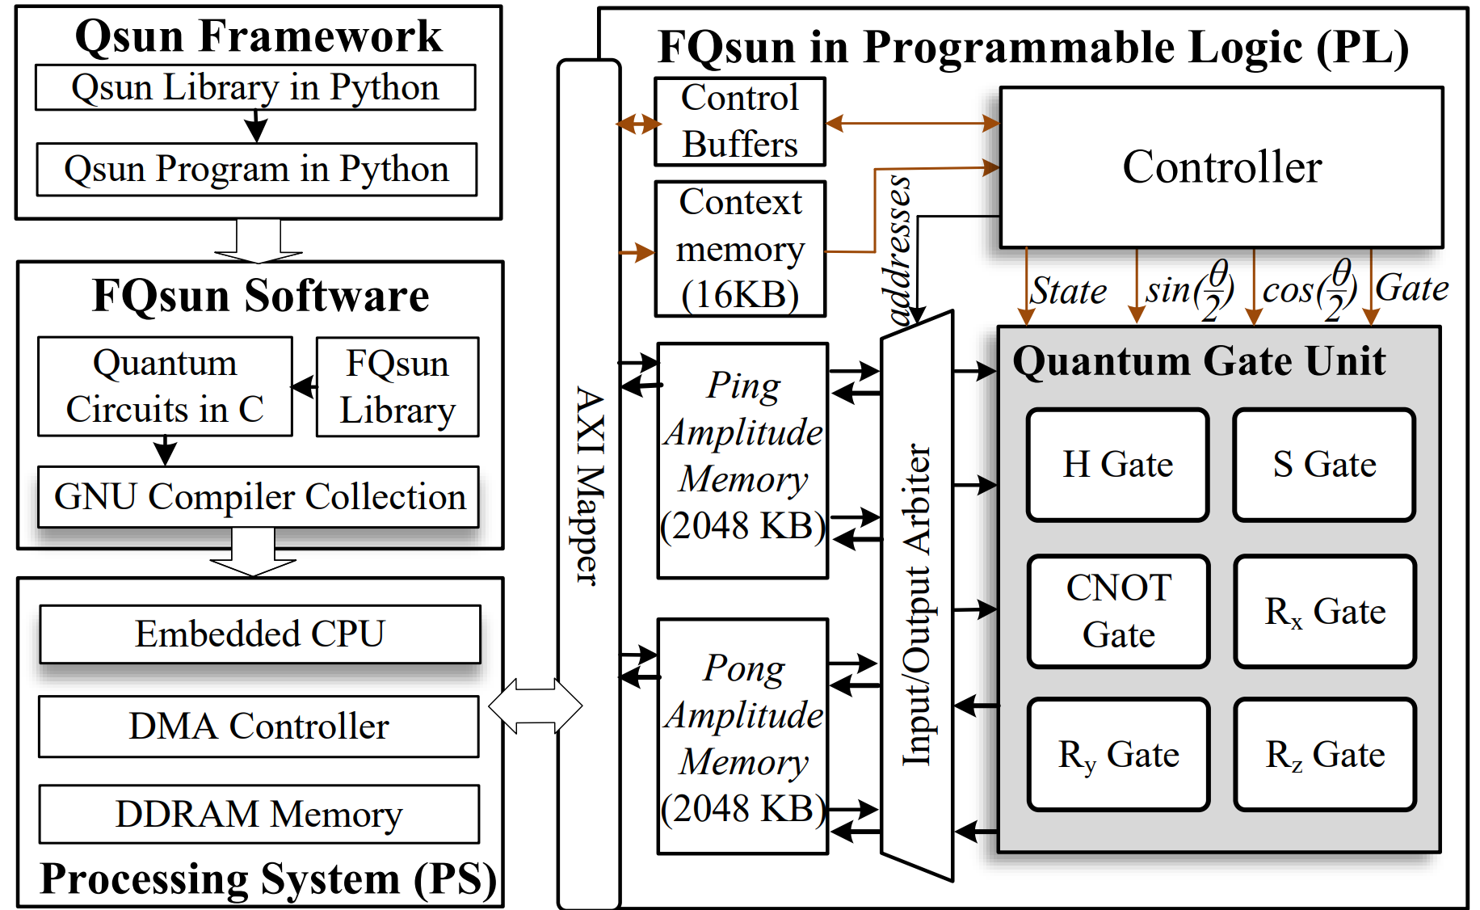
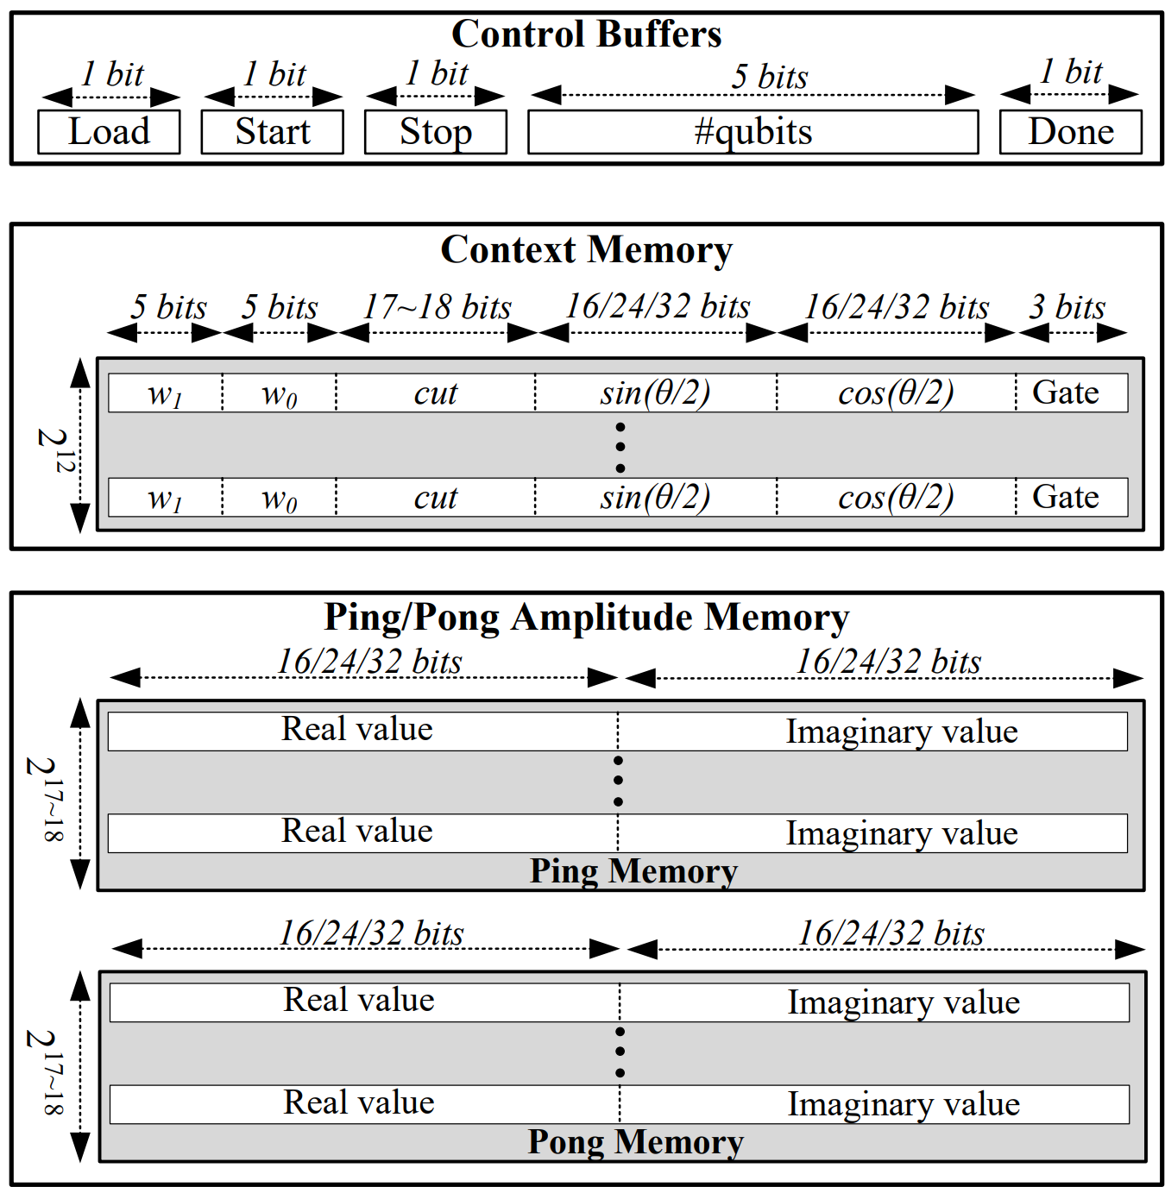
2.3. System overview/Ideals
Figure 2.1. Overview architecture of our FQsun at the system-on-chip (Soc) level on FPGA.
Ping-Pong memory
QGU
Figure 2.2. Memory organization of the proposed FQsun.
Notes:
Figure 2.1 details the proposed FQsun architecture on an FPGA at the systemon-chip (SoC) level. The system comprises four components: Qsun Framework, FQsun Software, Processing System (PS), and FQsun in Programmable Logic (PL).
The Qsun Framework, implemented in Python, includes libraries and programs for quantum simulation.
These programs can instruct the hardware to execute gates through the FQsun C library in FQsun Software.
Within the PS, the embedded CPU runs software such as the Qsun Framework and FQsun Software to control FQsun in PL for executing quantum simulation tasks.
In the PL, it consists of four modules: AXI Mapper, memory system, FQsun controller, and QGU.
The AXI Mapper manages and routes data exchanged between the PS and the FQsun memory system.
The FQsun memory system comprises Control Buffers, Context Memory, and a pair of Ping/Pong Amplitude Memory modules.
Control Buffers store control signals for the host FQsun Controller.
Context Memory holds configuration information such as gate type, gate location (cut, sin(θ/2), cos(θ/2), w0, w1), and gate parameters.
Notably, the Ping/Pong Amplitude 2 ×2048 (KB) Memory is the largest memory unit designed to store {α (t) j } for QGU. Finally, QGU serves as the main processing unit of FQsun.
QGU contains six fundamental gate units: {H, S, CX, Rx, Ry, Rz}. These basic gates can be combined to implement most other gates, ensuring high flexibility.
The hardware platforms such as FPGAs are limited by storage resources. To support large #Qubits, the memory organization of FQsun must be optimized.
Figure 2.2 illustrates the memory organization. There are three types of memory: Control Buffers, Context Memory, and Ping/Pong Amplitude Memory.

Slide 11
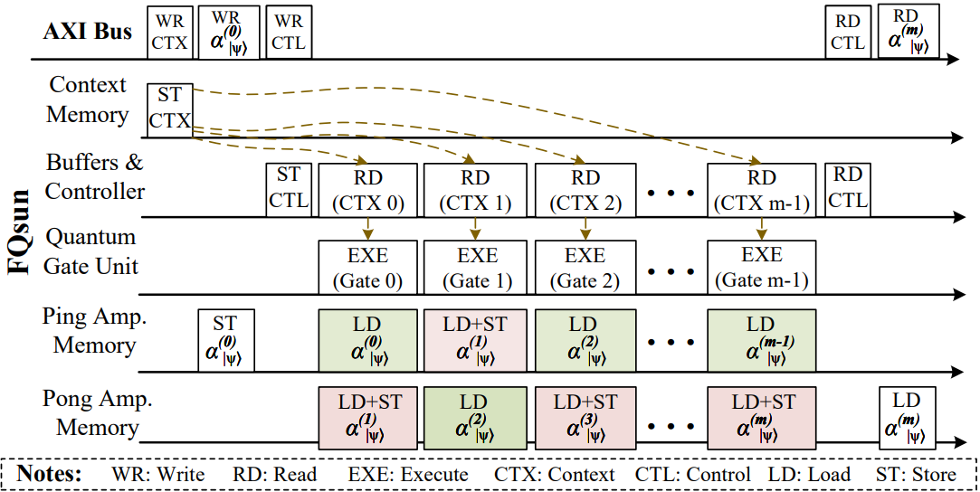

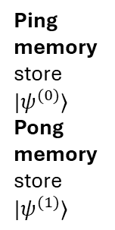









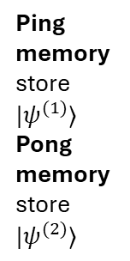



2.3.1-2. Idea #1: efficient memory organization
Idea #2: optimized scheduling
$$|ψ^{\left(t\right)}⟩$$
$$|ψ^{\left(t+1\right)}⟩$$
Ping memory store $|ψ^{(0)}⟩$
Pong memory store $|ψ^{(1)}⟩$
Ping memory store $|ψ^{(1)}⟩$
Pong memory store $|ψ^{(2)}⟩$
$$α_{0}$$
$$α_{1}$$
$$⋮$$
$$⋮$$
$$⋮$$
$$⋮$$
is controlled by
Real values
Real values
Imaginary values
Imaginary values
$$α_{N−1}$$
$$⋮$$
$$⋮$$
$$⋮$$
$$⋮$$
Figure 2.4. Timing chart of FQsun operation using Ping/Pong Amplitude Memories.
Figure 2.3. Memory organization detail
Ping
Pong
Notes:
Control Buffers: These buffers store 1-bit control signals such as load, start, done, and stop. The load signal is used by the host to indicate the state where it writes context and amplitude data. Additionally, the host uses a 5-bit signal to indicate #Qubits, which FQsun is supporting. After completing the load state, the host triggers the start signal to begin the session. The done signal is continuously read by the host to track the completion time of each gate operation. Finally, the stop signal is used to end the session by resetting the address register of the Context Memory.
Context Memory (16 KB): This memory stores configuration dataand has d = 2048. The configuration data includes a 3-bit gate opcode indicating the type of gate to be executed. The values sin(θ/2) and cos(θ/2), with a bit width of 16/24/32 depending on the precision type, are parameters for Ri , pre-computed by FQsun software to reduce hardware complexity. Additionally, parameters such as the 5-bit cut and gate positions {w0, w1} must also be stored.
Ping/Pong Amplitude Memory (2 MB): used to store {α (t) j } for QGU.
This memory must have a d = 2^17 or d = 2^18 to support up to 17 or 18 qubits for 16-bit precision or 32-bit precision, calibrated to fit the maximum BRAM (block ram) capacity of the Xilinx ZCU102. (5.3 Mb)
In case Ping/Pong Amplitude Memory is applied to FPGAs with more BRAM resources, such as the Alveo or Versal series, FQsun could support a larger #Qubits.
To enable amplitude updates as described in Algorithms 2.1, a dual-port Ping/Pong memory design is applied.
Specifically, if the ping memory holds the current amplitude {α (t) j }, the pong memory will store the new amplitude {α (t+1) j }, and vice versa. This design is essential on the grounds that, during the calculation of {α (t+1) i+cut} and {α (t+1) i−cut}, both the current and new amplitudes are needed.

Slide 12
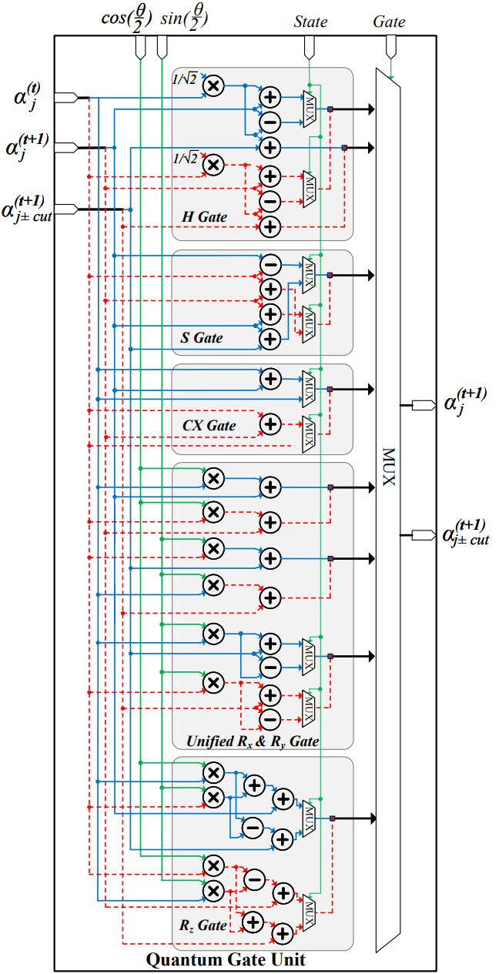
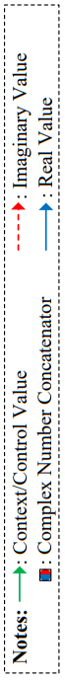

2.3.3. Idea #3: configurable Quantum Gate Unit (QGU)
Figure 2.5. Micro-architecture of Quantum Gate Unit (QGU).
Clifford gates: H, S, CX
Non-Clifford gates: $R_{x},R_{y},R_{z}$
Notes:
The micro-architecture of the QGU consists of five main modules designed to perform six fundamental gates following software design.
The computational data for the QGU includes {α (t) j }, {α (t+1) j }, {α (t+1) j±cut}, and parameters (sin(θ/2) and cos(θ/2)) used by Ri .
Essentially, the operations of Rx and Ry are relatively similar; hence, they are implemented using a Unified Rx & Ry Gate unit to conserve hardware resources.
To ensure proper execution of the if-else logic, a 2-to-1 multiplexer system controlled by the state value is used to select the output value.
Finally, a multiplexer controlled by the gate operation input is employed

Slide 13
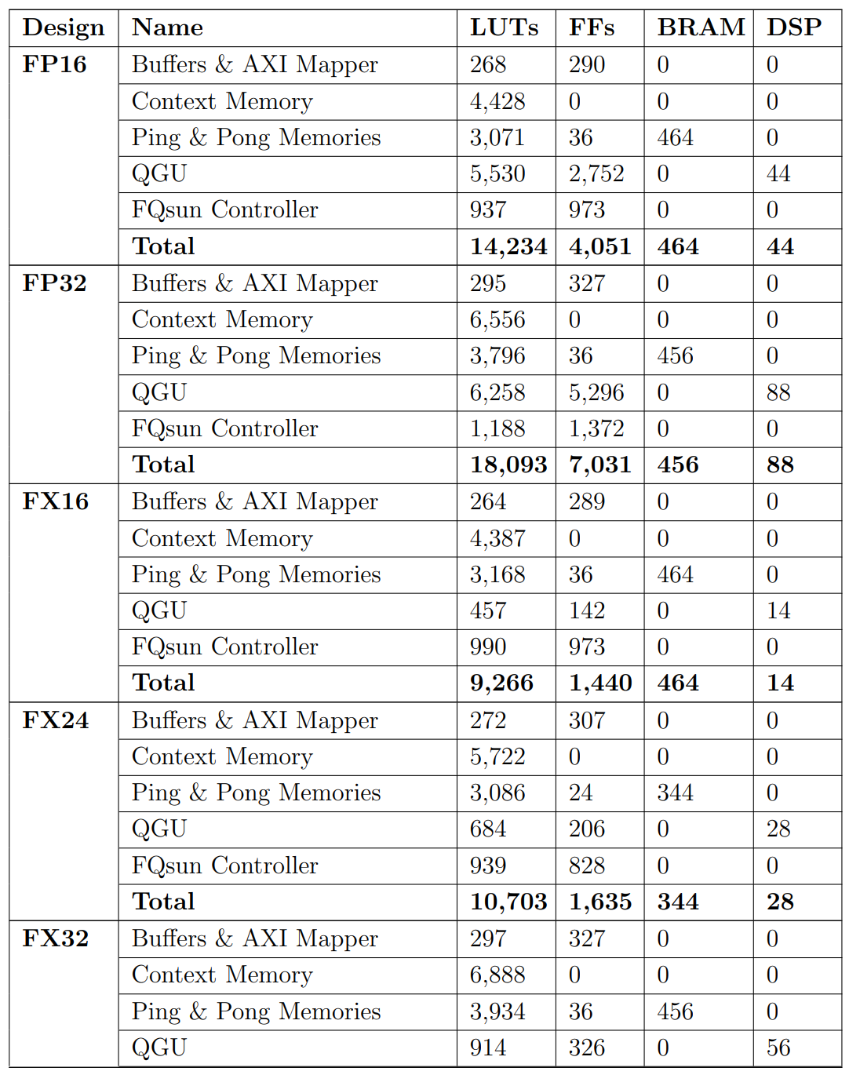
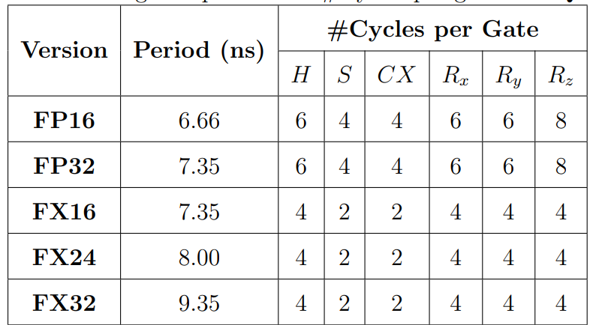
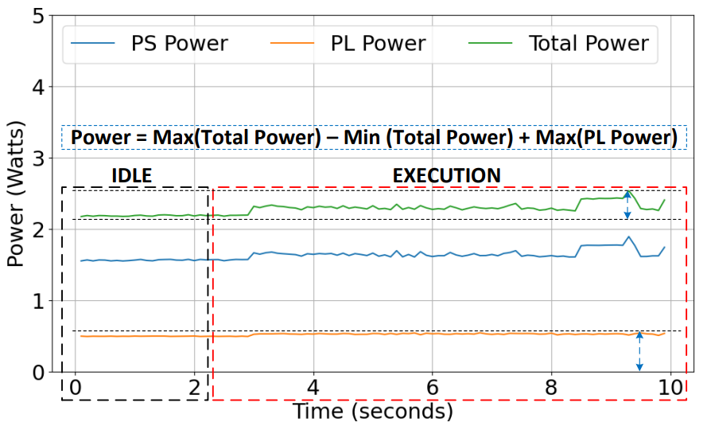
2.3.4. #Idea 4: multiple precisions
Table 2.3. Utilization of FQSun on ZCU102 FPGA
Table 2.4. Basic gate’s period and #Cycles per gate on FQsun
Figure 2.6. Power measurement of FQsun (FX32).
Notes:
Almost all related work on emulators has primarily focused on performance evaluation while lacking criteria for accuracy.
I realize that lower precision while affect on the fidelity heavily.
So I designed with five configurations, each corresponding to a different precision on slides.
Pipeline and Complexity: FP numbers utilize two pipeline stages for both the multiplier and the adder/subtractor units, while FX numbers require only two stages for the multiplier and one stage for the adder/subtractor. As a result, the latency of FX design is lower compared to FP design.
Range and Precision: following normalize condition, |α_j| ∈ [−1, 1]; then, FX numbers used in FQsun are configured with 1 sign bit, 1 integer bit, and the remaining bits allocated to the fractional part
Specifically, the PS consumes a maximum of 1.84 (W) (with 0.34 (W) dynamic power). The PL consumes a maximum of 0.61 (W). The total power reaches a maximum of 2.41 (W) (with 0.23 (W) dynamic power). Accordingly, the power consumption for FQsun is determined by adding the total dynamic power to the maximum PL power, reaching 0.81 (W). These power values are kept for all #Qubits.
FFs: flip-flop
DSP: digital signal processor
PS: processing system
PL: programmable logic

Slide 14
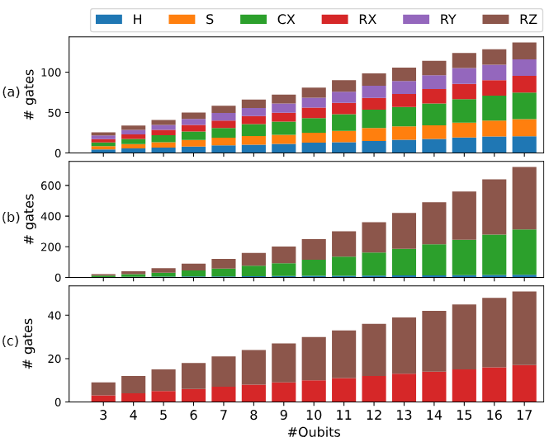
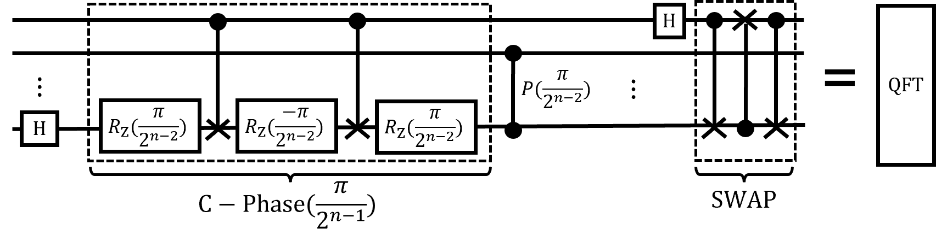
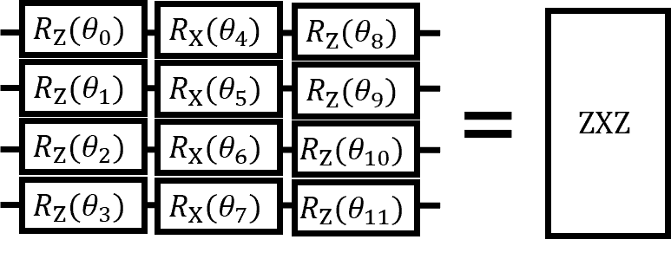
2.4. Benchmarking tasks
Randomize quantum circuit (RQC) with ~uniform gate’s distribution
Figure 2.7. Gate distribution for
Random quantum circuit (RQC)
Quantum Fourier Transform (QFT) and
ZXZ with parameter-shift rule (PSR).
Figure 2.8. Circuit representation for
(b) QFT and
(c) PSR.
Notes:
We benchmark the Fqsun on three different quantum algorithms, each algorithms has the different gate organization and number of gates.

Slide 15
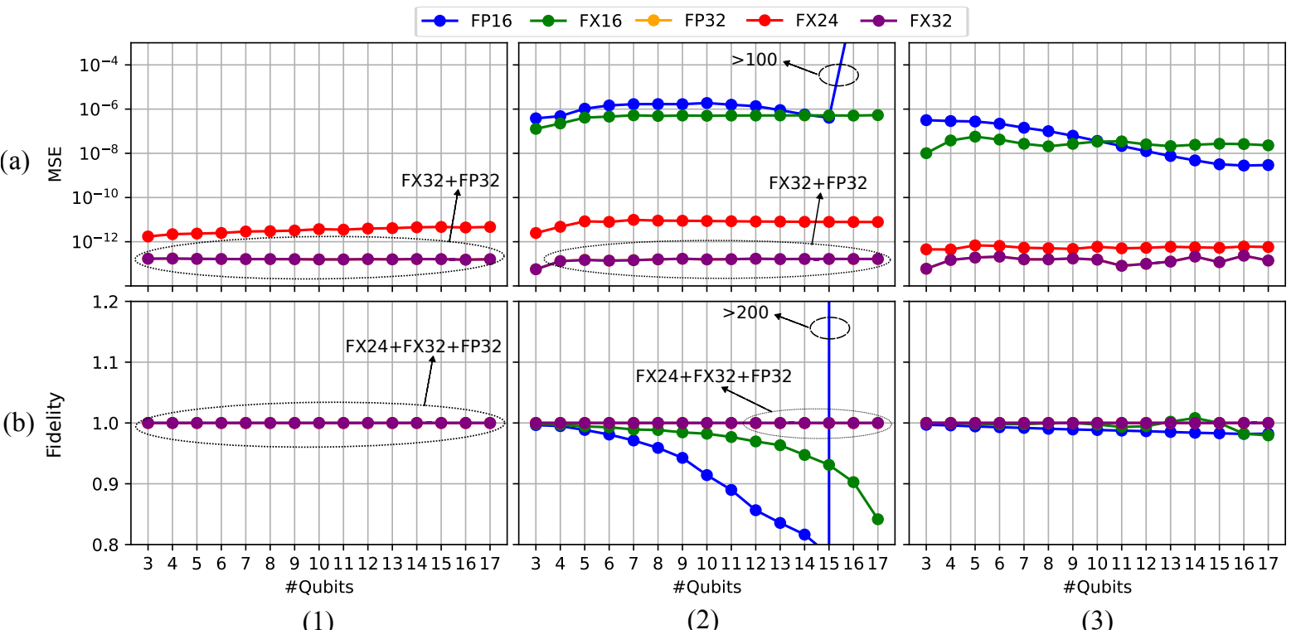
2.4.1. Result #1: accuracy metrics
~0 is good
~1 is good
RQC
QFT
PSR
Figure 2.9. MSE/Fidelity between FQsun version. In all cases, FP32 and FX32 are overlapped. For QFT, the FP16 version performs the wrong results since it can not present any $α_{j} ≤ 1/2^{16} ≈ {10}^{−5}$.
Notes:
We can see on all task, Fqsun nearly achieve the perfect MSE and fidelity.
Except the FP16 and FX16, it turn to be wrong on QFT because of not enough bit for fraction part.

Slide 16
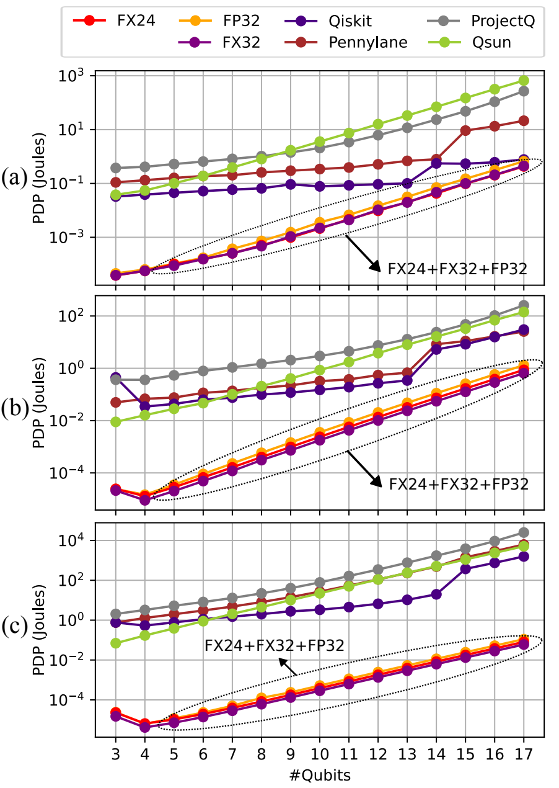
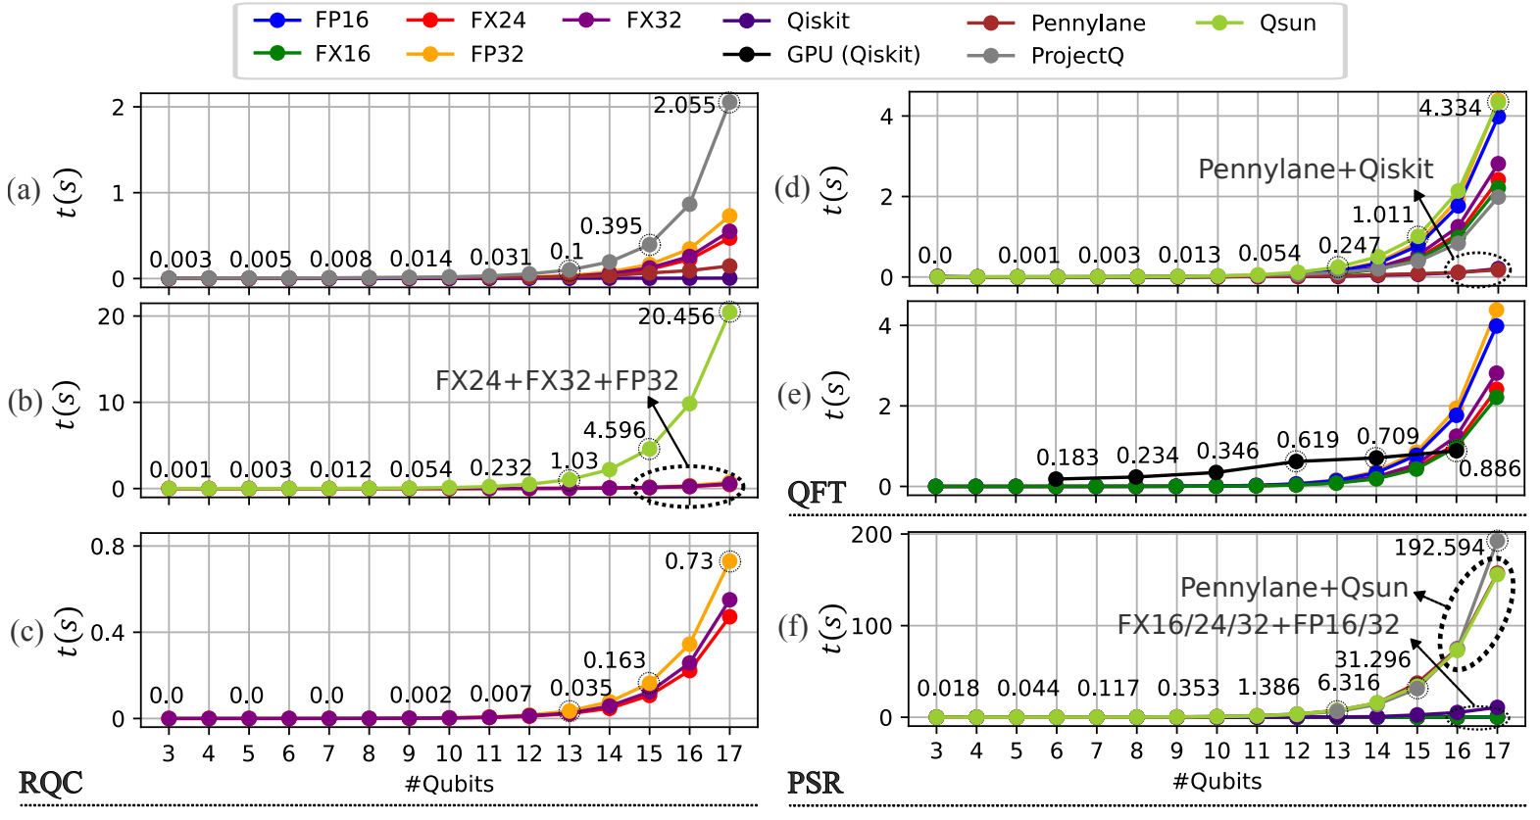
2.4.2. Results #2: execution time & PDP
In this case, Software seems better due to the stabilizer rank
Figure 2.10. The execution time on (a-c) RQC (d) QFT execution time comparison between Software + FQsun. (e) We compare GPU A100 and FQsun. (f) PSR execution time comparison between Software + FQsun.
Figure 2.11. PDP through (a) RQC (b) QFT and (c) PSR.
Notes:
In this slide, we compare the execution time and pdp (power delay product) = time x power between Fqsun and CPU/GPU
In almost case, Fqsun achieve the better exe time and superior PDP compared to all related works.
an exception at subfigure 2.10 (d), pennylane and qiskit faster than Fqsun due to the stabilizer rank (will be explain in the next slide and section 3)

Slide 17
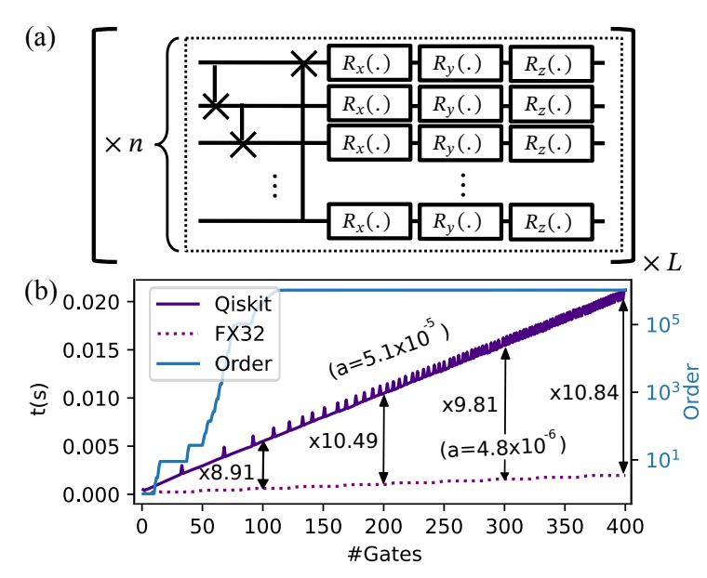
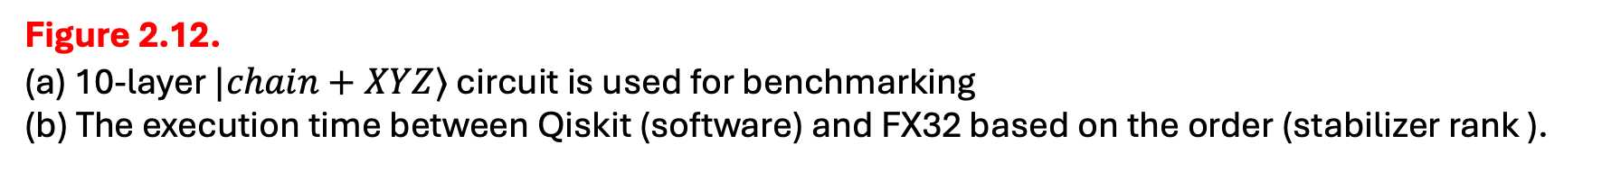
2.4.3. Result #3: High-stabilizer rank benchmarking
This circuit make sure that the stabilizer rank is high
Hard to simulate/emulate
(stabilizer rank )
Figure 2.12.
(a) 10-layer $|chain+XYZ⟩$ circuit is used for benchmarking
(b) The execution time between Qiskit (software) and FX32 based on the order (stabilizer rank ).
Notes:
In the figure 2.10. d, qiskit faster than fqsun because it efficient simulate the low-rank stabilizer circuit.
I compare qiskit and FX32 from low to high stabilizer rank, we can see that the gap will be increase based on the stabilizer rank.
In the highest stabilizer rank, Fqsun faster than qiskit 10 times.

Slide 18
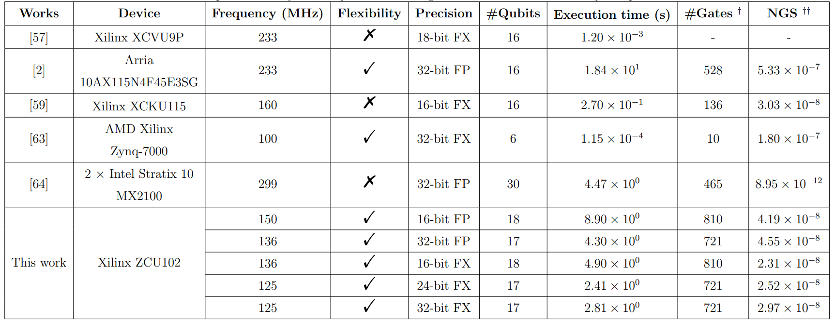

2.4.4. Result #4: comparison between related works
Table 2.5. Comparative analysis of FQsun and existing FPGA-based emulators on QFT’s performance.
No flexibility
No flexibility
(†) The #Gate in this work is higher than other work due to the no-use of control-rotation gates.
(††) The Normalized Gate Speed (NGS) (s / (gate $×$ amplitude)) = Execution time / (#Gates $×$ $2^{\text{\#}\text{Qubits}}$), smaller is better.
Notes:
Compared to other emulators [56,57,60–62], our emulator support various applications. The work [59/64] achieve the best normalized gate speed however, these designs support only the QFT circuit and then have no use case because they provide a fixed output.
For a fair comparison, FQsun is comparable to other flexible emulators that support a wide range of algorithms, including Arria 10AX115N4F45E3SG [2] and AMD Xilinx Zynq-7000 FPGA [63].
Regarding execution time, FX32 achieves a computation speed-up of 17.9 times and 6.1 times compared to [2] and [63], respectively.
Furthermore, FQsun supports computations across five precision types and offers different performance and accuracy.

Slide 19
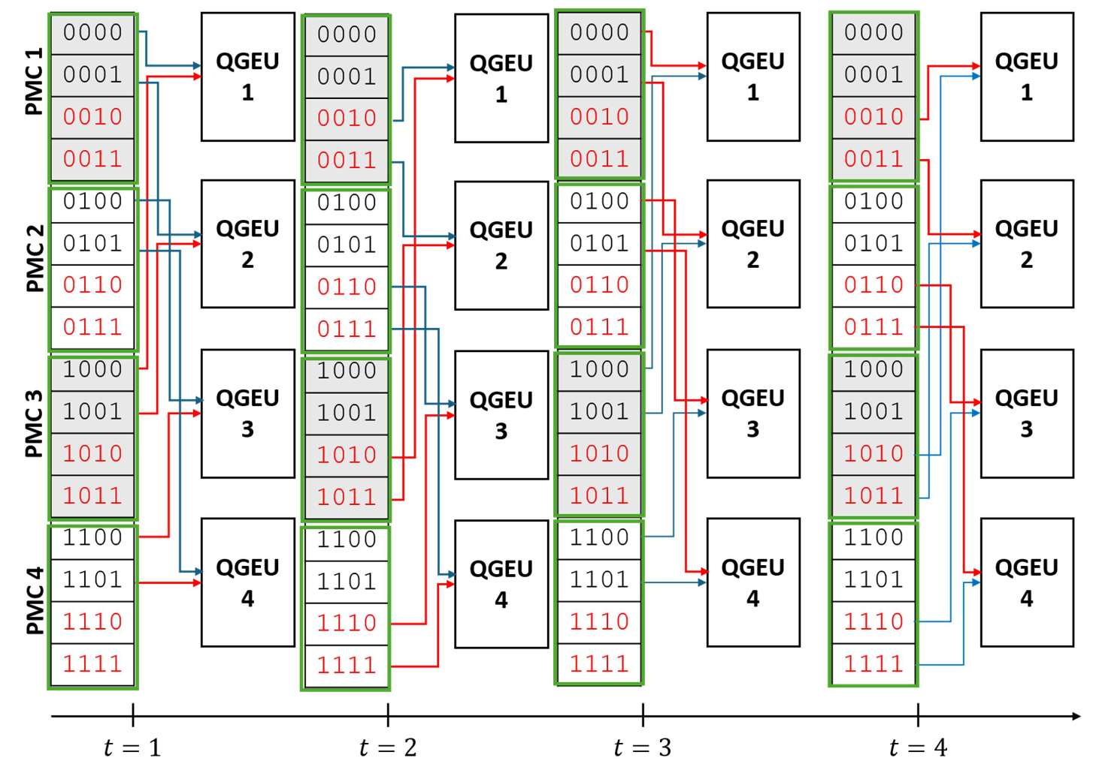
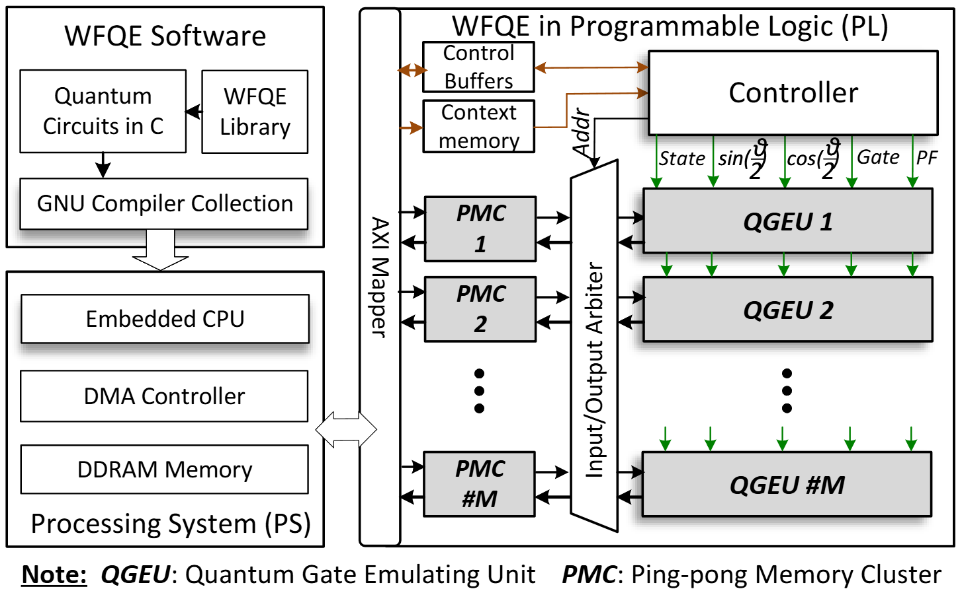
2.5. Analyzing on the parallelization of FQsun (WFQE)
Each PMC/QGEU has two ports in and out
Figure 2.13. The architecture of multi-QGEU (extended QGU) and multi-PMC (Ping-pong memory cluster) at the system-on-chip (Soc) level on FPGA.
Figure 2.14. A 4-qubit state-vector is being processed by four QGEU and four PMC.
Notes:
Recently, I designed the parallel version of Fqsun, called WFQE which use multple QGU ínstead of one, each QGU will handle a part of wave function.

Slide 20
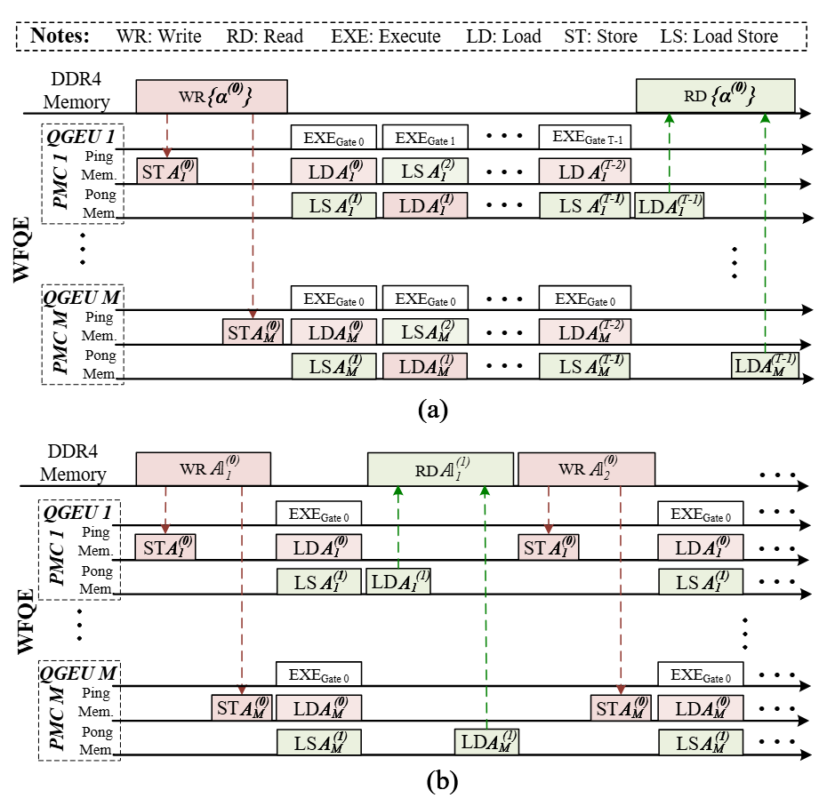
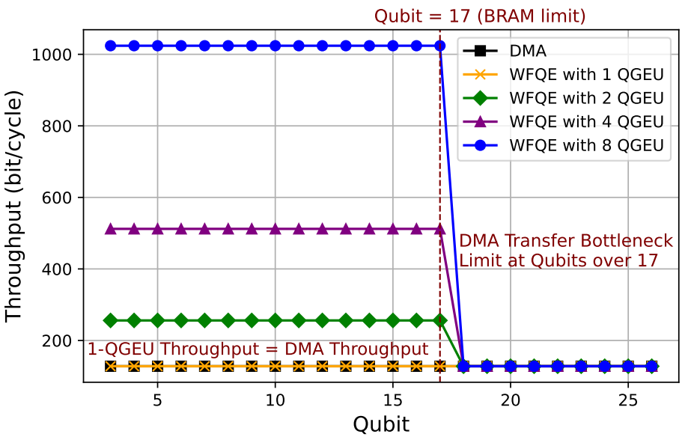
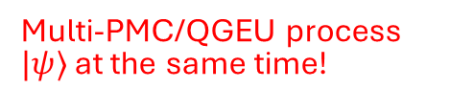
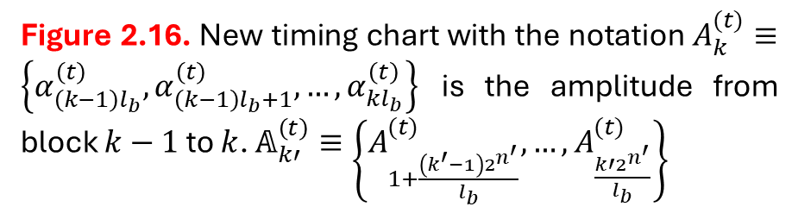
2.5. Analyzing on the parallelization of FQsun (WFQE)
Multi-PMC/QGEU process $|ψ⟩$ at the same time!
Figure 2.15. Throughput comparison with various QGEU configurations. The DMA transfer becomes a bottleneck at Qubit = 17 (BRAM limit), where all configurations are limited to the same throughput as a single Extended QGU (QGEU).
Figure 2.16. New timing chart with the notation $A_{k}^{(t)}≡\left\{α_{\left(k−1\right)l_{b}}^{\left(t\right)},α_{\left(k−1\right)l_{b}+1}^{\left(t\right)},…,α_{kl_{b}}^{\left(t\right)}\right\}$ is the amplitude from block $k−1$ to $k$. $𝔸_{k′}^{\left(t\right)}≡\left\{A_{1+\frac{\left(k^{′}−1\right)2^{n^{′}}}{l_{b}}}^{(t)},…,A_{\frac{k′2^{n^{′}}}{l_{b}}}^{(t)}\right\}$
Notes:
We can see that using multiple qgu will increase the throughput efficiently but there is a limit at qubit over 17.
Because at qubit equal to 17, 1-QGU throughput will be equal to DMA throughput, so it is meaningless if we use more QGU.

Slide 21
3. Quantum simulation theory
3.1. State vector
3.2. Stabilizer formalism
3.3. Tensor network (Matrix product state)

Slide 22

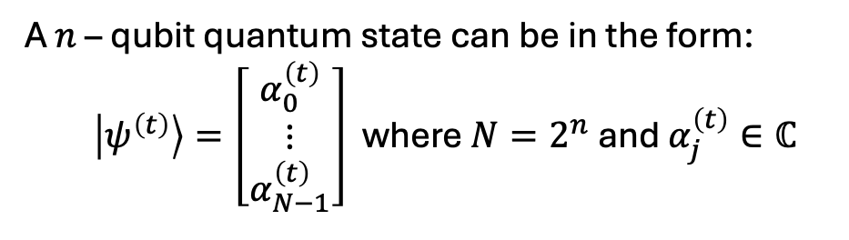




3.1. Quantum simulation
State vector
A $n$ – qubit quantum state can be in the form:
  $\left|ψ^{\left(t\right)}\right\rangle =\left[\begin{matrix}α_{0}^{\left(t\right)} \\ ⋮ \\ α_{N−1}^{\left(t\right)}\end{matrix}\right]$ where $N=2^{n}$ and $α_{j}^{\left(t\right)}∈ℂ$
The number of amplitudes grows exponentially based on #Qubits
$$\left\|α_{j}^{\left(t\right)}\right\|≤1$$
A quantum gate update amplitudes $\left\{α_{j}^{\left(t\right)}\right\}$:
$$g\left(w,θ\right):\left\{α_{j}^{\left(t\right)}\right\}→\left\{α_{j}^{\left(t+1\right)}\right\}$$
Traversing on a long vector
where $w$ and $θ$ are wires and parameter (if applicable).
Our target is to compute the evolved (final) state:
$$\left|ψ^{\left(m\right)}\right\rangle =U\left(θ\right)|ψ^{(0)}⟩$$
Both $\left|ψ^{\left(t+1\right)}\right\rangle$ and $\left|ψ^{\left(t\right)}\right\rangle$ need to be saved at the same time
under unitary $U$. $U$ is composed from gates or sub-operators via tensor product/matrix multiplication
Notes:
The state, gate and operator presented in the last slide can be viewed as vector and matrix in the state-vector approach.
A state is simply a normalized vector which has dimensional two exponential of n where n is the number of qubits.
Because the length of state is only 1, so each element on state always has the norm less or equal 1.
The gate and operator is actually the matrix which has the element is the complex number.
A operator can be reconstructed by tensor multiplication between gates.
And when a operator acts on a state as Eq 1.2, it is equivalent to a matrix-vector multiplication.
But note that the dimensional of both state and operator increase exponentially based on the number of qubits.
Computing this term is a hard problem.

Slide 23
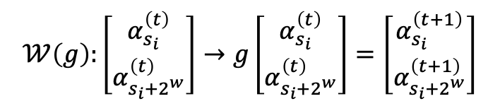
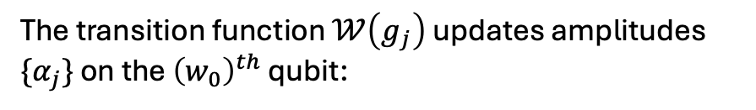
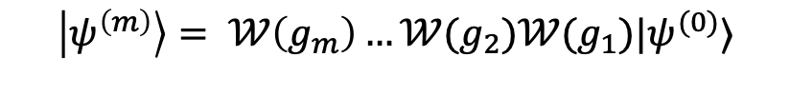
3.1. Quantum simulation
State vector
Tab. Comparison between variants ($†$) ${\hat{n}}_{j}∈ [1, 2]$
Matrix-vector multiplication
Op | Wave-function | Density-matrix
Mul/gate | $2^{n+{\hat{n}}_{j}+1}$ ($†$) | $2^{2n}$
Add/gate | $2^{n+{\hat{n}}_{j}+1}$ ($†$) | $2^{2n−2}$
Depend on type
The final state is calculated through series of $𝒲$:
$$\left|ψ^{\left(m\right)}\right\rangle = 𝒲\left(g_{m}\right)…𝒲(g_{2})𝒲(g_{1})|ψ^{(0)}⟩$$
The transition function $𝒲\left(g_{j}\right)$ updates amplitudes $\{α_{j}\}$ on the ${\left(w_{0}\right)}^{th}$ qubit:
$$𝒲\left(g\right):\left[\begin{matrix}α_{s_{i}}^{\left(t\right)} \\ α_{s_{i}+2^{w}}^{\left(t\right)}\end{matrix}\right]→g\left[\begin{matrix}α_{s_{i}}^{\left(t\right)} \\ α_{s_{i}+2^{w}}^{\left(t\right)}\end{matrix}\right]=\left[\begin{matrix}α_{s_{i}}^{\left(t+1\right)} \\ α_{s_{i}+2^{w}}^{\left(t+1\right)}\end{matrix}\right]$$
Algorithm. The implementation of single- and multiple-qubit gates is unified into a common framework
Notes:
We can easily see that applying a operator on a n-qubit state has the complexity 2^2n because of the matrix-vector multiplcation.
Instead of that, we design an algorithm that only traverse on the state vector, the action will be design by quantum gate and the ooerator will not be constructed.
That help reduce both time and space complexity from 2^2n to 2^n.

Slide 24
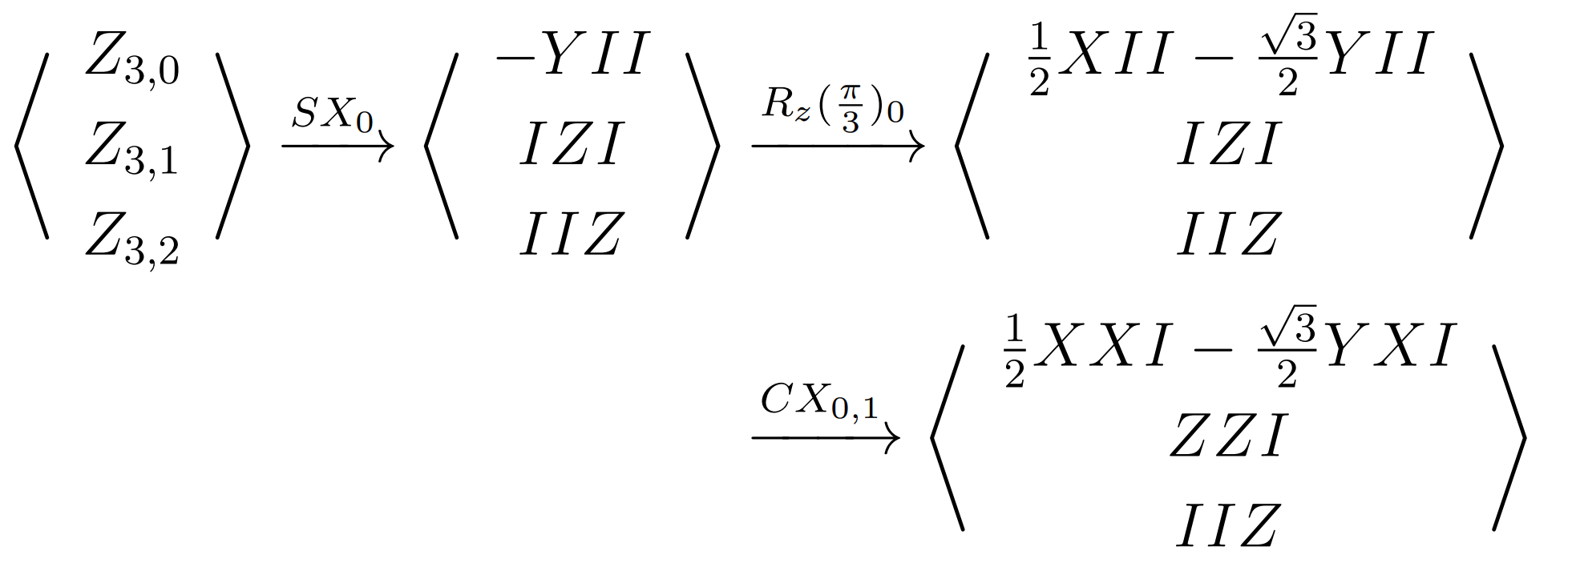
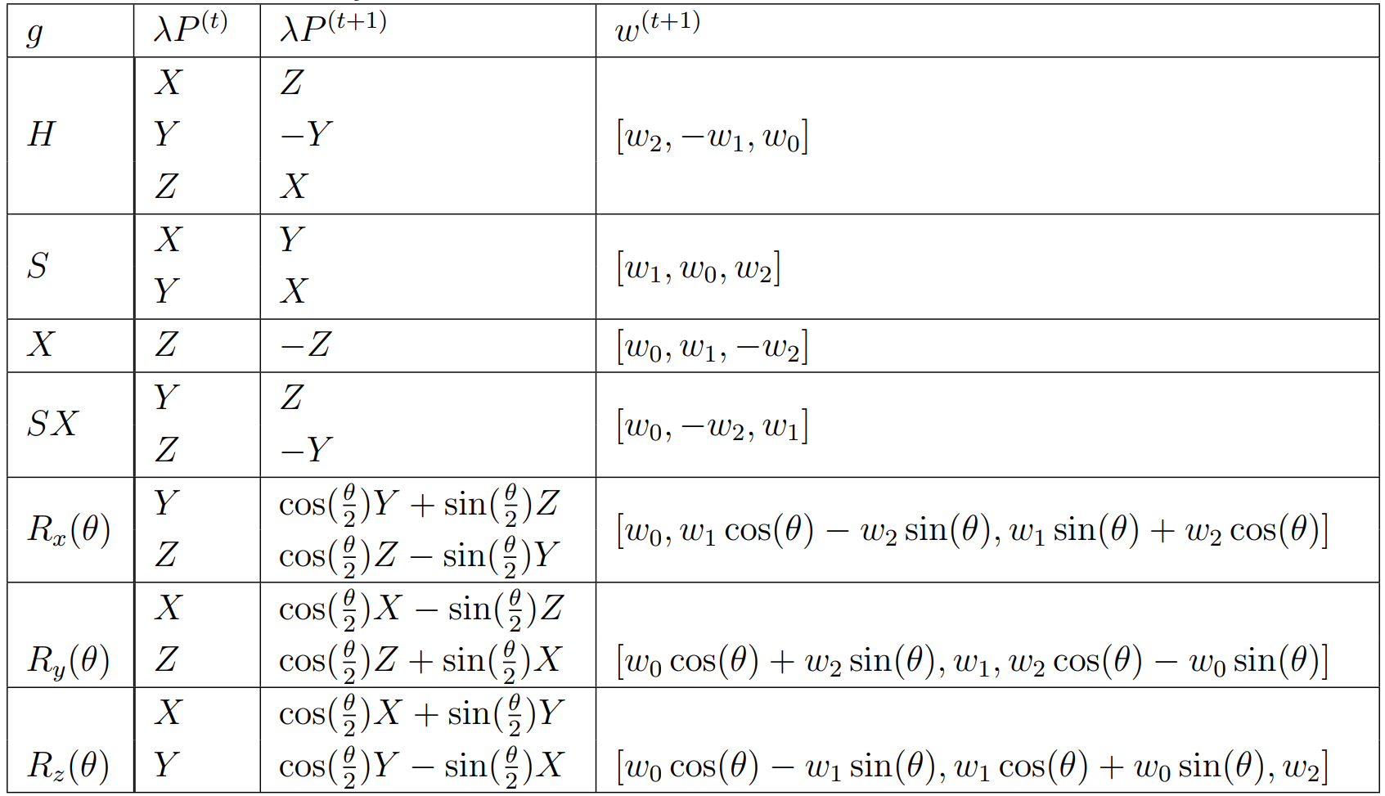
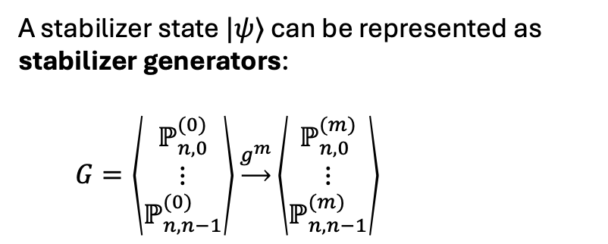
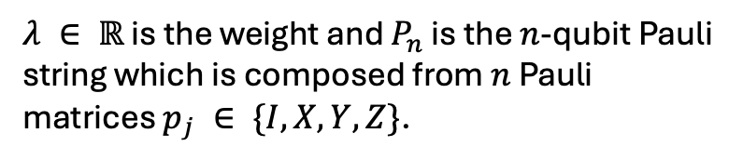
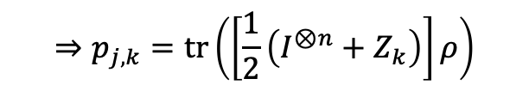
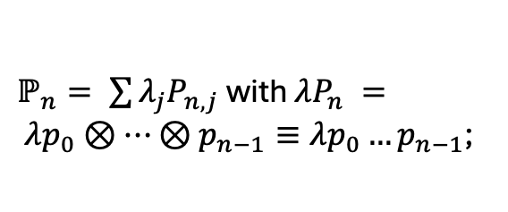
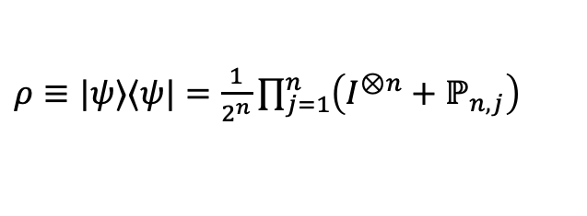
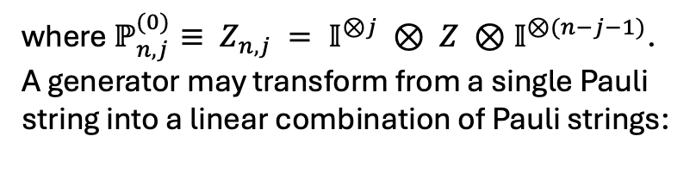
3.2. Quantum simulation
Stabilizer formalism
A stabilizer state $|ψ⟩$ can be represented as stabilizer generators:
  $G=\left\langle \begin{matrix}ℙ_{n,0}^{(0)} \\ ⋮ \\ ℙ_{n,n−1}^{(0)}\end{matrix}\right\rangle \underset{→}{g^{m}}\left\langle \begin{matrix}ℙ_{n,0}^{(m)} \\ ⋮ \\ ℙ_{n,n−1}^{(m)}\end{matrix}\right\rangle$
Example. Consider a 3-qubit circuit $CX_{0,1}R_{z}{\left(\frac{π}{3}\right)}_{0}SX_{0}|000⟩$.
(3.1)
where $ℙ_{n,j}^{(0)}≡ Z_{n,j} = 𝕀^{⊗j} ⊗ Z ⊗𝕀^{⊗(n−j−1)}$.
A generator may transform from a single Pauli string into a linear combination of Pauli strings:
Table. Quantum gate operations
$ℙ_{n}= \sum{λ_{j}P_{n,j}}$with $λP_{n} = λp_{0}⊗…⊗p_{n−1}≡λp_{0}…p_{n−1}$;
(3.2)
$λ ∈ ℝ$ is the weight and $P_{n}$ is the $n$-qubit Pauli string which is composed from $n$ Pauli matrices $p_{j} ∈ \{I, X, Y, Z\}$.
$ρ≡|ψ⟩⟨ψ|=\frac{1}{2^{n}}\prod_{j=1}^{n}{\left(I^{⊗n}+ℙ_{n,j}\right)}$
$$⇒p_{j,k}=tr\left(\left[\frac{1}{2}\left(I^{⊗n}+Z_{k}\right)\right]ρ\right)$$
[3.1] C. Gidney, “Stim: a fast stabilizer circuit simulator,” Quantum, vol. 5, p. 497, Jul. 2021
Notes:
We come to the next approach, stabilizer formalism.
Instead of reprenseting quantum system by state-vector, we can represent it as stabilizer generator. The stabilizer generator is the sum of Pauli strings and The number of generator will be equal to the number of qubits, the length of each generator depend on the complexity of circuit.
Applying operator or gate on stabilizer generators will transform the pauli terms.

Slide 25
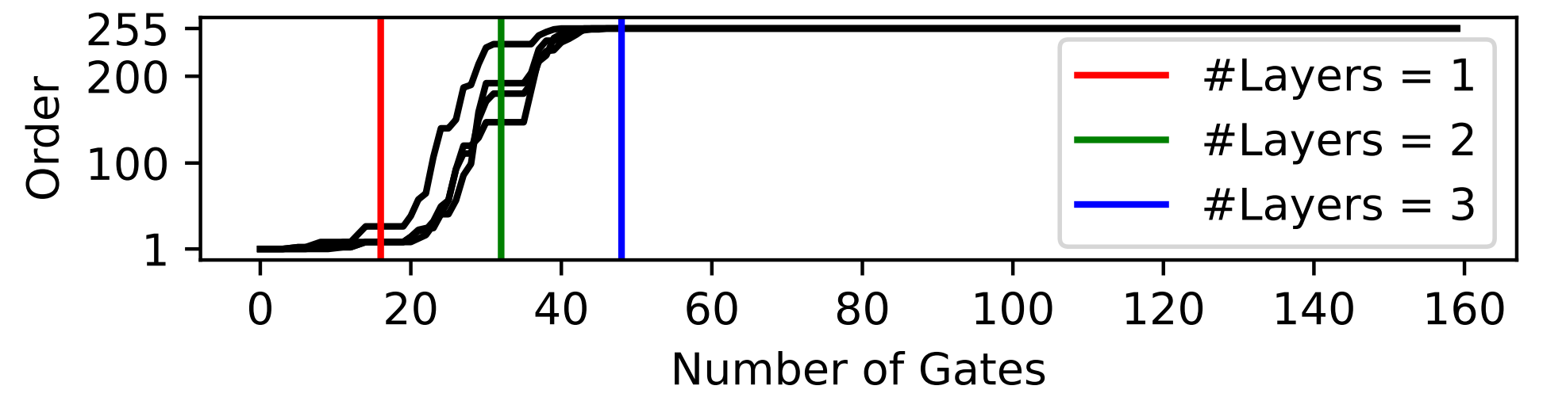

3.2. Quantum simulation
Challenges in stabilizer formalism
Applying non-Clifford gates increases the stabilizer rank (non-stabilizerness) of a stabilizer state: higher stabilizer rank, harder for simulate.
The current stabilizer formalism are sequentially updated gate by gate: limited the power of GPU.
The stabilizer rank on four generators is shown as four black lines. We are considering the worst cases by using 4-qubit $|XYZ + chain⟩$ansatz.
Notes:
Challenge (a) About the theory aspect, applying Clifford gate protect the stabilizer rank but non-Clifford gate will increase the stabilizer rank fastly as analysis in the previous section.
Challenge (b) The current version of stabilizer formalism package is that all of them are the sequential algorithm, not parallel, so it limit the power of GPU.

Slide 26
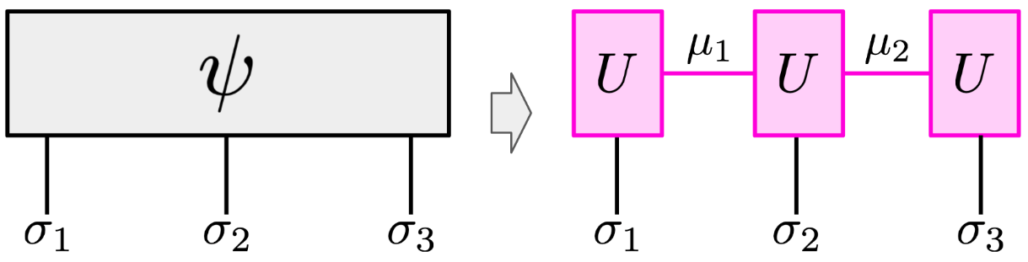

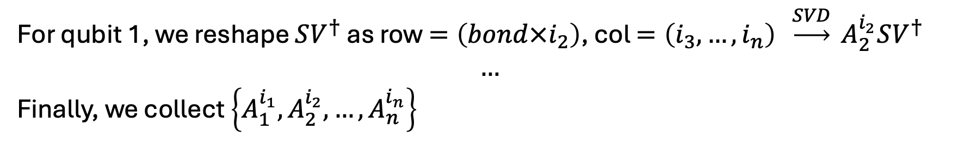

3.3. Quantum simulation
Tensor network
Virtual (Bond) index
Physical index
We present $2^{n}$ statevector as $\underset{n}{\underbrace{\left(2,2,…,2\right)}}$ tensor
$$A_{1}^{i_{1}}$$
For qubit 0, we reshape $|ψ⟩$ as row = $\left(i_{1}\right),$ col $=\left(i_{2},…,i_{n}\right)$, $ψ_{i_{1},\left(i_{2},…,i_{n}\right)}\underset{→}{SVD} U SV^{†}$
For qubit 1, we reshape $SV^{†}$ as row $=\left(bond×i_{2}\right)$, col $=\left(i_{3},…,i_{n}\right)$ $\underset{→}{SVD} A_{2}^{i_{2}}SV^{†}$
$$…$$
Finally, we collect $\left\{A_{1}^{i_{1}},A_{2}^{i_{2}},…,A_{n}^{i_{n}}\right\}$

Slide 27











3.3. Quantum simulation
Tensor network
$$\left|W_{4}\right\rangle =1/\sqrt{4}\left(\left|0001\right\rangle +\left|0010\right\rangle +\left|0100\right\rangle +|1000⟩\right)$$
$$\left|W_{4}\right\rangle {\underset{→}{ (lvbond×\left|σ_{1}\right|)×\frac{2^{n}}{lvbond×\left|σ_{1}\right|}}ψ}_{i_{1},\left(i_{2}i_{3}i_{4}\right)}\underset{→}{SVD}UΣV^{†}$$
Virtual (Bond) index
$$U Σ{ V}^{†}$$
$Σ=\left[\begin{matrix}\sqrt{3}/2 & 0 \\ 0 & 1/2\end{matrix}\right]$
$$2×2$$
$$2×2$$
$$2×8$$
$$U\left(μ_{0},σ,μ_{1}\right)→\left\{\begin{aligned}A_{0,μ_{0},μ_{1}}=\left[\begin{matrix}\frac{1}{\sqrt{3}} & \frac{1}{\sqrt{6}}\end{matrix}\right] \\ A_{1,μ_{0},μ_{1}}=\left[\begin{matrix}\frac{1}{\sqrt{3}} & \frac{−2}{\sqrt{6}}\end{matrix}\right]\end{aligned}\right.$$
(l)vbond = 1
(r)vbond = $\{1,2\}$
Physical index
In qubits system:$σ_{j}=\{0,1\}$
[3.2] Siddhartha Patra, Saeed S. Jahromi, Sukhbinder Singh, Roman Orus “Efficient tensor network simulation of IBM’s largest quantum processors” arXiv:2309.15642, 2023.
[3.3] H. C. Jiang, Z. Y. Weng, T. Xiang “Accurate determination of tensor network state of quantum lattice models in two dimensions” arXiv:0806.3719, 2008.
For next iteration
$$B=ΣV^{†}$$
Collect $A_{σ_{0},μ_{0},μ_{1}}$

Slide 28




3.3. Quantum simulation
Tensor network: gate application
Compose
A local gate $U=\left[\begin{matrix}a & b \\ c & d\end{matrix}\right]$ act on wire $j$ and transform only $A_{j}$
$$A_{0,j}^{′}={aA}_{0,j}+bA_{1,j}$$
$$A_{1,j}^{′}={cA}_{0,j}+dA_{1,j}$$
A non-local gate $CU$ act on wires $j,k,…$ which is a ‘bit’ complicated
Apply
Decompose

