Slide 1




Aff
Lecturer at SE-UIT-VNUHCM
Adjunct Researcher at FRIS, Tohoku University, Japan
Co-Investigator at AISeQ lab
Join our lab:

Slide 2





Info
Email: haivt@uit.edu.vn / tuan.hai.vu.b7@tohoku.ac.jp
Phone: 0814822188 / (+81) 07084962244
/vutuanhai237

Slide 3
Research
Quantum computing for machine learning
Machine learning for quantum computing
Hardware accelerator
Functional programming
Paper: journal [14], conference [28], book [2] (September 2025)
Fund: NAIST Granite, Unitary Fund, …
Reviewer: SOICT, SoftwareX, Quantum Information Processing, …
See more: https://aiseqlab.github.io/demo/

Slide 4
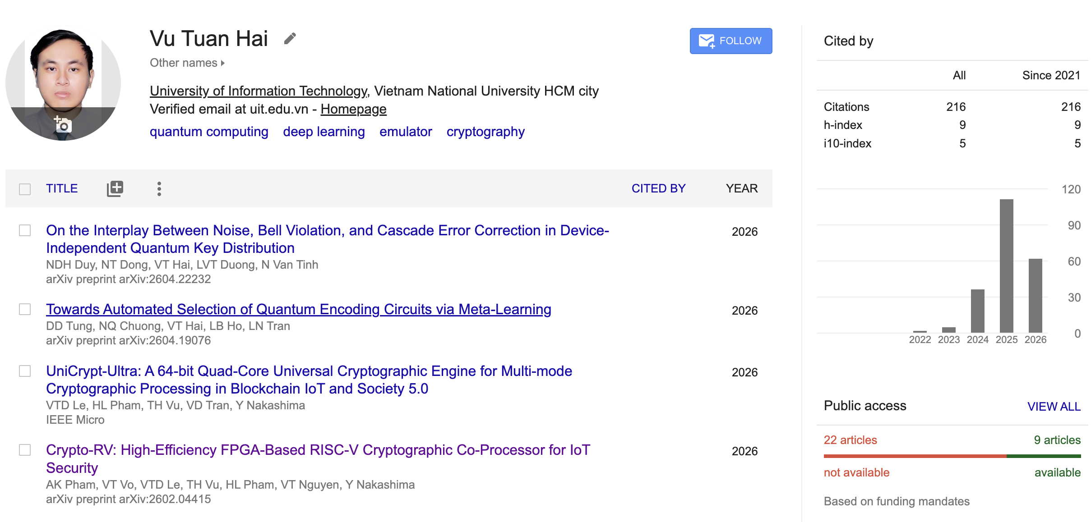
Many works were published!
1/2019
5/2021
2/2022
6/2023
11/2023
10/2025
Join ICIP lab as newbie
Graduated
1st journal paper published
TA at SE, UIT
Master student
Graduated
3rd journal paper published
Got PhD scholarship at NAIST, Japan
Graduated
Back to UIT

Slide 5
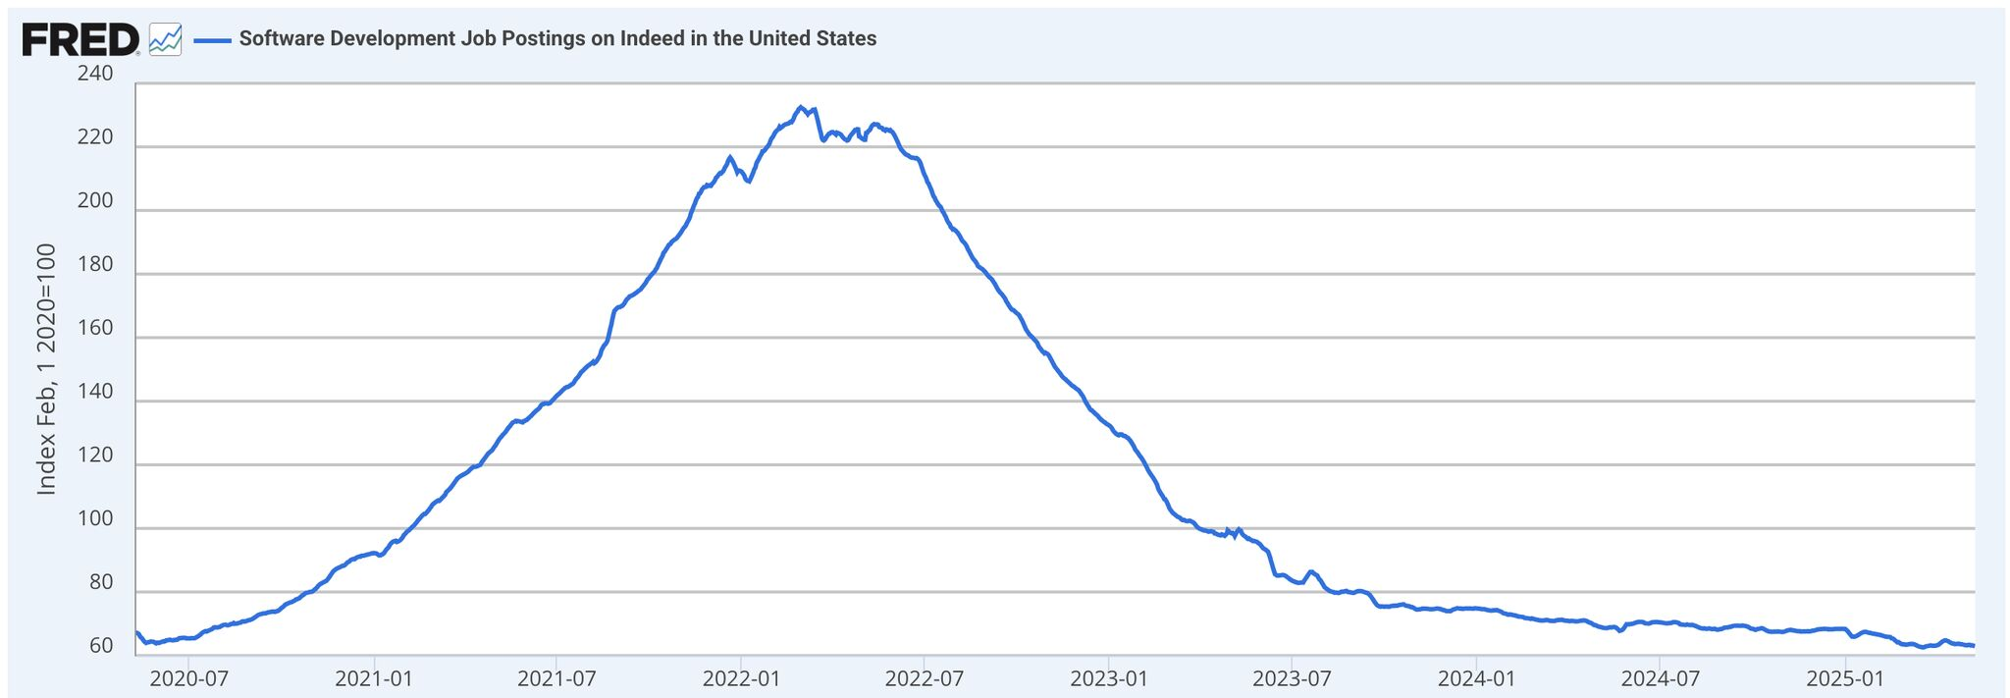

Why research? (1/3)
Job market is changing now
”SE job declining”
Ez get job after 3-6 months learn code
FOMO
AI era
Customer
Company
Employee
Outsource
Low risk, low return
R&D
Customer
Company
Employee
High risk, high return

Slide 6
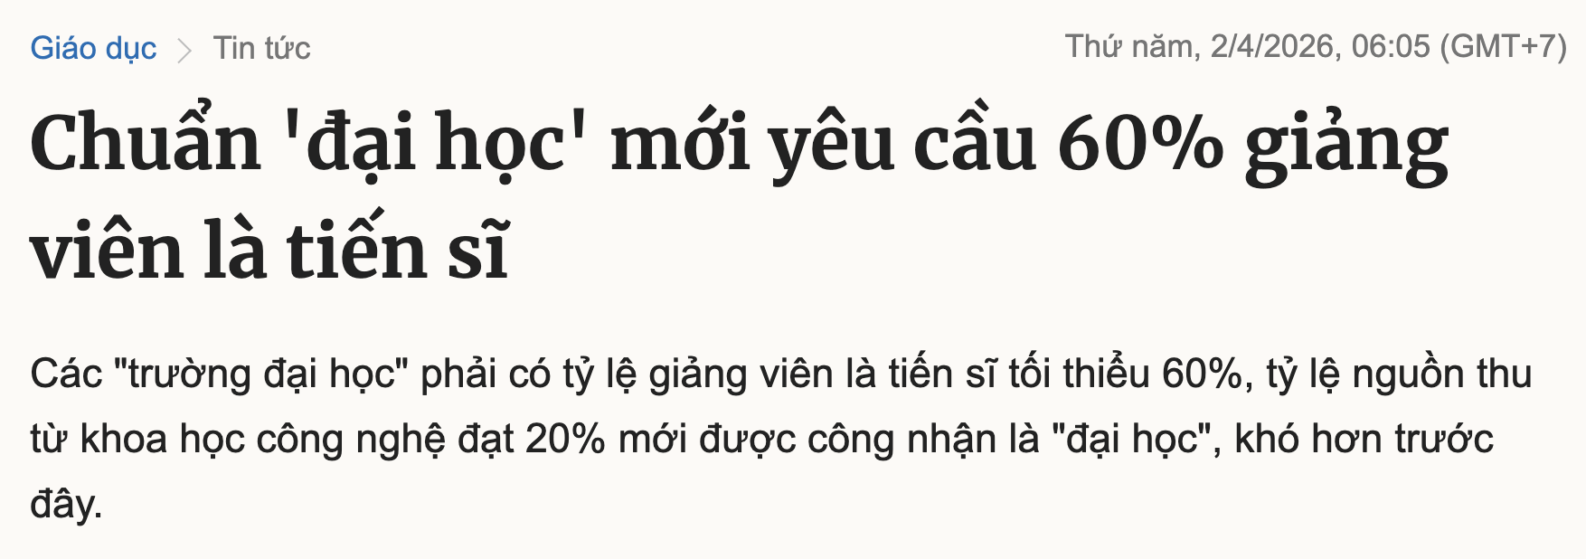

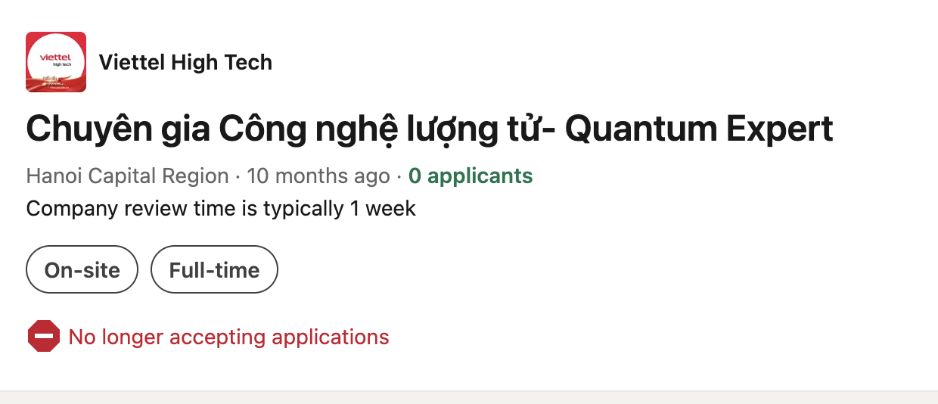

Why research? (1/3)

Slide 7

Why research? (2/3): Research $→$ Many skills
 | Coding | Coding + Research
Ez? | Ez | Hard
Self-learning | Possible | Need supervisor + lab equipment
Required skills | Coding | Problem solving Visualization Presenting skill Teamwork Coding …
Spending time + health | Short, only take 3-6 months | Long, few years

Slide 8
Why research? (3/3): Job market
 | Coder | Researcher
Money | Average | Much better (R&D, lecturer, …)
Credits | Project | Project + Paper + Patent + Relationship
Number of positions | Decrease | Increase

Slide 9
Paths
Bachelor
Teaching assistant
R&D engineer
Master
Lecturer
R&D lead
PhD
Senior Lecturer
R&D lead
Academic
Industry

Slide 10
Simple guideline
Choose your interested research aspects
Find a suitable supervisor
Keep going on!

Slide 11
Detail steps
3. Keep going on
Balancing between researching and studying
Group or solo?
Research method
Research tool
Research outcome
Use the outcome for: scholarship, job, …

