Slide 1
Researcher trends in quantum computing
SE-UIT-VNUHCM, 19-Dec-2025
PhD. Vu Tuan Hai
Email: haivt@uit.edu.vn

Slide 2
Outline
0. Quantum foundation
Quantum optimization
Quantum machine learning

Slide 3
0. Quantum foundation
0.1. Models (quantum circuit, adiabatic, annealing, …)
0.2. Complexity (BQP)
0.3. Quantum information (entanglement, quantum channel, noise)
0.4. Quantum algorithms
0.5. ECC
0.6. Quantum computing for physical problems

Slide 4
1. Quantum optimization
1.1. Parameterized quantum circuit (PQC)
1.2. Circuit ansatz
1.3. Compilation
1.4. Gradient and optimizer
1.5. Encoding
1.6. Quantum optimization
1.7. Additional informations

Slide 5
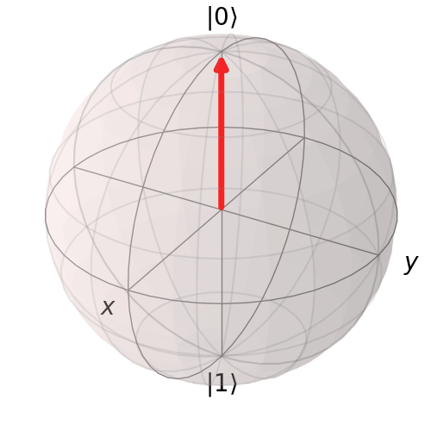

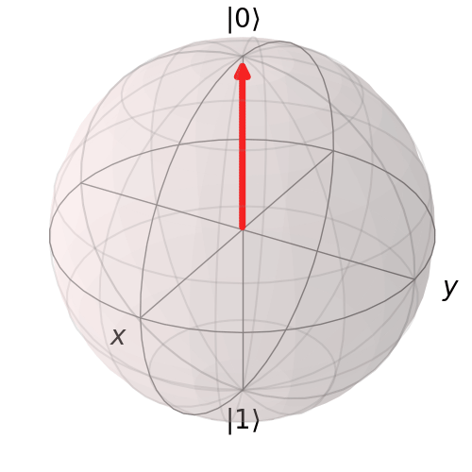











1.1. Parameterized quantum circuit (PQC)
(Main) qubits
$${\left|0\right\rangle }^{⊗m}$$
$$R_{Y}\left(θ_{0}\right)$$
Ancilla qubits
$$U\left(θ\right)$$
$$R_{X}\left(θ_{2}\right)$$
$$V\left(θ_{4−7}\right)$$
$${\left|0\right\rangle }^{⊗n}$$
$$R_{X}\left(θ_{1}\right)$$
$$R_{Z}\left(θ_{3}\right)$$
Trainable parameter
Classical channel
$$c$$
1-qubit gates
2-qubit gates
multi-control gate
complex gate
$θ={\left[\begin{matrix}θ_{0} & θ_{1} & …\end{matrix}\right]}^{⊺}$
[1.2] Benedetti, M et al, Parameterized quantum circuits as machine learning models. Quantum Science and Technology, 4(4), 043001 (2019)
Gate $R_{i}(θ)$ rotate state $θ^{o}$ about the $i$-axis where $i∈\left\{X,Y,Z\right\}$ and $θ∈[0,2π]$
Notes:
Vector đầu vào được ánh xạ sang không gian Hilbert $φ(x)$ bằng Encoder $U_{φ}$.
Circuit $U(θ)$ tác động và trả về $U\left(θ\right)Uφ\left(x\right){\left|0\right\rangle }^{⊗\left(n+m\right)}$.
Tập các observable $\{M_{i}\}$ hỗ trợ thao tác đo, ánh xạ trạng thái lượng tử tới không gian output thông qua hàm $f$.

Slide 6
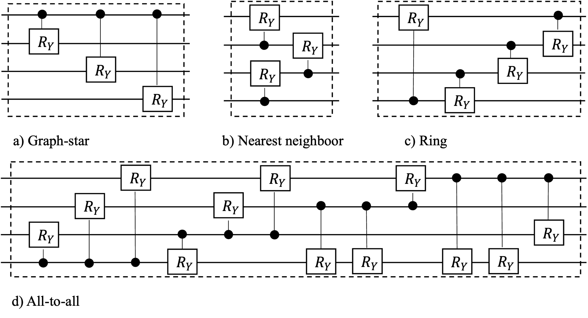






























1.2. Circuit ansatz
Existing ansatzes
All-to-all
$$R_{Y}$$
$$R_{Y}$$
$$R_{Y}$$
$$R_{Y}$$
$$R_{Y}$$
$$R_{Y}$$
Odd layer
Even layer
$${g) W}_{all−to−all}$$
Graph-star & Nearest Neighboor
$$R_{Y}$$
$$W_{i}$$
$$R_{X}$$
$$R_{Z}$$
$$R_{Y}$$
$$R_{X}$$
$$R_{Z}$$
$$R_{Y}$$
$$R_{Y}$$
$$R_{X}$$
$$R_{Z}$$
$${f) W}_{alternating}$$
$$R_{X}$$
$$R_{Z}$$
$$R_{Y}$$
Ring
$$R_{Y}$$
$L$ layer
$$R_{Y}$$
$R_{i}\left(.\right)$
Control $R_{i}$ gate
[1.5] Haug, T et al, Capacity and quantum geometry of parametrized quantum circuits. PRX Quantum, 2(4), 040309. (2021)
$$e) W_{chain}$$
$R_{i}\left(.\right)$
$R_{i}$ gate
Notes:
Các cấu trúc graph – based, ring, nearest neighboor, all-to-all. Biến đổi một chút => các cấu trúc W

Slide 7
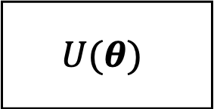

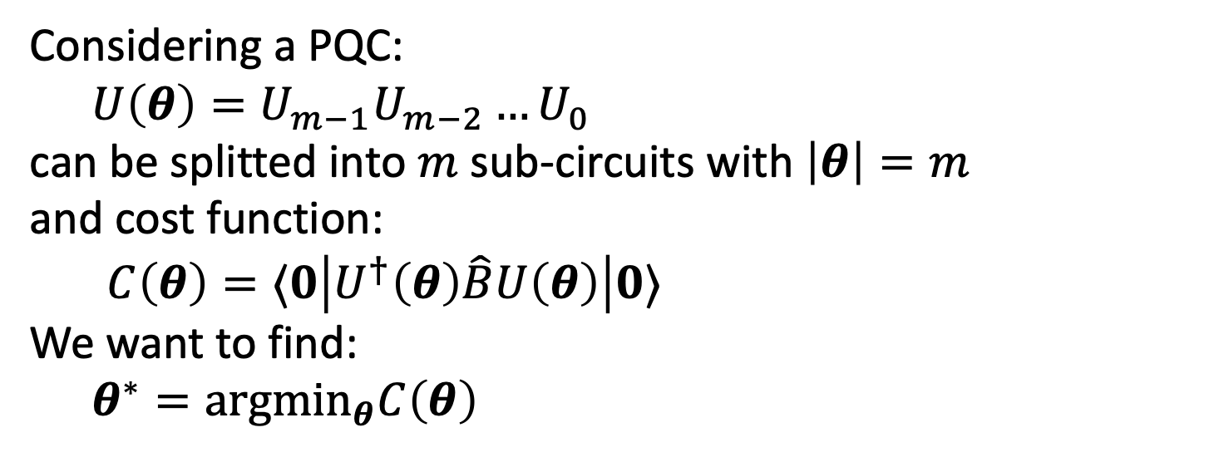
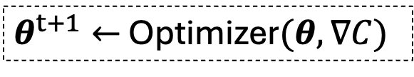


1.4. Gradient and optimizer
Considering a PQC:
  $U\left(θ\right)=U_{m−1}U_{m−2}…U_{0}$
can be splitted into $m$ sub-circuits with $\left|θ\right|=m$
and cost function:
$C\left(θ\right)=⟨0\left|U^{†}\left(θ\right)\hat{B}U\left(θ\right)\right|0⟩$
We want to find:
  $θ^{∗}={argmin}_{θ}C\left(θ\right)$
Gradient
$$U(θ)$$
$$C\left(θ\right)$$
$$∇C$$
$θ^{t+1}←$ Optimizer$(θ,∇C)$
Update $θ$ until $C\left(θ\right)<τ$

Slide 8
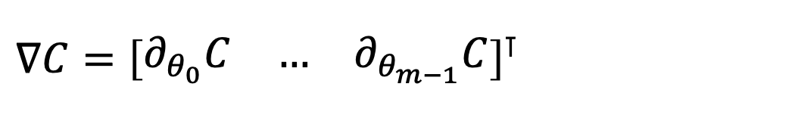
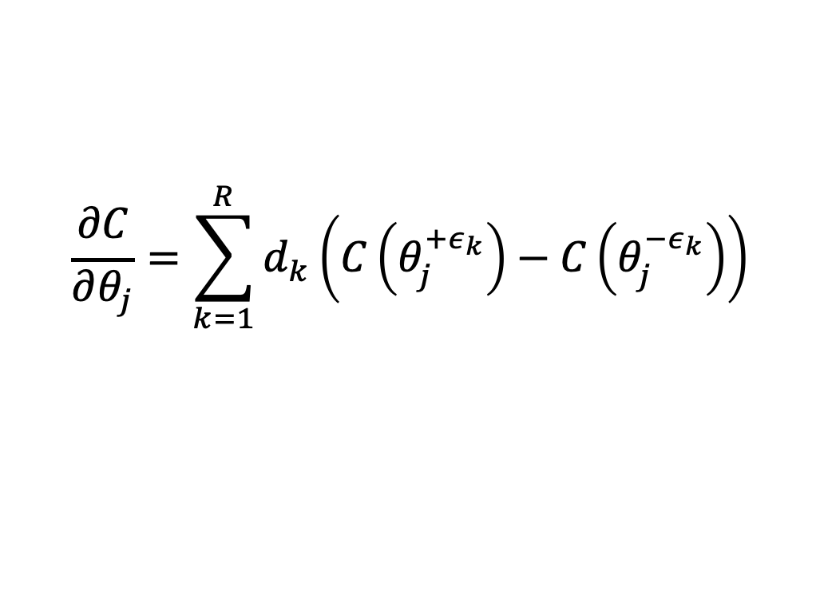
1.4. Gradient
Computing PQC’s gradient is the key in quantum optimization:
$∇C={\left[\begin{matrix}∂_{θ_{0}}C & … & ∂_{θ_{m−1}}C\end{matrix}\right]}^{⊺}$
The partial derivative can be computed through parameter-shift rule [1.17]:
$$\frac{∂C}{∂θ_{j}}=\sum_{k=1}^{R}{d_{k}\left(C\left(θ_{j}^{+ε_{k}}\right)−C\left(θ_{j}^{−ε_{k}}\right)\right)}$$
and $C\left(θ_{j}^{+ε_{k}}\right)≡C\left(θ+e_{j}ε_{k}\right)$, $e_{j}$ is the $j^{th}$ unit vector, $ε_{k}$ is the shift-value
[1.17] D. Wierichs, J. Izaac, C. Wang, and C. Y.-Y. Lin, “General parameter-shift rules for quantum gradients,” Quantum, vol. 6, p. 677, Mar. 2022

Slide 9
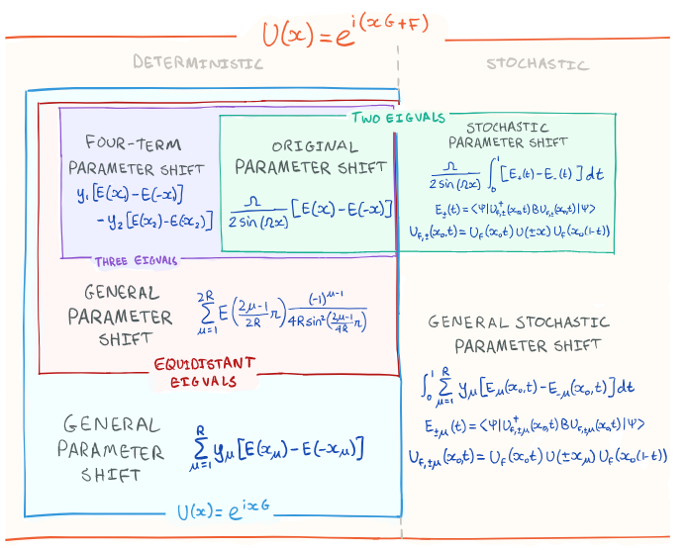
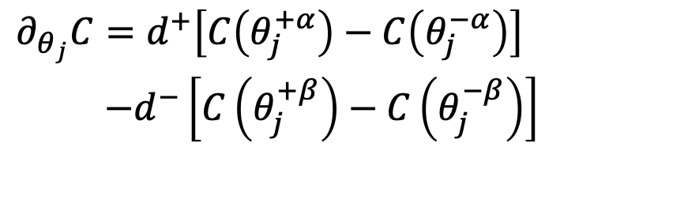


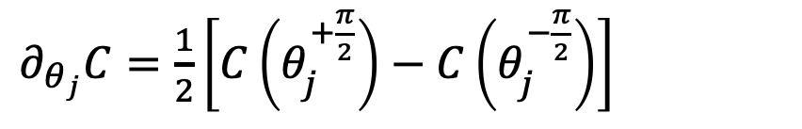
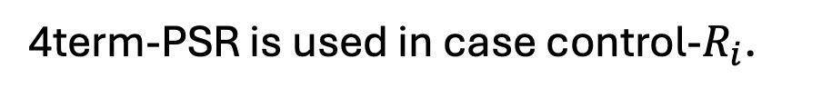
1.4. Gradient
Parameter-shift rule
Commonly, we only use 2term-PSR,
in case $R_{i}$.
$∂_{θ_{j}}C=\frac{1}{2}\left[C\left(θ_{j}^{+\frac{π}{2}}\right)−C\left(θ_{j}^{−\frac{π}{2}}\right)\right]$
4term-PSR is used in case control-$R_{i}$.
$∂_{θ_{j}}C=d^{+}\left[C\left(θ_{j}^{+α}\right)−C\left(θ_{j}^{−α}\right)\right]$
$−d^{−}\left[C\left(θ_{j}^{+β}\right)−C\left(θ_{j}^{−β}\right)\right]$
Take $2m/4m$ quantum evaluations for a single gradient!
$f\left(x\right)=\sin{x},f^{′}\left(x\right)=\frac{1}{2}\left[\sin\left(x+\frac{π}{2}\right)−sin⁡(x−\frac{π}{2})\right]$ $=\frac{1}{2}\left[\cos\left(x\right)+cos⁡(x)\right]$ $=cos⁡(x)$
Notes:
Cho C là loss/cost function, tính đạo hàm riêng thứ i bằng phương pháp sai phân hữu hạn, tuy nhiên trong trường hợp này ta tính các hệ số cụ thể. Với các eigenvalues khác nhau, độ dời s và hệ số tự do r sẽ có giá trị khác nhau.
Cách tính cụ thể được trình bày trong paper.

Slide 10

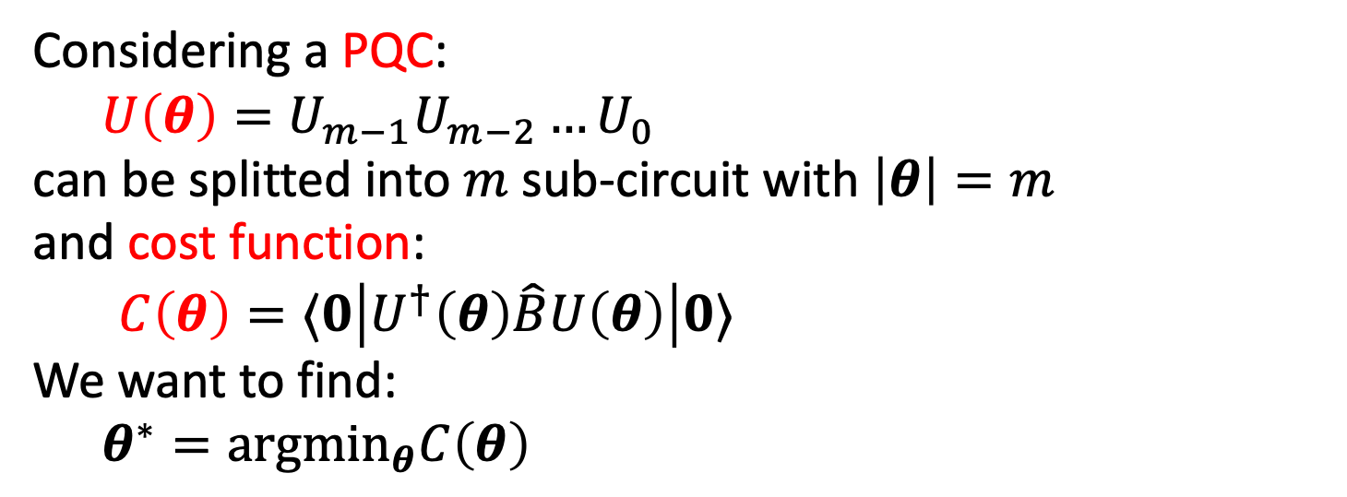
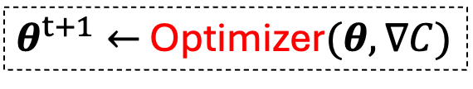

1.6. Quantum optimization
Considering a PQC:
  $U\left(θ\right)=U_{m−1}U_{m−2}…U_{0}$
can be splitted into $m$ sub-circuit with $\left|θ\right|=m$
and cost function:
$C\left(θ\right)=⟨0\left|U^{†}\left(θ\right)\hat{B}U\left(θ\right)\right|0⟩$
We want to find:
  $θ^{∗}={argmin}_{θ}C\left(θ\right)$
Trainable parameters
Objective associated with expectation values
Optimal parameters
$$U(θ)$$
$$C\left(θ\right)$$
$$∇C$$
$θ^{t+1}←$ Optimizer$(θ,∇C)$
Update $θ$ until $C\left(θ\right)<τ$
Quantum computer
Classical computer

Slide 11
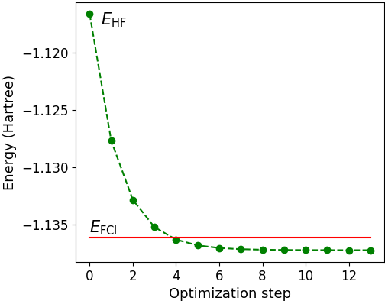



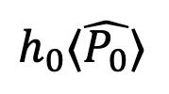



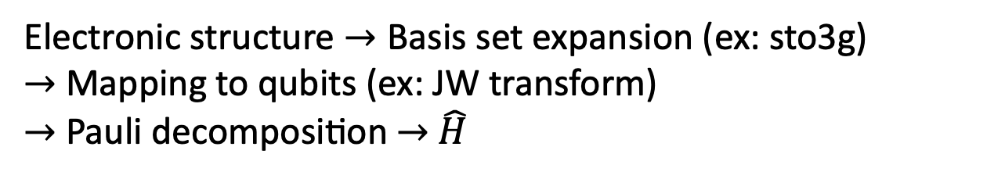


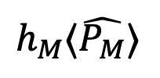
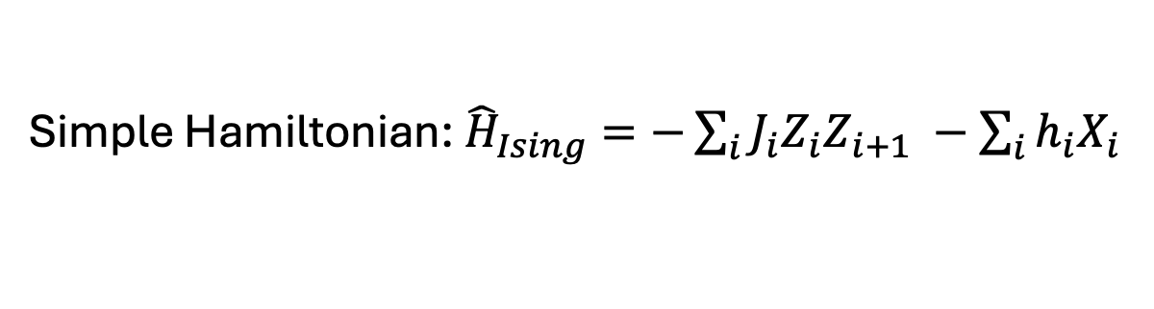





1.6.1. Quantum optimization
Variational Quantum Eigensolver (VQE)
associated with Hamiltonian $H=\sum_{i=0}^{M}{h_{i}}P_{I}$
Finding ground energy $E_{0}$ corresponding to ground state $\left|ψ_{0}\right\rangle$ of Hamiltonian $H$
$$U(θ)$$
Solution!
$$h_{0}⟨\hat{P_{0}}⟩$$
$$H\left|ψ_{0}\right\rangle =E_{0}|ψ_{0}⟩$$
True
$$+$$
$$⇒$$
$$⋮$$
$$⋮$$
$$⋮$$
$$E$$
$$E≤E_{0}?$$
Quantum state preparation
$$U(θ)$$
$$+$$
False
$$h_{M}⟨\hat{P_{M}}⟩$$
Update $θ$
Simple Hamiltonian: ${\hat{​H}}_{Ising}=−\sum_{i}{J_{i}​Z_{i}​Z_{i+1}}$ $​−\sum_{i}{{h_{i}X}_{i}}​$
Electronic structure $→\text{Basis} \text{set} \text{expansion}\text{ (}\text{ex}\text{: }\text{sto}\text{3}\text{g}\text{)}$
$→$ Mapping to qubits (ex: JW transform)
$→$ Pauli decomposition $→$ $\hat{H}$
[1.31] https://pennylane.ai/qml/demos/tutorial_vqe_intro

Slide 12
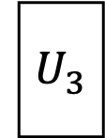


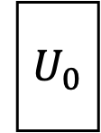
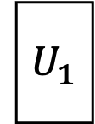


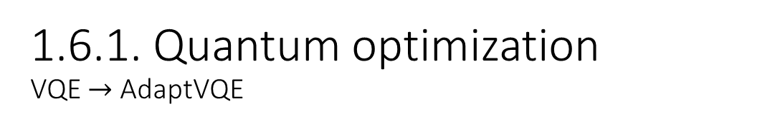
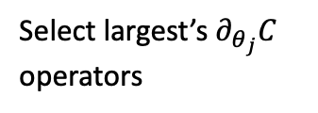



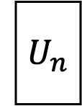



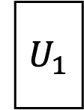
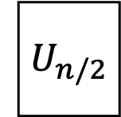

1.6.1. Quantum optimization
VQE $→$ AdaptVQE
$${ U}_{0}$$
$${ U}_{1}$$
$${ U}_{n}$$
$$⋮$$
$$\left\{{\hat{A}}_{m}\right\}$$
False $→$ Add more operator
Measure partial derivates $\left\{∂_{θ_{j}}C\right\}$
Heavy pre-constructed ansatz
$$\{∂_{θ_{0}}C$$
$$∂_{θ_{1}}C$$
$$∂_{θ_{n}}C\}$$
AdaptVQE
Select largest’s $∂_{θ_{j}}C$ operators
$${ U}_{1}$$
$${ U}_{3}$$
$${ U}_{n/2}$$
Reoptimize
$${ U}_{1}$$
$$⋮$$
$$E≤E_{0}?$$
True $→$ Done
For LiH
[1.32] Grimsley, H. R., Economou, S. E., Barnes, E., & Mayhall, N. J. (2019). An adaptive variational algorithm for exact molecular simulations on a quantum computer. Nature communications, 10(1), 3007.

Slide 13
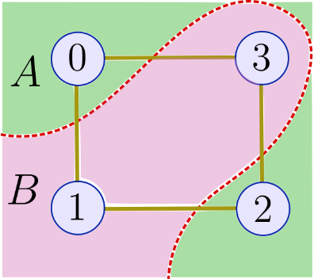
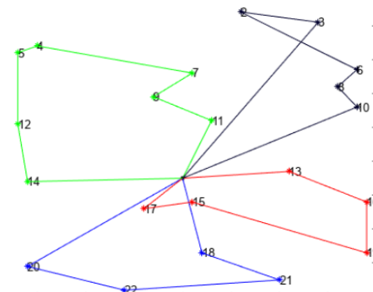




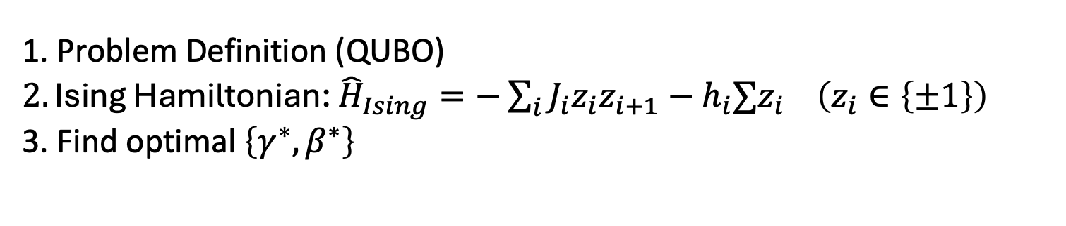


1.6.2. Quantum optimization
Quantum Approximate Optimization Algorithm (QAOA)
$$U\left(γ,β\right)$$
$$e^{−iγ_{n}H_{C}}$$
$$e^{−iβ_{n}H_{M}}$$
Quantum state preparation
$$E$$
$$E≤E_{0}?$$
Min/Max cut
False $→$ Update $\left\{γ,β\right\}$
Implemented by quantum gates
1. Problem Definition (QUBO)
$2. \text{Ising} \text{Hamiltonian}\text{: }{\hat{​H}}_{Ising}=−\sum_{i}{J_{i}​z_{i}​z_{i+1}}−h_{i}∑​z_{i}​ \left(z_{i}∈\left\{±1\right\}\right)$
3. Find optimal $\left\{γ^{∗},β^{∗}\right\}$
Vehicle routing
[1.33] https://pennylane.ai/qml/demos/tutorial_qaoa_intro

Slide 14
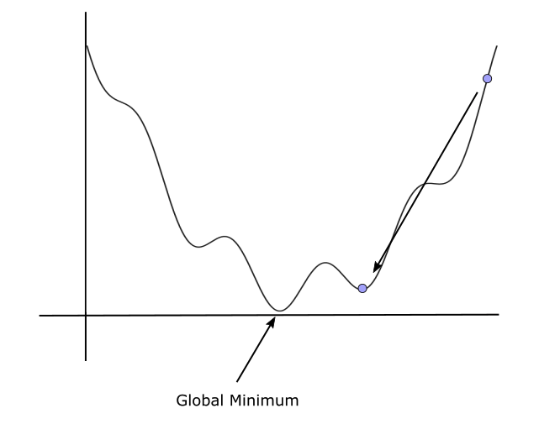




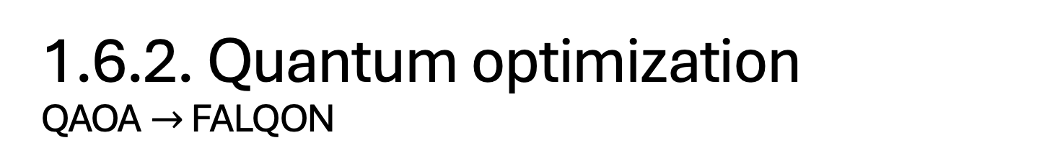


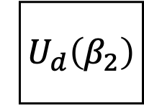

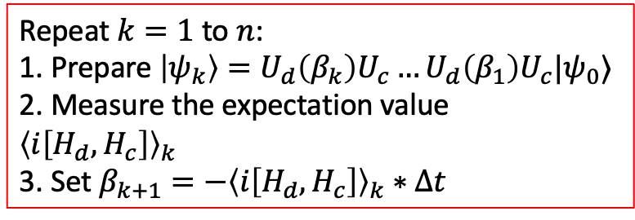
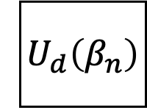

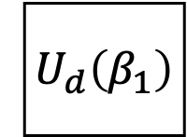





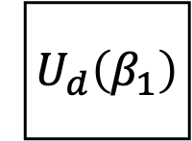

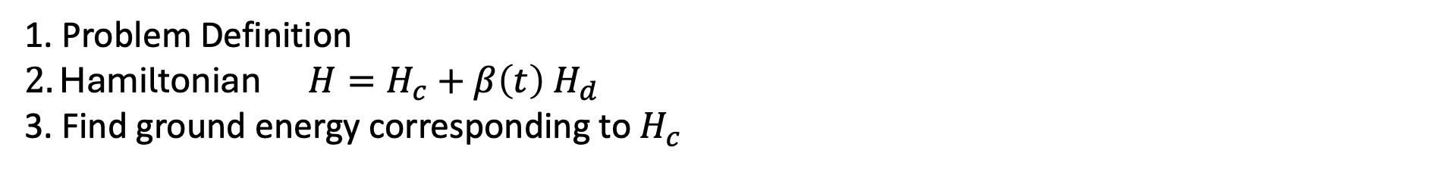




1.6.2. Quantum optimization
QAOA$→$ FALQON
$${\left\langle i\left[H_{d},H_{c}\right]\right\rangle }_{k}≡⟨ψ_{1}|i\left[H_{d},H_{c}\right]|ψ_{1}⟩$$
Step
$${ U}_{c}$$
$${ U}_{d}\left(β_{1}\right)$$
$$k=1$$
$${\left\langle i\left[H_{d},H_{c}\right]\right\rangle }_{1}$$
$$β_{2}=−{\left\langle i\left[H_{d},H_{c}\right]\right\rangle }_{1}∗Δt$$
Repeat $k=1$ to $n$:
1. Prepare$\left|ψ_{k}\right\rangle =U_{d}\left(β_{k}\right)U_{c}…U_{d}\left(β_{1}\right)U_{c}|ψ_{0}⟩$
2. Measure the expectation value ${\left\langle i\left[H_{d},H_{c}\right]\right\rangle }_{k}$
3. Set $β_{k+1}=−{\left\langle i\left[H_{d},H_{c}\right]\right\rangle }_{k}∗Δt$
$${ U}_{c}$$
$${ U}_{d}\left(β_{1}\right)$$
$${ U}_{c}$$
$${ U}_{d}\left(β_{2}\right)$$
$${\left\langle i\left[H_{d},H_{c}\right]\right\rangle }_{2}$$
$$…$$
$$…$$
$$β_{k+1}=−{\left\langle i\left[H_{d},H_{c}\right]\right\rangle }_{k}∗Δt$$
$$…$$
$${ U}_{c}$$
$${ U}_{d}\left(β_{1}\right)$$
$$…$$
$${ U}_{c}$$
$${ U}_{d}\left(β_{n}\right)$$
$$⟨ψ_{n}|H_{c}|ψ_{n}⟩$$
$$k=n$$
Ground energy
1. Problem Definition
$2.\text{Hamiltonian} {H=H}_{c}+β\left(t\right){ H}_{d}$
3. Find ground energy corresponding to $H_{c}$
Objective
Avoid local minimals
[1.34] https://pennylane.ai/qml/demos/tutorial_falqon

Slide 15

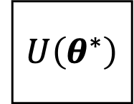

















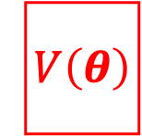
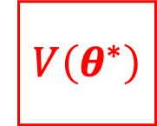









1.6.3. Quantum Optimization
Quantum compiling
$$U$$
$$V$$
$p_{0}\left(θ\right)$
$$C\left(θ\right)=1−p_{0}$$
False $→$ Update $θ$
$$C\left(θ\right)<τ?$$
Transfer
$$U\left(θ\right)$$
$$V^{†}$$
$$U\left(θ^{∗}\right)$$
$$V^{†}$$
$$V$$
$$V^{†}$$
$$p_{0}≈1$$
$$⇒$$
$$≡$$
Preparation
Trainable unitary
Target unitary
Optimized unitary
Target unitary
Explicity
Unknown
Transfer
$$U$$
$$V\left(θ\right)$$
$$U$$
$$V\left(θ^{∗}\right)$$
$$U$$
$${ U}^{†}$$
$$⇒$$
$$≡$$
Tomography
Target unitary
Trainable unitary
Target unitary
Optimized unitary
Explicity
Unknown
[1.35] Hai, V. T., Viet, N. T., & Ho, L. B. (2024). SoftwareX, 26, 101726. https://doi.org/10.1016/j.softx.2024.101726

Slide 16
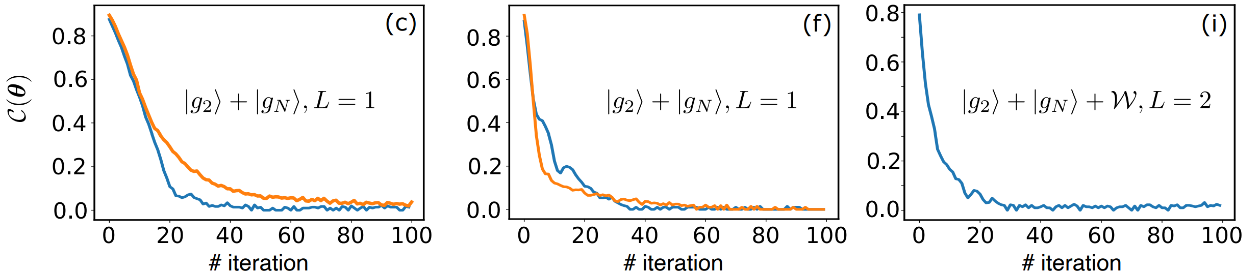


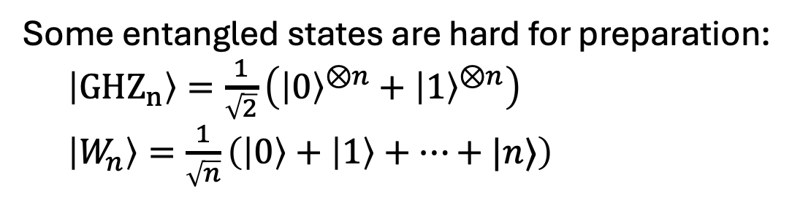









1.6.3. Quantum Optimization
Quantum compiling
Some entangled states are hard for preparation:
$\left|GHZ_{n}\right\rangle =\frac{1}{\sqrt{2}}\left({\left|0\right\rangle }^{⊗n}+{\left|1\right\rangle }^{⊗n}\right)$
$\left|W_{n}\right\rangle =\frac{1}{\sqrt{n}}\left(\left|0\right\rangle +\left|1\right\rangle +…+|n⟩\right)$
$$U\left(θ^{∗}\right)$$
$$GHZ^{†}$$
then preparing $|GHZ⟩$ through $U\left(θ^{∗}\right)$ is better
If
$$≡$$
Preparation
Almost unitaries acts as “black-box”
$$V\left(θ^{∗}\right)$$
$$U$$
we know structure of $U$ via $V\left(θ^{∗}\right)$
$$U$$
only being extracted via measurement
If
$$≡$$
Tomography
[1.36] Hai, V. T., & Urbaneja, J. (2025, July). Entangled State Preparation via Cluster States on Quantum Computers with $⟨qo|op⟩$ Software. In 2025 IEEE International Conference on Quantum Software (QSW) (pp. 116-122). IEEE.
[1.37] Hai, V. T., & Ho, L. B. (2023). Universal compilation for quantum state tomography. Scientific Reports, 13(1), 3750.

Slide 17



1.7. Additional informations
Can we apply classical techniques into quantum optimization?
Consider a set of $K$ optimization targets denoted as $T_{1}, T_{2}, …,T_{K}$, all defined over the same search space $S$. Each target $T_{k}$ is associated with its own cost function:
$$C\left(θ_{\left(k\right)}\right): R^{m} → \left[0, 1\right]$$
The goal of multi-target optimization is to find a set of solutions:
$$\{θ_{\left(1\right)}^{∗},θ_{\left(2\right)}^{∗},…θ_{\left(K\right)}^{∗}\}$$
[1.41] Hai, V. T., Doanh, B. C., Duong, L. V. T., Luan, P. H., & Nakashima, Y. (2025). Transfer-Based Strategies for Multi-Target Quantum Optimization. CANDAR 2025.
17

Slide 18



1.7. Additional informations
Can we apply classical techniques into quantum optimization?
Warm-starting method: simply set $θ_{x_{(k)}}^{∗}$as initial parameter $θ_{y_{\left(k′\right)}}^{\left(0\right)}=θ_{x_{(k)}}^{∗}$.
If $y≈x+ε$, $x$ and $y$ are targets, considering the first-order Taylor expansion of cost function $C$ with respect to $θ$ at $θ_{x}^{∗}$ and fixed $y$, we have:
$${\tilde{θ}}_{ y}^{∗}≈θ_{x}^{∗}−\frac{∇_{θ}C_{y}\left(θ_{x}^{∗}\right)}{{\left\|∇_{θ}C_{y}\left(θ_{x}^{∗}\right)\right\|}^{2}}C_{y}\left(θ_{x}^{∗}\right)$$
Parameter estimator

Slide 19
2. Quantum machine learning (QML)
2.1. Overview
2.2. Quantum machine learning algorithms
2.3. Quantum deep learning
2.4. Additional information

Slide 20
2.1. Overview
Type of algorithm
classical
quantum
Hybrid quantum – classical learning: algorithm running on both quantum and classical computers
QC | QQ
CC
CQ
classical
QML model should resolve below classical machine learning problems:
(1) Require huge dataset
(2) High computation resources
(3) Lack of generality
Type of data
quantum
Classical model: KNN, SVM, Deep learning, …
Quantum Machine learning (QML): algorithm running on only quantum computer or both quantum / classical computers
Notes:
Làm rõ một số định nghĩa trong QML:
- QML: thuật toán machien learning có chạy trên quantum computer
- Hybrid quantum – classical learning: tập con của QML, chạy trên cả quantum và classical computer. => Được chú ý hiện nay vì các quantum algorithm yêu cầu số qubit cao => chưa thích hợp chạy vì ko có tài nguyên

Slide 21

2.1. Overview
What QML models can do?
Based on quantum advantage [2.2]
(1) Require huge dataset
$⇒$ Require less items
(2) High computation resources
$⇒$ Lower time complexity
(3) Lack of generality
$⇒$ Example: Require less #parameter than classical ML model or achieve higher accuracy on the same dataset.
Be careful with hype QML papers!
[2.1] Simões, R. D. M., Huber, P., Meier, N., Smailov, N., Füchslin, R. M., & Stockinger, K. (2023). Experimental evaluation of quantum machine learning algorithms. IEEE Access, 11, 6197-6208.
[2.2] Schuld, M., & Killoran, N. (2022). Is quantum advantage the right goal for quantum machine learning?. Prx Quantum, 3(3), 030101.
Notes:
Một số tiềm năng, đặc trưng của các mô hình QML đề xuất khi so sánh với mô hình ML cổ điển.

Slide 22

2.1. Overview
Type of QML model
a) Speed up version of classical ML algorithms:
QKNN
QKmean
QSVM
b) Quantum analogue version of a deep learning model
- QuNN, QCNN
- QGNN
- QGAN
c) Quantum learning
$→$ I don’t know this type
Notes:
Phân chia tạm thời các lớp trong QML.
- Liên quan đến ML cổ điển: phiên bản quantum của các thuật toán truyền thống như KNN, SVM, ..
- Liên quan đến Neural network (nói đúng ra lớp này được gọi là quantum deep learninng): phiên bản quantum của các kiến ttrúc neural network khác nhau.
- pure quantum learning: các thuật toán mới hoàn toàn và ko có phiên bản cổ điển tương ứng.

Slide 23




2.1. Overview
Pioneers in QML
Maria Schuld
Xanadu.ai (Pennylane)
Ryan Babbush
Google Quantum
John Preskill
Caltech
Hsin-Yuan Huang
Google Quantum AI
Notes:
Các nhà nghiên cứu nên theo dõi:
- Maria schuld: đưa ra các định nghĩa, khái niệm, triết lý, phương pháp tính, … của các mô hình QML. Thiên về lý thuyết.
- Ryan Babbush: đề xuất các mô hình QML mới và thiên về thực nghiệm

Slide 24



2.2. QML algorithms
QkNN
positive
For each test data point $a$:
Step 1: Calculate ${Ds}_{a}=dist\left(a, x_{i}\right) ∀ i=1..n$
Step 2: Sort and get $k$ smallest dist in $Ds_{a}$.
Step 3: Get $k$ corresponding label and do major vote
negative
undetermined
$$k=3$$
Time complexity: $𝒪({mnn}_{test})$
where:
$m$: dimensional of $x_{i}$
$n$: # train data points
$n_{test}:$ # test data points
Notes:
Fig 2.1. mình hoạ quá trình xác định label của hình tròn màu trắng
Tóm tắt thuật toán KNN
Độ phức tạp

Slide 25



2.2. QML algorithms
$k$-means
Step 1. Select $k$ random centers.
Step 2. Assign each data point to the closest center.
If the assigned labels do not change, then stop.
Step 3. New center = average of all assigned points
Step 4. Return to step 2.
Swap-test procedure can be applied again!
Notes:
Fig 2.1. mình hoạ quá trình xác định label của hình tròn màu trắng
Tóm tắt thuật toán KNN
Độ phức tạp

Slide 26









2.2. QML algorithms
Quantum SVM
Kernel method
$$⇒$$
$$⇒$$
separate hyperplane.
Inseparable data $x={\left[\begin{matrix}x_{1} & x_{2}\end{matrix}\right]}^{⊺}$
Separable data
$φ\left(x\right)={\left[\begin{matrix}x_{1} & x_{2} & x_{1}x_{2}\end{matrix}\right]}^{⊺}$
We have:
$f^{∗}\left(x\right)=sgn(w·x±b)$,
with target ($w^{∗}$,$b^{∗}$):
$\min_{w,b,c}{\frac{1}{2}{\left\|w\right\|}_{2}^{2}+C\sum_{i=1}^{n}{ε_{i}}}$
$$\max_{β} L\left(β\right)=\sum_{i=1}^{n}{β_{i}−\frac{1}{2}}\sum_{i=1}^{n}{\sum_{j=1}^{n}{β_{i}β_{j}y_{i}y_{j} φ{\left(x_{i}\right)}^{⊺}φ\left(x_{j}\right)}}{ }$$
parameters
Inner product
$𝒪\left(M∗?\right)$ complexity
$$K\left(x_{i},x_{j}\right)≡φ{\left(x_{i}\right)}^{⊺}φ\left(x_{j}\right)$$
Kernel function is faster!

Slide 27

2.3. Quantum deep learning
Encoder
Neural net
Decoder
Quantum neural network (QNN)
[2.4] Benedetti, M et al, Parameterized quantum circuits as machine learning models. Quantum Science and Technology, 4(4), 043001 (2019)
Notes:
Vector đầu vào được ánh xạ sang không gian Hilbert $φ(x)$ bằng Encoder $U_{φ}$.
Circuit $U(θ)$ tác động và trả về $U\left(θ\right)Uφ\left(x\right){\left|0\right\rangle }^{⊗\left(n+m\right)}$.
Tập các observable $\{M_{i}\}$ hỗ trợ thao tác đo, ánh xạ trạng thái lượng tử tới không gian output thông qua hàm $f$.

Slide 28

2.3. Quantum deep learning
QNN
Attribute | Classical deep learning | Quantum deep learning
Main concept | Neural network | Parameterized quantum circuit (PQC)
Parameter | Weight ${\{w}_{i}\}$ in nodes | Angle value $\left\{θ_{i}\right\}$ in rotation gates $\left\{R_{X},R_{Y},R_{Z}\right\}$
Gradient | Backpropagation | General parameter-shift rule and gradient tensor metric
Optimizer | Classical optimizer | Classical optimizer + gradient-free optimizer
Loss | Various type | Associated with expectation values
Notes:
Parameterized quantum circuit : mạch lượng tử có chứa tham số
parameter-shift rule : phương pháp tính đạo hàm cho tham số thứ I
Quantum Natural Gradient: đạo hàm có nhân với ma trận G được gọi là tensor metric, ma trận G tương đương phép biến đổi cơ sở.
Expectation value $⟨ψ\left|H\right|ψ⟩$: giá trị kì vọng của một Hamiltonian, H là bài toán đang giải quyết.

Slide 29



















2.3. Quantum deep learning
Variational classifier for simple classification problem
$$⟨Z_{0}⟩$$
$$U_{φ}\left(x\right)$$
$$U\left(θ\right)$$
#qubits = 4
#qparam = 24
#cparam = 1
Optimizer: Adam
$$p_{0}$$
$$C\left(θ,b\right)$$
$$⨁$$
$$|0⟩$$
$$|0⟩$$
$$|0⟩$$
$$X$$
$$|1⟩$$
$$|0⟩$$
$$|0⟩$$
Update $θ,b$
classical bias $b$
$$|0⟩$$
$$|0⟩$$
Problem:
Simulate $f:x∈{\left\{0,1\right\}}^{⊗n}→y=⨁_{i}x_{i}$
Example: $f(|0100⟩)=1$
Cost function $C\left(θ,b\right)=\frac{1}{N}{\sum{\left({\hat{y}}_{i}−y_{i}\right)}}^{2}→0$
Accuracy metric $A=\frac{1}{N}∑𝕀\left(\left|y_{i}−{\hat{y}}_{i}\right|<τ\right)→1$
[2.5] https://pennylane.ai/qml/demos/tutorial_variational_classifier

Slide 30

2.3.1. Quantum deep learning
Quanvolutional NN (QuNN)
[2.6] Y. Lecun et al, Gradient-based learning applied to document recognition, Proceedings of the IEEE 86(11) (1998) 2278–2324
[2.7] T. Hur et al, Quantum convolutional neural network for classical data classification, Quantum Machine Intelligence 4 (Feb 2022) p. 3.
Notes:
Mô hình QNN, trong đó lớp Convolutional được thay bằng lớp Quanvolutional (Quantum convolutional), lớp này ít tham số hơn, độ phức tạp tính toán thấp hơn và extract feature tốt hơn

Slide 31













2.3.2. Quantum deep learning
Quantum Convolution NN (QCNN)
$$U$$
$$V$$
$$U$$
$$V$$
$$F$$
$$ρ_{in}$$
$$U$$
$$U$$
$$V$$
$$…$$
$$…$$
$$U$$
$$…$$
Quantum convolutional
Pooling
Quantum convolutional
Pooling
Fully connection
No classical steps
[2.9] Cong, I., Choi, S. & Lukin, M.D. Quantum convolutional neural networks. Nat. Phys. 15, 1273–1278 (2019). https://doi.org/10.1038/s41567-019-0648-8
Notes:
Mô hình QNN, trong đó lớp Convolutional được thay bằng lớp Quanvolutional (Quantum convolutional), lớp này ít tham số hơn, độ phức tạp tính toán thấp hơn và extract feature tốt hơn

Slide 32

2.4. Additional information
Power of QML
We will focus on PQC which is the main computation in QML
Encoder: use a very small qubit ($\log_{2}{N}$) to loading / encoding $N$ – dimensional normalized $x$.
Operator: like classical NN, the structure of $U(θ)$ decides the model extract feature / process information good or bad.
Decoder: quantum information $→$ classical information.
Notes:
Encoder: chuẩn hoá trước khi đưa vào mạch vì trạng thái lượng tử tuân theo born rule.
Operator: ko biết rõ nên sắp xếp các cổng trong mạch ntn nên thường xuyên sử dụng các mạch có cấu trúc dạng graph.
Measure: thường chỉ lấy được p_0000, nếu muốn lấy tất cả các p thì phải sử dụng quantum tomography

Slide 33

2.4. Additional information
Challenge in QML field
Standard architechture?
Trainability, Expressibility
Lack of experiment resources (not enough simulated #qubit to transform toy dataset $→$ real dataset)
Hype in QML: some applied QML models are actually worse than classical models.
Other problems
[2.12] Joseph Bowles, Shahnawaz Ahmed, & Maria Schuld. (2024). Better than classical? The subtle art of benchmarking quantum machine learning models.
[2.13] Schuld, M., & Killoran, N. (2022). Is Quantum Advantage the Right Goal for Quantum Machine Learning?. PRX Quantum, 3, 030101.
[2.14] Jens Eisert, & John Preskill. (2025). Mind the gaps: The fraught road to quantum advantage.
Notes:
Encoder: chuẩn hoá trước khi đưa vào mạch vì trạng thái lượng tử tuân theo born rule.
Operator: ko biết rõ nên sắp xếp các cổng trong mạch ntn nên thường xuyên sử dụng các mạch có cấu trúc dạng graph.
Measure: thường chỉ lấy được p_0000, nếu muốn lấy tất cả các p thì phải sử dụng quantum tomography

Slide 34
Accelerators for quantum computer: interdisciplinary research direction between “Vi mạch” & Quantum

Slide 35


AI (GPU, TPU, …) for ‘smart’ control
Quantum computer (QPU) as powerful weapon
CPU for autonomic nervous system
VLSI design as a backbone for whole system

Slide 36






Heart of quantum computers, we can not cover this part!
(3) Control and deploy on real quantum computers
(1) Deploy quantum programs at small scale
(2) Pass all test cases?
Then deploy on real quantum computers
Turn to ~ 0ºK
Cryogenic system
Quantum Emulator
(GPU/FPGA/ASIC)
Control
Quantum Processing Unit
Noise mitigation
We CAN cover this
Classical computer
(Your computer)
Control Electronics
(FPGA/ASIC)
We CAN cover this
Error correcting code device (FPGA/ASIC)
Quantum Computer

Slide 37


IBM hybrid quantum-classical computer
USA
HPCi Japan
Replacing “GPU for quantum task”

Slide 38
1.1. Quantum simulation approach
Table 1.1. My research’s contribution.
Note: △: Not implemented ○: Implemented/Available ◎: Improved
Approach | Device | Type | Theory analysis | Software design | Hardware design
Density matrix variant (state vector) [2] | FPGA ZCU102 | Emulator | ◎ | ○ | ◎
Wave function variant (state vector) [3] | FPGA ZCU102 | Emulator | ◎ | ○ | ◎
Extended stabilizer formalism [4] | GPU RTX4090 | Simulator | ◎ | ◎ | △
Tensor-network [5]
Decision diagram [6]
All related works are only focus on one of these aspects!
[2] Ali Javadi-Abhari,, et al. Quantum computing with Qiskit. arXiv preprint arXiv:2405.08810, 2024.
[3] Nguyen et al. Qsun: an open-source platform towards practical quantum machine learning applications. Machine Learning: Science and Technology, 3(1):015034, 2022.
[4] Andi Gu, Salvatore F. E. Oliviero, and Lorenzo Leone. Doped stabilizer states in many-body physics and where to find them. Phys. Rev. A, 110:062427, Dec 2024
[5] Feng Pan, Hanfeng Gu, Lvlin Kuang, Bing Liu, and Pan Zhang. Efficient quantum circuit simulation by tensor network methods on modern gpus. ACM Transactions on Quantum Computing, 5(4), November 2024.
[6] Thomas Grurl and et al. Arrays vs. Decision Diagrams: A Case Study on Quantum Circuit Simulators. In 2020 IEEE 50th International Symposium on Multiple-Valued Logic (ISMVL), pages 176–181, 2020.
Notes:
I summarized my research’s contribution in this slides.
There are a five major simulation approaches but I only focus on state-vector and stabilizer formalism (the first three row).
Each approach have its advantage and disadvantage in different context and different usecase.
Currently, many works accelerate the processing on quantum simulation, almost from software side.
but none of them improve both theory, software and hardware design at the same time.
While my work has been improve all three aspects. The state-vector approach is implemented on FPGA ZCU102, stabilizer formalism is just done on rtx4060.

Slide 39






1.3. Representation of state & gate
A $n$ – qubit quantum state can be in the form:
  $\left|ψ^{\left(t\right)}\right\rangle =\left[\begin{matrix}α_{0}^{\left(t\right)} \\ ⋮ \\ α_{N−1}^{\left(t\right)}\end{matrix}\right]$ where $N=2^{n}$ and $α_{j}^{\left(t\right)}∈ℂ$
The number of amplitudes grows exponentially based on #Qubits
$$\left\|α_{j}^{\left(t\right)}\right\|≤1$$
A quantum gate update amplitudes $\left\{α_{j}^{\left(t\right)}\right\}$:
$$g\left(w,θ\right):\left\{α_{j}^{\left(t\right)}\right\}→\left\{α_{j}^{\left(t+1\right)}\right\}$$ | (1.1)
Traversing on a long vector
where $w$ and $θ$ are wires and parameter (if applicable).
Our target is to compute the evolved (final) state:
$$\left|ψ^{\left(m\right)}\right\rangle =U\left(θ\right)|ψ^{(0)}⟩$$ | (1.2)
Both $\left|ψ^{\left(t+1\right)}\right\rangle$ and $\left|ψ^{\left(t\right)}\right\rangle$ need to be saved at the same time
under unitary $U$. $U$ is composed from gates or sub-operators via tensor product/matrix multiplication
Notes:
The state, gate and operator presented in the last slide can be viewed as vector and matrix in the state-vector approach.
A state is simply a normalized vector which has dimensional two exponential of n where n is the number of qubits.
Because the length of state is only 1, so each element on state always has the norm less or equal 1.
The gate and operator is actually the matrix which has the element is the complex number.
A operator can be reconstructed by tensor multiplication between gates.
And when a operator acts on a state as Eq 1.2, it is equivalent to a matrix-vector multiplication.
But note that the dimensional of both state and operator increase exponentially based on the number of qubits.
Computing this term is a hard problem.

Slide 40
2. A wave-function based emulator (FQsun)
The wave-function approach is based on the representation in the last slides.
Challenges:
Efficient Memory Management: able to process large #Qubits
Flexible Quantum Gate Configuration: an adaptable gate configuration system is needed
Optimized Task Scheduling: the emulator requires an optimized scheduling mechanism to ensure continuous processing without latency.
Multi-Level Precision Support: supporting various precision levels allows the emulator to balance accuracy with resource usage
Notes:
In this section, we present how the equation 1.2 is emulated on ZCU102 following wave function variant. This emulator is called FQsun.
Challenge (a): Quantum emulation requires managing and processing large memory, especially as the #Qubits increases, which dramatically expands memory demands. Efficient data handling and minimized memory access times are crucial to achieving high processing speeds without excessive energy consumption.
Challenge (b): Different quantum algorithms rely on a variety of quantum gates, but many emulators are constrained by limited gate support. To effectively execute diverse algorithms, an adaptable gate configuration system is needed to facilitate a wide range of computations with minimal hardware reconfiguration.
Challenge (c): Quantum emulators must execute sequential calculations, where delays in one step can impact the entire system’s performance. To avoid bottlenecks, the emulator requires an optimized scheduling mechanism to ensure continuous processing without latency, thus maximizing resource utilization and computation speed.
Challenge (d) Quantum algorithms often demand different levels of numerical precision, from FX to FP, depending on application requirements. Supporting various precision levels allows the emulator to balance accuracy with resource usage, adapting performance to meet the specific needs of each quantum task while minimizing computational overhead.

Slide 41






2.2. Algorithm
Table 2.2. Comparison between variants ($†$) ${\hat{n}}_{j}∈ [1, 2]$
Matrix-vector multiplication
Op | Wave-function | Density-matrix
Mul/gate | $2^{n+{\hat{n}}_{j}+1}$ ($†$) | $2^{2n}$
Add/gate | $2^{n+{\hat{n}}_{j}+1}$ ($†$) | $2^{2n−2}$
Depend on type
The final state is calculated through series of $𝒲$:
$\left|ψ^{\left(m\right)}\right\rangle = 𝒲\left(g_{m}\right)…𝒲(g_{2})𝒲(g_{1})|ψ^{(0)}⟩$ (2.1)
The transition function $𝒲\left(g_{j}\right)$ updates amplitudes $\{α_{j}\}$ on the ${\left(w_{0}\right)}^{th}$ qubit:
$$𝒲\left(g\right):\left[\begin{matrix}α_{s_{i}}^{\left(t\right)} \\ α_{s_{i}+2^{w}}^{\left(t\right)}\end{matrix}\right]→g\left[\begin{matrix}α_{s_{i}}^{\left(t\right)} \\ α_{s_{i}+2^{w}}^{\left(t\right)}\end{matrix}\right]=\left[\begin{matrix}α_{s_{i}}^{\left(t+1\right)} \\ α_{s_{i}+2^{w}}^{\left(t+1\right)}\end{matrix}\right]$$
(2.2)
Algorithm 2.1. The implementation of single- and multiple-qubit gates is unified into a common framework
Notes:
We can easily see that applying a operator on a n-qubit state has the complexity 2^2n because of the matrix-vector multiplcation.
Instead of that, we design an algorithm that only traverse on the state vector, the action will be design by quantum gate and the ooerator will not be constructed.
That help reduce both time and space complexity from 2^2n to 2^n.

Slide 42


2.3. System overview/Ideals
Figure 2.1. Overview architecture of our FQsun at the system-on-chip (Soc) level on FPGA.
Ping-Pong memory
QGU
Figure 2.2. Memory organization of the proposed FQsun.
Notes:
Figure 2.1 details the proposed FQsun architecture on an FPGA at the systemon-chip (SoC) level. The system comprises four components: Qsun Framework, FQsun Software, Processing System (PS), and FQsun in Programmable Logic (PL).
The Qsun Framework, implemented in Python, includes libraries and programs for quantum simulation.
These programs can instruct the hardware to execute gates through the FQsun C library in FQsun Software.
Within the PS, the embedded CPU runs software such as the Qsun Framework and FQsun Software to control FQsun in PL for executing quantum simulation tasks.
In the PL, it consists of four modules: AXI Mapper, memory system, FQsun controller, and QGU.
The AXI Mapper manages and routes data exchanged between the PS and the FQsun memory system.
The FQsun memory system comprises Control Buffers, Context Memory, and a pair of Ping/Pong Amplitude Memory modules.
Control Buffers store control signals for the host FQsun Controller.
Context Memory holds configuration information such as gate type, gate location (cut, sin(θ/2), cos(θ/2), w0, w1), and gate parameters.
Notably, the Ping/Pong Amplitude 2 ×2048 (KB) Memory is the largest memory unit designed to store {α (t) j } for QGU. Finally, QGU serves as the main processing unit of FQsun.
QGU contains six fundamental gate units: {H, S, CX, Rx, Ry, Rz}. These basic gates can be combined to implement most other gates, ensuring high flexibility.
The hardware platforms such as FPGAs are limited by storage resources. To support large #Qubits, the memory organization of FQsun must be optimized.
Figure 2.2 illustrates the memory organization. There are three types of memory: Control Buffers, Context Memory, and Ping/Pong Amplitude Memory.

Slide 43
















2.3.1-2. Idea #1: efficient memory organization
Idea #2: optimized scheduling
$$|ψ^{\left(t\right)}⟩$$
$$|ψ^{\left(t+1\right)}⟩$$
Ping memory store $|ψ^{(0)}⟩$
Pong memory store $|ψ^{(1)}⟩$
Ping memory store $|ψ^{(1)}⟩$
Pong memory store $|ψ^{(2)}⟩$
$$α_{0}$$
$$α_{1}$$
$$⋮$$
$$⋮$$
$$⋮$$
$$⋮$$
is controlled by
Real values
Real values
Imaginary values
Imaginary values
$$α_{N−1}$$
$$⋮$$
$$⋮$$
$$⋮$$
$$⋮$$
Figure 2.4. Timing chart of FQsun operation using Ping/Pong Amplitude Memories.
Figure 2.3. Memory organization detail
Ping
Pong
Notes:
Control Buffers: These buffers store 1-bit control signals such as load, start, done, and stop. The load signal is used by the host to indicate the state where it writes context and amplitude data. Additionally, the host uses a 5-bit signal to indicate #Qubits, which FQsun is supporting. After completing the load state, the host triggers the start signal to begin the session. The done signal is continuously read by the host to track the completion time of each gate operation. Finally, the stop signal is used to end the session by resetting the address register of the Context Memory.
Context Memory (16 KB): This memory stores configuration dataand has d = 2048. The configuration data includes a 3-bit gate opcode indicating the type of gate to be executed. The values sin(θ/2) and cos(θ/2), with a bit width of 16/24/32 depending on the precision type, are parameters for Ri , pre-computed by FQsun software to reduce hardware complexity. Additionally, parameters such as the 5-bit cut and gate positions {w0, w1} must also be stored.
Ping/Pong Amplitude Memory (2 MB): used to store {α (t) j } for QGU.
This memory must have a d = 2^17 or d = 2^18 to support up to 17 or 18 qubits for 16-bit precision or 32-bit precision, calibrated to fit the maximum BRAM (block ram) capacity of the Xilinx ZCU102. (5.3 Mb)
In case Ping/Pong Amplitude Memory is applied to FPGAs with more BRAM resources, such as the Alveo or Versal series, FQsun could support a larger #Qubits.
To enable amplitude updates as described in Algorithms 2.1, a dual-port Ping/Pong memory design is applied.
Specifically, if the ping memory holds the current amplitude {α (t) j }, the pong memory will store the new amplitude {α (t+1) j }, and vice versa. This design is essential on the grounds that, during the calculation of {α (t+1) i+cut} and {α (t+1) i−cut}, both the current and new amplitudes are needed.

Slide 44



2.3.3. Idea #3: configurable Quantum Gate Unit (QGU)
Figure 2.5. Micro-architecture of Quantum Gate Unit (QGU).
Clifford gates: H, S, CX
Non-Clifford gates: $R_{x},R_{y},R_{z}$
Notes:
The micro-architecture of the QGU consists of five main modules designed to perform six fundamental gates following software design.
The computational data for the QGU includes {α (t) j }, {α (t+1) j }, {α (t+1) j±cut}, and parameters (sin(θ/2) and cos(θ/2)) used by Ri .
Essentially, the operations of Rx and Ry are relatively similar; hence, they are implemented using a Unified Rx & Ry Gate unit to conserve hardware resources.
To ensure proper execution of the if-else logic, a 2-to-1 multiplexer system controlled by the state value is used to select the output value.
Finally, a multiplexer controlled by the gate operation input is employed

Slide 45



2.3.4. #Idea 4: multiple precisions
Table 2.3. Utilization of FQSun on ZCU102 FPGA
Table 2.4. Basic gate’s period and #Cycles per gate on FQsun
Figure 2.6. Power measurement of FQsun (FX32).
Notes:
Almost all related work on emulators has primarily focused on performance evaluation while lacking criteria for accuracy.
I realize that lower precision while affect on the fidelity heavily.
So I designed with five configurations, each corresponding to a different precision on slides.
Pipeline and Complexity: FP numbers utilize two pipeline stages for both the multiplier and the adder/subtractor units, while FX numbers require only two stages for the multiplier and one stage for the adder/subtractor. As a result, the latency of FX design is lower compared to FP design.
Range and Precision: following normalize condition, |α_j| ∈ [−1, 1]; then, FX numbers used in FQsun are configured with 1 sign bit, 1 integer bit, and the remaining bits allocated to the fractional part
Specifically, the PS consumes a maximum of 1.84 (W) (with 0.34 (W) dynamic power). The PL consumes a maximum of 0.61 (W). The total power reaches a maximum of 2.41 (W) (with 0.23 (W) dynamic power). Accordingly, the power consumption for FQsun is determined by adding the total dynamic power to the maximum PL power, reaching 0.81 (W). These power values are kept for all #Qubits.
FFs: flip-flop
DSP: digital signal processor
PS: processing system
PL: programmable logic

Slide 46



2.4. Benchmarking tasks
Randomize quantum circuit (RQC) with ~uniform gate’s distribution
Figure 2.7. Gate distribution for
Random quantum circuit (RQC)
Quantum Fourier Transform (QFT) and
ZXZ with parameter-shift rule (PSR).
Figure 2.8. Circuit representation for
(b) QFT and
(c) PSR.
Notes:
We benchmark the Fqsun on three different quantum algorithms, each algorithms has the different gate organization and number of gates.

Slide 47

2.4.1. Result #1: accuracy metrics
~0 is good
~1 is good
RQC
QFT
PSR
Figure 2.9. MSE/Fidelity between FQsun version. In all cases, FP32 and FX32 are overlapped. For QFT, the FP16 version performs the wrong results since it can not present any $α_{j} ≤ 1/2^{16} ≈ {10}^{−5}$.
Notes:
We can see on all task, Fqsun nearly achieve the perfect MSE and fidelity.
Except the FP16 and FX16, it turn to be wrong on QFT because of not enough bit for fraction part.

Slide 48


2.4.2. Results #2: execution time & PDP
In this case, Software seems better due to the stabilizer rank
Figure 2.10. The execution time on (a-c) RQC (d) QFT execution time comparison between Software + FQsun. (e) We compare GPU A100 and FQsun. (f) PSR execution time comparison between Software + FQsun.
Figure 2.11. PDP through (a) RQC (b) QFT and (c) PSR.
Notes:
In this slide, we compare the execution time and pdp (power delay product) = time x power between Fqsun and CPU/GPU
In almost case, Fqsun achieve the better exe time and superior PDP compared to all related works.
an exception at subfigure 2.10 (d), pennylane and qiskit faster than Fqsun due to the stabilizer rank (will be explain in the next slide and section 3)

Slide 49


2.4.4. Result #4: comparison between related works
Table 2.5. Comparative analysis of FQsun and existing FPGA-based emulators on QFT’s performance.
No flexibility
No flexibility
(†) The #Gate in this work is higher than other work due to the no-use of control-rotation gates.
(††) The Normalized Gate Speed (NGS) (s / (gate $×$ amplitude)) = Execution time / (#Gates $×$ $2^{\text{\#}\text{Qubits}}$), smaller is better.
Notes:
Compared to other emulators [56,57,60–62], our emulator support various applications. The work [59/64] achieve the best normalized gate speed however, these designs support only the QFT circuit and then have no use case because they provide a fixed output.
For a fair comparison, FQsun is comparable to other flexible emulators that support a wide range of algorithms, including Arria 10AX115N4F45E3SG [2] and AMD Xilinx Zynq-7000 FPGA [63].
Regarding execution time, FX32 achieves a computation speed-up of 17.9 times and 6.1 times compared to [2] and [63], respectively.
Furthermore, FQsun supports computations across five precision types and offers different performance and accuracy.

