Slide 1



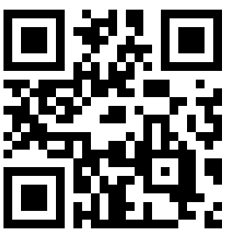



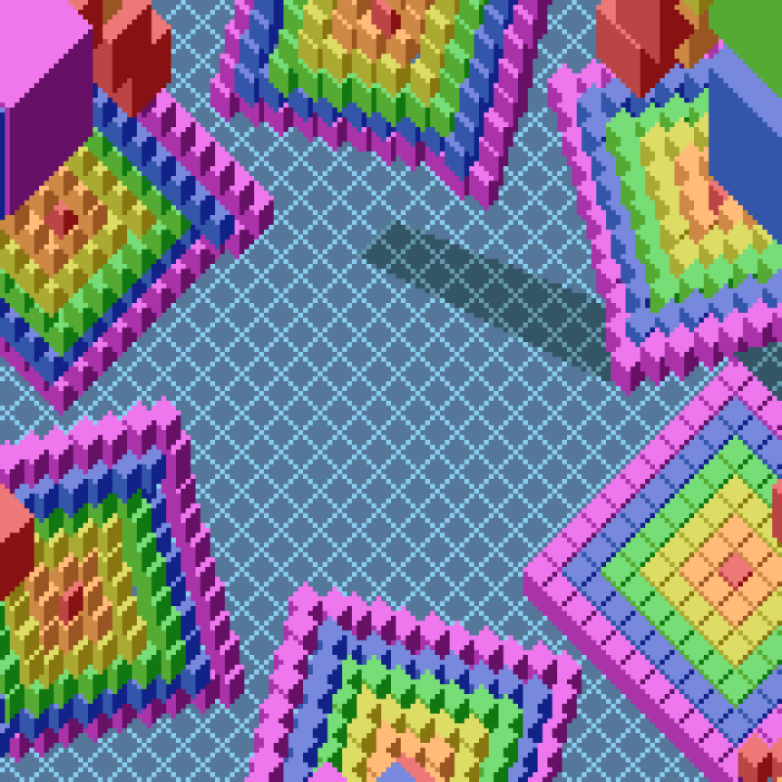
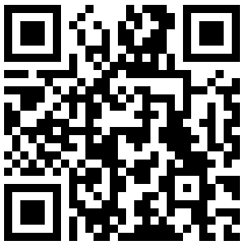
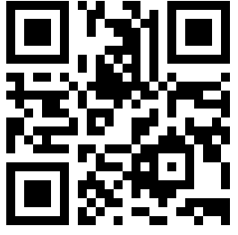
Vietnam National University – Ho Chi Minh city
UNIVERSITY OF INFORMATION TECHNOLOGY
Vietnam National University – Ho Chi Minh city
UNIVERSITY OF INFORMATION TECHNOLOGY
PhD. PHAM HOAI LUAN
Lecturer, Faculty of Computer Engineering
PhD. VU TUAN HAI
Lecturer, Faculty of Software Engineering
Email: luanph@uit.edu.vn
Phone: (+84) 383609042
Email: haivt@uit.edu.vn
Phone: (+84) 814822188
Quarter 34, Linh Trung ward, Ho Chi Minh city, Vietnam
Quarter 34, Linh Trung ward, Ho Chi Minh city, Vietnam
Nara Institute of Science and Technology
Graduate School of Science and Technology
Tohoku University
Frontier Research Institute
for Interdisciplinary Sciences
PhD. PHAM HOAI LUAN
Assistant. Prof, Information Science division
PhD. VU TUAN HAI
Visiting Researcher
Email: pham.luan@is.naist.jp
Phone: (+81) 8095315365
Email: tuan.hai.vu.b7@tohoku.ac.jp
Phone: (+81) 7089462244
Computing Architecture lab
Quantar lab
8916-5 Takayama, Ikoma, Nara 630-019, Japan
Aoba-6-3 Aramaki, Aoba Ward, Sendai, Miyagi 980-0845, Japan

