Slide 1


AISeQ
AISeQ

Slide 2
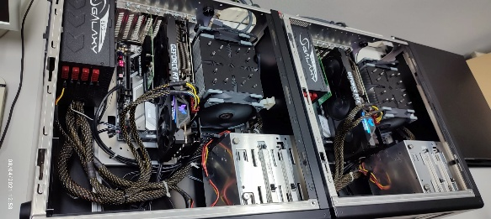
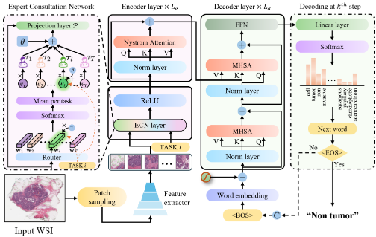




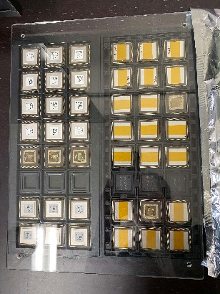
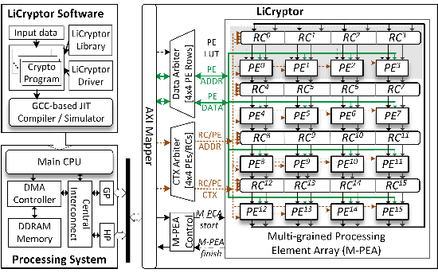
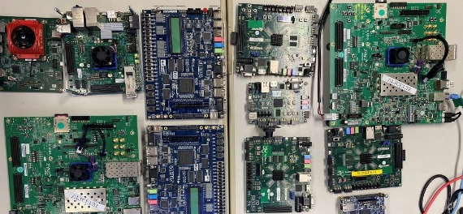
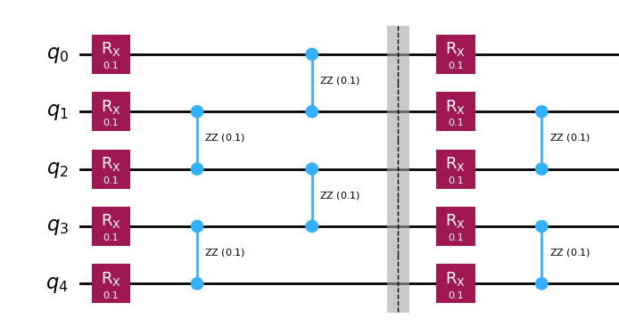
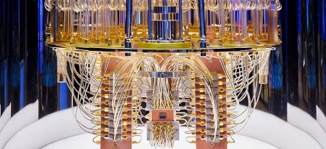
AI
Propose model
Training on GPU
Inference model
Semiconductor
RTL design
Simulating on FPGA
Fabricate chip
Quantum Computing
Deploy on real quantum computer
Quantum algorithms
Simulating on CPU/GPU/…

Slide 3

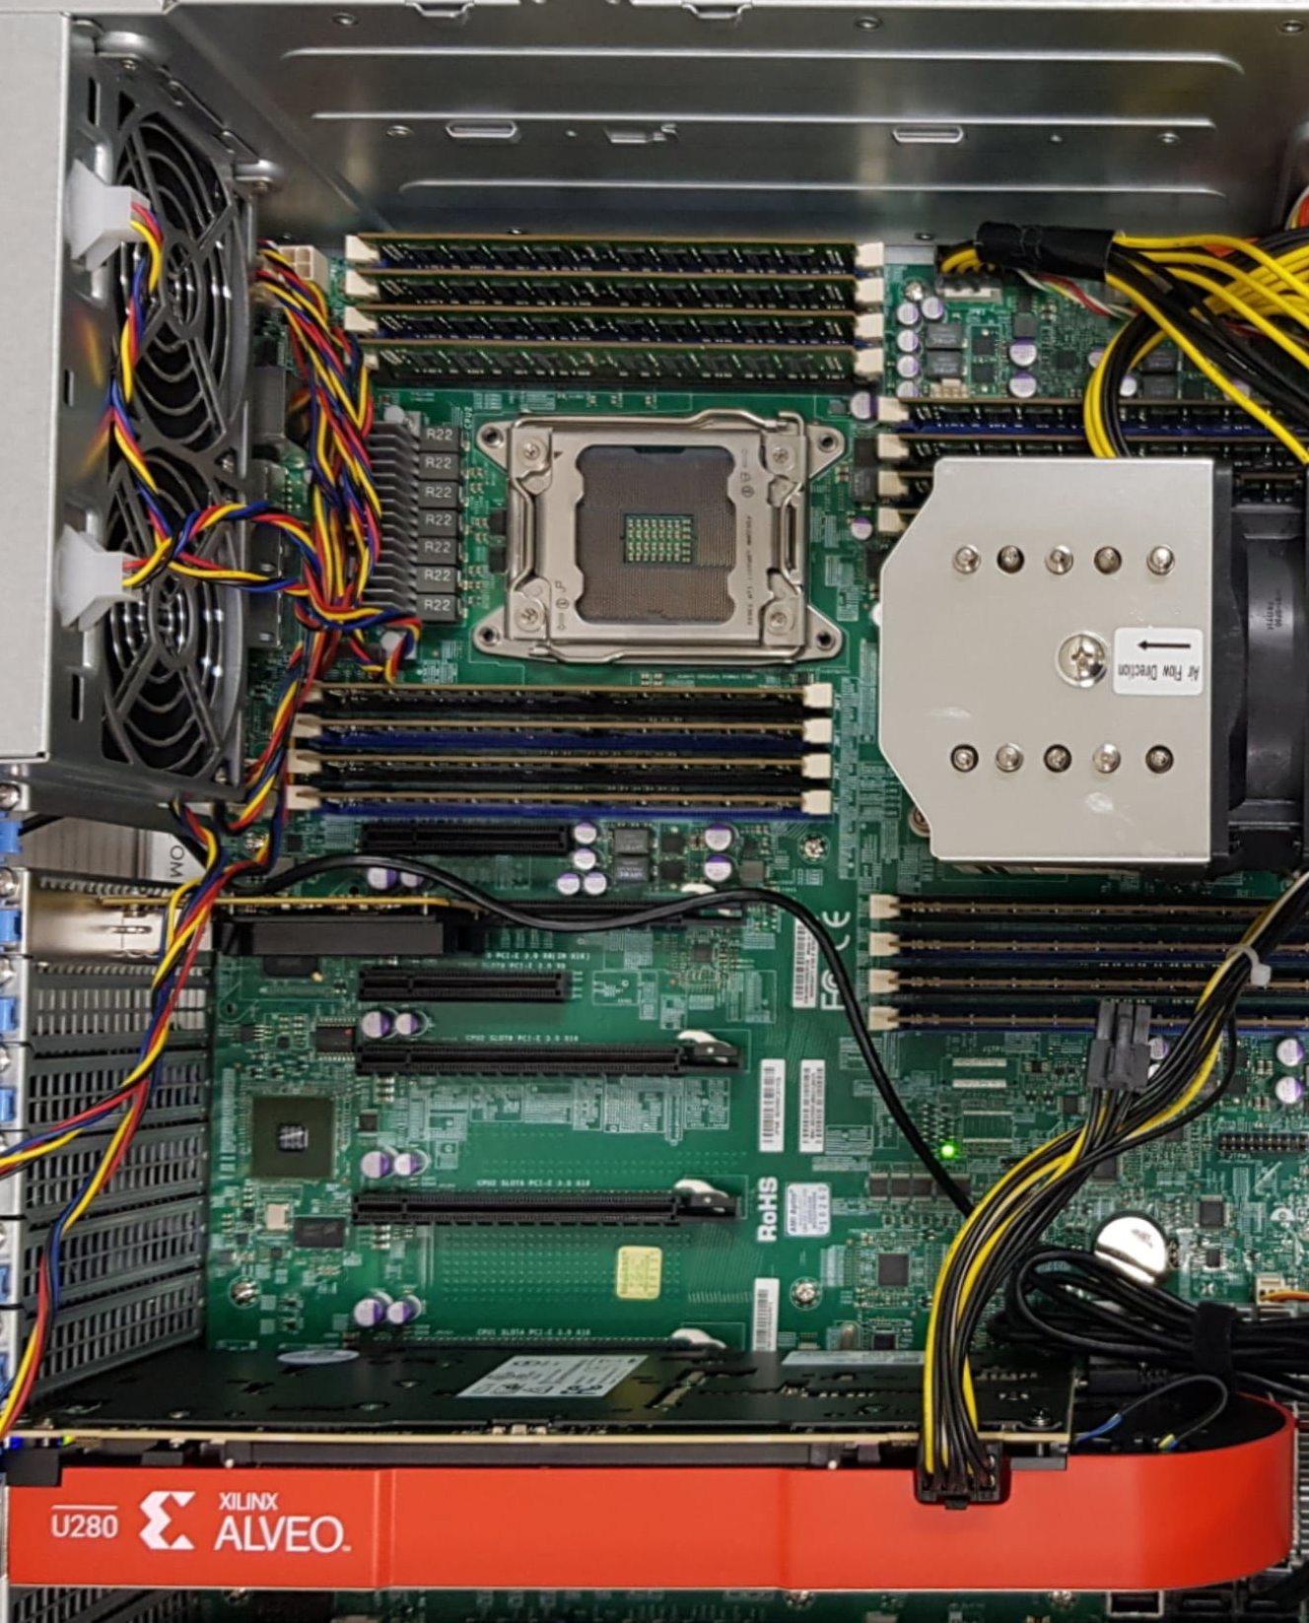
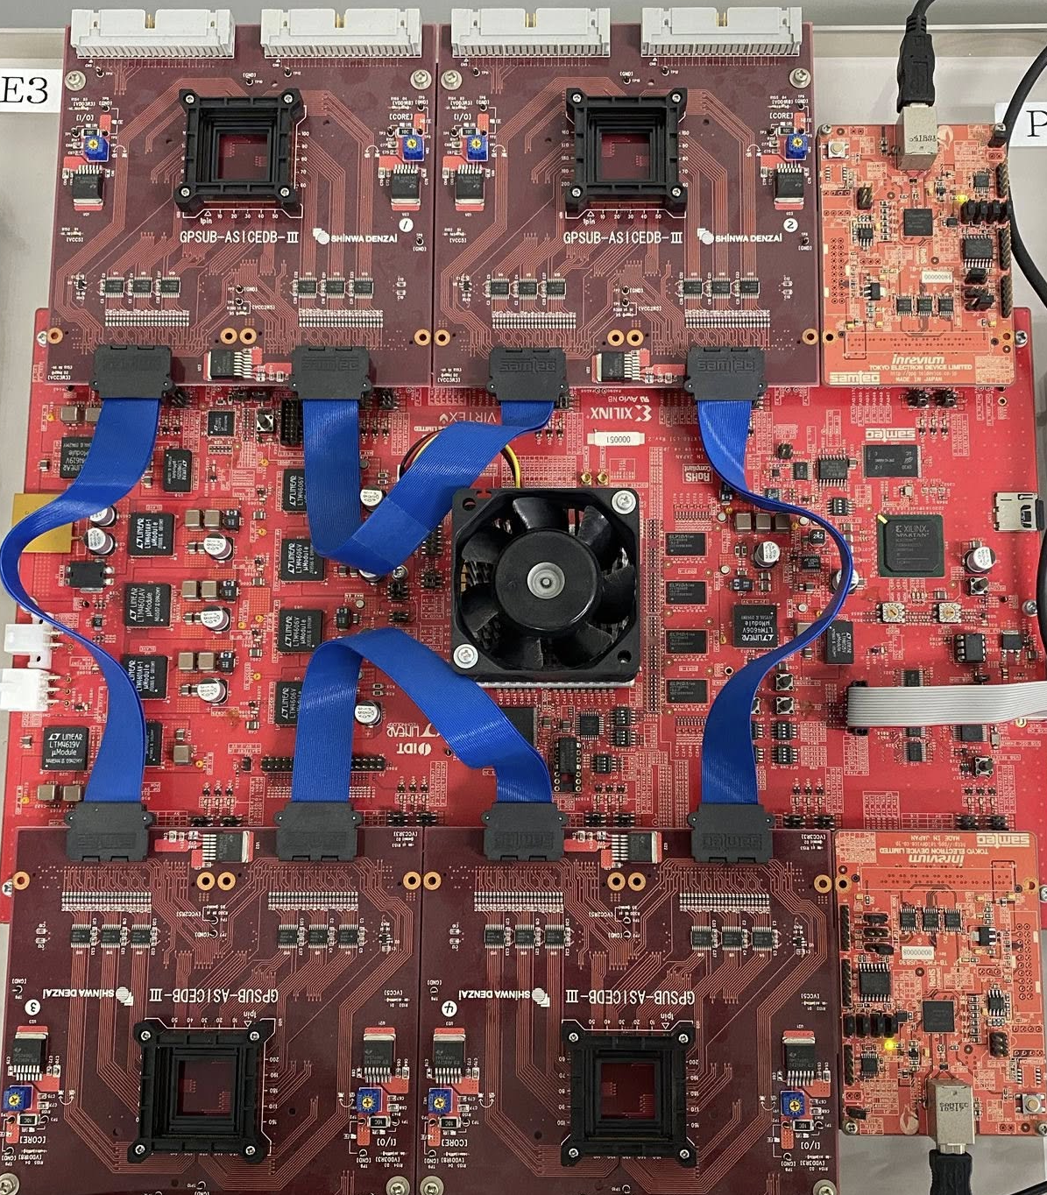
3 months
3 months
3 months
3 months
Basic knowledge*
Module 1**
Module 2**
Module 3**
Project*
High school student
Project 1,2
Thesis
End
Academy
Undergraduate student
Test
End
Test
MS/PhD student
End
Staff
R&D
Fabricate chip
Design
Simulation
Test
Partner
Mentor
Startup
Advisor
*Free, **Paid

Slide 4
AISeQ

Slide 5
AISeQ

