Slide 1


AISeQ
AISeQ

Slide 2

Q uantum at
Q uantum
research
Q uantum
Ho Chi Minh city
at

Slide 3
Q uantum at
Q uantum at

Slide 4
AISeQ

Slide 5
AISeQ

Slide 6
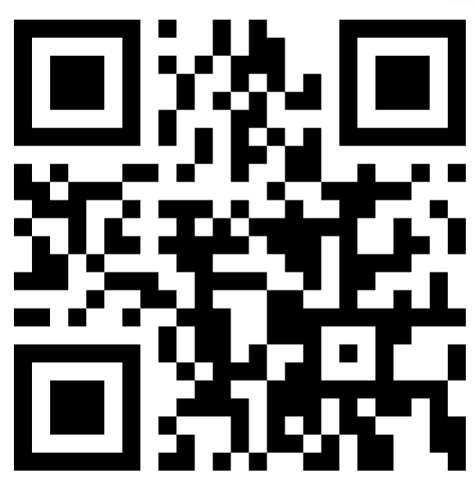

AISeQ
Discord server
https://discord.gg/Ct87Yzqbgz

