Slide 1

AIT BRAIN LAB
AI in Health
Hospital IT History, Modern Standards (HL7 v2, FHIR R4), and Clinical AI Modalities
Morning Theory Session: 10:00 – 12:00 | Venue: Library Studio Room

Slide 2
WORKSHOP ROADMAP
Agenda
History of Hospital IT
How healthcare evolved from paper charts and 1960s mainframes to HL7 v2 and modern FHIR R4 web standards. • Pre-1960 Analog Paper & Tubes • 1960s Mainframes & MUMPS • 1980s Sockets & HL7 Delimiters • 2014+ FHIR REST APIs
Evolution of AI Modalities
How medical data transforms into mathematical representations across four core AI paradigms. • 1. Tabular (Classical ML) • 2. Spatial / Images (Vision) • 3. Time-Series (Telemetry) • 4. Text & LLMs (RAG / MCP)

Slide 3
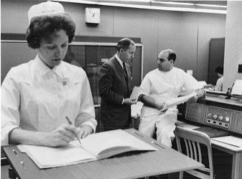
HISTORY OF HOSPITAL IT
Pre-1960: How Hospitals Kept Records Before Digital
Physical charts, pneumatic vacuum tubes, and the dangers of lost medical memory
THE ANALOG HEALTHCARE SYSTEM
Paper Folders, Bed Clipboards, and Vacuum Tubes
• The Basement Record Room: Patient histories lived as physical paper sheets in cardboard folders filed in massive hospital basements. Retrieving a record required orderlies to manually locate and pull folders.
• Clipboards at the Foot of the Bed: Vital signs (temperature, pulse, blood pressure) and medication doses were hand-scribbled by nurses onto paper flowsheets hanging on patient beds.
• Pneumatic Tube Transport: Blood vials and paper requisition forms were loaded into brass canisters and propelled through hospital pneumatic vacuum tubes directly into the laboratory.
• The Severe Failure Mode: Records were frequently misfiled, stained, illegible, or lost in fires. If a patient moved to another town or hospital, their clinical history vanished completely.

Slide 4
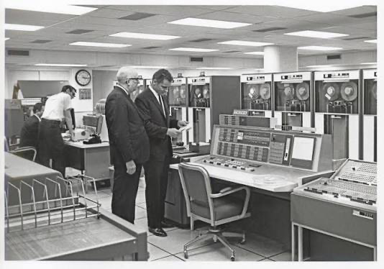
HISTORY OF HOSPITAL IT
The 1960s: Mainframes, Magnetic Tapes & MUMPS
The birth of digital healthcare computing and the operating system that still runs today
HARDWARE & SNEAKERNET
IBM Mainframes & Punch Cards
• Mainframe Era: Hospitals installed giant IBM 360/370 systems. Data was entered on 80-column Hollerith punch cards and 9-track magnetic tapes.
• The Sneakernet: No computer networks existed. To submit billing to Medicare or Blue Cross, technicians backed up data to tape reels, loaded them into car trunks, and physically drove them across town.
• Centralized Processing: Computing was strictly batch-oriented. Doctors could not view real-time records at the bedside.
SOFTWARE REVOLUTION
1966: MUMPS at Mass General
• Created for Medicine: Neil Pappalardo and Dr. Octo Barnett built MUMPS (Mass General Multi-Programming System) specifically for sparse medical records.
• Hierarchical Tree Globals: Used dynamic sparse trees (^PATIENT(id, 'LAB', 'GLUCOSE') = 105) rather than rigid relational SQL tables.
• The Modern Legacy: MUMPS powered the US Veterans Affairs VistA network. Today, Epic Systems (the world's largest EHR company) still runs its core backend on an advanced MUMPS engine (Caché / IRIS)!
The Medical Center’s IBM 7904 Mainframe Computer System (1969)

Slide 5
PHASE 1 · HISTORY OF HOSPITAL IT
The 1970s: Departmental Silos & Early Standards
Minicomputers fragmented the hospital into specialized islands; ASTM invented pipe delimiters
Minicomputers
DEC PDP-11 & VAX
Departments broke away from the central mainframe. Pathology, Radiology, and Pharmacy bought dedicated minicomputers running isolated software.
Typical ASTM E1238 Message Example
H|\^&|||LAB_ANALYZER||||||||19860512103000
P|1||P0001||DOE^JANE
O|1|ORD99||^^^2339-0^Glucose
R|1|^^^2339-0^Glucose|105|mg/dL|70-99|H||F
L|1|N
ASTM Committee E31
The Ancestor of HL7
ASTM standardized automated blood analyzer serial communication (ASTM E1238). Crucially, ASTM invented the pipe and caret delimiter syntax (| and ^)!
H (Header Segment): Initializes the transmission, establishes the dynamic delimiter set (|, \, ^, &), identifies the sending clinical instrument (LAB_ANALYZER), and stamps the exact message generation timestamp (19860512103000 -> May 12, 1986 at 10:30:00 AM).
P (Patient Segment): Contains the primary administrative records for patient sequence 1, documenting the unique patient identifier (P0001) and the patient's full name separated by the component hat (DOE^JANE -> Last Name: Doe, First Name: Jane).
O (Order Segment): Tracks specific test metadata for order sequence 1, binding the lab request to an internal specimen accession/tube barcode (ORD99) and identifying the requested test code and description (^^^2339-0^Glucose -> LOINC 2339-0 for Glucose).
R (Result Segment): Houses the exact quantitative metric generated from the blood specimen for result sequence 1. Documents a measured value of 105 with units mg/dL evaluated against the normal clinical reference range (70-99), automatically raising an abnormal high flag (H for High) with verified final status (F for Final).
L (Message Terminator Segment): Officially marks the absolute boundary of the diagnostic transmission batch at sequence 1, confirming successful completion with termination code N (Normal termination with zero errors).
UB-82 Billing
Financial Standardization
National Uniform Billing Committee created UB-82 paper and fixed-width ASCII tape claim formats. Standardized billing codes, but zero clinical clinical depth.

Slide 6
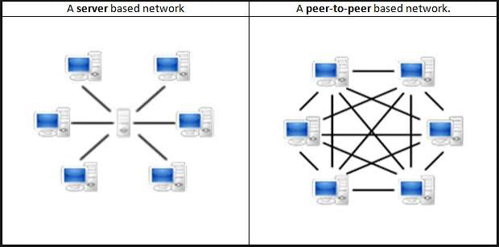
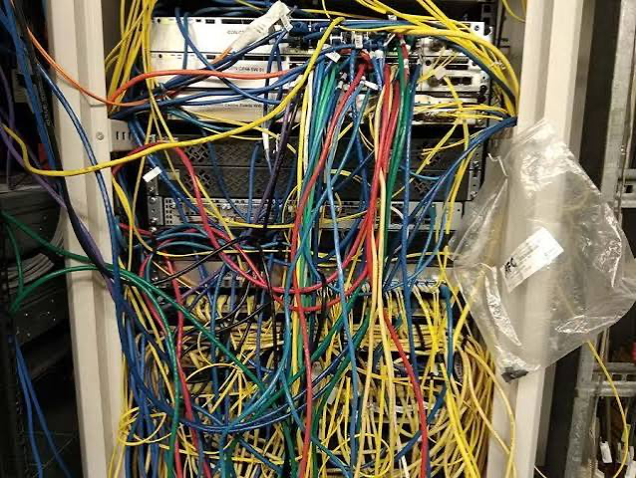
PHASE 1 · HISTORY OF HOSPITAL IT
The 1980s: Local Networks & The Integration Crisis
Ethernet connected the hardware, but software was trapped in quadratic complexity
THE INTEGRATION SPAGHETTI
The N(N-1)/2 Point-to-Point Trap
• Quadratic Explosion: Every medical vendor used a bespoke schema. Connecting 10 departmental systems required 45 custom interfaces. Connecting 50 required 1,225 bridges!
• ACR-NEMA 50-Pin Cable: In 1985, CT and MRI scanners required a custom, thick 50-pin copper cable running directly from scanner to console before DICOM existed.
• Brittle Fragility: Upgrading a single blood analyzer broke dozens of unmaintained point-to-point translation scripts.
THE ARCHITECTURAL GAP
OSI Layers 1–4 vs. Layer 7
• TCP/IP Solved Moving Packets: Layers 1 through 4 (Ethernet, IP, TCP) successfully routed raw bytes from Computer A to Computer B.
• What Do the Bytes Mean?: When a blood machine sent packets to an EHR, the receiving software had no idea whether the payload was a patient's potassium or a billing invoice.
• The Layer 7 Mandate: Healthcare desperately needed an agreement at the OSI Application Layer (Layer 7). That realization sparked the creation of HL7.

Slide 7
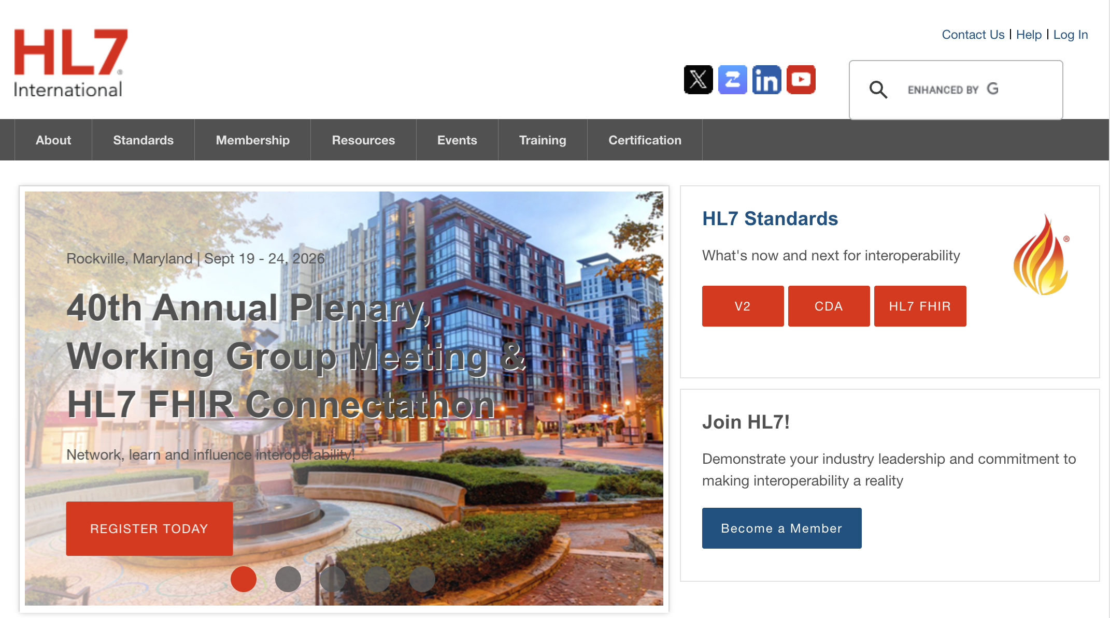
PHASE 1 · HISTORY OF HOSPITAL IT
1987–1989: The Birth of HL7 (Health Level Seven)
A grassroots group at the University of Pennsylvania solves hospital communication
MARCH 1987
Committee Formed at HUP
Dr. Sam Schultz (Hospital of the University of Pennsylvania) and Dr. Ed Hammond (Duke) convene hospital IT leaders to bypass slow academic standards.
OCTOBER 1987
HL7 Version 1.0 (Draft)
An 84-page working draft covering basic Admission, Discharge, Transfer (ADT). Syncs patient room assignments over raw TCP sockets via MLLP framing.
1989
HL7 Version 2.1 (Commercial)
First production standard widely adopted by major commercial vendors (Baxter, SMS, Sunquest). Becomes the global workhorse of medicine.

Slide 8
PHASE 1 · HISTORY OF HOSPITAL IT
Anatomy of an HL7 v2 Message (`ORU^R01`)
The pipe-and-hat (| and ^) ASCII format powering hospital messaging since 1989
Real HL7 v2.5 ORU^R01 (Lab Result Transmission)
MSH|^~\&|LAB_ANALYZER|HOSP|EMR|HOSP|19890512103000||ORU^R01|MSG01|P|2.1
PID|1||P0001^^^MRN||DOE^JANE||19800512|F
OBR|1|ORD99||2339-0^Glucose^LN|||19890512100000
OBX|1|NM|2339-0^Glucose^LN|1|105|mg/dL|70-99|H|||F
MSH (Message Header Segment): Initializes the transmission, establishes the encoding delimiters (|, ^, ~, \, &), identifies the sending laboratory device (LAB_ANALYZER) and facility (HOSP), directs the message to the receiving clinical record system (EMR), stamps the message creation time (19890512103000 -> May 12, 1989 at 10:30:00 AM), declares the trigger event (ORU^R01 for an unsolicited clinical observation report), assigns a unique transaction ID (MSG01), sets production mode (P), and specifies the standard version (2.1).
PID (Patient Identification Segment): Contains the primary administrative and demographic records for patient sequence 1, documenting the patient's medical record number (P0001^^^MRN), legal name separated by the component hat (DOE^JANE -> Last Name: Doe, First Name: Jane), date of birth (19800512 $\rightarrow$ May 12, 1980), and biological sex (F for Female).
OBR (Observation Request Segment): Tracks clinical order metadata for request sequence 1, binding the laboratory order to a specific specimen accession/tube number (ORD99), identifying the universal service requested via standard coding (2339-0^Glucose^LN -> LOINC code 2339-0 for Blood Glucose), and documenting the blood sample collection timestamp (19890512100000 -> May 12, 1989 at 10:00:00 AM).
OBX (Observation / Result Segment): Houses the exact quantitative metric generated from the specimen for result sequence 1. The NM flag designates a numeric format, recording the measured observation (2339-0^Glucose^LN) with an exact value of 105 and units mg/dL evaluated against the normal reference interval (70-99), automatically raising an abnormal high alert flag (H for High) with verified final diagnostic status (F for Final).

Slide 9
PHASE 1 · HISTORY OF HOSPITAL IT
Technological Relativity: Why HL7 v2 in 1989
An engineering triumph for 1989 hardware that accumulated 30 years of Z-segment integration debt
The Context of 1989
Why Not JSON / REST?
The Web didn't exist (HTTP came in 1991, JSON in 2001). Hardware was 1–4 MB RAM and 10 Mbps coax. Delimiter-separated ASCII allowed O(1) streaming directly into C buffers over raw TCP sockets without memory bloat.
The 'Z-Segment' Trap
Non-Standard Custom Extensions
HL7 v2 was so loosely specified that vendors added proprietary custom segments (ZBE, ZPD, ZAL). A message from Hospital A could not be parsed by Hospital B without bespoke translation code.
The Modern Debt
Point-to-Point Socket Piping
HL7 v2 runs over MLLP (raw TCP sockets). There are no URLs, no HTTP status codes, no authentication standards, and no query capabilities. Required costly interface engines (Mirth, Cloverleaf).

Slide 10
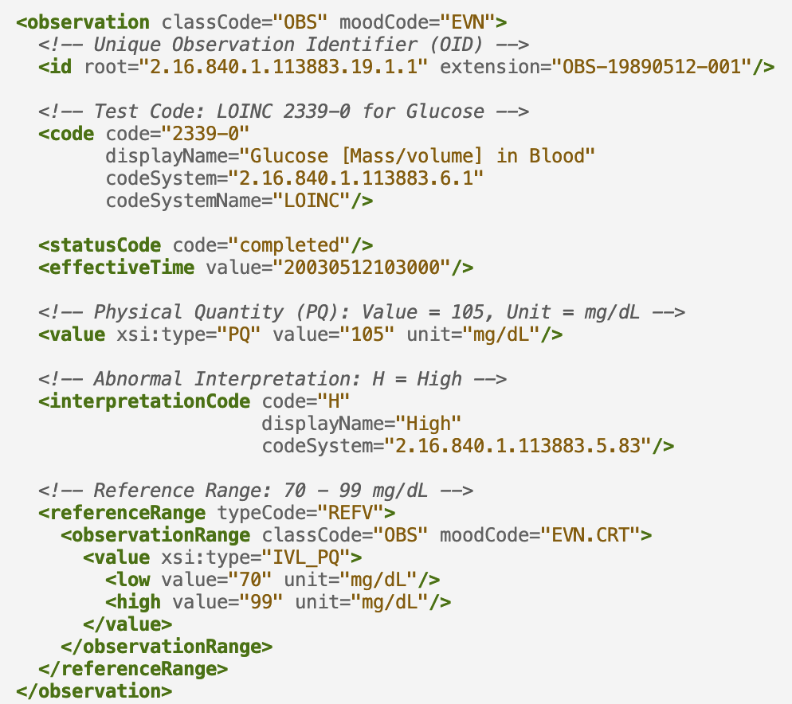
PHASE 1 · HISTORY OF HOSPITAL IT
2003: The Cautionary Tale of HL7 Version 3
The mathematically 'perfect' XML standard that software engineers completely rejected
THE DANGERS OF OVER-ENGINEERING
How Abstract Modeling Alienated Real-World Developers
• The Reference Information Model (RIM): HL7 attempted to create an all-encompassing, mathematically pure object-oriented model of all medicine. Everything was modeled as an Act, Entity, or Role.
• Massive XML Overhead: A simple patient temperature reading required thousands of lines of deeply nested XML tags, schemas, and abstract classes. Parsing was agonizingly slow on 2003 hardware.
• The Developer Rebellion: Software engineers refused to adopt it. It was too difficult to learn and implement without multimillion-dollar consulting contracts. Hospitals stuck with HL7 v2, cementing v3 as a famous software failure.
• The Engineering Lesson: In computing, pragmatic, developer-friendly designs always beat theoretically 'pure' but unusable standards.

Slide 11
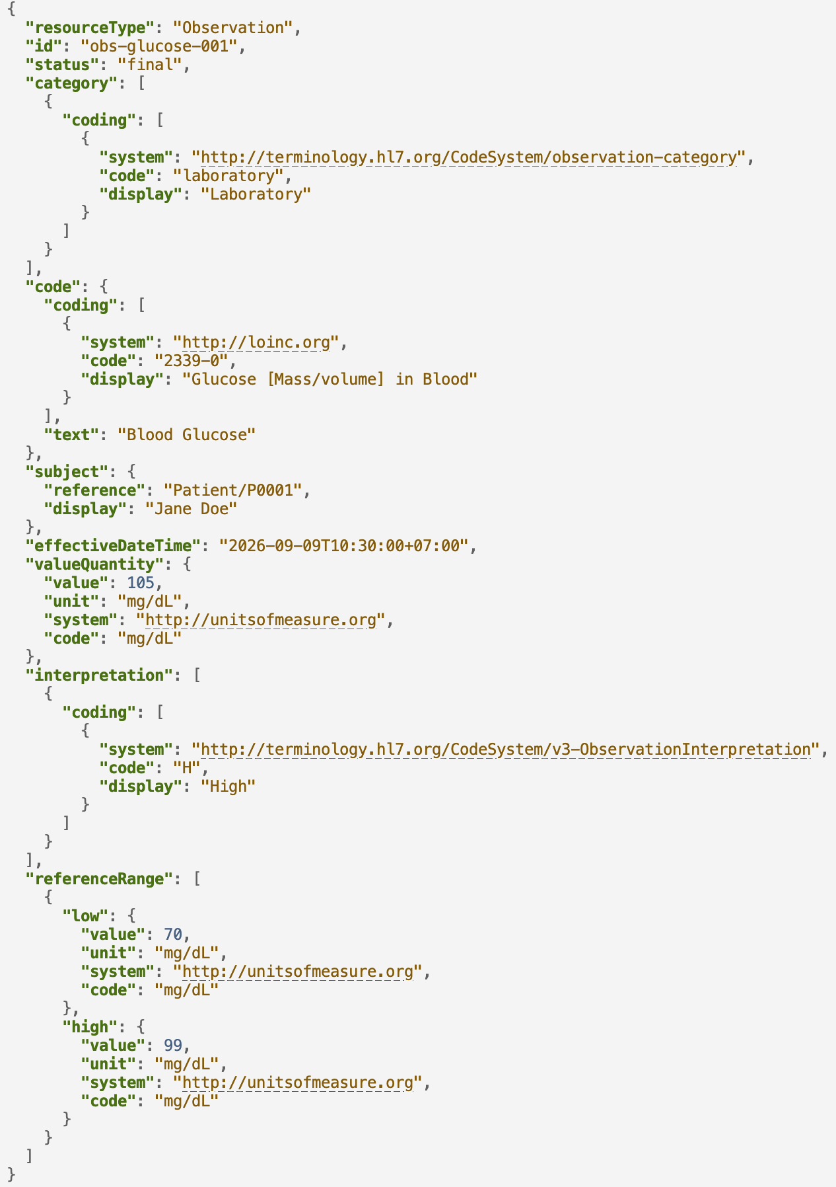
PHASE 1 · HISTORY OF HOSPITAL IT
2014–Today: Enter HL7 FHIR (Built for the Web)
Grahame Grieve redesigns healthcare data around HTTP REST, JSON, and web standards
Web-Native Standards
HTTP, REST & JSON
Built entirely on modern internet protocols. Developers query standard URLs (GET /Patient/P0001) and receive clean, human-readable JSON payloads.
The '80/20 Rule'
Pragmatic Scope
FHIR standardizes only the 80% of data concepts common across all healthcare globally. The remaining 20% edge cases are handled through explicitly validated Extensions.
Normative Stability
FHIR R4 (2019)
In 2019, FHIR Release 4 achieved Normative status. Core resources (Patient, Observation, Condition) are frozen with guaranteed permanent backwards compatibility.

Slide 12
PHASE 1 · HISTORY OF HOSPITAL IT
Core FHIR Architecture: Resources, References & Bundles
Modular clinical building blocks interconnected by unambiguous logical references
Patient Resource
Demographics & Master ID
The root subject. Contains biological sex, birthdate, identifier MRN, and contact info. Every clinical observation links here.
Observation Resource
Measurements & Vitals
Clinical measurements: lab tests, vital signs, biopsy metrics. Contains coded LOINC tag, timestamp, and numeric value with UCUM units.
Condition Resource
Clinical Diagnoses
Active health problems or diagnoses. Links to Patient and contains ICD-10 or SNOMED CT problem codes with clinical status (active/resolved).
Bundle Resource
Packaging Patient Records
A container resource holding multiple items. In this afternoon's lab, data/fhir/P0001.json is a Bundle packing 1 Patient, 10 Observations, and 1 Condition.

Slide 13
PHASE 1 · HISTORY OF HOSPITAL IT
Coded Vocabularies: The Semantic Glue
FHIR provides the grammatical schema; medical terminologies provide the dictionary
LOINC
Logical Observation Identifiers
The universal dictionary for lab assays and measurements. • Code 2339-0: Blood Glucose • Code 21908-9: Mean Cell Radius Becomes column headers in ML feature matrices.
SNOMED CT
Systematized Nomenclature
The global clinical terminology for findings, body sites, and procedures. • Code 439401001: Raman spectroscopy • Code 44054006: Ductal carcinoma Defines precise anatomical and procedural meaning.
ICD-10 / ICD-11
Disease Classification
The World Health Organization standard for diagnoses and epidemiology. • Code C50.9: Malignant breast tumor • Code E11.9: Type 2 diabetes Used globally for insurance claims and disease surveillance.

Slide 14
PHASE 1 · HISTORY OF HOSPITAL IT
Global Adoption: From Federal Law to Thailand
Where FHIR is legally mandated, and the reality of legacy hospital engines
MANDATED BY LAW
United States & Europe
• US 21st Century Cures Act: Made clinical 'data blocking' illegal. Certified hospital software MUST expose standardized FHIR APIs (SMART on FHIR). Apple Health connects directly to thousands of US clinics via FHIR.
• European Health Data Space (EHDS): Mandates cross-border clinical record exchange across all EU member states using FHIR.
LOCAL & REGIONAL REALITY
Thailand & Legacy Systems
• Thailand MOPH Initiatives: The Ministry of Public Health and Thai health-tech agencies are actively implementing FHIR-based Health Information Exchanges (HIE) for national universal coverage digital claims.
• The Hybrid Reality: Replacing hospital databases costs millions. Many provincial hospitals still run HL7 v2 and MySQL engines; FHIR is deployed as an API Gateway wrapper sitting on top.

Slide 15
PHASE 2 · CLINICAL DATA MODALITIES FOR AI
The Four Modalities of Health AI
From 2D Tabular Feature Matrices to Spatial Tensors, Signal Telemetry, and LLM Agents
Different Math, Different Algorithms:
There is no single 'Health AI algorithm.' Tabular data requires gradient trees; radiology requires 3D convolution; telemetry requires temporal state spaces; notes require LLMs.

Slide 16
PHASE 2 · MODALITY 1
Tabular Data: The Classical Machine Learning Engine
Structured numeric matrices powering clinical risk stratification and lab assays
DATA REPRESENTATION
2D Matrices: X in R^{N x D}
• Clinical Sources: Automated lab panels (glucose, creatinine), vital signs, cell morphometry from biopsies, and patient demographics.
• Mathematical Structure: A rectangular table of N patients (rows) by D features (columns). Targets y in {0, 1}.
• Strict Requirements: Every cell must be a valid float. Algorithms cannot handle raw nested JSON or string codes without preprocessing.
ALGORITHMS & WORKSHOP LINK
Afternoon Workshop Focus
• Core Models: Logistic Regression, Random Forests, XGBoost, and k-Means Clustering.
• Step 1 (Flatten FHIR): In scripts/01_fhir_to_table.py, we parse real FHIR bundles and extract LOINC observations into tabular columns.
• Step 3 (Train Pipelines): We fit Logistic Regression and Random Forest models to predict malignancy from 30 cell nucleus features.

Slide 17
PHASE 2 · MODALITY 2
Spatial & Imaging Data: Computer Vision in Medicine
Radiographs, 3D CT/MRI scans, and gigapixel histology whole-slide images
HIGH-DIMENSIONAL SPATIAL TENSORS
From 2D X-Rays to 3D/4D Volumetric Tensors
• The DICOM Standard: Medical images are not simple JPEGs. They are DICOM files storing calibrated pixel arrays alongside spatial metadata (slice thickness, magnetic field strength, patient positioning).
• Mathematical Format: Tensors in R^{C x D x H x W} where C = Channels/Sequences, D = Depth/Slices, H, W = Image dimensions. Whole Slide Images (WSI) reach 100,000 x 100,000 pixels.
• AI Architectures: Convolutional Neural Networks (ResNet, EfficientNet), Vision Transformers (ViT), and U-Net encoder-decoder models for anatomical tumor segmentation.
• Clinical Challenge: Multi-gigabyte file sizes, spatial resolution vs compute memory trade-offs, and requirement for expert radiologist pixel-level annotations.

Slide 18
PHASE 2 · MODALITY 3
Time-Series & Telemetry: Continuous Physiological Streams
High-frequency sensor waveforms from ICU monitors, ECG leads, and wearable devices
SEQUENTIAL TEMPORAL SIGNALS
Streaming Signals at 250 Hz to 1 Sample/Hour
• Clinical Telemetry Streams: 12-lead Electrocardiography (ECG), continuous arterial blood pressure in ICUs, pulse oximetry (PPG), and Continuous Glucose Monitors (CGM).
• Mathematical Representation: 1D sequential arrays x(t) sampled at high frequency. Processed via sliding windows, Fast Fourier Transforms (FFT), or Continuous Wavelet Transforms.
• Algorithms: Recurrent Neural Networks (LSTMs), 1D Temporal Convolutional Networks (TCN), and modern State Space Models (Mamba) for predicting acute sepsis 6 hours in advance.
• Engineering Reality: Sensor motion artifacts, loose electrodes, and non-stationary baseline drift require heavy digital signal processing before ML.

Slide 19
PHASE 2 · MODALITY 4
Unstructured Text: What 90% of People Mean by 'AI'
Physician progress notes, discharge summaries, operative logs, and clinical LLMs
THE UNSTRUCTURED MAJORITY
80% of Health Data Lives in Text
• Clinical Narratives: Doctors do not fill out structured dropdown forms; they write narrative stories explaining clinical reasoning, nuance, and history.
• Complex Medical Jargon: Heavy abbreviations ('sob' = shortness of breath, not an insult!), medical shorthand, and typos make rule-based parsers fail.
• Rich Hidden Signal: Social determinants of health (living alone, smoking history) are only documented in free-text clinical notes.
THE GENAI PARADIGM
Clinical LLMs & Copilots
• Medical Foundation Models: Specialized models (Med-PaLM 2, BioGPT, ClinicalBERT) trained on medical literature and clinical corpora.
• Ambient Clinical Scribing: Microphones listen to doctor-patient conversation in real time and automatically draft the clinical note into the EHR.
• Clinical Question Answering: Synthesizing complex multi-year patient records into concise diagnostic briefings for busy clinicians.

Slide 20
PHASE 2 · LLMS & FORMATS
The Formatting Dilemma: Why LLMs Choke on Raw FHIR
Nested JSON metadata dilutes clinical signal; Markdown tables provide the cure
THE RAW JSON TRAP
Token Bloat & Hallucination
• Severe Token Overhead: A single FHIR Observation consumes 300–500 tokens of nested boilerplate (resourceType, meta, system, coding). A patient chart burns 50,000+ tokens!
• Diluted Clinical Signal: The critical clinical number ('Glucose: 118') is buried inside hundreds of curly braces, degrading LLM attention.
• Hallucination Risk: High token boilerplate increases the probability that an LLM misassociates a test value with the wrong timestamp.
THE MODERN SOLUTION
Clean Markdown (.md) Tables
• 60–75% Token Reduction: Converting FHIR resources into clean Markdown tables preserves semantic clarity while stripping thousands of redundant JSON lines.
• Superior LLM Recall: Foundation models are pre-trained heavily on Markdown tables and bulleted text, leading to faster inference and zero syntactic hallucinations.
• Clean Architecture: FHIR remains the backend database protocol; Markdown is the token-efficient presentation layer for LLM prompts.

Slide 21
PHASE 2 · AI AGENTS
Clinical AI Agents: RAG & Model Context Protocol (MCP)
Moving from passive chatbots to autonomous clinical copilots with deterministic tools
KNOWLEDGE RETRIEVAL
Clinical RAG & Vector DBs
• Semantic Embeddings: Clinical narrative notes and medical guidelines are chunked and converted into vector embeddings via clinical embedding models.
• Vector Databases: Stored in high-speed vector stores (pgvector, Chroma, Pinecone) for sub-millisecond similarity search.
• Grounded Answers: When an agent answers a question, it retrieves the top-3 most relevant patient notes and clinical trial guidelines to prevent hallucinations.
DETERMINISTIC ACTION
Model Context Protocol (MCP)
• Tool-Calling Paradigm: Agents do not guess; they invoke structured tools: get_patient_labs(patient_id='P0001', code='2339-0').
• Scoped & Auditable: Every action an agent takes is logged, authenticated, and constrained by role-based access control.
• The Future Standard: MCP provides the open protocol for connecting AI agents to hospital databases and diagnostic instruments safely.

Slide 22
PHASE 2 · DATA ARCHITECTURE
The Fundamental Data Impedance Mismatch
Why machine learning frameworks cannot directly ingest clinical FHIR standards
HOW HOSPITALS STORE DATA
Hierarchical Clinical Events (FHIR)
• Data Structure: Deeply nested JSON resource trees linked by logical URIs and references.
• Temporal Characteristics: Variable-length event histories over months or years. Irregular sampling intervals.
• Heterogeneity: Mix of coded observations, narrative clinical notes, and multi-value panels.
WHAT MACHINE LEARNING REQUIRES
2D Numerical Feature Matrices
• Data Structure: Rigid 2D arrays: Feature matrix X in R^{N x D} and target label vector y in {0, 1}.
• Strict Demands: Every patient must have exactly D columns. Algorithms like Logistic Regression cannot handle raw JSON.
• The Workshop Core: Step 1 this afternoon (scripts/01_fhir_to_table.py) is the bridge that turns hierarchical FHIR into flat tabular features!

Slide 23
PHASE 2 · DATA REALITIES
Clinical Realities: Informative Missingness & Class Imbalance
Healthcare data is not sampled at random; absence of evidence is clinical information
DATA QUALITY REALITY
Informative Missingness
• Tests Ordered for Sick Patients: In sensors, missing data is hardware loss. In medicine, a troponin test or biopsy is ordered because disease is suspected! Healthy patients lack tests because they are healthy.
• The Imputation Trap: Imputing missing values with population mean assigns sick values to healthy people. Must be handled deliberately via SimpleImputer inside cross-validation folds.
EVALUATION PITFALL
Class Imbalance (63% Trap)
• The Baseline Illusion: In cancer screening, 63% (or 95%) of patients are benign. A dummy model predicting 'benign' every time achieves 63% accuracy while failing 100% of cancer cases!
• Metric Requirements: Accuracy is dangerous. We evaluate models using Recall (Sensitivity), ROC-AUC, and tune the classification threshold deliberately.

Slide 24
PHASE 2 · FUTURE ARCHITECTURE
Towards AI-Native Health Data Standards
The emerging Dual-Stack Architecture uniting legal compliance and continuous learning
THE THREE ERAS OF HEALTH DATA
From Sockets to Autonomous AI
• Era 1: 1989–2011 (Local Machines): HL7 v2: Pipe-delimited ASCII strings over TCP sockets for local hospital LANs.
• Era 2: 2014–2025 (Web & Mobile): HL7 FHIR: JSON REST APIs and web standards for apps, clinicians, and portals.
• Era 3: 2026+ (Artificial Intelligence): AI-Native Stack: Vector embeddings, token-optimized Markdown, and Agentic MCP tool protocols.
THE DUAL-STACK SOLUTION
Record Layer + Intelligence Layer
• Layer A · System of Record (FHIR): FHIR remains the authoritative, legally audited, and human-verified patient ledger for billing, medication safety, and clinical charts.
• Layer B · System of Intelligence (AI Store): High-performance vector stores and feature stores (e.g. Feast, pgvector) continuously ingest FHIR streams, serving ML models and LLM agents in milliseconds.
• Health MCP Protocol Standard: Standardizing tool schemas so any clinical AI agent can query and propose treatment orders across any hospital safely.

Slide 25
BRIDGE TO AFTERNOON
Closing the Classical Loop & Tech Checkpoint
Verify your environment now so the room is 100% ready to run code at 14:00
CLOSING THE LOOP
Predictions Back as FHIR
In Step 5c of this afternoon's workshop, clicking 'Send to record' wraps our scikit-learn cancer risk prediction back into a valid FHIR RiskAssessment and Observation resource.
TERMINAL CHECK
Navigate to Repo Root
Open your terminal application and verify your current working directory: $ cd fhir-ml-workshop Ensure git branch is clean.
SYNC ENVIRONMENT
Verify Libraries Before Lunch
Run the fast package synchronizer from inside the repository: $ uv sync Verify sklearn: $ uv run python -c "import sklearn; print(sklearn.__version__)"

Slide 26
AIT Brain Lab
Telehealth
Monitoring and Assistive Systems for Elderly and Disabled People
Asst. Prof. Chaklam Silpasuwanchai
Grounding Theory in Real AIT Systems Engineering:
Connecting optical Raman laser sensors, computer vision telemetry, and haptic rehabilitation robotics to global clinical standards and FHIR microservices.

Slide 27
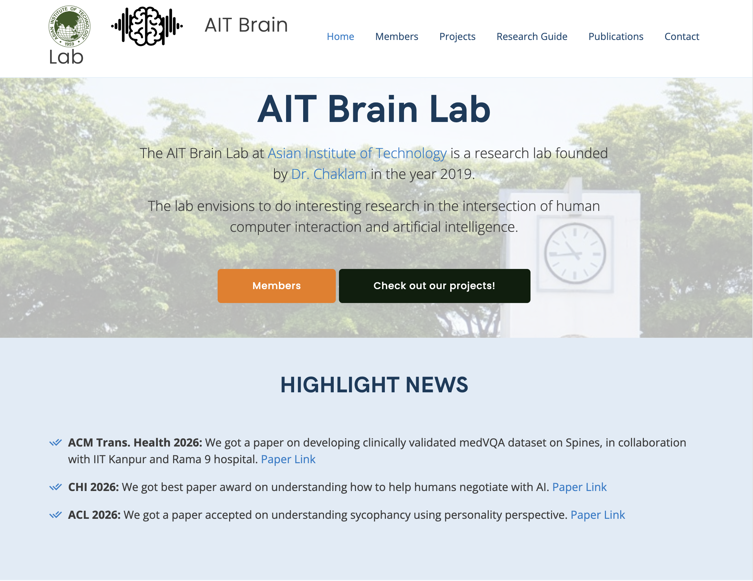
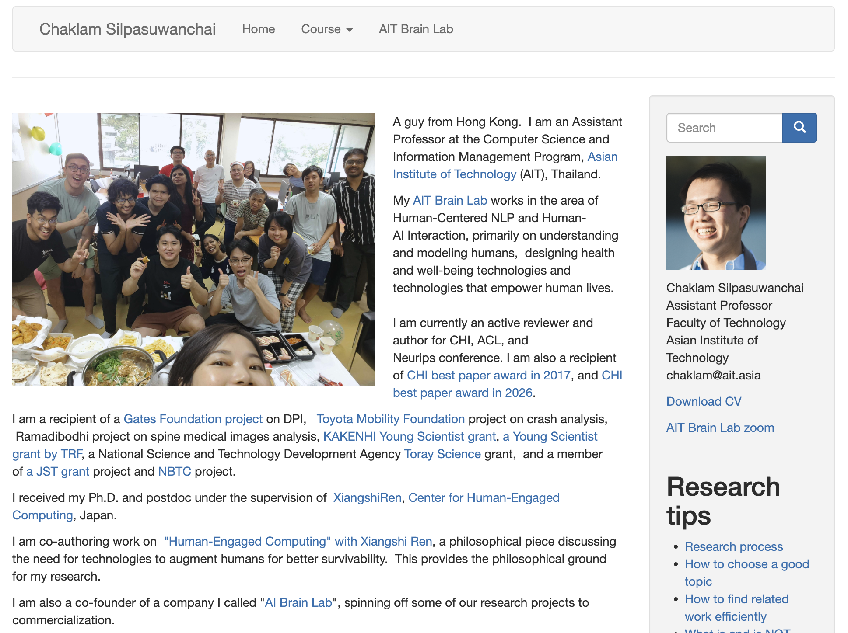
AIT Brain Lab

Slide 28
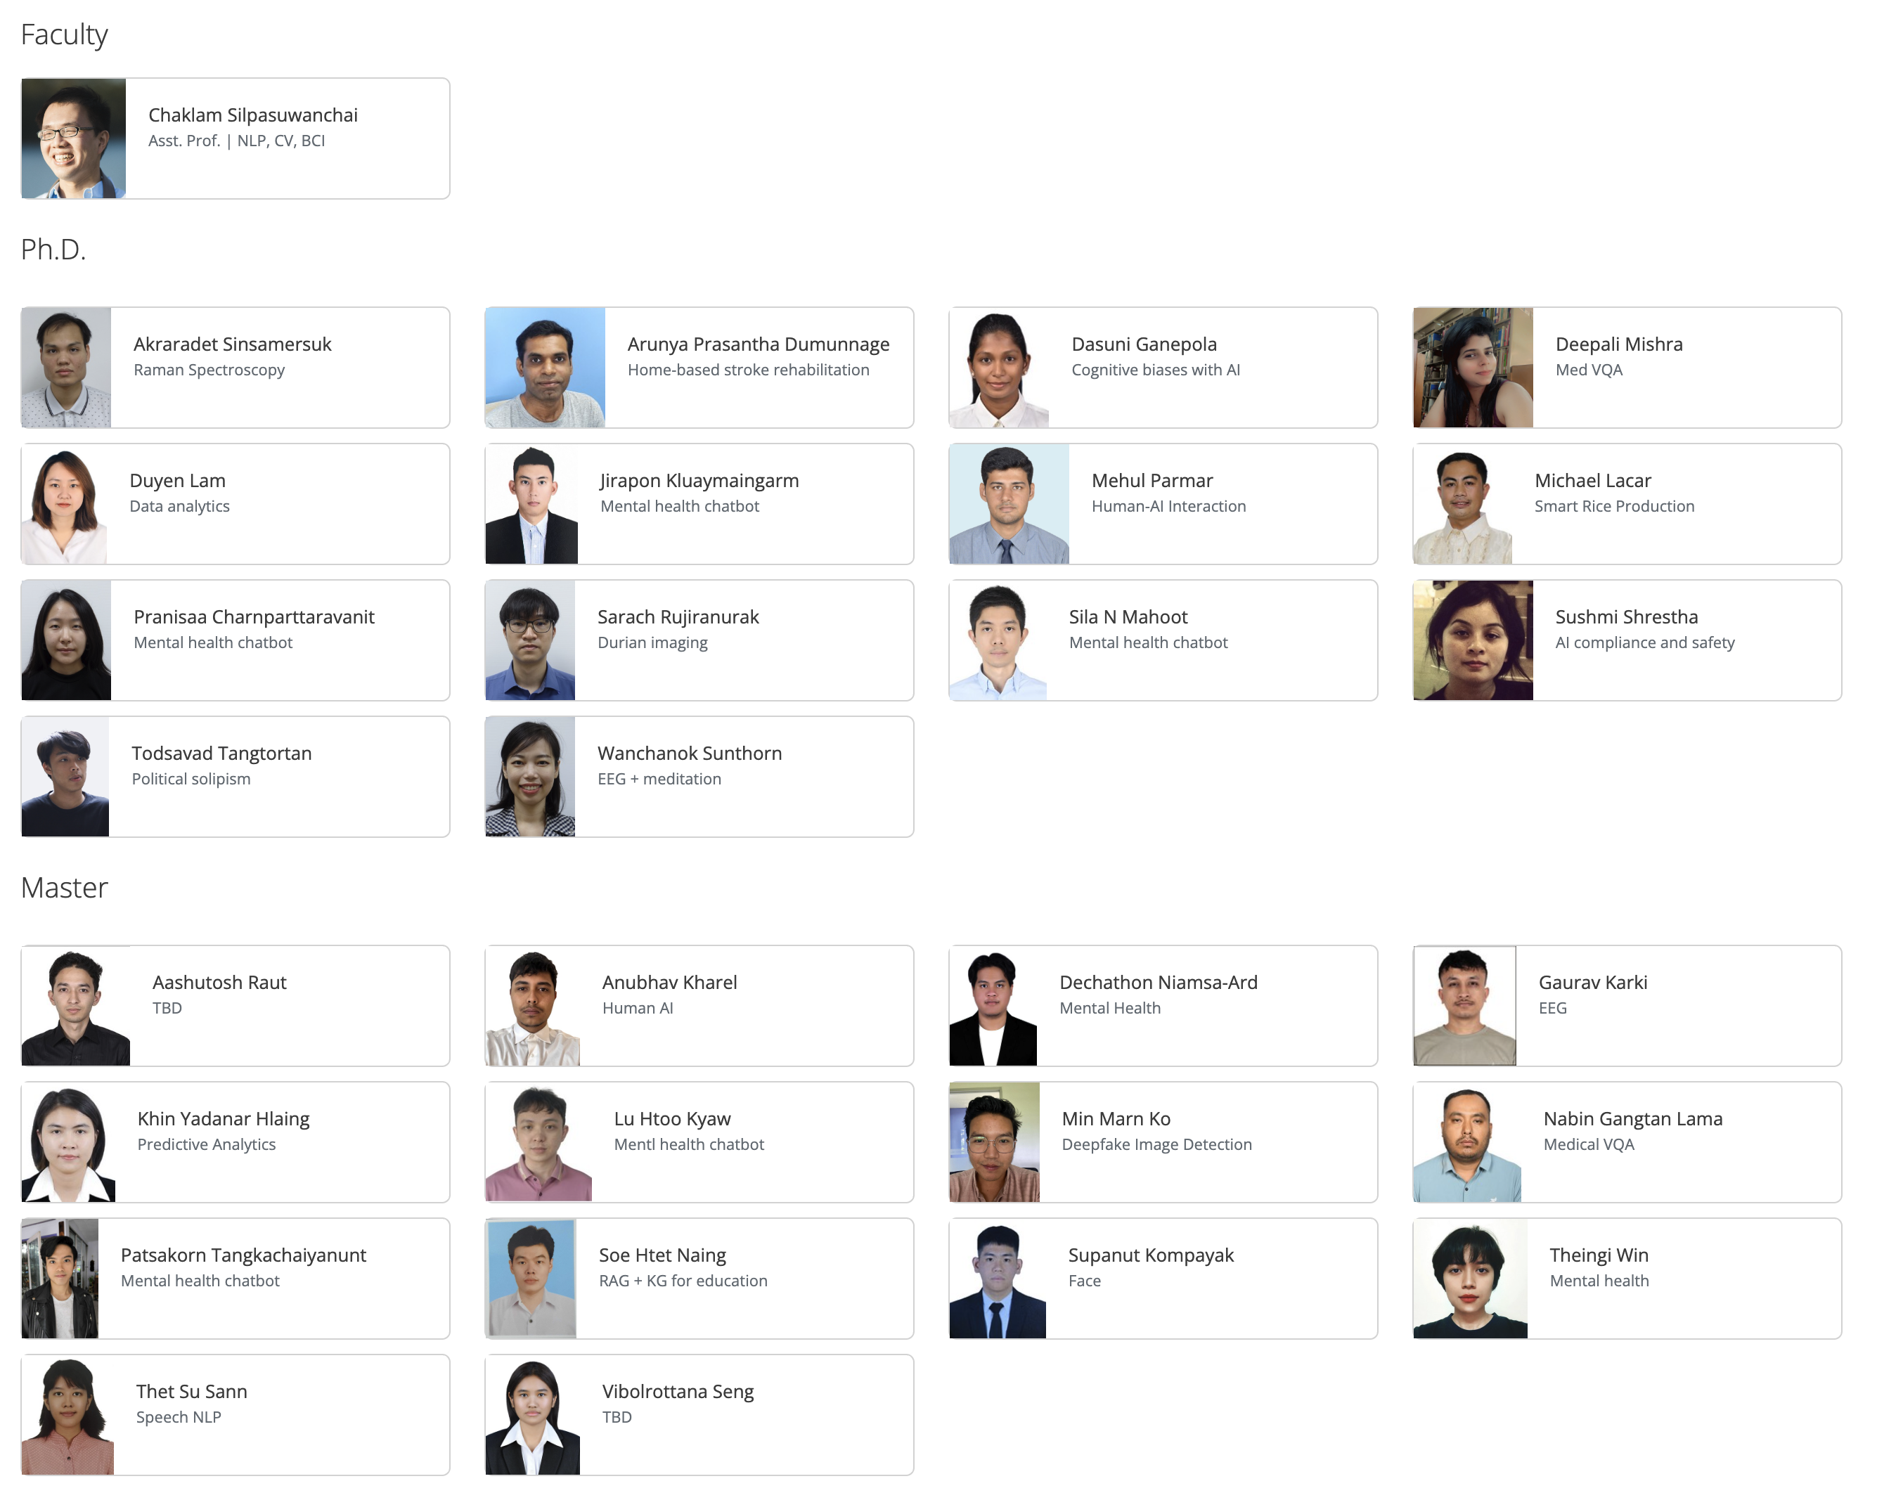
AIT Brain Lab
Area of interest
Natural Language Processing
Computer Vision
Medical AI
Brain-Computer Interfaces
Stats
14 Ph.D. students
14 Master students
50+ Alumni
Associated company
AI Brain Lab

Slide 29
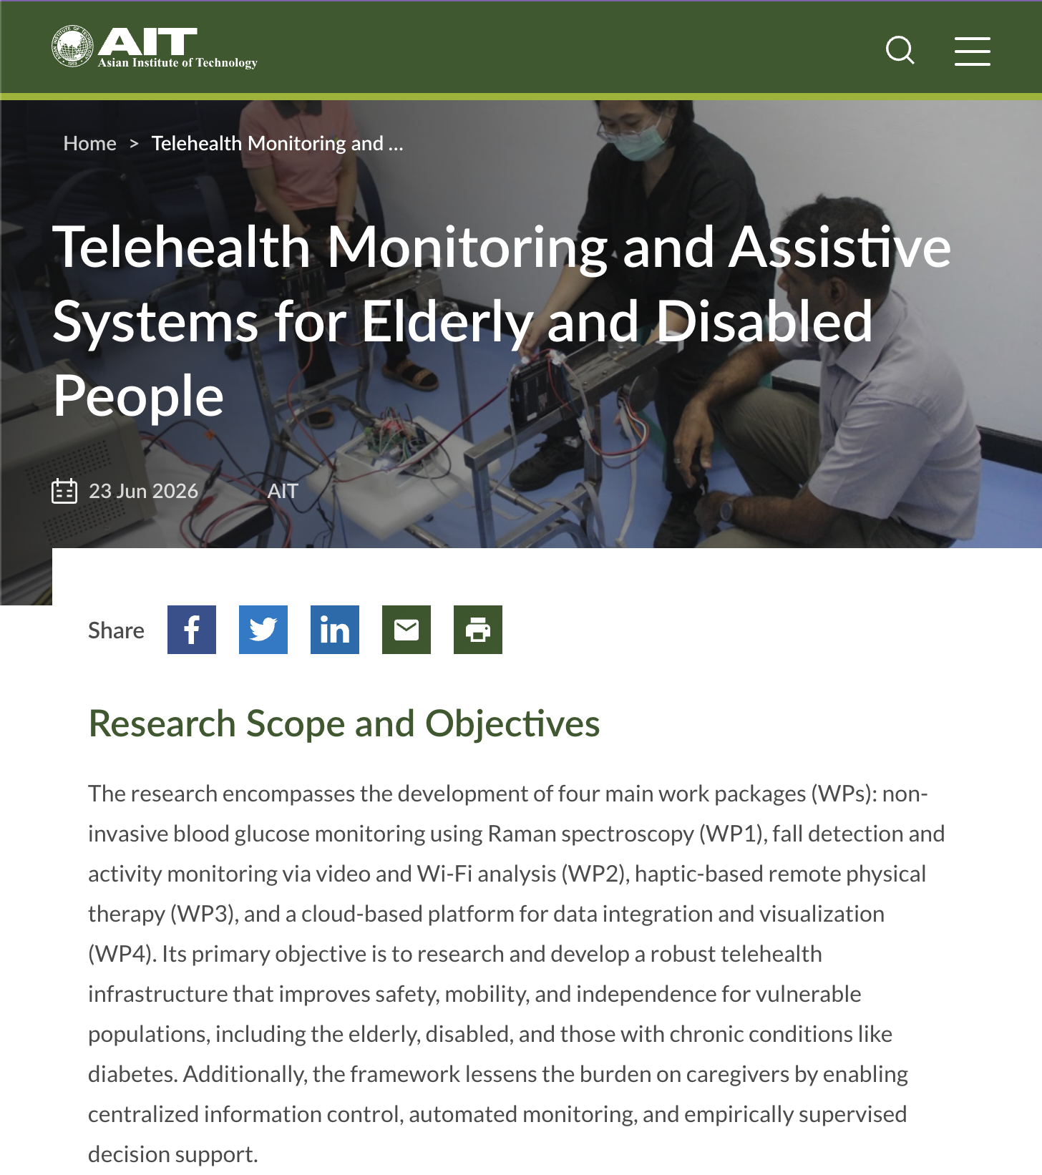
AIT Brain Lab
WP1: Optical Glucose Sensing
Non-Invasive Raman Sensor
Measures blood glucose without skin pricks using 785nm optical Raman laser spectroscopy.
Edge ML calibration models.
WP2: Activity & Fall Telemetry
Computer Vision & Wi-Fi CSI
Monitors elderly mobility and detects falls in real time using privacy-preserving camera feeds and Wi-Fi disturbance.
Continuous spatial & time-series AI Edge inference on embedded hardware.
WP3: Remote Haptic Therapy
Robotic Physical Rehabilitation
Upper-limb rehabilitation device providing programmable force-feedback for stroke patient recovery.
Bi-directional physical telemetry Remote clinician tele-operation.
WP4: Cloud Telehealth Platform
Centralize dashboard system
Consolidates telemetry from WP1–WP3 into an encrypted cloud backend for clinician review.
Real-time web & mobile dashboards.

Slide 30
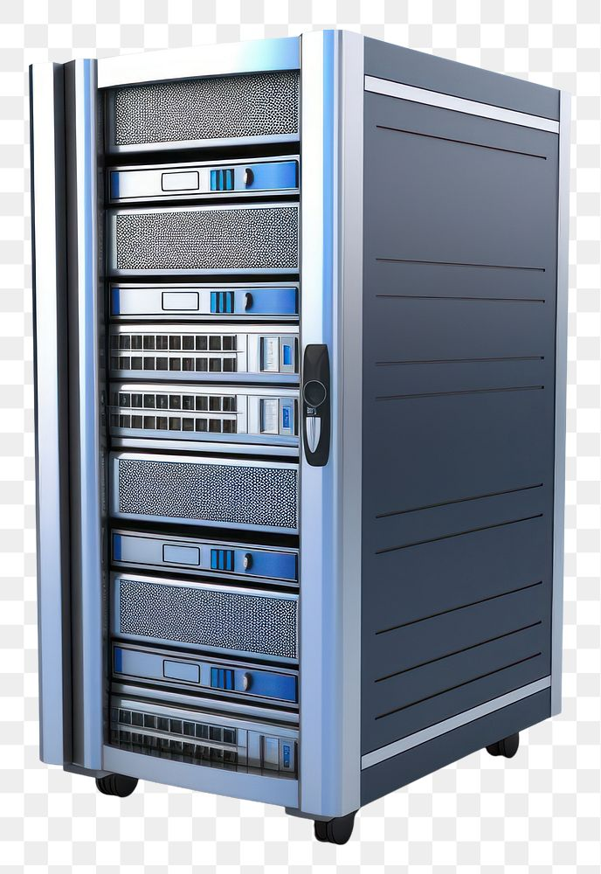
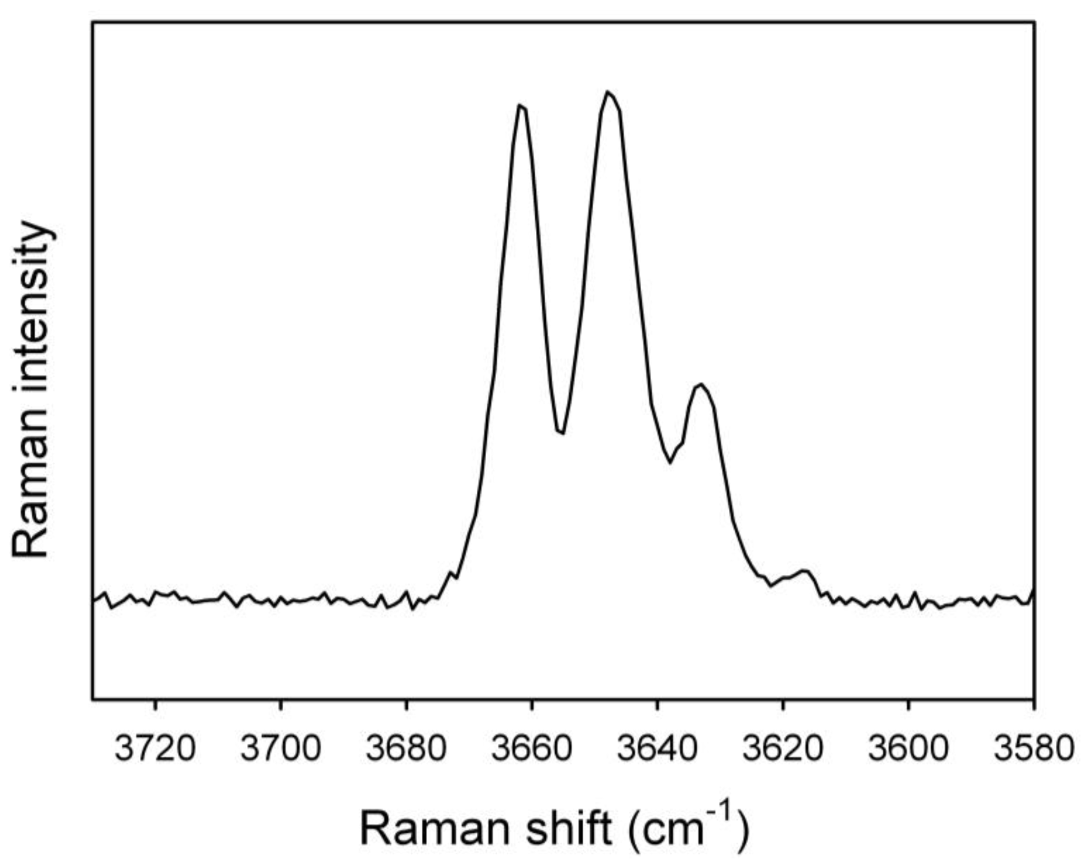
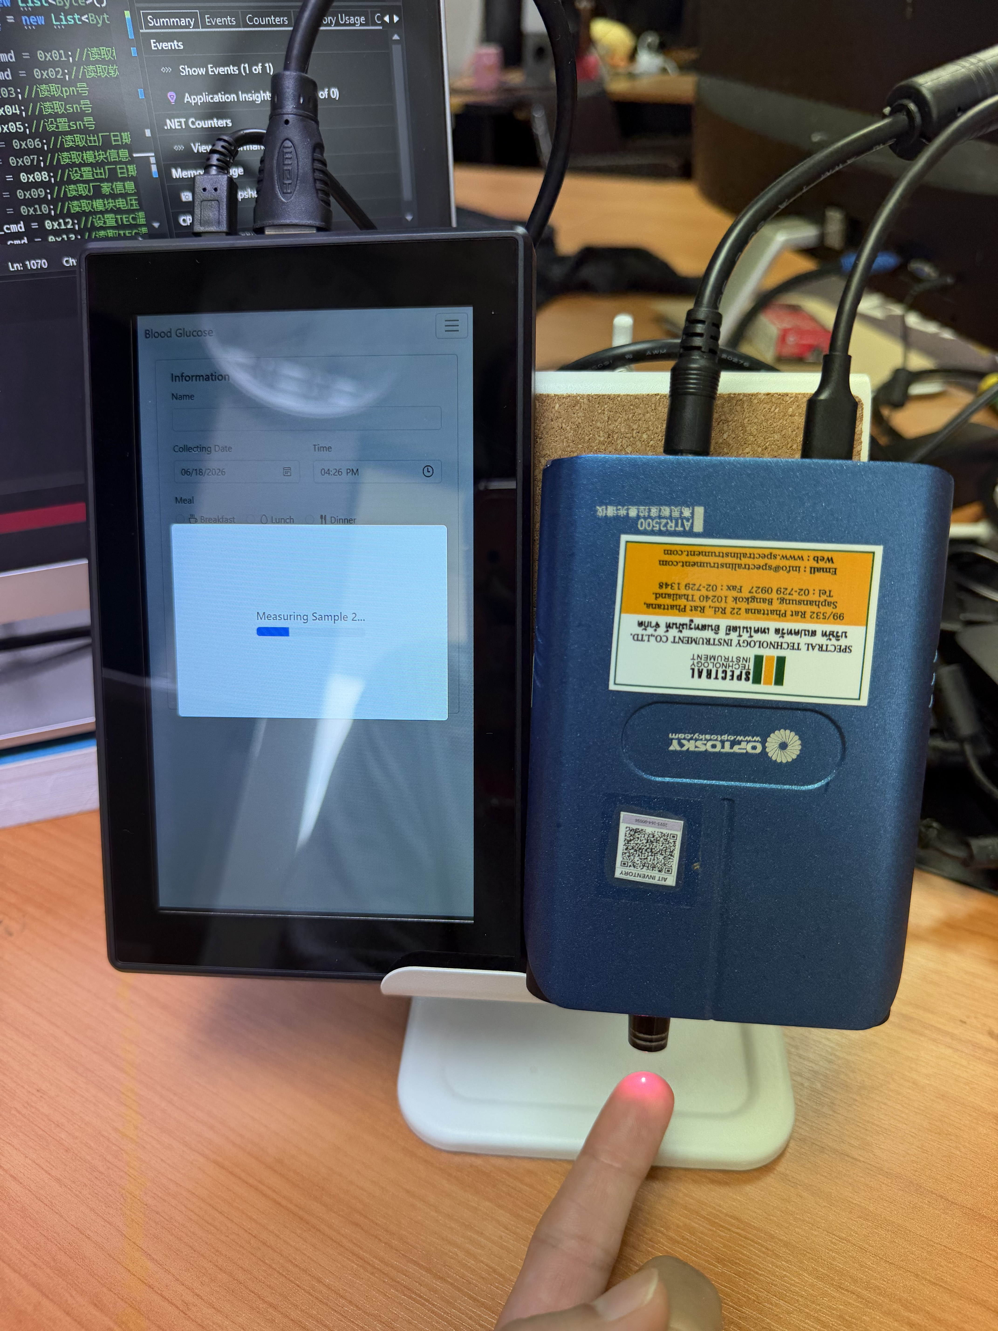
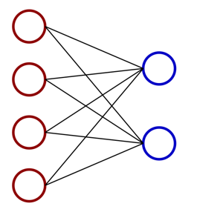
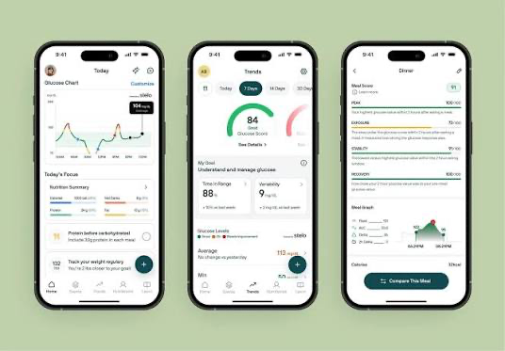
AIT Brain Lab
Non-Invasive Glucose via Raman Spectroscopy and Telehealth system
WP4: Cloud Telehealth Platform
WP1: Optical Glucose Sensing
POST /Observation
// Raman Glucose in FHIR R4 JSON
{ "resourceType": "Observation", "id": "ait-raman-glucose-001", "status": "final",
"code": { "coding": [{ "system": "http://loinc.org", "code": "2339-0", "display": "Glucose [Mass/vol] in Blood" }] },
"subject": { "reference": "Patient/P0001" }, "effectiveDateTime": "2026-09-09T10:30:00+07:00",
"valueQuantity": { "value": 118, "unit": "mg/dL", "system": "http://unitsofmeasure.org", "code": "mg/dL" },
"method": { "coding": [{ "system": "http://snomed.info/sct", "code": "439401001", "display": "In-vivo Raman spectroscopy" }] } }
GET /Observation
118 mg/dL

