Slide 1

Gas Pipeline Control System dataset

Slide 2
Introduction
The gas pipeline system used to collect the datasets was provided by Mississippi State University’s in-house SCADA lab
The system consists of three major components: sensors and actuators, a communication network, and supervisory control
Gas Pipeline System and HMI

Slide 3
Dataset Collection Methodology
The dataset proposed and created for this research is a second iteration of a previous dataset from a gas pipeline system to fill the void in IDS research for SCADA Applications.
The paper by Thornton showed that the previous dataset was unsuitable for IDS research due to obvious correlations between particular parameters and the result to be predicted by the algorithms.
Applying a new method to create dataset: parameterize and randomize the order in which the attacks were executed.

Slide 4
Dataset Description
274,627 instances.
Each instance in the dataset contains network traffic information along with payload information.
The network information provides a pattern of communication for intrusion detection systems to train against.
The payload information provides information about the gas pipeline’s state, settings, and parameters.

Slide 5
Raw dataset

Slide 6
Raw dataset
6 features:
Modbus frame: contain all information from the network, state, and parameters of the gas pipeline
The category of attack
Specific attack
Source of the frame
Destination of the frame
Time stamp
Master device
Man-in-the-middle
Slave device

Slide 7
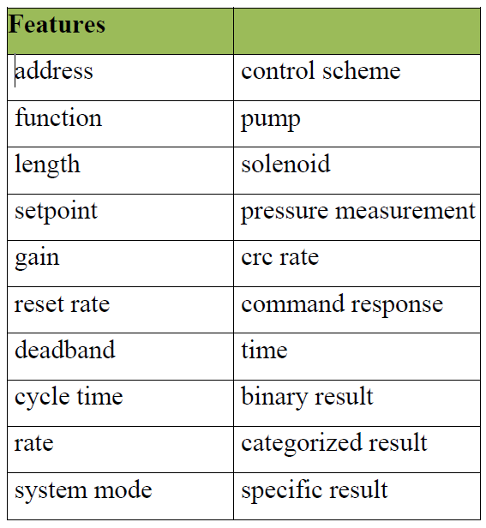
ARFF file
The ARFF dataset was created to be used with WEKA
20 features

Slide 8
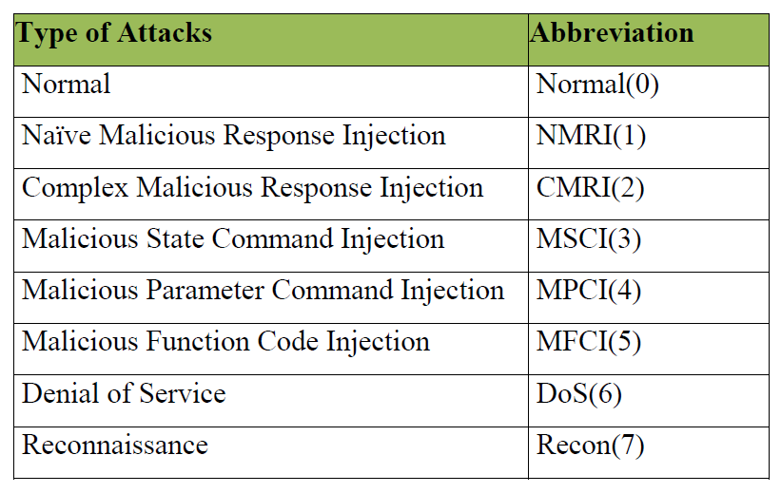
Label
Binary labels: 0 - normal
1 - anomaly
2. Categories of attacks:

Slide 9
Label
3. Specific attacks

Slide 10
Data mining tasks
Dealing with missing values (4 approaches):
Clustering the payloads with GMM
Clustering the payloads with K-means
Zeros imputation & indicators
Imputing missing values by keeping the prior existing value
Data normalization (2 approaches)
Mean & Std deviation
Min-Max

Slide 11
Dealing with missing values

Slide 12
Dealing with missing values

Slide 13
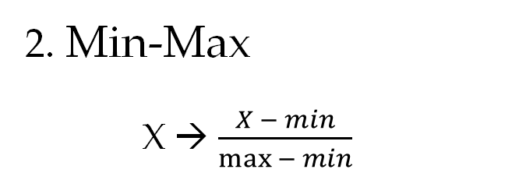
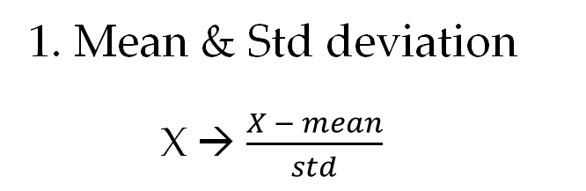
Data normalization
1. Mean & Std deviation
X → $\frac{X − mean}{std}$
2. Min-Max
X → $\frac{X − min}{\max{− min}}$

Slide 14
Application
This dataset has been used in several papers to create ML model for anomaly detection in SCADA system.
Some related papers:
R. Lopez Perez, F. Adamsky, R. Soua and T. Engel, "Machine Learning for Reliable Network Attack Detection in SCADA Systems," 2018 17th IEEE International Conference On Trust, Security And Privacy In Computing And Communications/ 12th IEEE International Conference On Big Data Science And Engineering (TrustCom/BigDataSE), New York, NY, USA, 2018, pp. 633-638, doi: 10.1109/TrustCom/BigDataSE.2018.00094.
J. M. Beaver, R. C. Borges-Hink and M. A. Buckner, "An Evaluation of Machine Learning Methods to Detect Malicious SCADA Communications," 2013 12th International Conference on Machine Learning and Applications, Miami, FL, USA, 2013, pp. 54-59, doi: 10.1109/ICMLA.2013.105.
Industrial Control System Traffic Data Sets for Intrusion Detection Research. Doi: 10.1007/978-3-662-45355-1_5
Classifying Categories of SCADA Attacks in a Big Data Framework. Doi: 10.1007/S40745-018-0141-8

