Slide 1
Multithreading

Slide 2
Thread
Thread is a single sequential flow of control with in a program
Completes a specific task
Java application uses a single thread – main
Java is a multithreaded programming language
A multithreaded program contains two or more parts that can run concurrently and
each part can handle different task at the same time
making optimal use of the available resources
JVM – thread scheduler, lets portions of each threads execute
All tasks running at the same time, give efficiency
Each of the threads can run in parallel

Slide 3
Typical uses of thread
Improve the applications with extensive I/O operation
Improve the response of GUI application
Allow to or more users to run server based application simultaneously

Slide 4
Life Cycle of a Thread
New: When a thread is created but not yet started, it is in the "new" state. In this state, the thread is allocated memory but has not yet begun executing.
Runnable: After calling the start() method on a thread object, it enters the "runnable" state. In this state, the thread is eligible to be scheduled for execution by the thread scheduler. However, it may or may not be currently running, as it depends on the availability of system resources.

Slide 5
Cont…….
Running: When a thread from the "runnable" state gets selected by the thread scheduler, it enters the "running" state. The thread's code is being executed in this state.
Blocked/Waiting: A thread can enter a "blocked" or "waiting" state in several situations. For example, if it is waiting for a lock to be released by another thread, waiting for user input, or waiting for a certain condition to be satisfied. In this state, the thread is not executing and is not eligible for scheduling until the condition changes.

Slide 6
Cont…….
Timed Waiting: Similar to the "blocked/waiting" state, a thread can enter the "timed waiting" state when it is waiting for a specific amount of time. For example, when it calls methods like sleep() or join() with a specified timeout period.
Terminated: A thread completes its execution or is explicitly terminated by calling the stop() method. In this state, the thread has finished executing, and its resources have been released. Once terminated, a thread cannot be restarted.

Slide 7
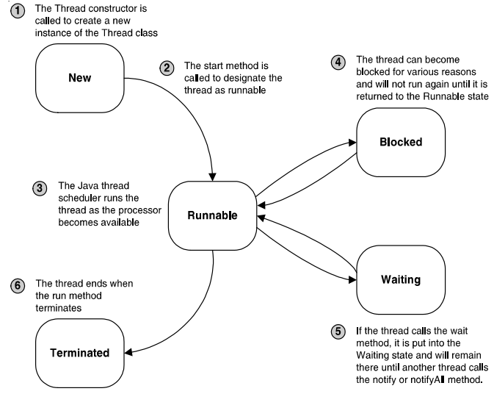

Slide 8
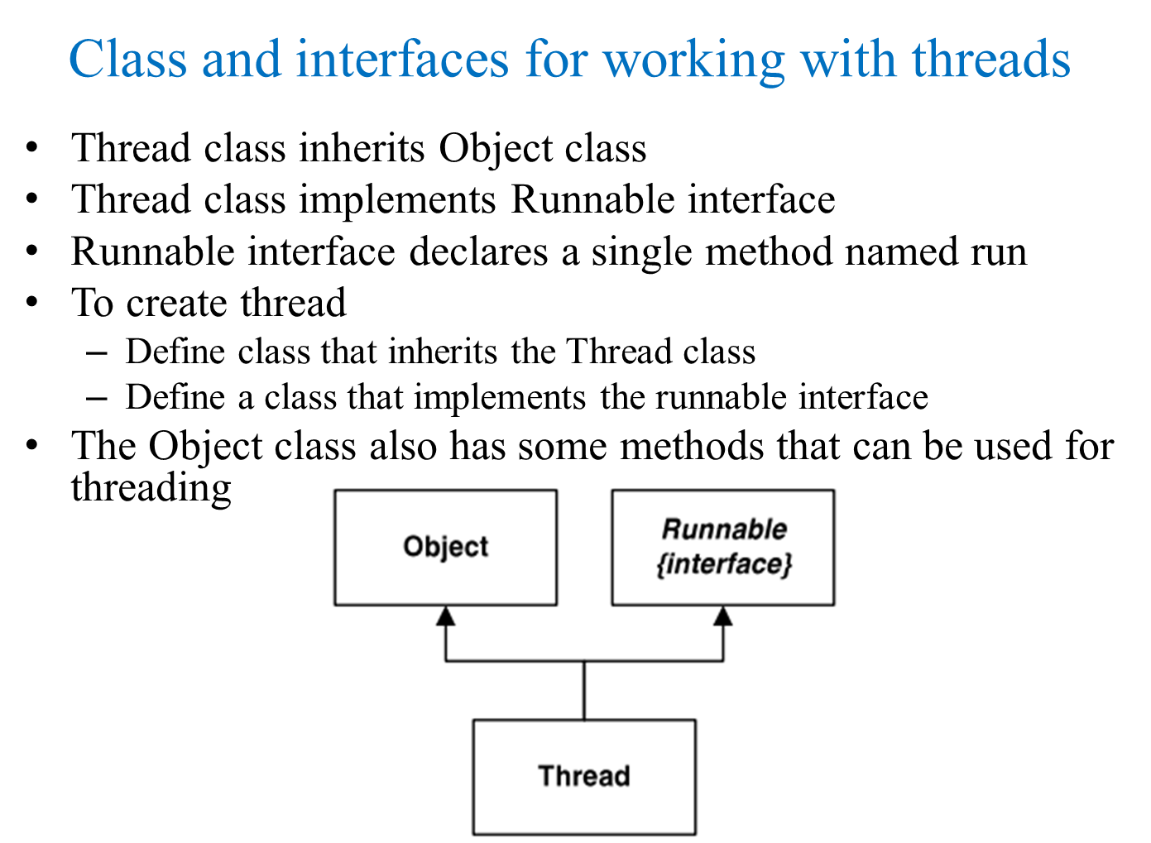

Slide 9
Methods of Thread class, Runnable interface, and Object class
start - Thread
Register Thread with the thread scheduler
run – Runnable, Thread
The thread scheduler calls this methods to run the thread
sleep – Thread
Causes the current thread to wait (sleep) for a specified period of time to the CPU can run other threads
wait - Object
Causes the current thread to wait until another thread calls the notify or notifyAll method for the current object
notify - Object
Notifies one arbitrary thread that waiting on this object that it can resume
notifyAll - Object
Notifies all the threads that are waiting on this object that they can resume execution

Slide 10
Creating a Thread
The Thread class
java.lang.Thread;
Common constructor
Thread()
Thread(Runnable)
Thread(String)
Thread(Runnable, String)
Common methods
run()
start()
getName()
currentThread()
setDaemon(boolean)
Sleep(long)
Interrupt()
isInterrupted()
yield()

Slide 11
Create Thread by Extending Thread Class
Create a class that inherits the Thread class
Override the run method to perform the desired task
public void run(
Create the thread by instantiating an object from the class
Call the start method
void start( );

Slide 12
Extending Thread Class
Creating a thread by extending the Thread class involves creating a subclass of Thread and overriding its run() method, which is where the new thread's execution will begin. Here is how to do it:

Slide 13
Extending Thread Class
// Define a class that extends the Thread class
public class MyThread extends Thread {
// Override the run() method to specify the thread's behavior
@Override
public void run() {
// Code written here will be executed by the new thread
System.out.println("The thread is running.");
}
}

Slide 14
Extending Thread Class…..
// Create and start the thread using a MyThread instance
public class Main {
public static void main(String[] args) {
// Create a MyThread object
MyThread myThread = new MyThread();
// Start the thread
myThread.start();
// Optional: Wait for the thread to finish using join()
try {
myThread.join();
System.out.println("Thread has finished execution.");
} catch (InterruptedException e) {
e.printStackTrace();
}
}
}

Slide 15
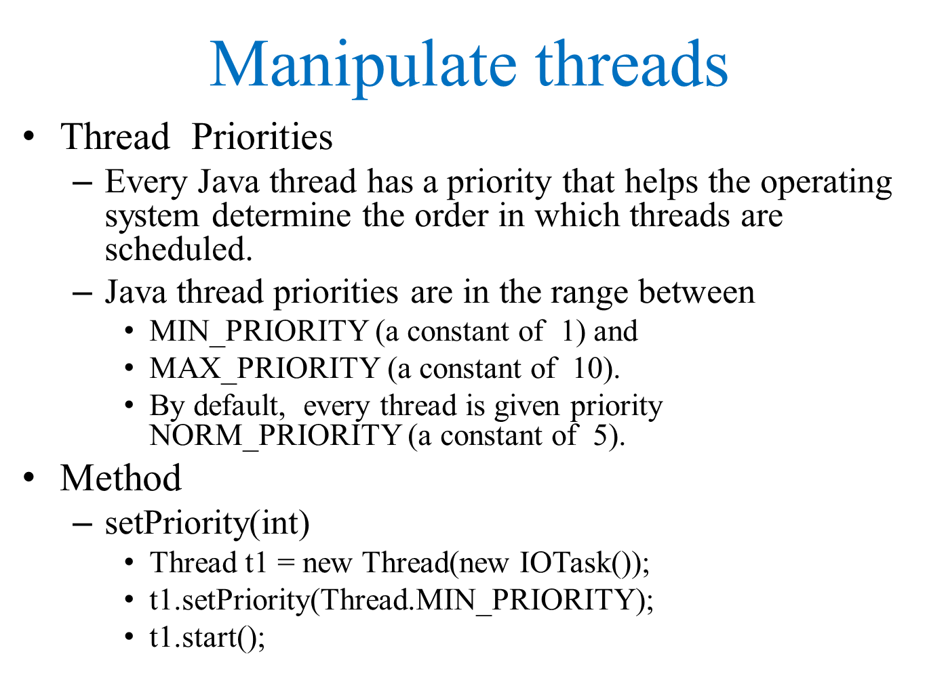

Slide 16
Interrupting a thread
Interrupting a thread involves stopping its execution before it completes its task. In most programming languages, including Python, there's no built-in interrupt mechanism for threads. However, you can implement interruption using various techniques. One common approach is to use a flag or an exception to signal the thread to stop.
Here's a brief overview of how you can interrupt a thread in Python:
Using a Flag:
Define a boolean flag variable that the thread periodically checks.
When you want to interrupt the thread, set this flag to True.
Inside the thread's code, check this flag periodically, and if it's True, gracefully exit the thread's execution.

Slide 17
Interrupting a thread….
1. Using Exceptions:
Inside the thread's code, wrap the main logic in a try-except block.
When you want to interrupt the thread, raise a specific exception inside the thread.
Handle this exception appropriately to gracefully exit the thread.

Slide 18
Using the interrupt() Method:
Call the interrupt() method on the thread object that you want to interrupt.
Inside the thread's code, periodically check whether the thread has been interrupted using Thread.interrupted() or Thread.currentThread().isInterrupted().
If the thread has been interrupted, gracefully exit the thread's execution.
class MyThread extends Thread { public void run()
{ try
{ while (!Thread.currentThread().isInterrupted())
{ System.out.println("Thread is running");
Thread.sleep(1000);
} }

Slide 19
catch (InterruptedException e) { System.out.println("Thread interrupted"); } } } public class Main { public static void main(String[] args)
{
MyThread myThread = new MyThread(); myThread.start(); // Let the thread run for some time try {
Thread.sleep(5000);
} catch (InterruptedException e) { e.printStackTrace();
} // Interrupt the thread myThread.interrupt(); } }

Slide 20
Synchronizing threads
Threads that share common recourses
Handling concurrency issue
To solve
Use Synchronize threads
The synchronized keyword assures that
only one thread at a time is allowed to execute any synchronized method of an object by locking the object
Public synchronize double getSGPA(int totalChr, double totalGradePoint){
return totalGradePoint/ totalChr;
}

Slide 21
communicating among threads
Communicating among threads in Java involves passing data or signals between threads to coordinate their activities. Here's a brief overview of how you can achieve thread communication in Java:
Shared Variables:
Threads can communicate by sharing variables. However, proper synchronization mechanisms (like synchronized blocks or volatile keyword) must be used to ensure thread safety.

Slide 22
Concurrency:
Concurrency in Java refers to the ability of the program to run multiple tasks simultaneously. Java provides built-in support for concurrency through threads. By using threads, you can perform multiple operations concurrently, which can improve the efficiency of your program.
Data Races:
Data races occur in concurrent programs when multiple threads access shared data concurrently, and at least one of the accesses is a write operation. If proper synchronization mechanisms are not used to coordinate access to the shared data, data inconsistency or unexpected behavior may result. In Java, data races can be mitigated using synchronization constructs like locks, synchronized blocks, or concurrent data structures..

Slide 23
3 Deadlocks:
Deadlocks occur in concurrent programs when two or more threads are blocked forever, waiting for each other to release resources that they need to proceed. Deadlocks typically happen when threads acquire multiple locks in a different order. Java provides mechanisms to prevent and resolve deadlocks, such as using a global ordering of locks, timeout-based lock acquisition, or using higher-level concurrency utilities like java.util.concurrent package.
4.Lock Starvation:
Lock starvation occurs when a thread is unable to obtain a lock indefinitely due to other threads continually acquiring the lock, preventing the starved thread from making progress. This can lead to poor performance or even deadlock if the starved thread is crucial for the program's execution. Java provides various techniques to mitigate lock starvation, such as fairness policies in lock implementations (ReentrantLock with fairness), using higher-level abstractions like semaphores or latches, or redesigning the concurrency model to reduce contention on critical sections

Slide 24


