Slide 1


Building an Unbeatable Tic-Tac-Toe AI
Introducing Our Team
Ashok Kumar Jarugubilli
Bharath Chandra Reddy Ukanti
Deshik Sastry Yarlagadda
by Bharath Reddy

Slide 2
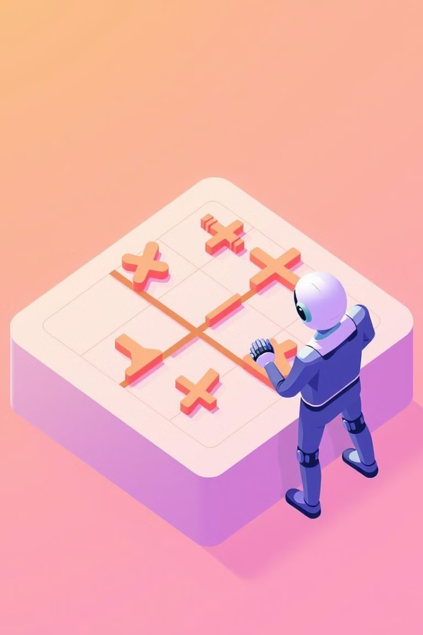
Project Objectives and Approach
1
Statement of Project Objectives
The objective of this project is to develop an AI agent for Tic-Tac-Toe that cannot be defeated by a human player. By leveraging the Minimax algorithm with Alpha-Beta Pruning, the AI will be able to evaluate all possible moves to ensure it always wins or forces a draw. The project aims to implement a game-playing agent that demonstrates optimal decision-making in a simple, yet illustrative two-player game environment.
2
Approach
Tools and Techniques:
Programming Language: Python
AI Techniques:
- Minimax Algorithm: A decision-making algorithm that evaluates all possible game outcomes, enabling the AI to make optimal moves.
- Alpha-Beta Pruning: An optimization technique to speed up the Minimax algorithm by reducing the number of moves evaluated.
Game Representation:
Game Tree Construction: Represent the game's possible moves and states in a tree structure to allow efficient traversal and evaluation.
Depth-First Search (DFS): Use DFS to explore each potential game outcome in the game tree.
Optional Tools:
Graphical Interface: Optionally use pygame to create a visual interface for the Tic-Tac-Toe board.

Slide 3

Project Deliverables
1
Tic-Tac-Toe AI Code
The core Python program implementing the Minimax algorithm with Alpha-Beta Pruning for Tic-Tac-Toe.
2
Documentation
Explanation of the algorithms used (Minimax and Alpha-Beta Pruning), the decision-making process, and the structure of the code.
3
Graphical Interface (Optional)
A basic graphical representation of the game board using pygame or a similar library to allow for human-AI gameplay.
4
Performance Metrics Report
A report evaluating the AI's performance based on win rate, decision time, and optimal move selection.

Slide 4

Evaluation Methodology
1
Win Rate
We will ensure that the AI consistently wins or forces a draw in every game, demonstrating its unbeatable nature.
2
Decision Time
We will measure the time taken for the AI to make a move, highlighting the efficiency of Alpha-Beta Pruning in reducing the number of moves evaluated.
3
Optimal Move Selection
We will confirm that the AI consistently selects the optimal move in each game state, verifying its adherence to the logic of the Minimax algorithm.
Notes:
• The goal of our evaluation methodology is to thoroughly test the capabilities of our AI system in the game of chess. • First, we will ensure that the AI consistently wins or forces a draw in every game, demonstrating its unbeatable nature. This will showcase the strength of our AI's strategic decision-making. • Next, we will measure the time taken for the AI to make a move, highlighting the efficiency of the Alpha-Beta Pruning algorithm in reducing the number of moves that need to be evaluated. This will showcase the AI's computational speed and decision-making efficiency. • Finally, we will confirm that the AI consistently selects the optimal move in each game state, verifying its adherence to the logic of the Minimax algorithm. This will validate the soundness of our AI's decision-making process. • By rigorously evaluating these key metrics, we will be able to comprehensively demonstrate the capabilities of our AI system and its suitability for real-world chess applications.

Slide 5
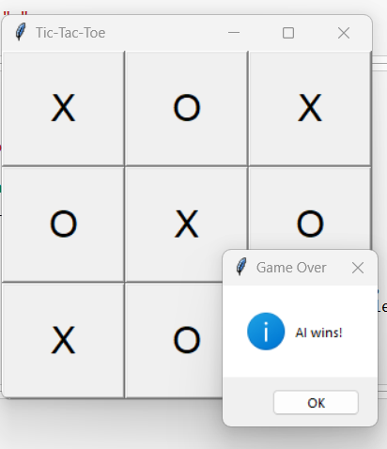
Results and Demonstration
The screenshot below shows a sample game where the AI demonstrates its ability to select optimal moves using the Minimax algorithm with Alpha-Beta pruning.
- The AI ('X') wins the game as expected.
- The interactive GUI enhances the player experience.

