Slide 1






JhariaWatch
JhariaWatch
(झरियावॉच)
Coal Mine Subsidence Risk Prediction & Early Warning System
Coal Mine Subsidence Risk Prediction & Early Warning System
(कोयला खदान धंसाव जोखिम भविष्यवाणी प्रणाली)
(कोयला खदान धंसाव जोखिम भविष्यवाणी प्रणाली)
Team HiggsBoson
TEAM DETAILS
Team name: HiggsBoson
Team leader name: Kamlesh KumarSharma
Problem statement: Coal Mine Subsidence Risk Prediction & Early Warning System
(BIT Sindri, Dhanbad)
HACK4SUSTAIN 2025
Notes:
1

Slide 2
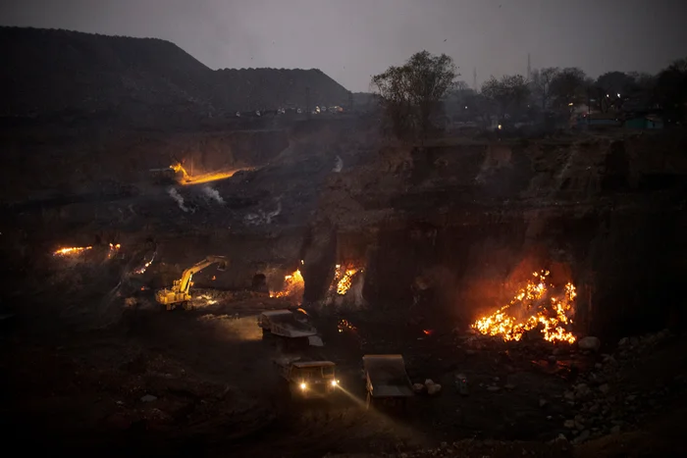
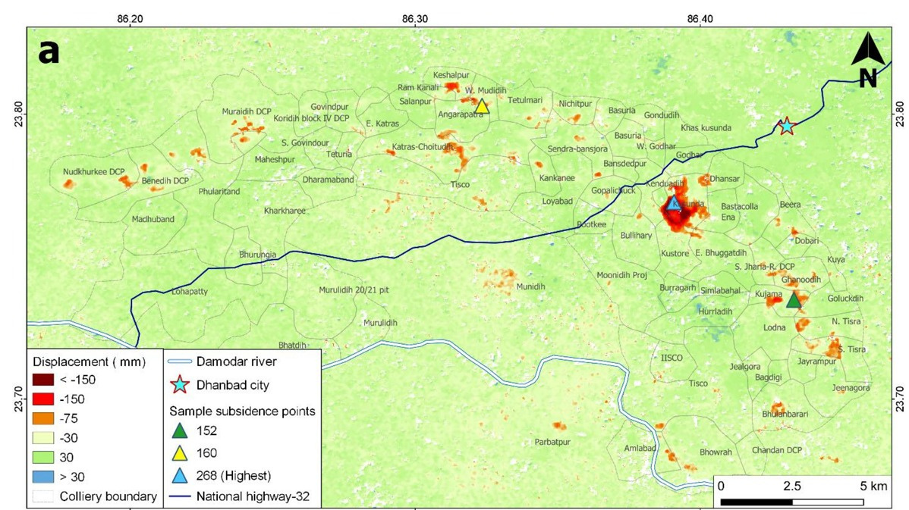
Problem statement :- Jharia Coal Mine Subsidence Risk Prediction & Monitoring System
1,00,000+
22 cm/yr
People in Danger Zones
Max Subsidence Rate
Critical Issues:
  Buildings collapsing due to subsidence
  450 sq km coalfield with underground fires
  Ground cracks appearing without notice
  No Public Warning System exists for residents
📊 Data: Alkusa 27-29mm/yr, Ena 28mm/yr | Source: ISPRS 2024
Notes:
2

Slide 3
Our Solution: JhariaWatch
Real-time Subsidence Risk Monitoring & Alert System
📱
🤖
🖥️
Mobile App
AI Analysis
Admin Dashboard
  Predicted risk mapping
  GPS-based alerts
  Photo reporting
  Emergency contacts
  Hindi + English
  Crack detection
  Severity scoring
  Satellite InSAR
  Risk prediction
  Crowdsourced data
  BCCL & Govt access
  Alert broadcasting
  Report management
  Analytics view
  Zone updates
🎯 Hyper-Local Focus
📊 Research-Backed
🆓 Free & Open Source
Notes:
3

Slide 4
Work Plan & Architecture
System Architecture
Sentinel-1 SAR
User Reports
Research Data
▼
Node.js Backend + MongoDB + AI
▼
Push Alerts
Risk Maps
Dashboard
Tech Stack
Mobile: React Native | Backend: Node.js
Database: MongoDB | Auth: Firebase
Maps: Leaflet.js | AI: TensorFlow.js
Notes:
4

Slide 5
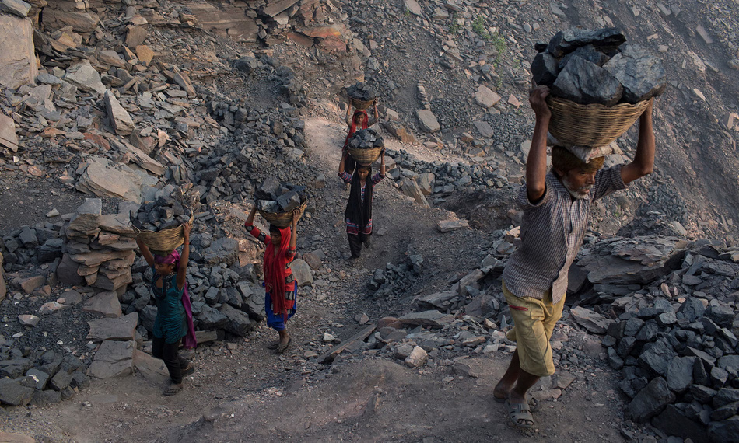
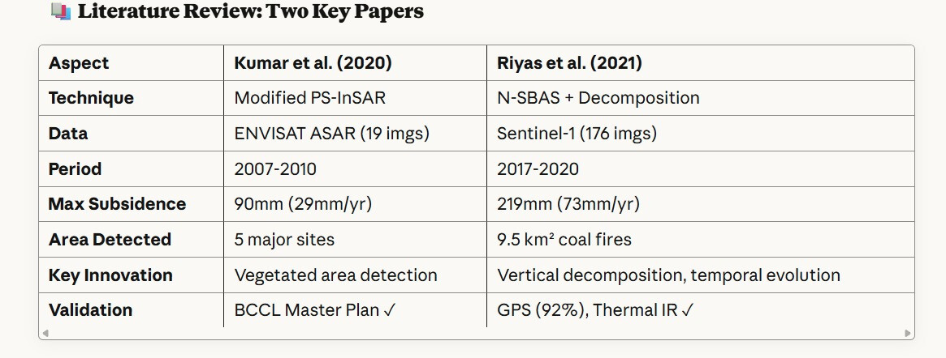
Preliminary Work & Research Data
Expected Impact
  Warn 1,00,000+ residents
  Reduce response time
  Crowdsourced monitoring
  Support BCCL decisions
Subsidence Data from Research
Performance Metrics:
Accuracy: ±8-10mm (single measurement),
±3-5mm/year (rate)
Detection Rate: 94% of known subsidence areas
False Positive Rate: <6%
GPS Agreement: 92%
Technical Thresholds:
Temporal Coherence: ≥0.50
Background Subsidence: ±30mm (ignore below this)
Alert Threshold: >30mm cumulative OR >10mm/year rate
Spatial Baseline: <364m (optimal: <200m)
Temporal Baseline: <630 days (optimal: 6-36 days)
Sources: Thakur et al. (2024) ISPRS, Kumar et al. (2020) J. Earth Syst. Sci.
Critical >7cm/yr
High 3-7cm/yr
Moderate
Stable
Notes:
5

Slide 6
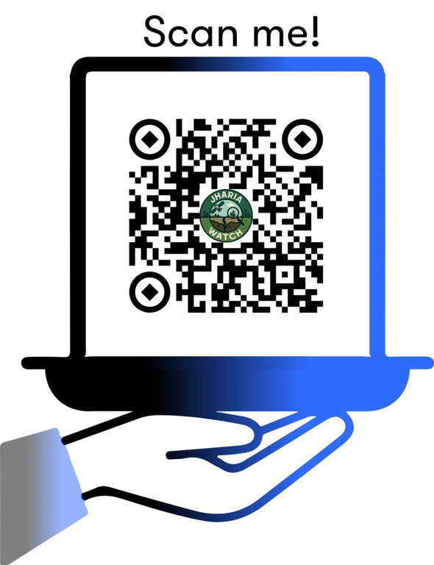
Thank You
धन्यवाद
Team HiggsBoson
Technology that can save lives in Jharia
1. Kamlesh Kumar Sharma (B.Tech)
Questions? We'd love to discuss!
2. Aman Kumar Arya (B.Tech)
3. Priyanshu Kumar (B.Tech)
4. Varun Kumar Barnwal (B.Tech)
BIT Sindri, Dhanbad
Birsa Institute of Technology
Visit My project - https://jhariyawatch.onrender.com/
Notes:
6

