Slide 1
Introduction

Slide 2
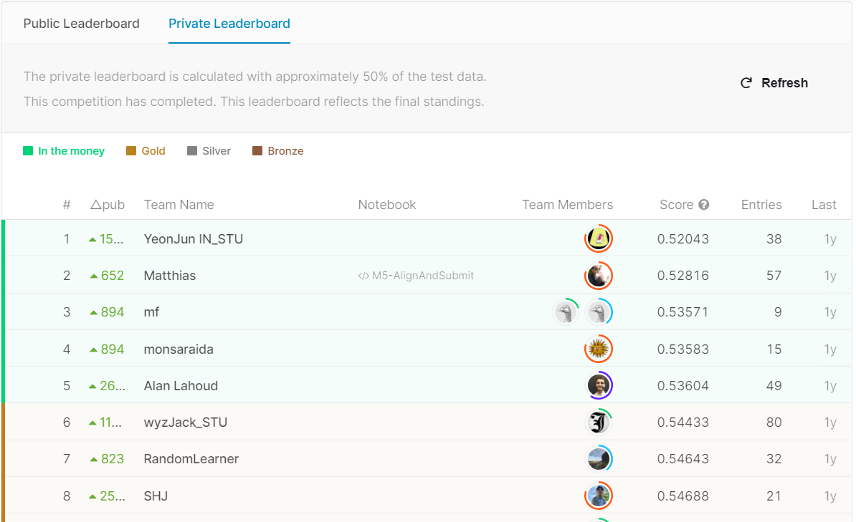
LightGBM
DeepAR
No Solution

Slide 3
Feature Engineering

Slide 4
Melt
ID
d
sales
HOBBIES_1_001
d_1
5
ID
d_1
d_2
….
d_1940
d_1941
HOBBIES_1_002
d_1
4
HOBBIES_1_001
5
….
HOBBIES_1_003
d_1
2
HOBBIES_1_002
4
….
HOBBIES_1_004
d_1
6
HOBBIES_1_003
2
….
HOBBIES_1_005
d_1
HOBBIES_1_004
6
….
2
….
…..
….
HOBBIES_1_005
….
17
HOBBIES_1_003
d_1941
HOBBIES_1_006
….
12
HOBBIES_1_004
d_1941
2
HOBBIES_1_007
….
16
HOBBIES_1_005
d_1941
17
HOBBIES_1_006
d_1941
12
HOBBIES_1_007
d_1941
16

Slide 5
Modeling

Slide 6
XGB
HP tuning: Optuna

