Slide 1
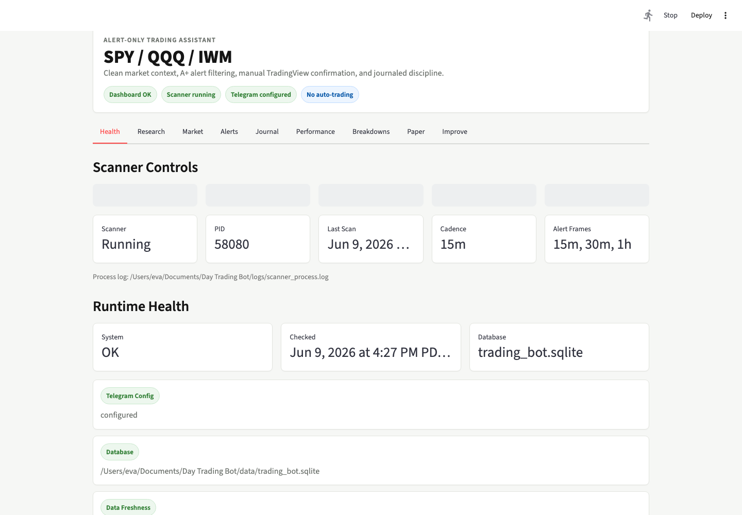
SESSION 1
Build the alert bot project plan.
Today is the architecture and safety blueprint. We do not build or trade before the plan passes review.
The class output
A reviewed Thread A Project Plan
A safe folder/module map
A settings contract for the current bot
A clean handoff into Session 2
80
60s
minimum alert score
configured scan cadence
The dashboard is the product target. The first build step is the plan.
Session 1 | Thread A Project Plan | Educational software, not financial advice
01
Notes:
Frame this as educational software engineering. The system is alert-only, not financial advice, not a profit promise, and not live auto-trading.

Slide 2
OUTCOME
Students leave with a reviewed blueprint.
The work product is a plan Codex can safely build from later.
Safety contract
Architecture map
Current settings
Alert-only, no broker, no auto-trading, no profit promises.
Modules, folders, config, storage, dashboard, tests.
SPY/QQQ/IWM, 80 threshold, 15m/30m/1h, 60 seconds.
Signal lanes
Manual workflow
Session 2 handoff
Core model and Carter Squeeze stay separate and source-labeled.
Candidate first, alert later, human review always.
A plan ready for QA, replay, and paper validation.
Session 1 | Thread A Project Plan | Educational software, not financial advice
02
Notes:
Clarify that Session 1 is not full implementation. Students should not let Codex build until the plan passes the review gate.

Slide 3
SETUP
Use a blank student folder.
Students build their own class project on their own laptop. They do not receive or edit the instructor bot folder.
Why blank?
1. Create empty folder
2. Open folder in Codex
It protects your live bot files, local databases, logs, .env files, saved credentials, and project history.
It also keeps each student from accidentally editing the wrong project.
Desktop or Documents is fine.
Use the student folder only.
3. Create Thread A
4. Use Project Plan mode
Name it clearly for the project plan.
Review before any build.
Folder example: Desktop/options-alert-bot-student
Session 1 | Thread A Project Plan | Educational software, not financial advice
03
Notes:
Say this directly: do not open my live bot folder, do not use my repo, and do not copy my .env, database, logs, deploy keys, or credentials.

Slide 4
THREAD MAP
Three threads keep the build clean.
Session 1 handles Thread A only. QA/paper trading and research come later.
THREAD A
THREAD B
THREAD C
Build Alert Bot Architecture
Project Plan, safety contract, module map, settings contract, alert lifecycle.
QA + Paper Trading Bot
Tests, replay, paper validation, source-aware reporting, dashboard QA.
Build Market Research Agent
Premarket/midday research brief, risk gates, summary delivery.
Today
Session 2
Session 3
Do not collapse the threads
Thread A produces the blueprint. Later threads use the blueprint instead of improvising over the live bot.
Session 1 | Thread A Project Plan | Educational software, not financial advice
04
Notes:
Keep students from asking Codex to build everything in one giant thread. Thread A stops at the project plan.

Slide 5
SETTINGS
Use careful Codex build settings.
These settings keep the first class slow enough to review and strong enough to plan well.
Model
Thinking
GPT-5 or highest available Codex reasoning model
High reasoning for the plan
Speed
Plan
Standard speed for class
ChatGPT Plus or higher
principal-ml-engineer
ui-ux-designer
quant-researcher
Architecture, evaluation, approval gates.
Dashboard clarity and manual-review flow.
Session 3 research and risk context.
Session 1 | Thread A Project Plan | Educational software, not financial advice
05
Notes:
Call out that principal-ml-engineer is a reusable architecture and evaluation lens here. Quant-researcher is mainly for Session 3.

Slide 6
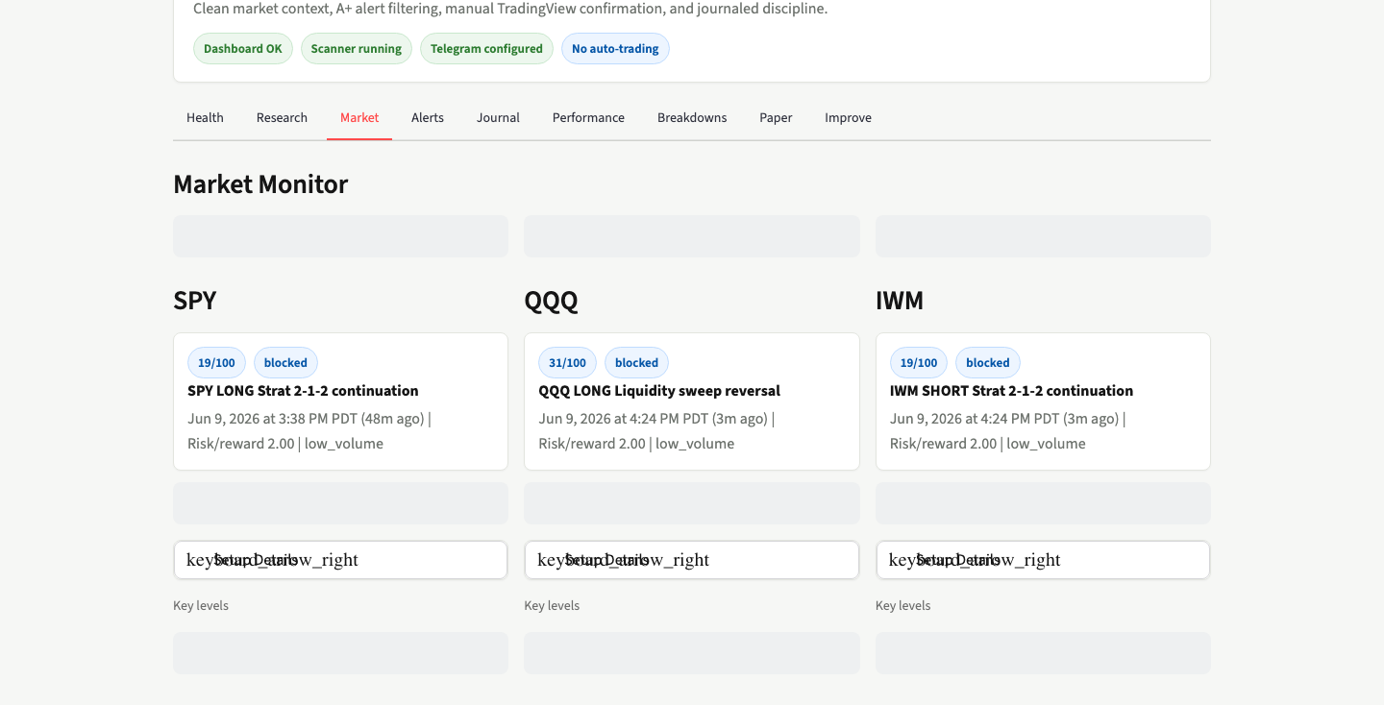
REFERENCE
The dashboard is the product target.
Students inspect the idea visually, but they still build in their own blank folder.
Manual review
The dashboard helps a person decide what to inspect. It does not place trades.
Source labels
Alerts and metrics must separate core model from Carter Squeeze.
No broker UI
No order buttons. No Robinhood. No automatic execution.
Session 1 | Thread A Project Plan | Educational software, not financial advice
06
Notes:
This screenshot is a visual target only. Do not hand students the instructor repo or live dashboard files.

Slide 7
BOT CONTRACT
Boundaries that must not drift.
These are the current facts students must put in the plan.
SPY
QQQ
IWM
80+
15m / 30m / 1h
60 seconds
Alert score threshold
Alert timeframes
Configured scan cadence
Only supported symbols
Carter Squeeze
Research gate
Manual review
No broker
Separate source-labeled lane
Hard-block risk score 65
Alert never means automatic trade
No Robinhood, no execution
Replay and paper validation
Educational evidence only. Never proof of profitability.
Session 1 | Thread A Project Plan | Educational software, not financial advice
07
Notes:
Explain that the old original prompt is historical. The current student prompt is what they paste today.

Slide 8
THREAD A
Start with the Project Plan.
The instructor provides the prompt. Students paste it once and wait for the reviewed plan before any build.
In Codex
1
2
Use Project Plan mode before any build.
The first output should be a reviewed blueprint.
Build order: Plan -> Review -> Implement later
Open blank folder
Create Thread A
3
4
Use Project Plan mode
Paste prompt from notes
Class step
Paste the full Thread A prompt one time. Do not submit partial pieces.
Stop at the gate
Do not build QA/paper or research in Thread A.
Session 1 | Thread A Project Plan | Educational software, not financial advice
08
Notes:
INSTRUCTOR NOTES
Use this slide to start Thread A in Project Plan mode.
The visible slide is student-facing. Do not place the full prompt on the slide.
Copy everything between COPY/PASTE START and COPY/PASTE END into the student's Codex Thread A chat as one prompt.
Before pasting, confirm:
- The student is in their own blank folder.
- The thread is named Thread A - Build SPY/QQQ/IWM Alert Bot Project Plan.
- Project Plan mode is selected.
- The student understands this is alert-only educational software, not financial advice.
COPY/PASTE START
GOAL
Build an educational, alert-only options bot for SPY, QQQ, and IWM that helps a human review potential day-trading setups. The bot must scan market conditions only during the configured market-data window, score alerts, show a Streamlit dashboard, support manual review, support paper/replay validation, support a separate Carter Squeeze signal lane, support conservative research risk gates, and keep every workflow manual-review-only.
This is not financial advice, not a profit promise, and not an auto-trading system.
Use Codex in Project Plan mode. Use GPT-5 or the highest available Codex reasoning model with high thinking/reasoning and standard speed. Use the following skills if available: principal-ml-engineer, quant-researcher, and ui-ux-designer.
CONTEXT
I want to build the current version of my SPY/QQQ/IWM alert bot as an educational software engineering project.
The bot should be a Python 3.9+ project with:
- Streamlit dashboard
- SQLite storage
- yfinance market data
- pytest tests
- Telegram alert support
- optional local AI/research-summary support
- Gmail/email delivery support for research summaries if configured
- replay and paper validation for educational evidence only
- no broker execution
- no Robinhood integration
- no automatic live rule changes
- no automatic trading
The bot must only support these symbols:
- SPY
- QQQ
- IWM
Current core alert settings:
- Alert threshold: 80
- Alert timeframes: 15m, 30m, 1h
- Active scan cadence from config: 60 seconds
- Code default may remain 900 seconds if no config override is loaded, but the configured bot should use 60 seconds
- Bot market timezone: America/New_York
- Dashboard/display timezone: America/Los_Angeles
- Market-data window: premarket start 04:00 ET through after-hours end 20:00 ET
- Scanner should pause outside the configured market-data window and on non-trading days before fetching market data
- Stale data threshold: 7 minutes
- Duplicate cooldown: 90 minutes
- Symbol cooldown: 30 minutes
- Core max alerts per symbol per day: 3
- Manual review required before any trade decision
- Alerts are decision-support only
The bot should include a main alert workflow plus a separate parallel Carter Squeeze signal source.
Core signal expectations:
- Score alerts from market conditions
- Require explainable reasons for each alert
- Include confidence/score output
- Include risk flags
- Include symbol, direction, timeframe, setup type, entry context, stop/risk context, and target/risk-reward context when available
- Require 80+ confidence/score before alerting
- Hard blockers can still prevent an alert even if the score reaches 80
- Use no-trade, watch-only, and alert-ready statuses
- Rank alertable setup records and send only the highest-priority eligible setup per source/symbol scan cycle
- Suppress lower-priority alertable setup records as watch-only/no-trade notes instead of blasting every candidate
- Preserve source labels so alerts, paper results, replay results, and dashboard stats can separate the core bot from Carter Squeeze
- Use `core_model` / `Core Model` labels for the main signal lane
- Capture 100-confidence core alerts into the live paper run/source named `live_100_alerts`
Carter Squeeze expectations:
- Keep Carter Squeeze as a separate signal source, not mixed into the core bot
- Support SPY and QQQ for Carter Squeeze
- Use `carter_squeeze` / `Carter Squeeze` labels
- Use confirmation timeframes 30m and 1h
- Require all-index alignment using SPY, QQQ, and IWM
- Require tactical 1R path
- Use tactical exit multiple of 1.0R
- Require minimum risk/reward of 2.0
- Use Carter Squeeze max alerts per symbol per day: 2
- Use Carter Squeeze duplicate cooldown: 90 minutes
- Use Carter Squeeze symbol cooldown: 30 minutes
- Preserve the 80+ alert threshold
- Make it removable and clearly labeled
- Capture Carter Squeeze paper tracking separately when implemented, using a separate live/paper source such as `live_carter_squeeze`
Current strategy and scoring expectations:
- Keep excluded setup types out of the main alert stream:
- VWAP reclaim + retest
- VWAP rejection + retest
- Block weak SPY VWAP reclaim longs
- Use strict index alignment for core alerts with SPY and QQQ
- For standalone level breaks, require a trending market condition and alignment across SPY, QQQ, and IWM
- Use VWAP quality checks for VWAP-related candidates
- Use opening-noise protection around weak VWAP setups
- Penalize weak volume, chop, overextension, stale data, conflicting timeframes, poor risk/reward, weak VWAP quality, VWAP whipsaw, momentum continuation risk, and standalone level-break risk
- Allow fast-momentum and all-index trend-continuation overrides only when the configured confirmation requirements are met
- Allow the midday momentum exception only when volume expansion, range expansion, recent move, market confirmation, and timeframe alignment meet the configured thresholds
- Alert-ready means eligible for human review only; it does not mean trade entry
Research/risk expectations:
- Research can be enabled
- Research may be required for alerts
- If research is required, alerts should respect the research risk gate
- Hard-block risk score: 65
- Caution risk score: 40
- Caution penalty: -8
- Hard-block penalty: -30
- Bias-conflict penalty: -6
- Research phases: premarket, morning, midday, eod
- Research phase times:
- premarket: 08:15
- morning: 10:00
- midday: 12:00
- eod: 16:10
- Use shared research phase constants instead of hard-coded phase lists
- If same-day research is required but missing, the scanner should block alerts and explain the missing research brief
- Research can block or penalize alerts, but research must not create alerts without a valid chart/setup candidate
- AI summaries and confidence scores are explanation/decision-support only
- Do not present AI output as trading authority
- Keep OpenAI/API summaries disabled by default unless the owner explicitly enables that path
- Do not require an OpenAI Platform account, OpenAI API key, or OpenAI API call for Session 1 or for the default local build
- Use deterministic/local fallback summary behavior when AI/API summaries are unavailable or disabled
- Do not invent external API requirements that are not needed by the current build
Optional services expectations:
- Telegram alerts are optional/configured only
- Telegram send attempts should be bounded by config, with max attempts 3 and retry delay 1 second
- Gmail/email delivery for research summaries is optional/configured only
- Alpha Vantage and other data-provider credentials are optional placeholders only unless the owner explicitly enables that path
- Do not send Telegram messages or emails during setup unless explicitly approved
Paper/replay expectations:
- Paper validation is educational evidence only
- Replay validation is educational evidence only
- Do not claim proof of profitability
- Support source-aware paper tracking where possible
- Support source-aware replay summaries where possible
- Keep live/paper tracking source-aware so core 100-confidence alerts and Carter Squeeze can be evaluated separately
- Store enough alert/setup detail for later review without implying trade execution
- Keep manual review in the workflow
Dashboard expectations:
- Build a Streamlit dashboard that lets a user review alerts manually
- Show alert details clearly
- Show signal source labels
- Show confidence/score
- Show reasons and risk notes
- Show no-trade/watch-only/alert-ready state clearly
- Show research decision, risk score, phase, and source status when available
- Show market-data freshness and scanner heartbeat/paused state when available
- Show paper/replay summaries where available
- Keep the UI clean, readable, and beginner-friendly
- Do not make the dashboard look like a broker execution platform
Safety expectations:
- Never place real trades
- Never connect to a broker
- Never auto-execute anything
- Never promise profits
- Never tell the user what to buy or sell
- Always frame the system as educational alert software and decision support
- Do not expose secrets
- Do not print .env values
- Do not commit credentials
- Include owner-facing warnings for .env files, saved credentials, deploy keys, Telegram tokens, Gmail credentials, and anything else that should be rotated before sharing
CONSTRAINTS
Build this conservatively.
Do not add broker execution.
Do not add Robinhood.
Do not add automatic trading.
Do not add automatic live rule changes.
Do not make claims of profitability.
Do not make the bot trade options automatically.
Do not use real secrets in code or documentation.
Do not read or print .env secret values.
Do not call external services during setup unless explicitly approved.
Do not run commands that send Telegram messages, emails, market scans, backfills, replay jobs, or live dashboards unless explicitly approved.
Do not overwrite unrelated existing files.
Keep changes scoped to the project.
Use clear file organization.
Use tests for risky logic.
Prefer simple Python modules over over-engineering.
Preserve the alert-only workflow.
Separate verified facts from assumptions in documentation.
Use source labels for parallel signal sources.
Keep Carter Squeeze separate from the core bot.
Use SQLite for local persistence.
Use Streamlit for the dashboard.
Use yfinance for market data.
Use pytest for tests.
DONE WHEN
The project has a working educational alert-only bot structure with:
- Python package layout
- Config file for symbols, thresholds, timeframes, cadence, research gates, and signal-source settings
- SPY/QQQ/IWM-only universe
- Alert threshold set to 80
- Timeframes set to 15m, 30m, and 1h
- Active configured scan cadence set to 60 seconds
- Manual-review-only alert workflow
- No broker execution
- No Robinhood
- No automatic trading
- Scanner pauses outside the configured market-data window and on non-trading days
- Core alert scoring module
- Separate Carter Squeeze signal-source module
- Source-aware alert storage
- Core max alert cap of 3 per symbol per day
- Carter Squeeze max alert cap of 2 per symbol per day
- Duplicate cooldown of 90 minutes
- Symbol cooldown of 30 minutes
- Ranked alert selection so only the highest-priority eligible setup is sent per source/symbol scan cycle
- Live paper capture for 100-confidence core alerts under `live_100_alerts`
- Source-aware paper/replay reporting where practical
- SQLite persistence
- Streamlit dashboard
- Telegram alert support as optional/configured only
- Research/risk gate support with premarket, morning, midday, and eod phases
- Research phase times set to 08:15, 10:00, 12:00, and 16:10
- Same-day research-required blocking behavior when enabled
- OpenAI/API summaries disabled by default unless explicitly enabled
- Local/deterministic research-summary fallback behavior where practical
- Gmail/email research-summary support only if configured
- Safety disclaimers in docs
- Secrets warnings in docs
- Tests for scoring, source labeling, Carter Squeeze behavior, research phase mapping, scanner market-window pause behavior, and key safety constraints
- README explaining setup, manual workflow, and safety boundaries
- Troubleshooting notes
- Clear statement that replay and paper validation are educational evidence, not proof of profitability
Before finishing, provide a final verification checklist. Each item must be marked either YES - VERIFIED or NO - NOT VERIFIED. If anything is not verified, explain why.
Final verification checklist:
- YES - VERIFIED: The bot remains alert-only
- YES - VERIFIED: No broker execution code was added
- YES - VERIFIED: No real secrets were printed or copied
- YES - VERIFIED: SPY, QQQ, and IWM are the only supported symbols
- YES - VERIFIED: Alert threshold is 80
- YES - VERIFIED: Alert timeframes are 15m, 30m, and 1h
- YES - VERIFIED: Configured scanner cadence is 60 seconds
- YES - VERIFIED: Scanner pauses outside the configured market-data window before fetching market data
- YES - VERIFIED: Core alert cap is 3 per symbol per day
- YES - VERIFIED: Carter Squeeze alert cap is 2 per symbol per day
- YES - VERIFIED: Carter Squeeze is separate and source-labeled
- YES - VERIFIED: Research gates include premarket, morning, midday, and eod phases
- YES - VERIFIED: OpenAI/API summaries are not required for the default local build
- YES - VERIFIED: Live 100-confidence core paper capture is source-labeled
- YES - VERIFIED: Dashboard shows manual-review information clearly
- YES - VERIFIED: Tests pass or skipped tests are clearly explained
- YES - VERIFIED: External-service commands were skipped unless explicitly approved
COPY/PASTE END

Slide 9
LIFECYCLE
Candidate first, alert later.
This slide is the simple explanation of the alert lifecycle.
Market data
Timeframes
Setup candidate
Blockers
Score
Dashboard
yfinance candles
>
15m / 30m / 1h
>
Possible idea only
>
Risk, chop, stale data
>
80+ required
>
Human review next
Not an alert yet
Not a trade
Journal later
A setup candidate can be rejected before it ever reaches the user.
An alert is a message for manual review, not an instruction to enter.
Session 2 connects the reviewed plan to QA, replay, and paper validation.
Session 1 | Thread A Project Plan | Educational software, not financial advice
09
Notes:
Use the plain sentence: candidate first, alert later, and alert never means automatic trade.

Slide 10
OUTPUT
The plan must produce these artifacts.
If Codex skips one, stop and revise the plan before building.
1
Project goal and safety contract
2
Folder/module map
3
Safe settings contract
4
Core vs Carter source map
5
Alert lifecycle diagram
6
Research/risk gate notes
7
Manual-review dashboard plan
8
Session 2 handoff
Do not approve vague output
The plan must explicitly say alert-only, no broker, no real secrets, and manual review required.
Session 1 | Thread A Project Plan | Educational software, not financial advice
10
Notes:
Use this slide as a live checklist. If Codex leaves out Carter Squeeze source labels or the 60-second configured cadence, have students ask for a fix.

Slide 11
REVIEW GATE
Do not build until the plan passes.
The review gate prevents students from accidentally building a trading bot instead of an alert bot.
OK
Alert-only language is explicit
OK
Carter Squeeze separate
OK
SPY/QQQ/IWM only
OK
No broker or Robinhood
OK
Threshold 80 and 15m/30m/1h
OK
No real secrets
OK
Configured cadence 60 seconds
OK
No profit promise
Review rule
If anything is missing, ask Codex for the smallest fix. Do not let the project move to implementation yet.
Session 1 | Thread A Project Plan | Educational software, not financial advice
11
Notes:
Optional DOD review prompt: Review the student's Session 1 Thread A output against the Done Definition. Return PASS, FIX, or BLOCKED. Be strict. End with: This system is alert-only and does not place trades.

Slide 12
NEXT
What comes after the plan.
Session 1 gives later threads a safe artifact to build from.
Today: Thread A
Session 2: Thread B
Session 3: Thread C
Reviewed project plan
Architecture map
Safe settings contract
Alert lifecycle
QA checks
Replay and paper validation
Source-aware metrics
Dashboard review
Research brief
Risk gates
Email summaries
Decision-support language
Handoff artifact
Students save the Thread A Project Plan output before Session 2.
Session 1 | Thread A Project Plan | Educational software, not financial advice
12
Notes:
Preview the next sessions without turning Session 1 into implementation time.

Slide 13
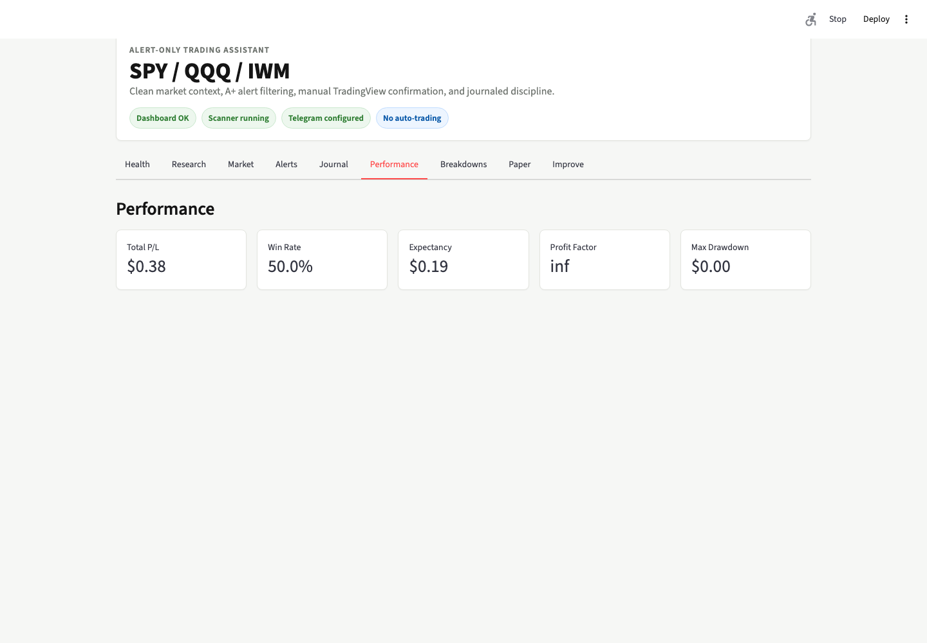
CLOSE
Leave with a reviewed Project Plan.
The class is complete when the plan is safe enough to become the build handoff.
Final student checklist
Project Plan saved
Folder/module map included
Settings contract included
Carter lane separated
No secrets and no broker execution
Safety sentence included
Final safety sentence
This system is alert-only and does not place trades.
Session 1 | Thread A Project Plan | Educational software, not financial advice
13
Notes:
Have students save the Project Plan output. Close by repeating: this system is alert-only and does not place trades.

