Slide 1

Wake County Parks

Slide 2
Problem: Finding the Right Parks in Wake County
Information on parks not readily available.
Too many choose from.
Too hard to know which facilities are available in each park

Slide 3
Data source and cleaning
Data obtained from http://data-wake.opendata.arcgis.com
Removed nonessential columns
Missing addresses and coordinate values
Use of geopy to get missing coordinates

Slide 4
Methodology and Results
Pandas powerful functions to manipulate data
Sorted the data to list parks with the most facilities to make a top 10 list.
Foursquare Api was used to get top 10 venues from each park in our top 10 list
Playgrounds and picnic shelters were the most common facilities

Slide 5
Observations and Recommendations
Most common venues were within the parks.
Foursquare top 10 venues matched our top 10 list from data
Parks in the top 10 lists are good enough diverse for any visitor.

Slide 6
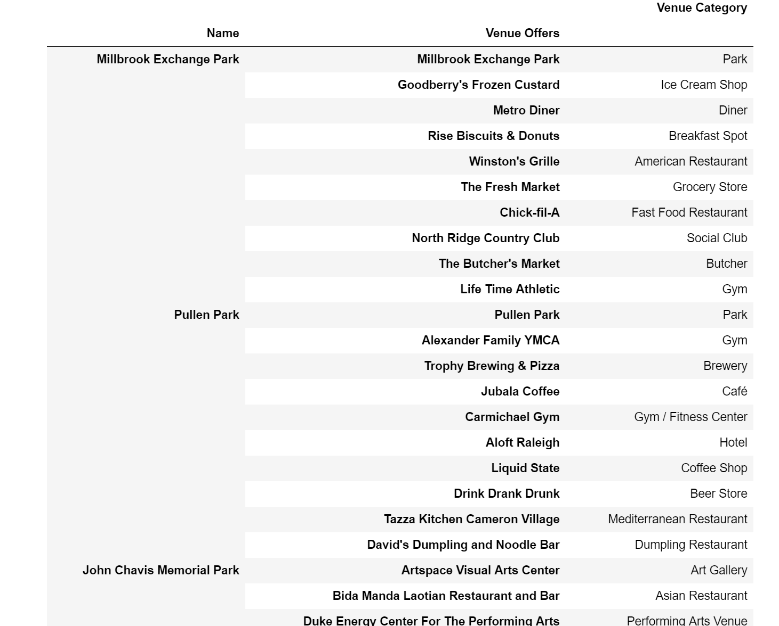
Conclusion
Our final list have all the 10 parks and their venues listed in one convenient place.
There is no need in browsing the website of each park to learn about its venues
If you have kids with you, it’s easy to look for parks with ice cream shop
All you need is in one table. For full table reference the notebook

Slide 7
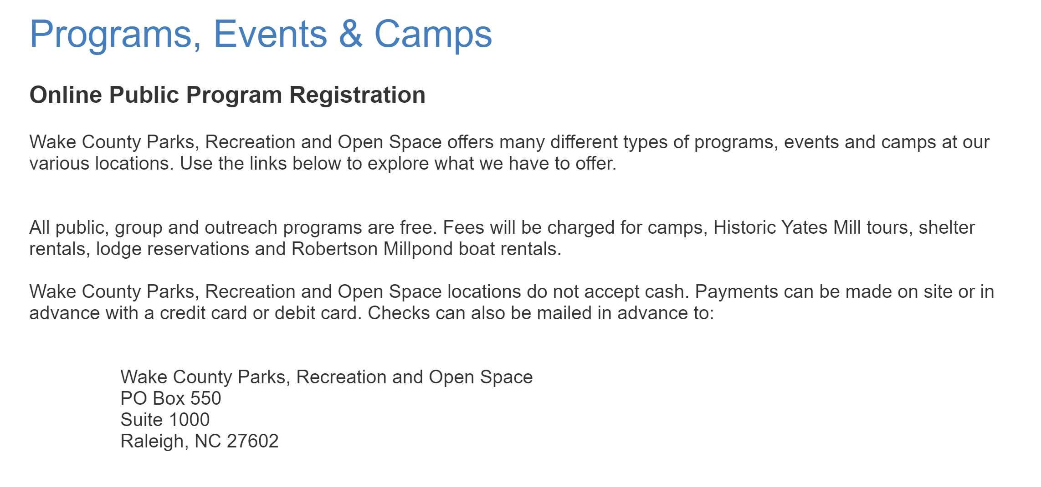
For More Information

