Slide 1
PERCENTAGE

Slide 2
50% of 146
20% of 625
33.33% of 12
16.66% of 3.6
14.28% of 749
37.5% of 24
55.55% of 81
63% of 14.28
45.45% of 20
30% of 40

Slide 3

1 = 100%
1/2 = 50%
1/3 = 33.33%
1/4 = 25%
1/5 = 20%
1/6 = 16.66%
1/7 = 14.28%
1/8 = 12.5%
1/9 = 11.11%
1/10 = 10%
1/11 = 9.09%

Slide 4
50% of 146
20% of 625
33.33% of 12
16.66% of 3.6
14.28% of 749
37.5% of 24
55.55% of 81
63% of 14.28
45.45% of 20
30% of 40

Slide 5
A girl gets 60 marks out of 80. What percent of marks does she get?
a) 60 b) 70 c) 75 d) 80

Slide 6
The monthly salary of Rohit is 24,000. If his salary increases by 12.5%, find his new salary.
a) 24500 b) 27000 c) 27500 d) 29000

Slide 7
Ex 1: Marks scored by A is 50 and marks scored by B is 40. Then (i) A is what % more than B? (ii) B is what % less than A? (iii) A is what % of B? (iv) B is what % of A?

Slide 8
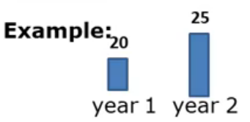
Percentage Change
Find the percentage increase/ decrease from 1st year to 2nd year?
Find the percentage increase/ decrease from 2nd year to 1st year?

Slide 9
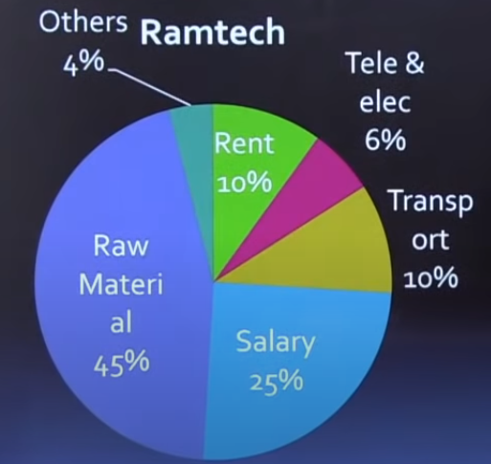
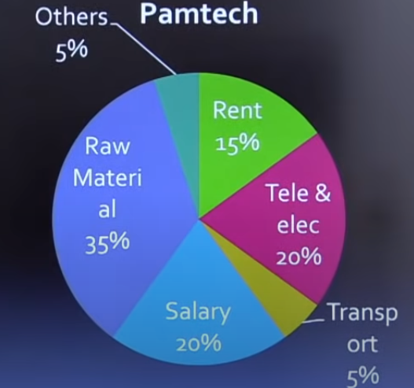
Following pie-chart shows the annual expenditure of two private companies.
Total: 40 crore
Total: 50 crore
The amount spent on Transport by Pamtech is what percentage of the amount spent by Ramtech on Transport?
a) 20 b) 30 c) 40 d)50

Slide 10
Following pie-chart shows the annual expenditure of two private companies.
Total: 40 crore
Total: 50 crore
The expenditure on Ramtech’s Rent is how much percentage less than the Pamtech’s Rent?
a) 33.33 b) 16.66 c) 20 d)25

Slide 11
Following pie-chart shows the annual expenditure of two private companies.
Total: 40 crore
Total: 50 crore
The expenditure on raw material for both campany taken together is approx what percentage of the total expenditure?
a) 20 b) 30 c) 40 d)50

Slide 12



- 10%
+ 10%
ZAALIM SINGH
ROBINHOOD
MAJBOOR INSAAN

Slide 13
+ 10%
- 10%
MAJBOOR INSAAN
ROBINHOOD
ZAALIM SINGH

Slide 14

- 10%
+ ? %
ZAALIM SINGH
ROBINHOOD
MAJBOOR INSAAN

Slide 15

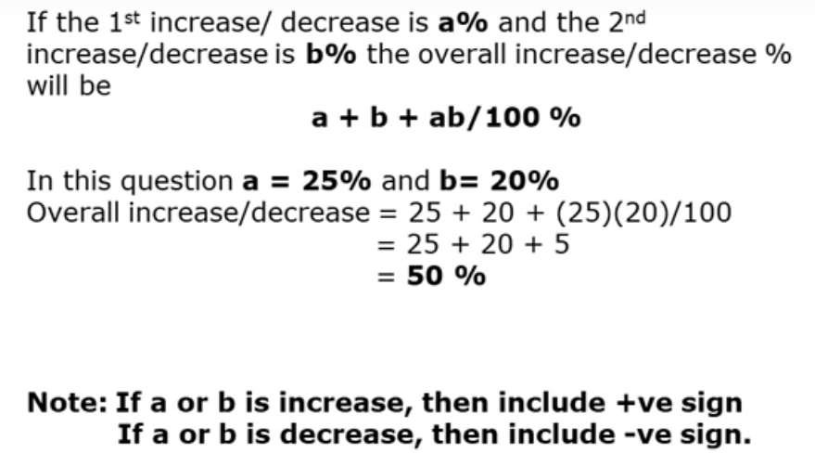

Slide 16
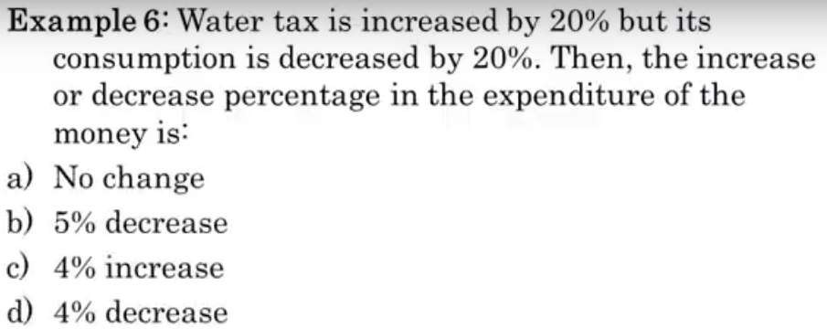

Slide 17
The number of seats in an auditorium is increased by 25%. The price on a ticket is also increased by 12%. What is the effect on the revenue collected?
A.40% B.45% C.50% D.60%

Slide 18
The price of petrol is increased by 25%. By how much percent a car owner should reduce his consumption of petrol so that the expenditure on petrol would not be change?
A.25% B.30% C.50% D.20%

Slide 19
The price of sugar is decreased by 10%. By how much percent consumption can be increased without changing the overall expense?
A.11.11% B.9.09% C.10% D.None of these

Slide 20
By how much percent a family reduce its consumption of tea if the cost of tea got increased by 12.5%.
A.11.11% B.9.09% C.14.28% D.None of these

Slide 21
The cost of datapack is decreased by 16.66%. By how much percent consumption can be increased without changing the overall expense?
A.20% B.25% C.14.28% D.None of these

Slide 22

% Change = Final Value – Initial Value
Initial Value
%Profit/Loss =Selling Price(SP) – Cost Price(CP)
Cost Price(CP)
% Discount = Selling Price – Mark Price
Mark Price

Slide 23
The price of rice rises from Rs. 30 to Rs. 36. Find the percentage Find the percentage rise.
A.20% B.25% C.30% D.16.66%

Slide 24
The population of Gokuldham Society was 400 in 2001 and 450 in 2005. By what percentage the population increased.
A.20% B.25% C.12.5% D.16.66%

Slide 25
Radha spends 40% of her salary on food, 20% on house rent, 10% on entertainment and 10% on conveyance. If her savings at the end of a month are Rs 1500, then her salary per month is?
A.Rs 8000
C.Rs 6000
B.Rs 7500
D.Rs 10000

Slide 26
Out of the salary of 13,500, a man keeps one- third as his saving. Of the remaining money, he spend 50% on food and 20% on rent. How much money has he left ?
A.Rs 6300
C.Rs 2700
B.Rs 9000
D.Rs 4500

Slide 27
PRACTICE
Q. 1. The difference between 56% of a number and 39% of the same number is 425. What is 60% of that number?
1525 (b) 1650 (c) 1700 (d) 1500

Slide 28
PRACTICE
Q. 2. 60 per cent of first number is 40 per cent of the second number. What is the respective ratio of the second number to the first number?
3 : 2 (b) 2 : 3 (c) 7 : 10 (d) cannot be determined

Slide 29
PRACTICE
Q. 3. If the numerator of a fraction is increased by 200% and the denominator is increased by 300%, the resultant fraction is 15/26. What was the original fraction?
8/11 (b) 10/13 (c) 9/13 (d) 10/11

Slide 30
Q. 4. In an examination it is required to get 40% of the maximum marks to pass. A student gets 275 marks and is declared fail by 65 marks. What are the maximum marks in the exam?
(a) 850 (b) 800 (c) 650 (d) Cannot be determined

Slide 31
Q. 5. In a class of 50 students and 5 teachers, each student got sweets that are 14% of the total number of students and each teacher got sweets that are 20% of the total number of students. How many sweets were there?
(a) 345 (b) 375 (c) 350 (d) 400

Slide 32
Q. 6. In an election between two candidates, one candidate got 52% of the total valid votes. 25% of the total votes were invalid. The total number of votes was 8400. How many valid votes did the other candidate get?
(a) 3276 (b) 3196 (c) 3024 (d) Cannot be determined

Slide 33
Q. 7. If the height of a triangle is decreased by 50% and its base is increased by 50%, what will be the effect on its area?
(a) No change (b) 20% increase (c) 16% decrease (d) 25% decrease

Slide 34
Q. 8. Amit gave 35% of the amount he had to Billu. Billu in turn gave two-thirds of what he received from Amit to Chandan. After spending Rs.150 on lunch out of the amount he got from Billu, Chandan now has Rs.550 left with him. How much amount did Amit have?
(a) Rs.2500 (b) Rs.2000 (c) Rs.3000 (d) Rs. 3500

Slide 35
PROPORTIANLITY

Slide 36
The height of a person varies directly as the square root of his age. If a person is 4 ft. tall at 25 years, find the height of the person at 36 years?
a. 6 ft
b. 4.5 ft
c. 4.7 ft
d. 4.8 ft

Slide 37
According to the Boyle’s Law, Pressure varies inversely with volume while Temperature varies directly with pressure. At a time, volume = 50 m³, Temperature = 25°C at unit atmospheric Pressure. If the volume increased to 200 m³ and pressure is kept constant, then the temperature will be:
A. 100 °C
B. 50 °C
C. 12.5 °C
D. 0 °C

Slide 38
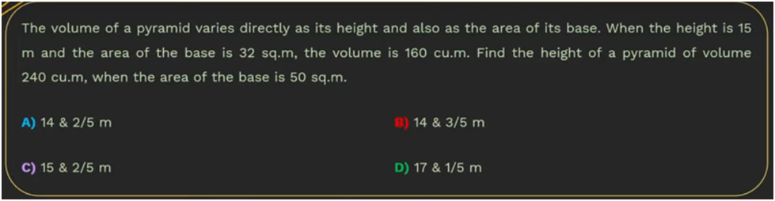
~ CAT 2023

Slide 39
Q29. A precious stone weighing 35 grams worth Rs 12,250 is accidently dropped and gets broken into two pieces having weights in the ratio of 2 : 5. If the price varies as the square of the weight then find the loss due to breaking of stone?
(a) Rs 5750 (b) Rs 6000 (c) Rs 5500 (d) Rs 5000 (e) Rs. 5200

Slide 40
The price of piece of diamond varies accordingly to square of its weight. When he breaks the diamond into four pieces of different weights in the ratio 2:3:4:5 , he incurs a loss of Rs. 28400. Calculate the price of original piece of diamond.
A. Rs. 39200
B. Rs. 38200
C. Rs. 35500
D. None of these

