Slide 1
SERIES

Slide 2
Difference Series:
1, 4, 7, 10, 13, 16, 19, 22, ______
1, 2, 4, 7, 11, 16, 22, 29, ______
1, 3, 6, 8, 11, 13, 16, 18, 21, ____
52, 49, 46, 43, 40, 37, 34, 31, 28, ___
6, 11, 19, 30, 44, 61, 81, ___

Slide 3
Power Series:
1, 4, 9, 16, 25, 36, 49, 64
0, 3, 8, 15, 24, 35, 48, 63
1, 2, 6, 15, 31, 56, 92
1, 8, 27, 64, 125, 216, 343
2, 9, 28, 65, 126, 217, 344
2, 10, 30, 68, 130, 222, 350
2, 7, 28, 63, 126, 215, 344

Slide 4
Dependent Series:
1, 1, 2, 3, 5, 8, 13, 21, 34
1, 2, 4, 8, 16, 32, 64, 128
1, 6, 36, 216, 1296, 7776, 46656
3, 1.5, 0.75, 0.375, 0.1875, 0.09375
4, 9, 20, 43, 90, 185

Slide 5
Alphabet Series:
A, C, E, G, I, K, M, O
AC, BE, CG, DI, EK, FM
A4, C9, F16, H25, K36, M49
T4E, W9C, Y19Z, B39X

Slide 6
Combination Series:
1, 1, 4, 4, 7, 9, 10, 16, 13, 25, 16, 36
2, 5, 9, 3, 7, 12, 4, 9, 15, 5, 11, 18

Slide 7
Review
i) 4, -8, 16, -32, 64, ?
ii) 1, 4, 9, 16, 25, 36, 49, ?
iii) 1, 3, 6, 10, 15, 21, ?
iv) 2, 6, 18, 54, 162, ?

Slide 8
Review
i) 3, 10, 21, 36, 55, 78.
ii) 5,10,13,26,29, 58.
iii) 125, 123, 120, 115, 108, 97.

Slide 9
Review
iv) 8, 14, 26, 50, 98, 194
v) 8, 8, 9, 9, 11, 10, 14, 11
vi) 325, 259, 204, 160, 127, 105
vii) 824, 408, 200, 96, 44, 18
viii) 16, 17, 21, 30, 46, 71
ix) 3, 3, 6, 18, 72, 360

Slide 10
Review
x) 24, 35, 51, 73, 102, ?
xi) 5, 13, 22, 34, 51, 75, 108, 152, ?
xii) 5, 13, 37, 109, 325, ?
xiii) 10, 100, 200, 310, ?

Slide 11
33) a _ b _ a b b _ a b _ a _ b b a
Pattern Series
bbaab
babba
baaba
aabba

Slide 12
34) a _ b _ a _ _ n _ b b _ a b b n
abnabb
bnbban
bnbbna
babban

Slide 13
35) d _ _ n _ _ n n d m _ n
ndmnm
mndmn
mdmnm
dmnnm

Slide 14
36) _ o p _ m o _ n _ _ p n m o p _
mnpomn
mnompn
mnpmon
mpnmop

Slide 15
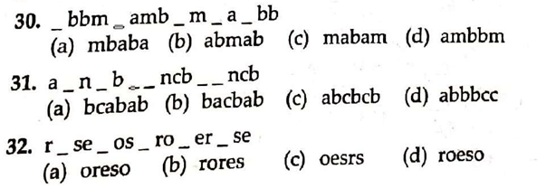
Pattern Series

