Slide 1
Procedure Followed: 1) Downloaded sample_superstore.xlx from Tableau. 2) Made interactive dashboard using filters for Key Performance Indicators (KPIs) like profit,sales,quantity,city over the years for each city and their graphs. 3) Published the same in Tableau Public.

Slide 2
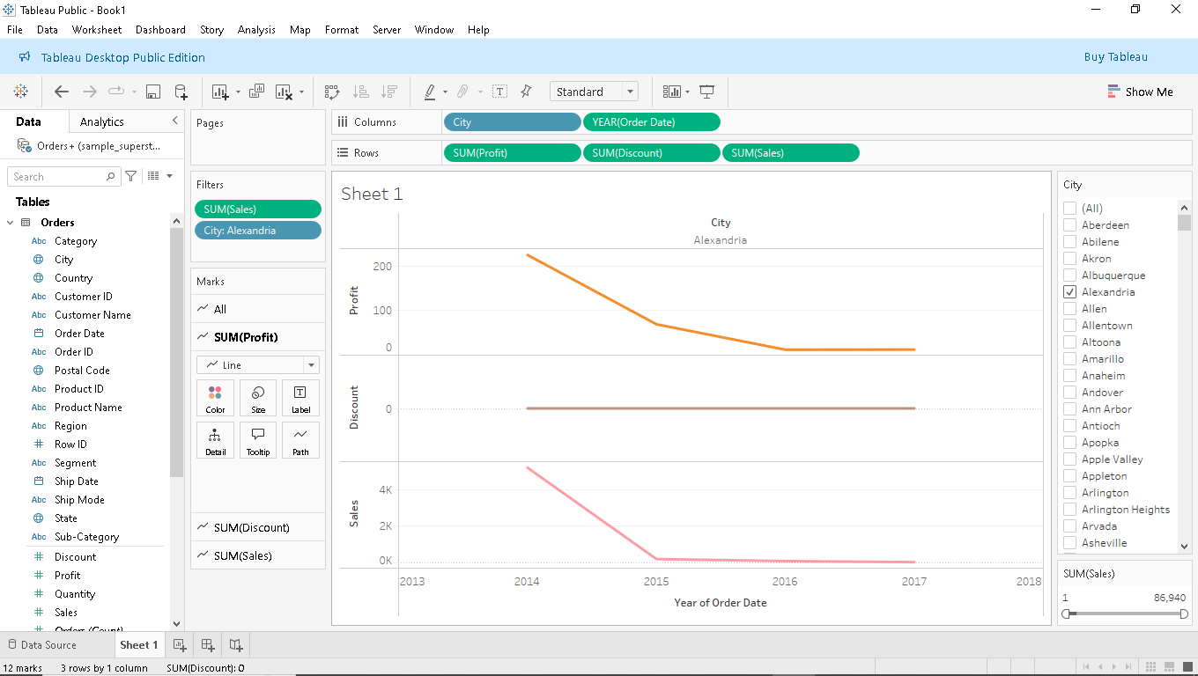

Slide 3
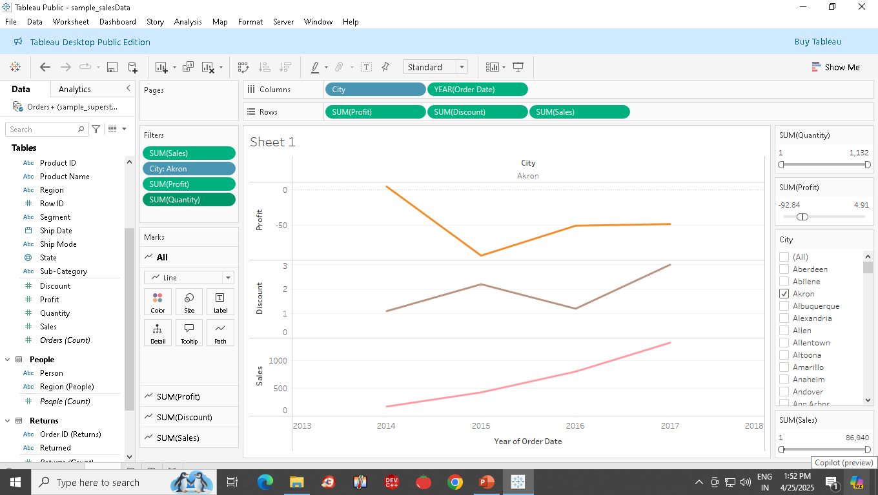

Slide 4
Published in Tableau public:
https://public.tableau.com/app/profile/sudhakar.s5439/viz/sample_salesData/Sheet1?publish=yes

