Slide 1
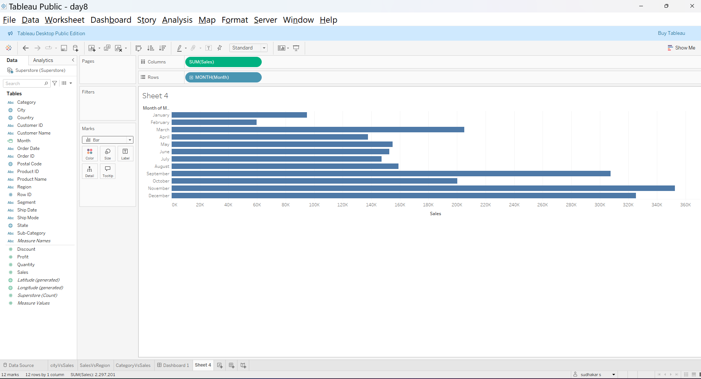
Month Vs Sales:
https://public.tableau.com/app/profile/sudhakar.s5439/viz/day8_17462601436250/MonthVsSales?publish=yes

Slide 2
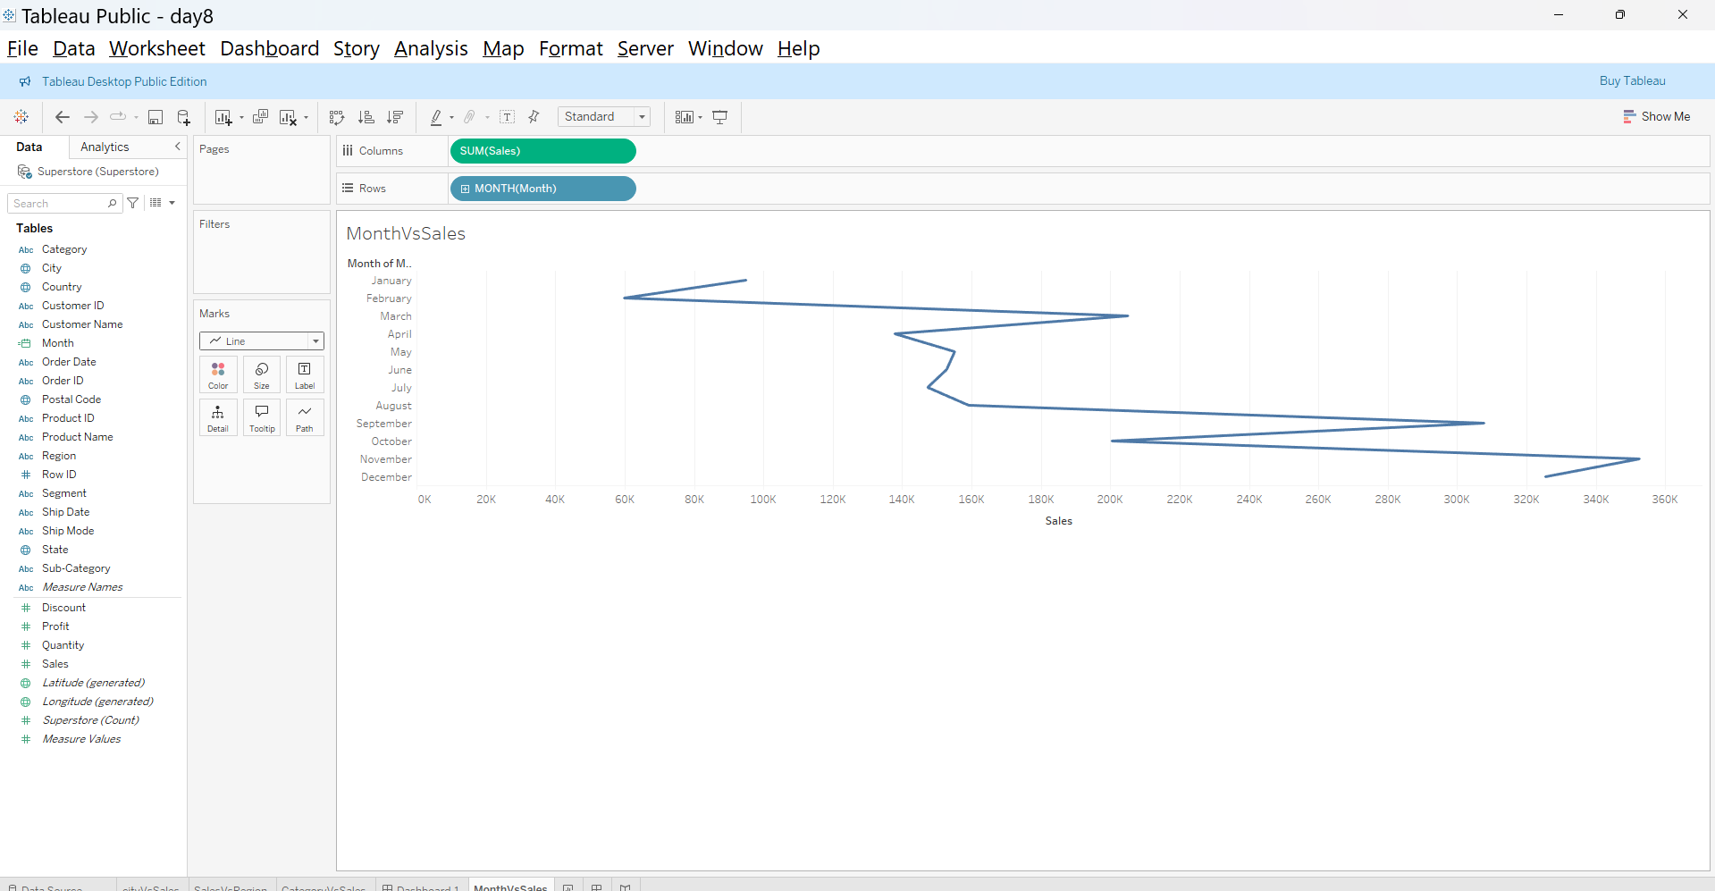
Month Vs Sales:
https://public.tableau.com/app/profile/sudhakar.s5439/viz/day8_17462601436250/MonthVsSales?publish=yes

Slide 3
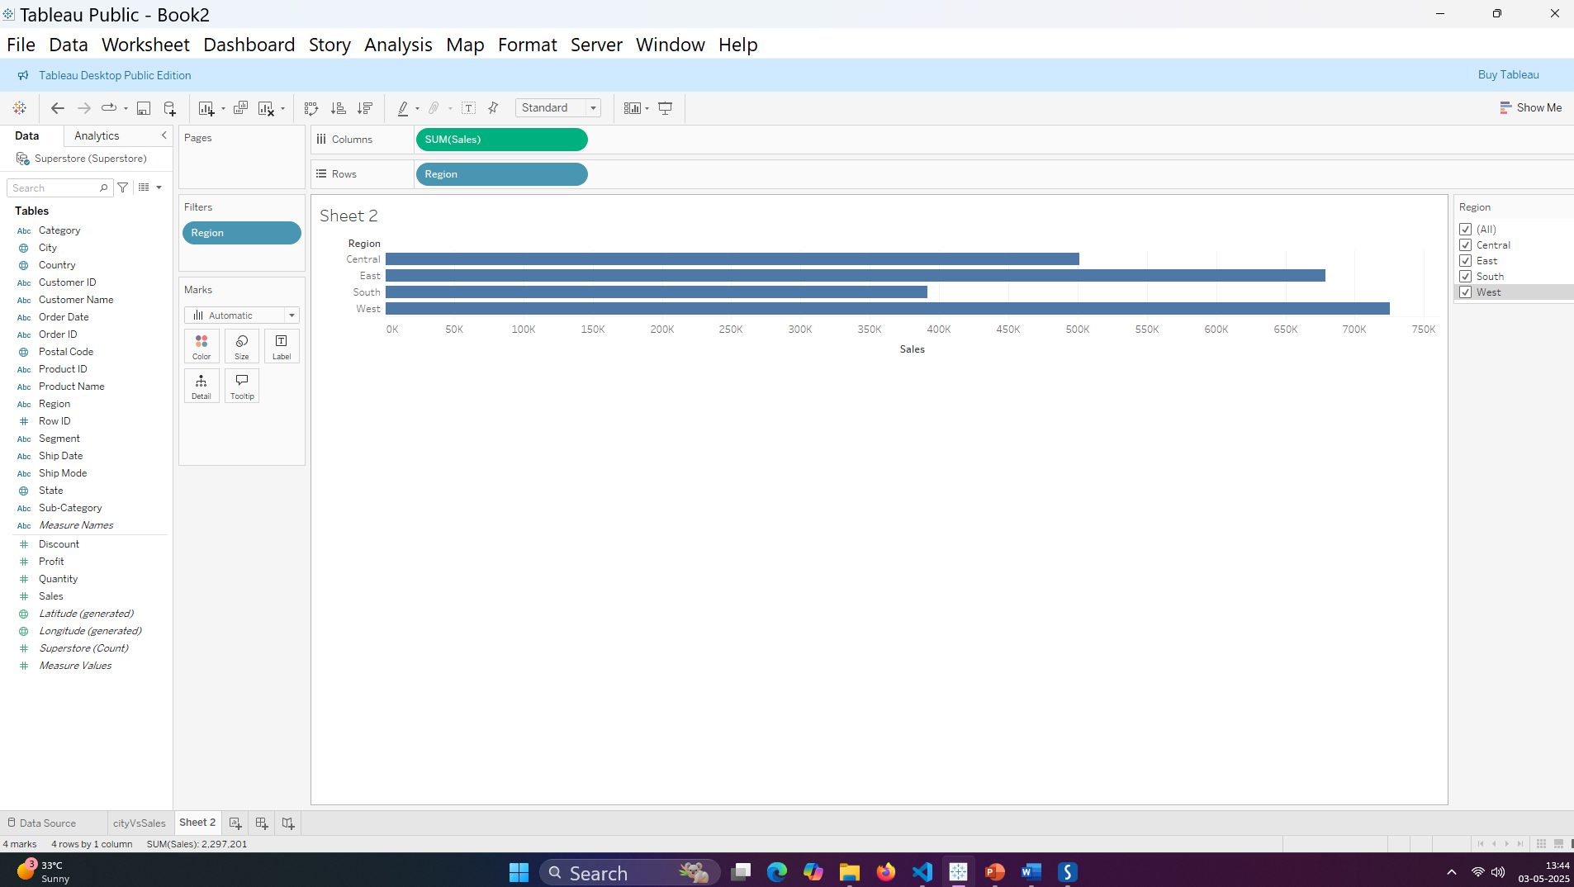
RegionVs Sales:
https://public.tableau.com/app/profile/sudhakar.s5439/viz/day8_17462601436250/SalesVsRegion?publish=yes

Slide 4
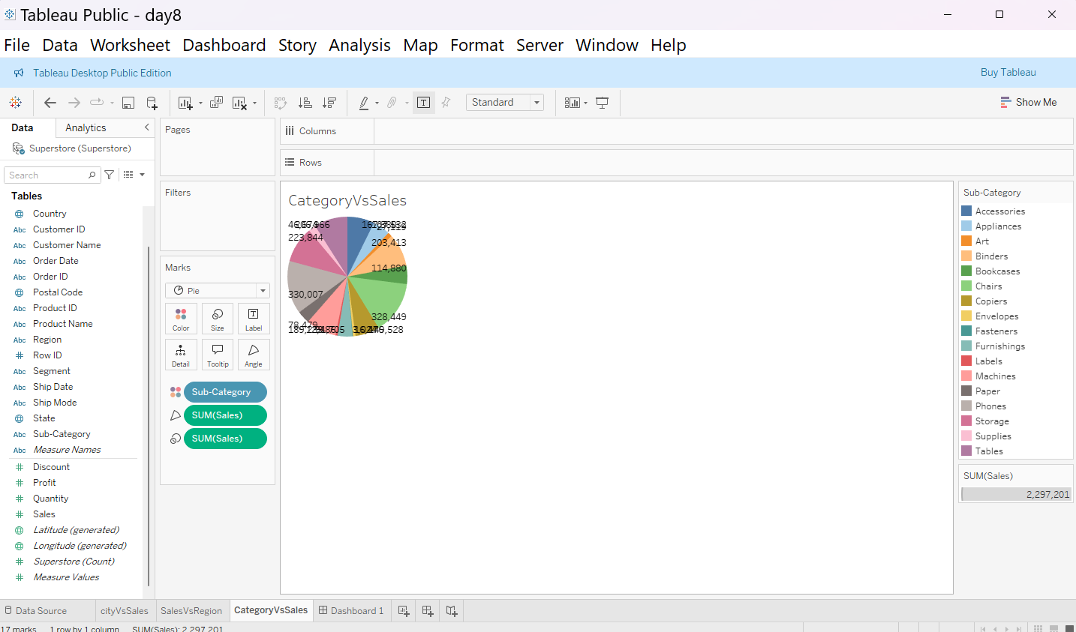
Category Vs Sales:
https://public.tableau.com/app/profile/sudhakar.s5439/viz/day8_17462601436250/CategoryVsSales?publish=yes
Donut is not available in tableau public

Slide 5
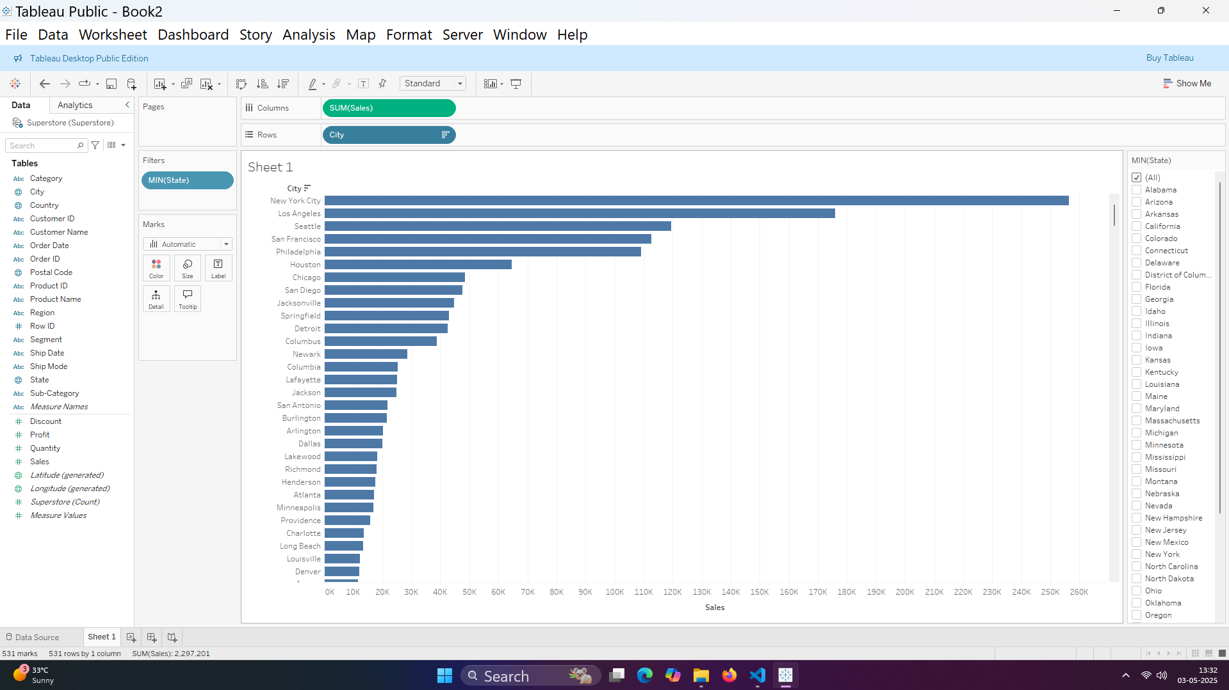
City Vs Sales:
https://public.tableau.com/app/profile/sudhakar.s5439/viz/day8_17462601436250/cityVsSales?publish=yes

Slide 6
Procedure:
Data Cleaning or checking using python:
Loading required libraries
Loading data in .csv to a data frame using pandas
Finding null values/ missing values and replacing
if exists.
Doing data analysis using python.
Data presentation using Tableau:
The following charts were prepared.
Month Vs Sales (Line and Bar charts)
Region Vs Sales (Bar chart)
Category Vs Sales (Pie Chart since Donut chart is not in Tableau Public)
City Vs Sales (Bar Chart).

Slide 7
Summary:
No null values were observed in data source (Confirmed with python).
Using Tableau:
November month has maximum sales of 352,461 (Month Vs Sales)
West region has highest sales of 725,458 (Region Vs Sales)
Phones were sold maximum 330,007 compared to any category (Category Vs Sales)
New York City sales were maximum 256368 (City Vs Sales)

