Slide 1
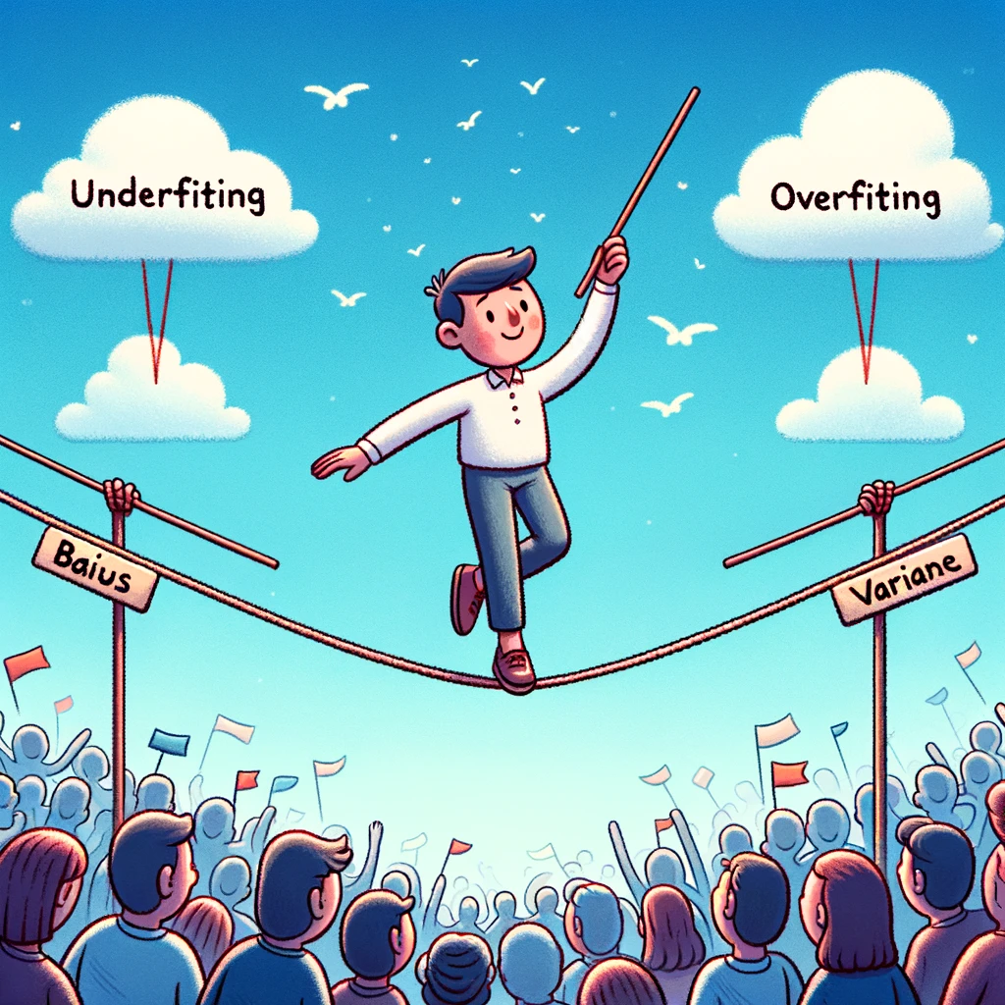
kokchun giang
the art of finding a model not too complex to overfit and not too simple to underfit

Slide 2
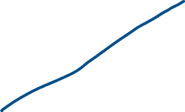

how to fit this data?
Notes:
TODO: draw 2nd degree with data and a line to illustrate underfitting
Non linear relationship
Show line fit -> underfit as the model is too simple to capture the datas variance
Wrong predictions

Slide 3

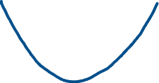
feature engineering for polynomial regression
Notes:
TODO: draw 2nd degree with data and a line to illustrate underfitting
Non linear relationship
Show line fit -> underfit as the model is too simple to capture the datas variance
Wrong predictions

Slide 4


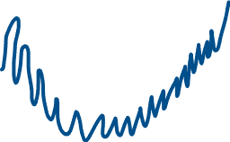
what if we make a very complex model?
Notes:
Bias variance tradeoff
Too high → high variance → model too complex
Too low → low variance → model too simple

Slide 5


need to find a balance – bias-variance tradeoff
Notes:
Bias variance tradeoff
Too high → high variance → model too complex
Too low → low variance → model too simple

Slide 6


elbow plot

