Slide 1

kokchun giang
logistic regression to classify data

Slide 2


when we have labels we are dealing with supervised learning

Slide 3




categorical features require encoding

Slide 4
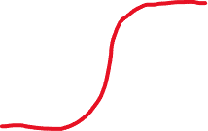

model categorical label with logistic regression

Slide 5

evaluate a classification model
Notes:
We say that it is spam when it actually is ham, then a real mail is going to the spambox. The model is too sensitive, which we don’t want, we are more okay with FN as a spam that goes into the mailbox is not good but more acceptable than a ham going into spambox.
Covid case: FN -> predicts not sick when actually sick, this means we’ll miss that patient. FP on the other hand means saying the patient is sick while not being sick, thus we can go on with more robust test with higher precision than the first screening test.

Slide 6







multinomial logistic regression for many classes

