Slide 1
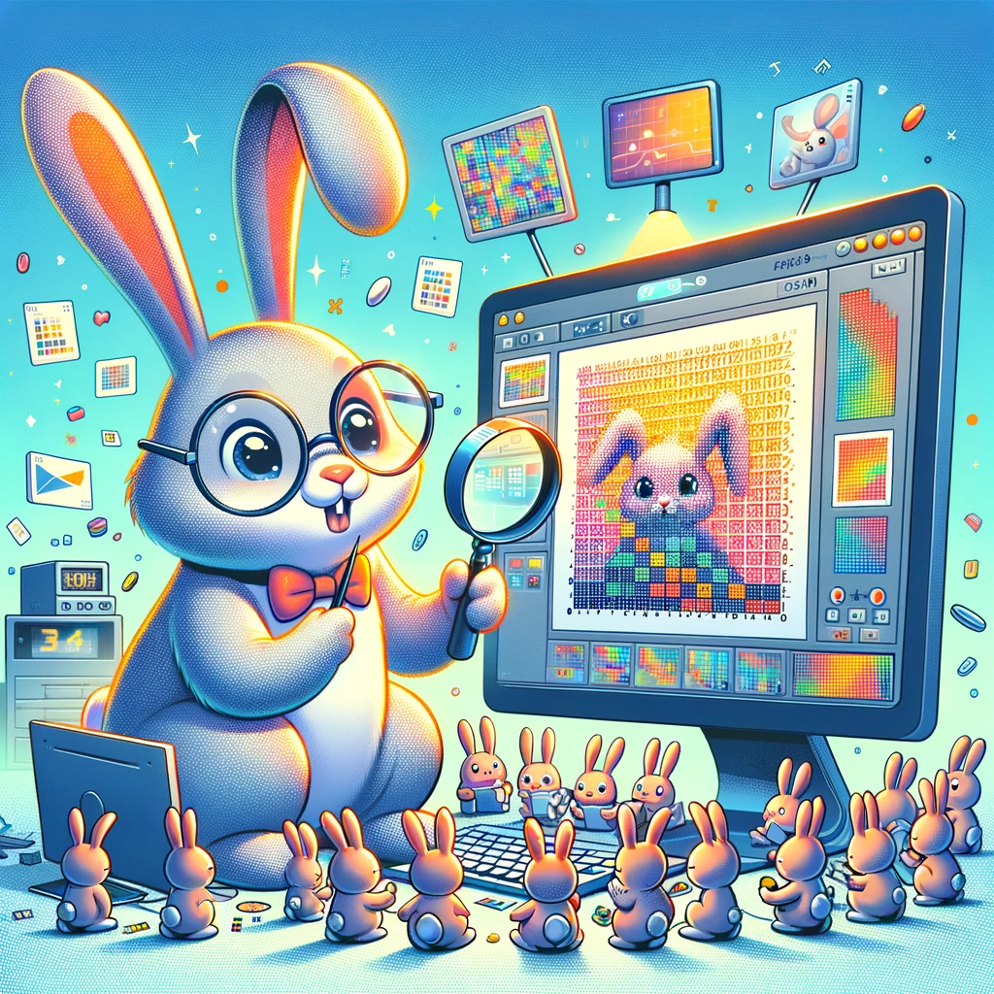
kokchun giang
images are simply matrices of numbers which we can process using linear algebra

Slide 2



images are matrices, pixels are elements

