Slide 1
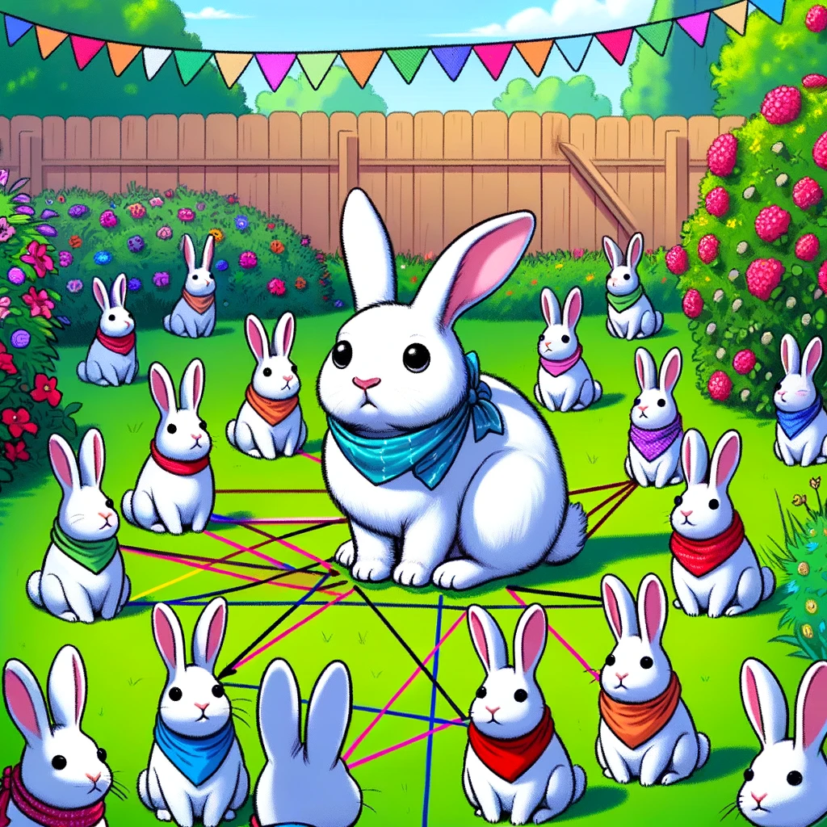
kokchun giang
leverage the distance to your neighbours for classification or regression using KNN

Slide 2


find closest distance to your k neighbours

Slide 3







there are several ways to measure distances

