Slide 1
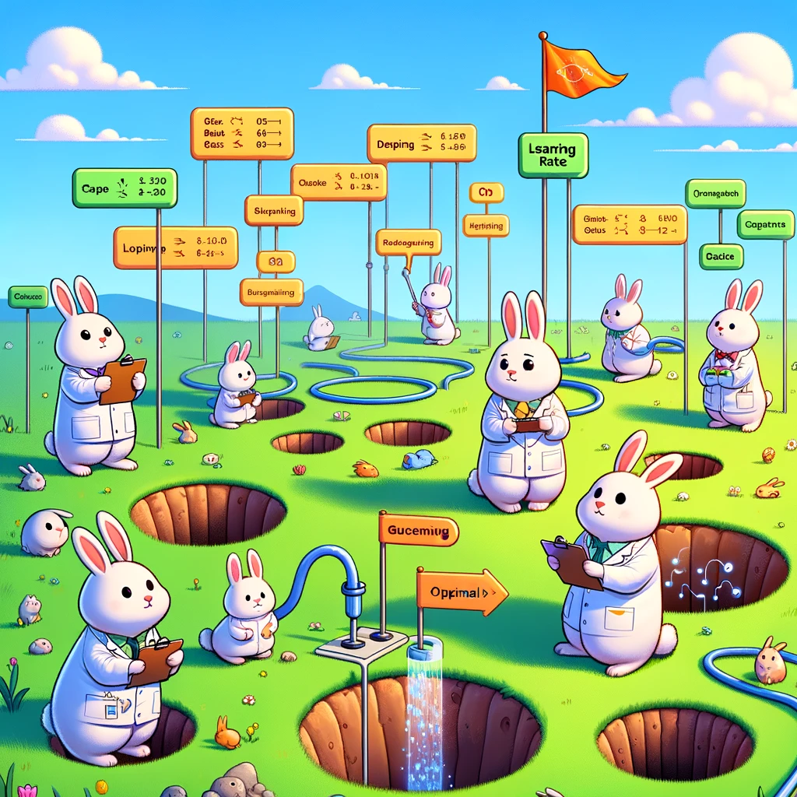
kokchun giang
searching for the right model with the right parameters require pipelines and gridsearch

Slide 2






which model to choose and what hyper parameters?

