Slide 1
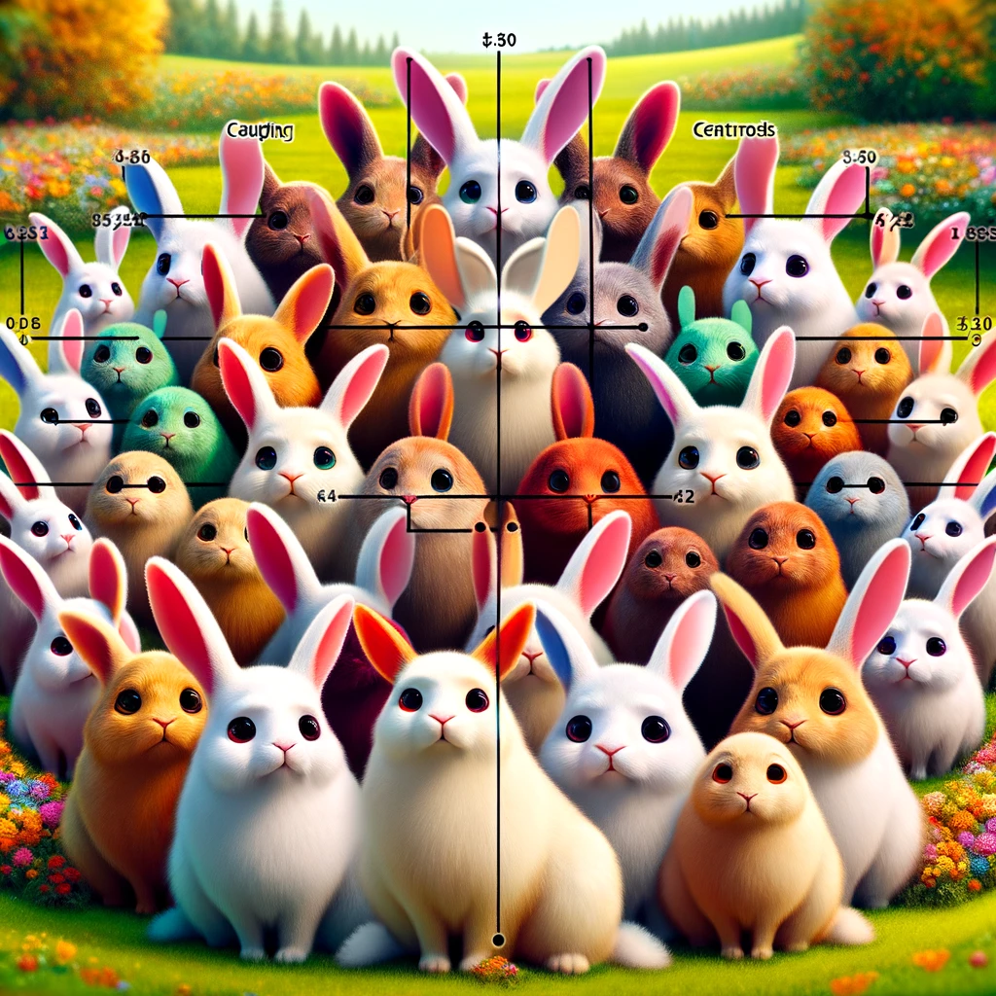
kokchun giang
in unsupervised learning you find groups of similar characteristics and cluster them together

Slide 2



when there is no label you can cluster the data points

Slide 3


choose k through elbow and silhouette

