Slide 1
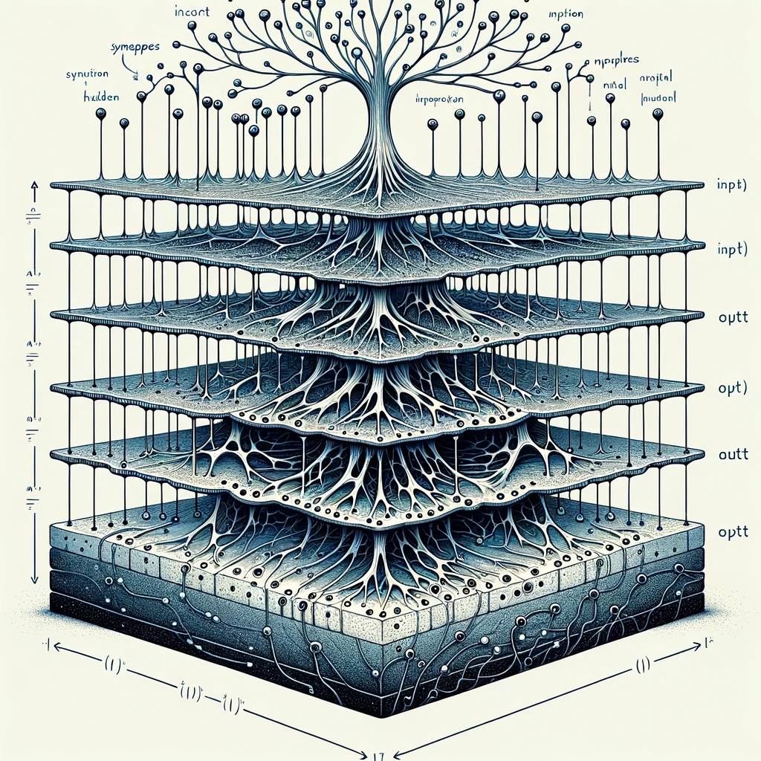
kokchun giang
artificial neural networks (ANN) mathematical models with inspiration from biological neurons

Slide 2


an inspiration from biological neuron

Slide 3












many neurons in a network of layers form a neural network

Slide 4



training the weights and biases

Slide 5


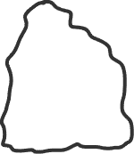
gradient descent and backpropagation

