Slide 1
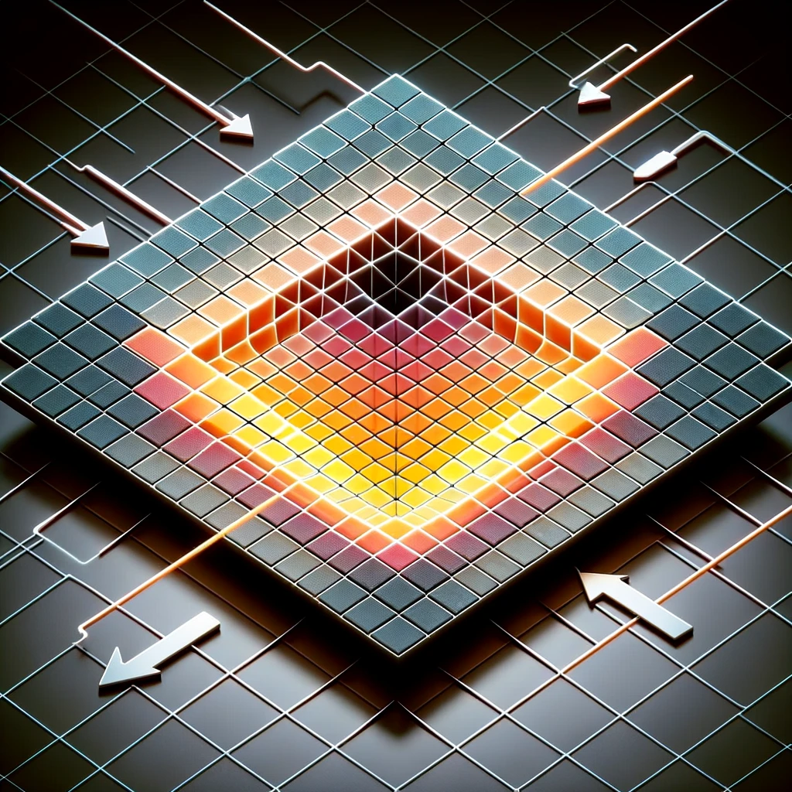
kokchun giang
image kernel – a building block for convolutional neural networks

Slide 2

convolution to extract feature maps

