Slide 1
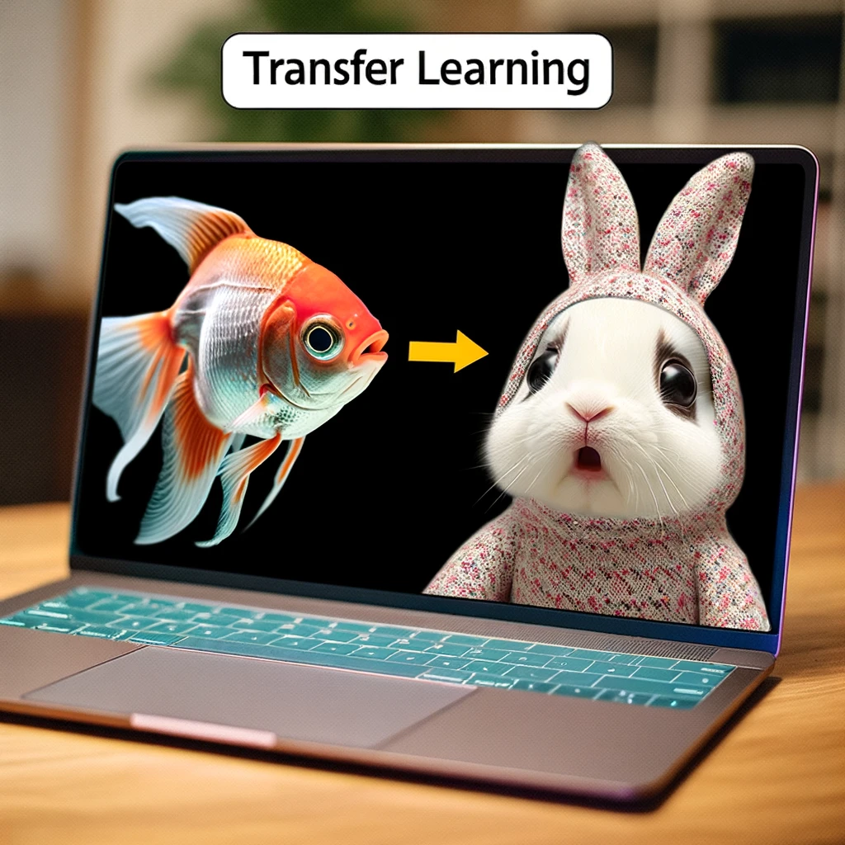
kokchun giang
transfer learning - don’t reinvent the wheel, instead reuse the heavylifting

Slide 2









use a pretrained network as feature extractor

Slide 3


fine tuning

