Slide 1





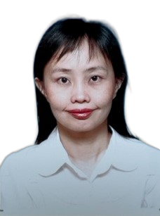
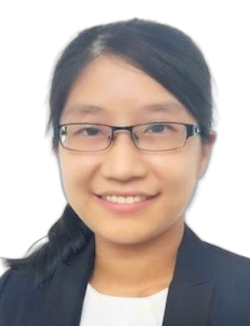
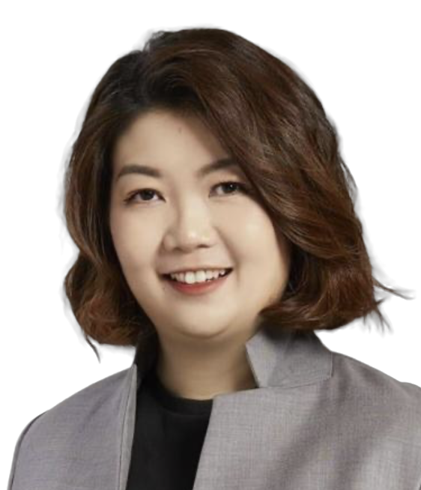
Proudly bought to you by:
Machine Intelligence Meets Neurotechnology:
From Decoding to Applications
MINDA 2026
Date: 15 May 2026 Friday Time: 1:00 PM – 6:00 PM
Venue: A3#618
Host(s): Sim Kuan GOH, XMUM Daniel Chan, Danmedik
This workshop features:
Inspiring Invited Talks
Interactive Live Demonstrations
Innovative Project Showcases & Sessions
Hands-on EEG Processing Workshops
Invited Speakers
Prof Dr Tan Hui Jan
Universiti Kebangsaan Malaysia
Assoc. Prof. Dr. Fong Si Lei
Universiti Malaya
Dr. Shiw Shin Yeen
BrainScience Academy
Register Now https://docs.google.com/forms/d/e/1FAIpQLSeSZCDYlkBxwhbRiQBZKWiVlq2EUKAIZ4homF27DIyxyIGBIw/viewform

