Slide 1

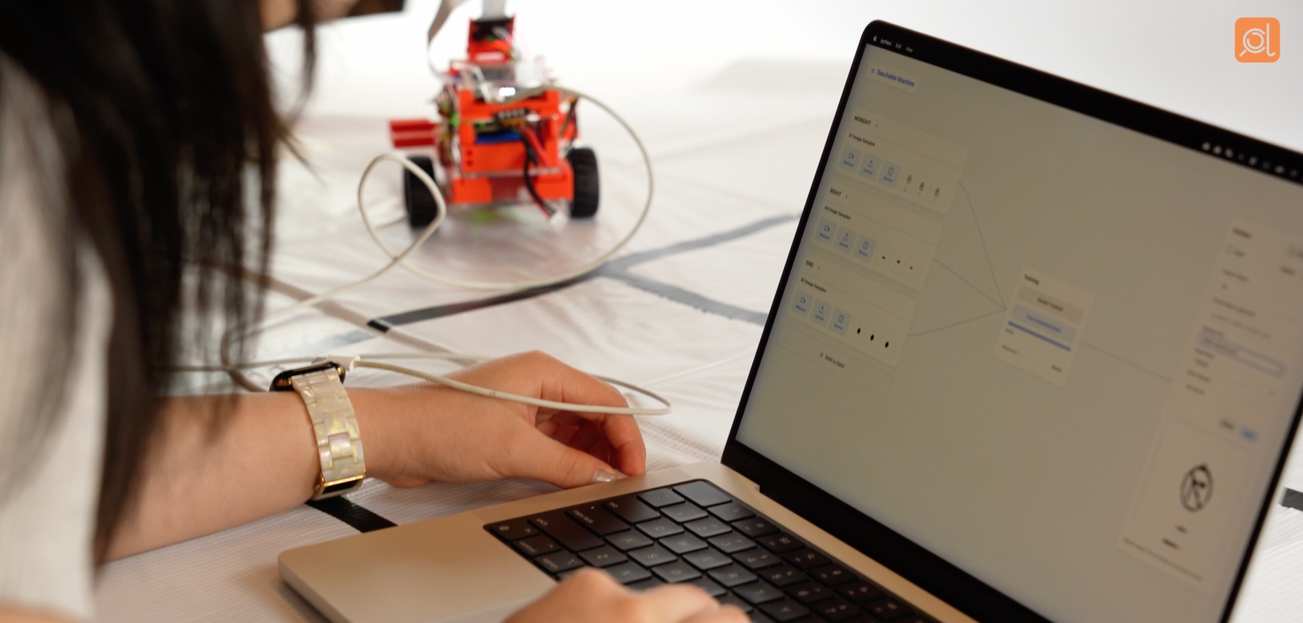
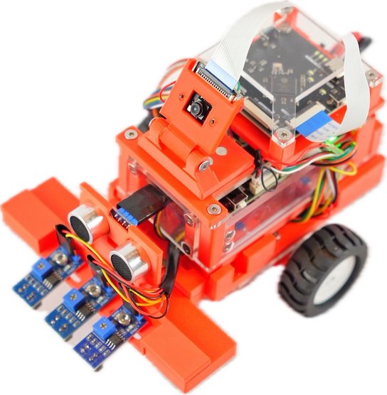
AI LITERACY WORKSHOPBY
Intro to Physical AI
with Edge AI Vision Demo Project
PRESENTED BY AIOSCOUT
AIOSCOUT · EDGE AI VISION WORKSHOP
Notes:
1

Slide 2
1 · INTRO LECTURE
Agenda
01
02
03
04
1 · Intro lecture
2 · Lab tutorial
3 · Hands-on lab
4 · Demo & sharing
~15 min
~15 min
~60 min
~30 min
  Intro to physical AI components
  Model training terms explanation
  Brief intro to physical AI ethics
Introduce to our training platform and watch the instructor train a road-sign recognizer live.
In teams of 3: build own digit recognizer (0–9) and run it on the car.
Each team demos their model, shows their score, shares one lesson.
2
AIOSCOUT · EDGE AI VISION WORKSHOP
Notes:
2

Slide 3
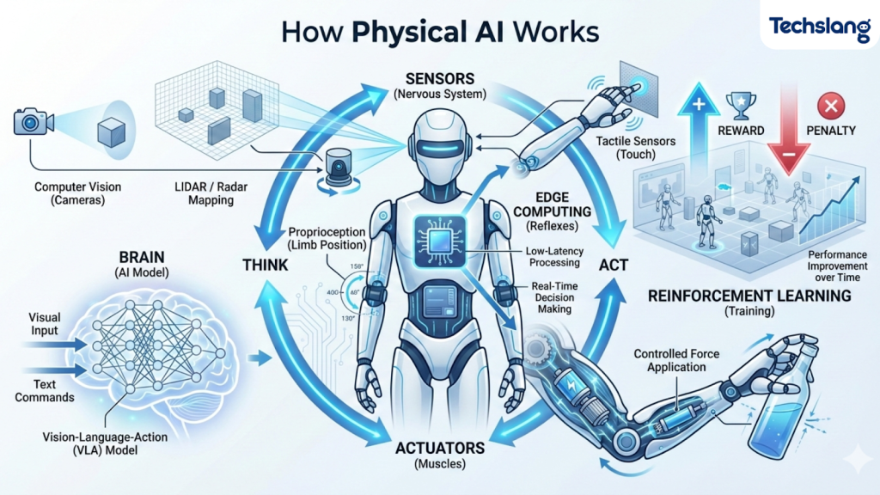
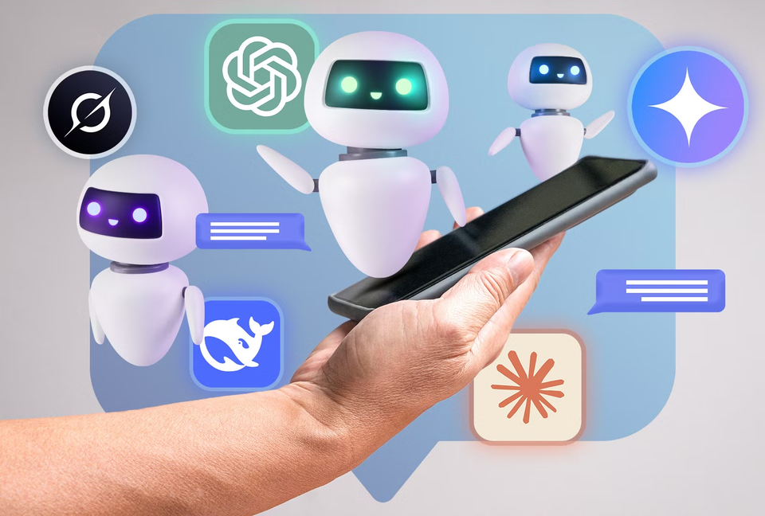
1 · INTRO LECTURE
What is Physical AI?
Chatbot AI is what you may already be familiar with, but Physical AI is very different, and have greater potential on doing much more different tasks
3
AIOSCOUT · EDGE AI VISION WORKSHOP
Notes:
2

Slide 4
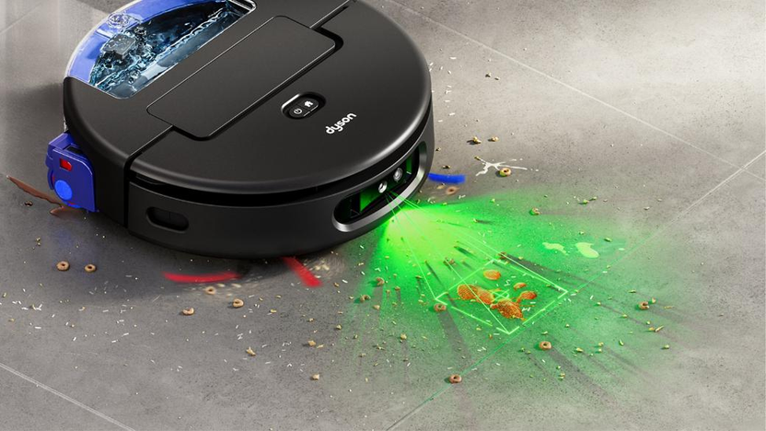
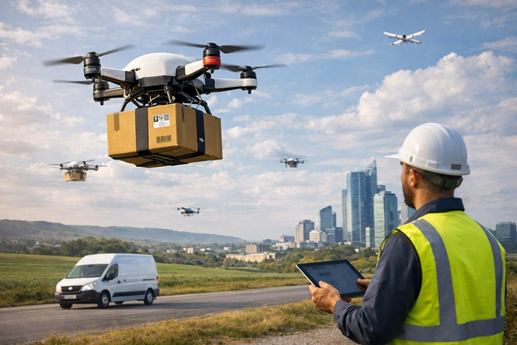
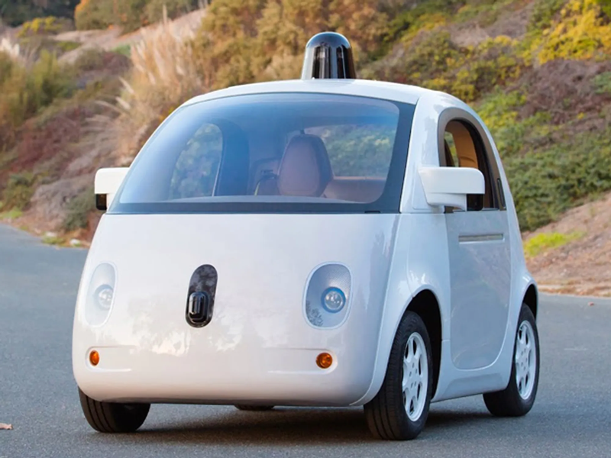
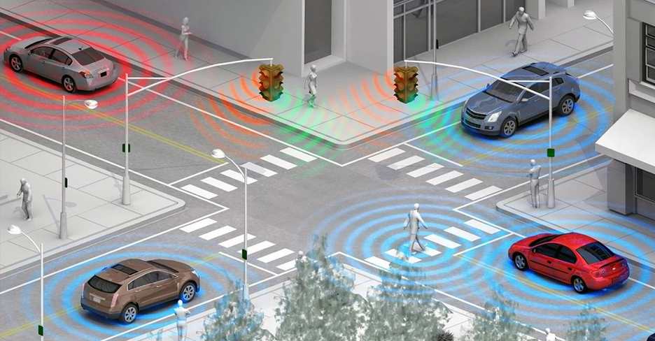
1 · INTRO LECTURE
You already meet Physical AI
Robot vacuum
feels walls, avoids stairs, goes home to charge
Delivery drone
finds the landing spot with its camera
Self-driving car
reads lanes, signs, and people — like ours, but giant
Smart traffic light
watches the road and changes its own timing
Let’s now look at some import parts of Physical AI
4
AIOSCOUT · EDGE AI VISION WORKSHOP
Notes:
5

Slide 5
1 · INTRO LECTURE
What is Physical AI?
Could you name any familiar components?
5
AIOSCOUT · EDGE AI VISION WORKSHOP
Notes:
2

Slide 6
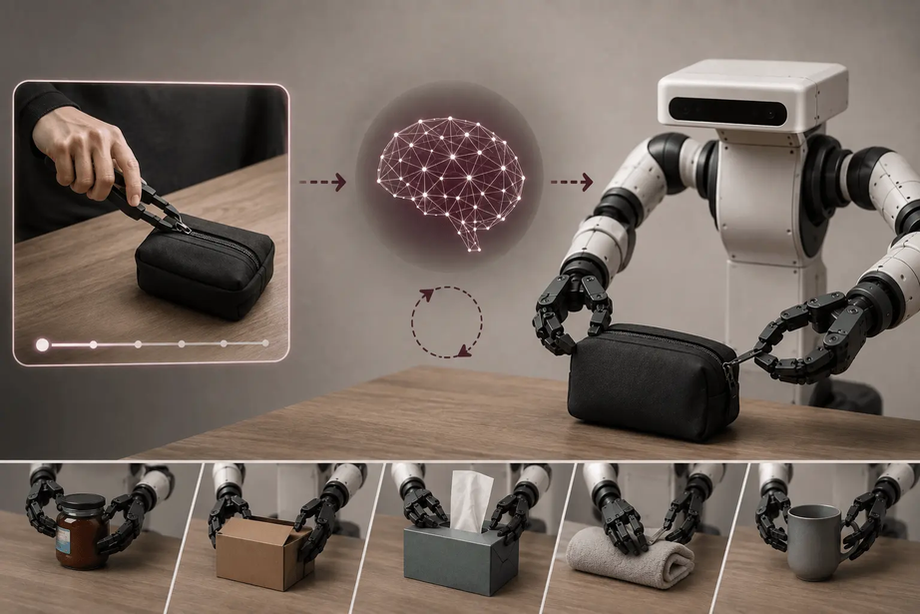
1 · INTRO LECTURE
AI Model
≈ the brain
  A program that has learned (trained) from examples
  It looks at what the sensors see and decides what to do next
6
AIOSCOUT · EDGE AI VISION WORKSHOP
Notes:
2

Slide 7
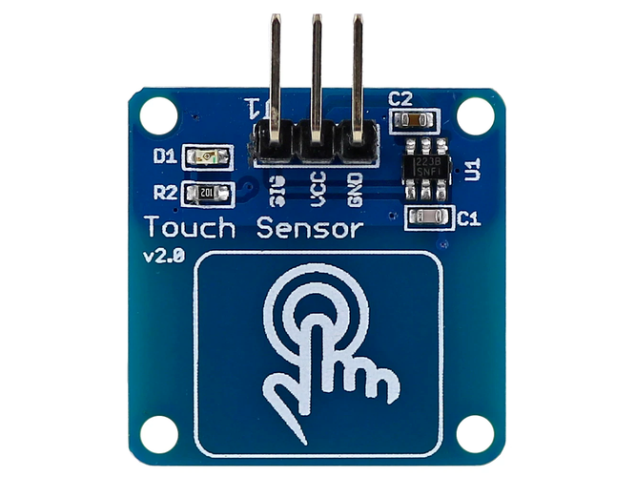
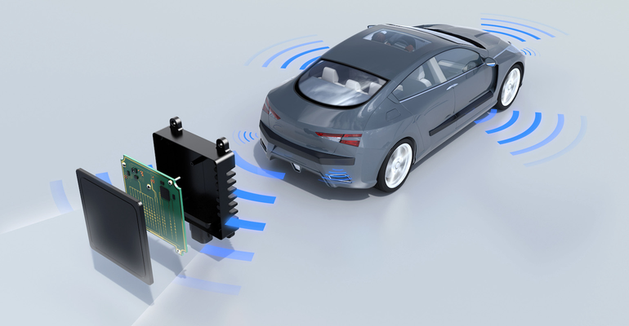
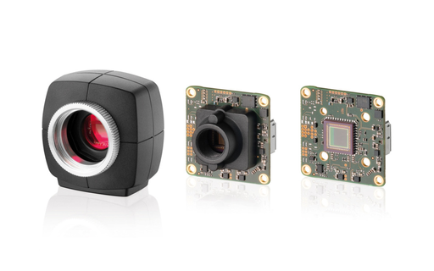
1 · INTRO LECTURE
Sensors - nervous systems
e.g. hands / eyes / nose
Devices that measure the real world,
for example:
  Cameras see
  Touch sensors feel
  Radar measures distance
7
AIOSCOUT · EDGE AI VISION WORKSHOP
Notes:
2

Slide 8
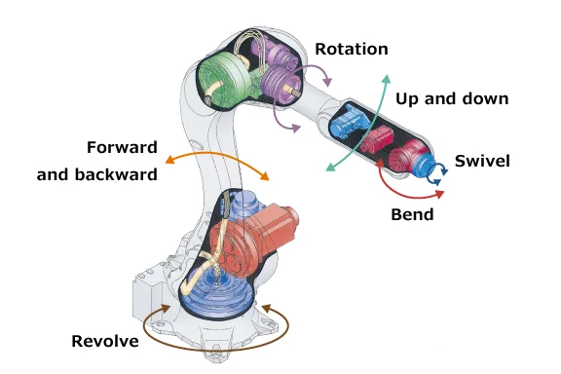
1 · INTRO LECTURE
Actuators
≈ Muscles
  Parts that move the body, for example motors spin wheels, joints move arms.
  They turn the AI's decision into action.
8
AIOSCOUT · EDGE AI VISION WORKSHOP
Notes:
2

Slide 9
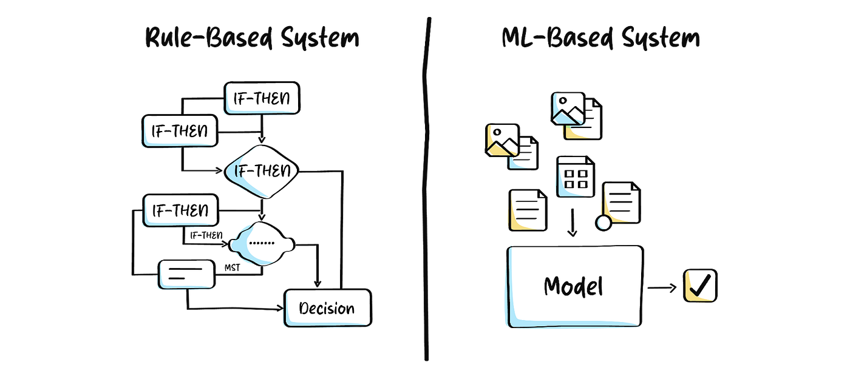
1 · INTRO LECTURE
How is the model trained?
9
AIOSCOUT · EDGE AI VISION WORKSHOP
Notes:
6

Slide 10
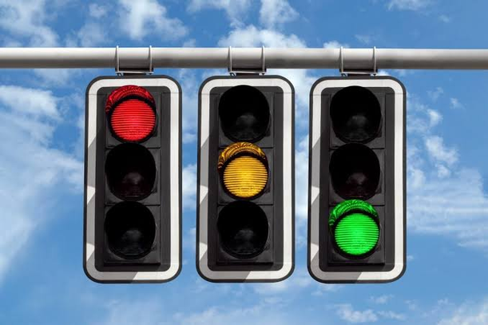
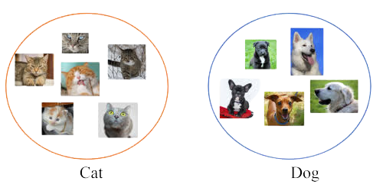
1 · INTRO LECTURE
How is the model trained?
WAY 1 · RULE-BASED
WAY 2 · MACHINE LEARNING
A human writes every rule
Show it examples with answers
“Red stop and Green go for traffic lights”
Works for simple, fixed jobs.
How to tell apart cat and dog pictures, or other any animals or objects?
Can’t write rules for all possible images.
10
AIOSCOUT · EDGE AI VISION WORKSHOP
Notes:
6

Slide 11
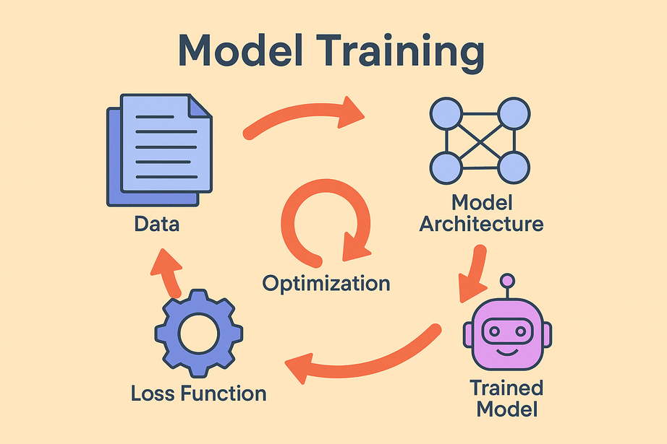
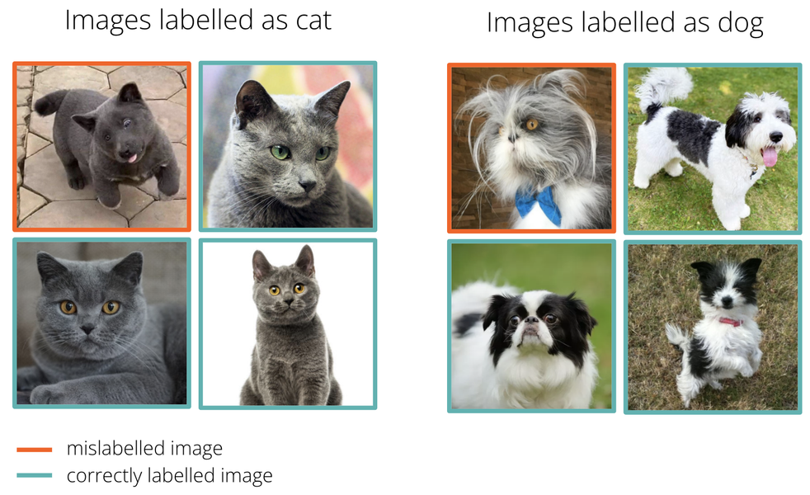
1 · INTRO LECTURE
Model Training Process
  Showing the AI many labelled examples - Data
e.g. one photo + its correct answer
Remember — no rules written, AI learns through data
The smart brain after learning is called the Trained Model
  The AI guesses → checks the answer → adjusts itself a little
  Repeat hundreds of times → guesses get better
11
AIOSCOUT · EDGE AI VISION WORKSHOP
Notes:
7

Slide 12
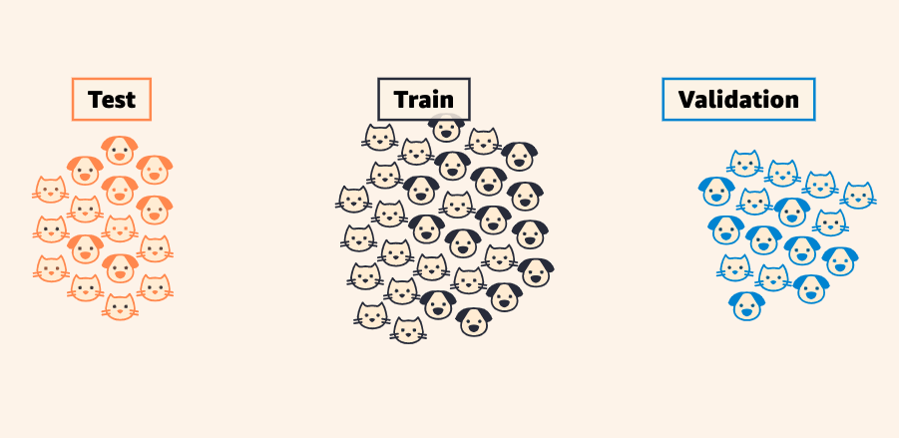
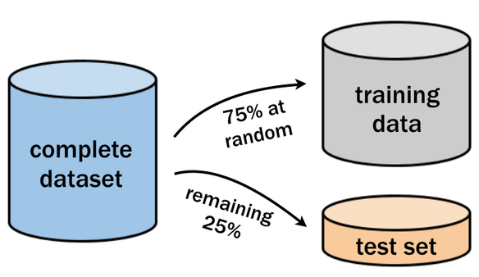
1 · INTRO LECTURE
Two datasets: training and test datasets
TRAINING DATA
Homework — with answers (correct label)
TESTING DATA
Exam — answers hidden (no label, just image)
Never test on your training photos, that is like grading yourself on questions you already memorized.
We usually use more training data (practice more) and less test data to verify the performace
12
AIOSCOUT · EDGE AI VISION WORKSHOP
Notes:
8

Slide 13
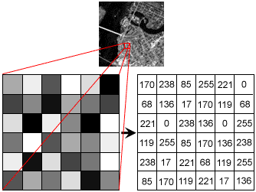
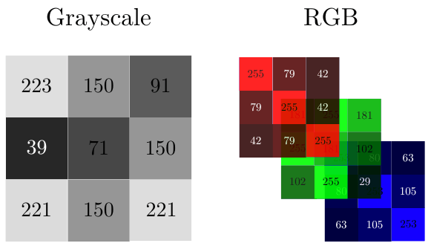
1 · INTRO LECTURE
Pixels into Digits
  A camera image is a grid of tiny squares — pixels
  Each pixel is one number: 0 = black, 255 = white, in between = different gray values
  Our model uses small 96×96 grayscale images — that is still 9,216 numbers
  Image recognition = finding patterns in those numbers
13
AIOSCOUT · EDGE AI VISION WORKSHOP
Notes:
9

Slide 14
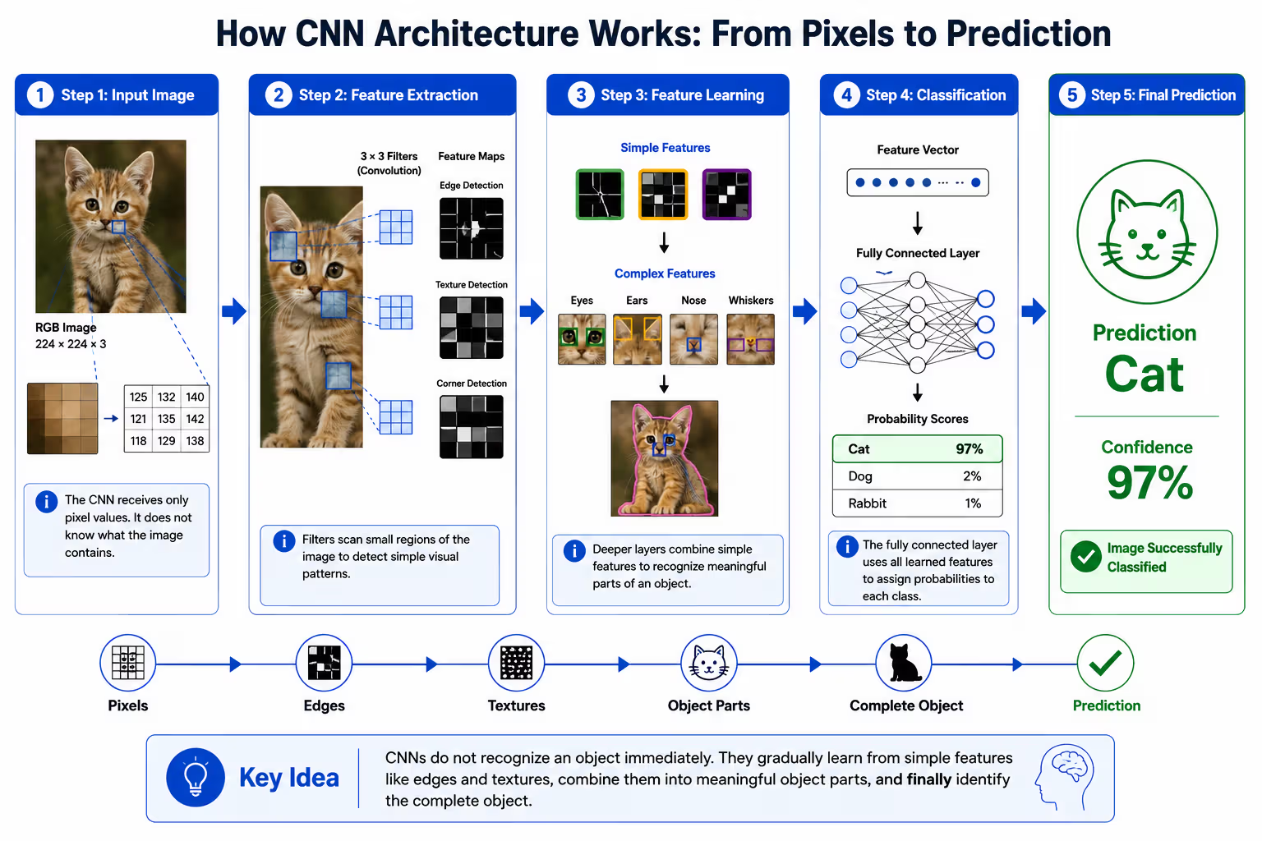
1 · INTRO LECTURE
CNN (Convolutional Neural Network)
14
AIOSCOUT · EDGE AI VISION WORKSHOP
Notes:
10

Slide 15
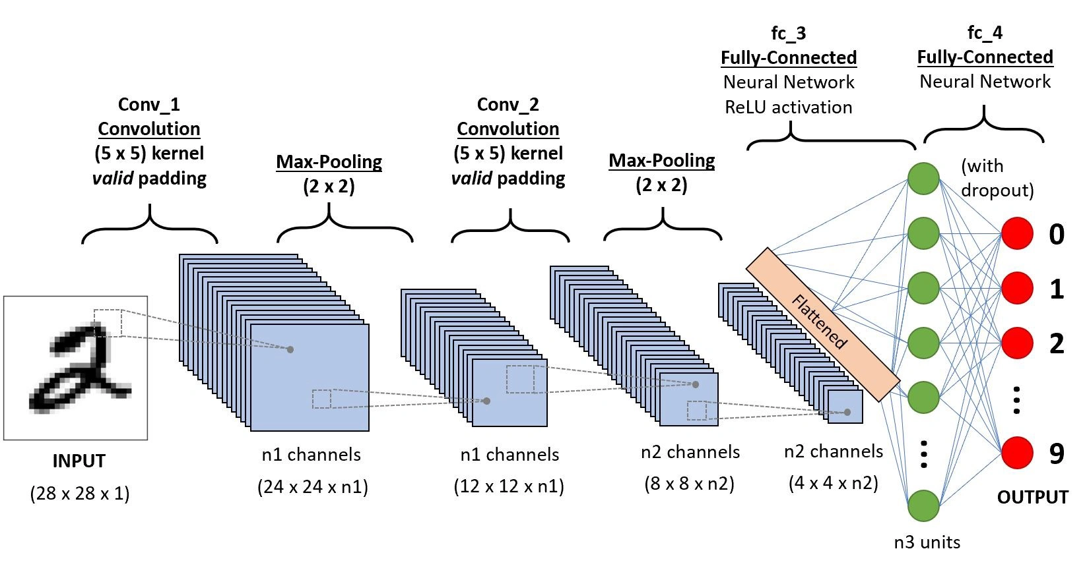
1 · INTRO LECTURE
CNN (Convolutional Neural Network)
15
AIOSCOUT · EDGE AI VISION WORKSHOP
Notes:
10

Slide 16
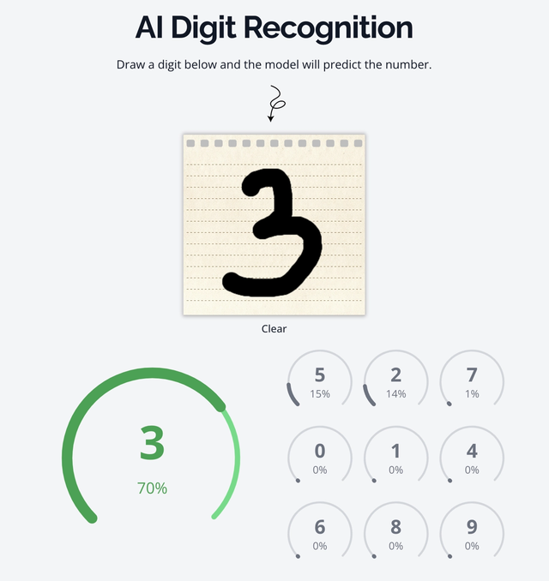
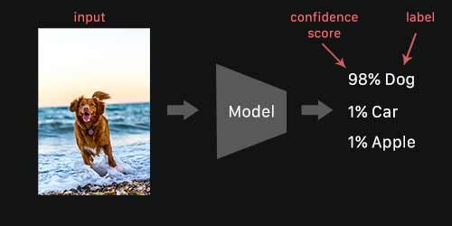
1 · INTRO LECTURE
Confidence
Or labels could be 1/2/3/4/5...9, numbers
how sure the model is, 0–100%
The CNN never outputs a plain yes or no. For every
class/label it gives a confidence score.
For example:
The labels could be: Dog / Car / Apple
Careful — high confidence does not guarantee correct. The model can be confidently wrong !
16
AIOSCOUT · EDGE AI VISION WORKSHOP
Notes:
11

Slide 17
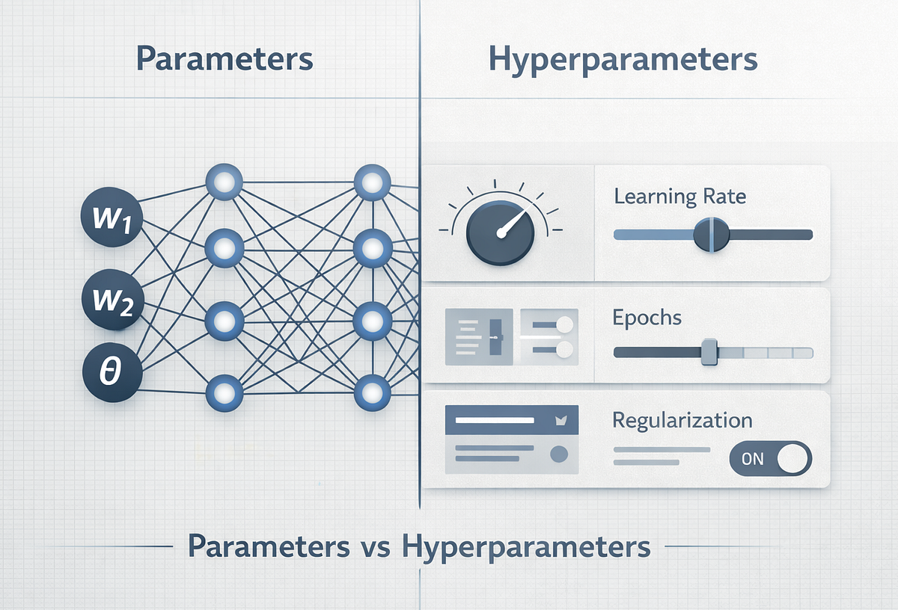
1 · INTRO LECTURE
Hyperparameters
PARAMETERS
HYPERPARAMETERS
Parameters are learned by the model, which you cannot change.
You choose the how it learns, the conditions: how long it studies, how fast it adjusts, etc.
17
AIOSCOUT · EDGE AI VISION WORKSHOP
Notes:
13

Slide 18

1 · INTRO LECTURE
Physical AI in the real world: the Tesla Cybercab
  No driver, no steering wheel — cameras + AI make every decision
  Promised as a cheap robotaxi for everyone
  Same core idea as our car: camera in → AI decides → wheels act.
Questions every engineer must answer:
  How safe is “safe enough” to drive without a driver?
  If it crashes — who is responsible?
  What happens to the jobs of drivers?
Tesla Cybercab | The Future is Autonomous
https://www.youtube.com/watch?v=Qfj4urMF8CU
Building Physical AI is not only an engineering question, but also a question of related to ethics.
18
AIOSCOUT · EDGE AI VISION WORKSHOP
Notes:
16

Slide 19
LAB TUTORIAL
Road-sign recognizer.
1 · COLLECT
2 · PREPROCESS
3 · TRAIN
4 · TEST LIVE
5 · EXPORT
6 · RUN ON CAR
Then you repeat the same steps with digits, in your lab time.
19
AIOSCOUT · EDGE AI VISION WORKSHOP
Notes:
20

Slide 20
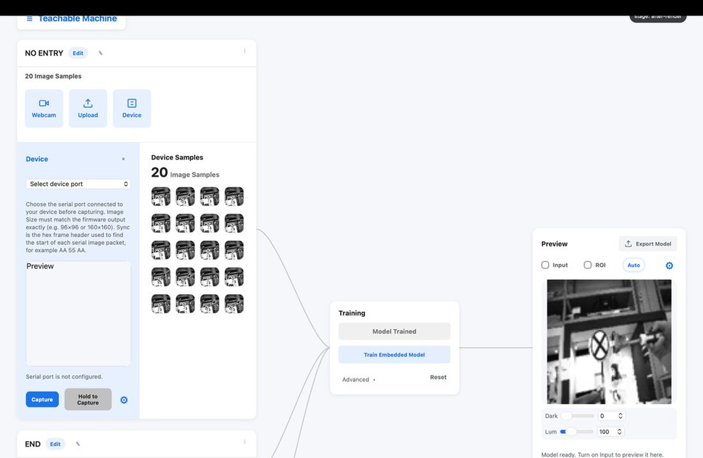
2 · LAB TUTORIAL · STEP 1 OF 5
Collect the photos
  Connect the car; in the app choose Device — photos come from the car’s camera
  Three classes: left arrow · right arrow · stop
  ~40 photos per class, counts equal
  Vary it while shooting: near / far, straight / tilted, different sides of the frame
CAPTURING FROM THE CAR’S CAMERA
20
AIOSCOUT · EDGE AI VISION WORKSHOP
Notes:
21

Slide 21
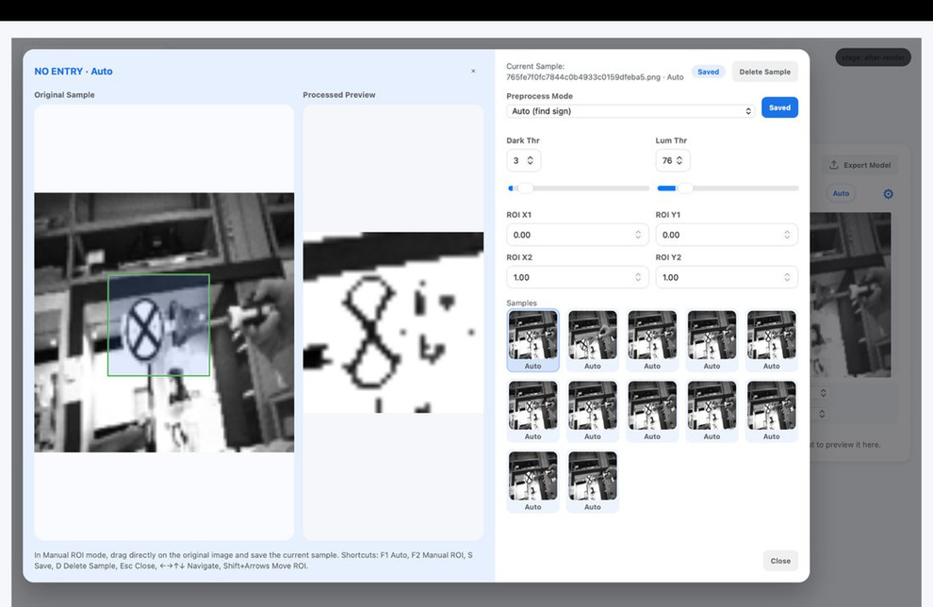
2 · LAB TUTORIAL · STEP 2 OF 5
Clean the photos
  Crop tight around the sign (the ROI box) — throw away the background
  Two thresholds clean the rest: too-dark pixels → white, too-bright pixels → white
  Target: black sign on white background
  Press S to save — every time
CROPPING AND THRESHOLDING
21
AIOSCOUT · EDGE AI VISION WORKSHOP
Notes:
22

Slide 22
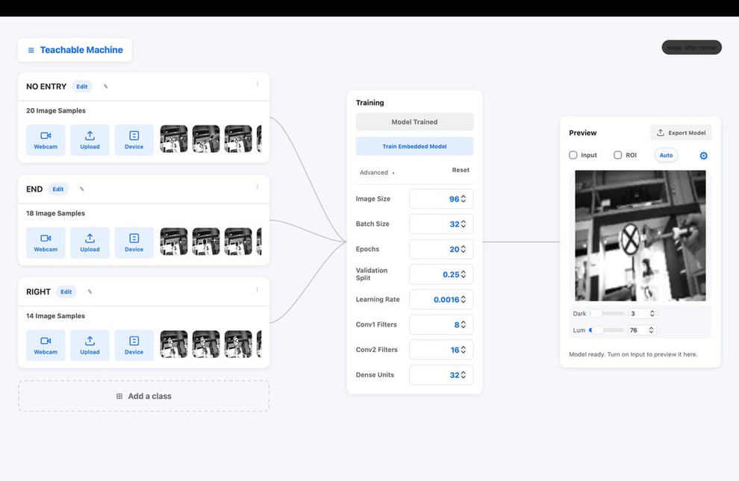
2 · LAB TUTORIAL · STEP 3 OF 5
Train
  Click “Use recommended” — the app fills in sensible settings
  Click “Train Embedded Model” and watch the accuracy climb
  Takes under a minute on this dataset
  If live results turn out poor later — the fix is usually more varied photos, not more training
THE TRAINING PANEL
22
AIOSCOUT · EDGE AI VISION WORKSHOP
Notes:
23

Slide 23
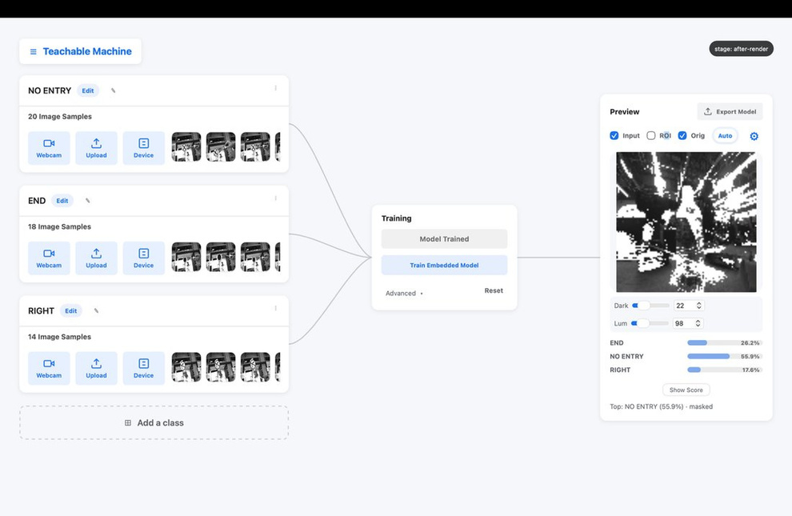
2 · LAB TUTORIAL · STEP 4 OF 5
Test it live
  Point at a sign — read the confidence bar
  Try a tilted sign, a far sign, a half-covered sign
  Show an empty scene: the model answers “No Sign” — the OOD gate says “no target here”, instead of guessing
LIVE CONFIDENCE + “NO SIGN”
23
AIOSCOUT · EDGE AI VISION WORKSHOP
Notes:
24

Slide 24
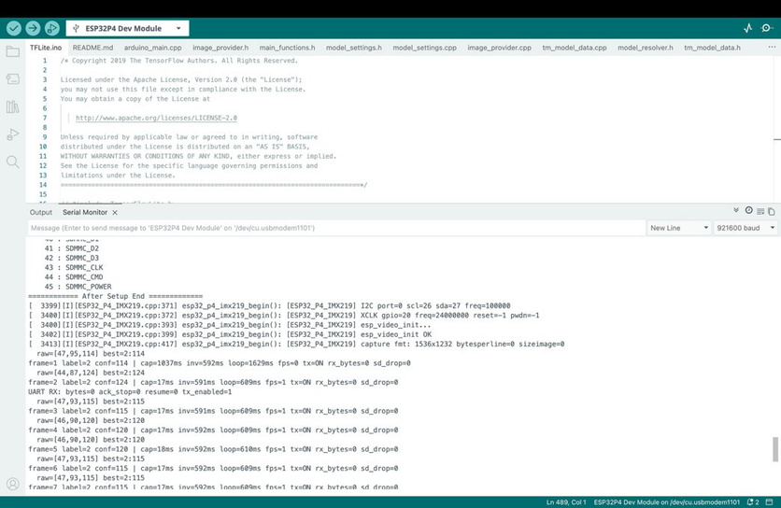
2 · LAB TUTORIAL · STEP 5 OF 5
Put it on the car
  Export → five small files
  Copy them into the project, check IMG_SIZE = 96
  Upload — the car now recognizes signs by itself
  Serial commands can adjust things later (get ood shows the settings)
THE MODEL RUNNING ON THE CAR
24
AIOSCOUT · EDGE AI VISION WORKSHOP
Notes:
25

Slide 25
2 · LAB TUTORIAL
Your task: a digit recognizer
Train a model that reads handwritten digits 0–9 on paper, and runs live on the car.
RULE 1
RULE 2
RULE 3
SHORTCUT
Trained today
Fair test
Pass mark
Short on time?
by your team, with photos you take here
10 unseen digits written by ANOTHER team
8 of 10 correct = project complete
start with digits 1, 2, 3, 7 — the most confusable ones
Full instructions: check the lab manual
25
AIOSCOUT · EDGE AI VISION WORKSHOP
Notes:
26

Slide 26
3 · HANDS-ON LAB · ~60 MINUTES
Build. Test. Ask.
Collect · 20 min
Preprocess · 10 min
Train · 5 min
Test · 10 min
Deploy · 10 min
Evaluate · 5 min
Stuck?
Better result?
Finished early?
The lab manual has a troubleshooting table — port busy, one-class collapse, upload errors.
You can always ask the TA for help at anytime
Train → test → fix the photos → retrain. Two or three loops are normal.
Extensions in the manual: fewer photos, bigger model, new handwriting.
26
AIOSCOUT · EDGE AI VISION WORKSHOP
Notes:
28

Slide 27
4 · DEMO & SHARING · ~30 MINUTES
Demo & sharing
Every team shows what they built — 1 minutes each.
SHOW
a live demo: your model reading digits on the car
SHOW
your scorecard: the 10 unseen digits and your result
TELL
one change you made, and what happened
ASK
what would you try with one more hour?
27
AIOSCOUT · EDGE AI VISION WORKSHOP
Notes:
29

Slide 28
AIOSCOUT WORKSHOP · PHYSICAL AI
Thank You
AIOSCOUT · EDGE AI VISION WORKSHOP
Notes:
1

Slide 29
AIOSCOUT WORKSHOP · PHYSICAL AI
Q&A
AIOSCOUT · EDGE AI VISION WORKSHOP
Notes:
1

