Slide 1
AIOSCOUT WORKSHOP · EDGE AI VISION
Image classification on a microcontroller.
This lesson trains an image classifier without programming and runs it live on the ESP32-P4, using road-sign recognition as the worked example. The project session that follows applies the same workflow to a digit recognizer (0–9).
45-MIN LESSON + 90-MIN PROJECT · ESP32-P4 · CNN · TENSORFLOW LITE MICRO
AIOSCOUT · EDGE AI VISION WORKSHOP
01 / 22

Slide 2
SESSION PLAN
Session structure
Time | Block | Content
45 min | Lesson (this deck) | Concepts of edge-AI image classification, followed by a live road-sign training demonstration
90 min | Project (lab manual) | Teams build a digit recognizer: collect, train, deploy, evaluate
10 min | Evaluation | Each team's model is evaluated on 10 unseen digits written by another team
PREREQUISITE — PRE-LAB MANUAL COMPLETED: SOFTWARE INSTALLED AND SELF-CHECK PASSED
AIOSCOUT · EDGE AI VISION WORKSHOP
02 / 22

Slide 3
WHY THIS MATTERS
Visual recognition on the playfield
DETECTION VS. DECISION
On the AIoScout playfield, the robot car encounters road signs: turn left, turn right, stop. A line follower can track a line — but interpreting what a sign says requires a different kind of program.
The central problem of this workshop: distinguishing a left arrow from a right arrow, reliably and in real time, on a processor with kilobytes of memory.
Sensors answer "how far"
Ultrasonic and IR sensors measure the world, but they cannot read symbols. Camera images carry more information — and are harder to interpret.
WHERE THE AI RUNS
On the car, not the cloud
No network and no round trip: the camera and the decision operate on one chip. This is edge AI.
AIOSCOUT · EDGE AI VISION WORKSHOP
03 / 22

Slide 4
CONCEPT 01
Rules vs. learning
CLASSIC PROGRAMMING
A conventional program follows rules written by a programmer. Rules for "this pixel pattern is a left arrow" must cover every distance, angle, lighting condition, and shadow — an impractical task by hand.
Machine learning inverts this arrangement: labeled examples — images with the correct answer attached — are provided, and the computer derives the rules itself. This process is training.
Output: a confidence per class — "sign: 92% · wall: 5% · floor: 3%".
Rules + data → answers
Sufficient for LEDs and motors; inadequate for variable real-world images.
MACHINE LEARNING
Data + answers → rules
The machine derives the rules; the collected data determines their quality.
AIOSCOUT · EDGE AI VISION WORKSHOP
04 / 22

Slide 5
CONCEPT 02
The training process
THE OUTPUT
The network is shown thousands of samples — small images, each labeled with its class
After every batch, the network adjusts its weights to reduce its errors
One full pass over the dataset is an epoch; training runs many epochs
A held-out portion of the data (the validation split) is used to evaluate the model on images not used in training
A confidence per class
left arrow 91% ███ top class
right arrow 7% ▌
wall 2% ▏
The car acts on the highest-scoring class; the goal is a clear margin between the top class and the rest.
Key idea — sample quality determines model quality, before any hyperparameter takes effect.
AIOSCOUT · EDGE AI VISION WORKSHOP
05 / 22

Slide 6
CONCEPT 03
Convolutional neural networks
WORKSHOP ARCHITECTURE
A Convolutional Neural Network is a stack of small feature detectors. Early layers detect edges and blobs; deeper layers combine them into shapes; the final layer converts shapes into class confidences.
input 96×96 grayscale
↓
Conv1 — 8 filters // edges, blobs
↓
Conv2 — 16 filters // shapes, strokes
↓
Dense — 32 units // decisions
↓
confidence per class // left / right / stop…
Filters are the detectors; more filters detect more patterns at the cost of a larger model
Dense units form the decision layer
Each of these values is a hyperparameter set in the application
Small by the standards of AI systems — the size a microcontroller can execute in real time.
AIOSCOUT · EDGE AI VISION WORKSHOP
06 / 22

Slide 7
CONCEPT 04
Edge AI: the runtime stack
THE TOOL
Quantization to int8 — 1 byte per number instead of 4: ~4× smaller and faster, negligible accuracy cost
TensorFlow Lite Micro — runtime for microcontrollers; the core fits in 16 KB, no OS needed
ESP32-P4 — dual-core SoC with camera support, programmed via Arduino IDE
The exported model is a C array compiled into the firmware; no network is involved at runtime.
TFLiteTraining app
The complete pipeline in one window — collect, preprocess, train, preview, export — and the same application used in the project.
THE PIPELINE
Six steps
Collect → Preprocess → Train → Preview → Export → Deploy. Every step of this workshop maps onto these six.
AIOSCOUT · EDGE AI VISION WORKSHOP
07 / 22

Slide 8
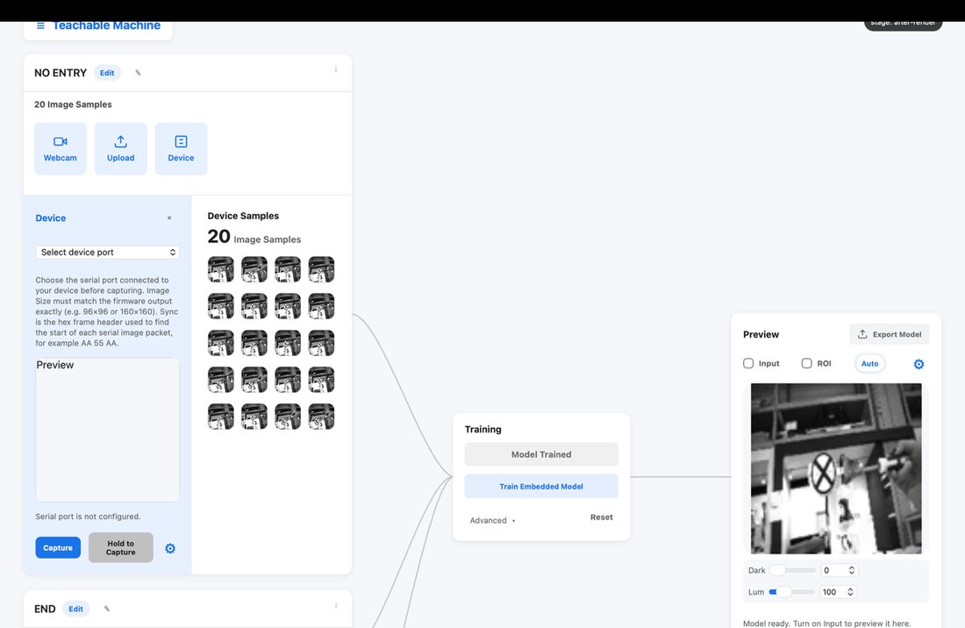
DATA PREPARATION 01
Collecting samples
One class per object to recognize — for example "left", "right", "stop"
30–50 samples per class, with counts approximately equal
Vary distance, angle, position in frame, and lighting while capturing
Capture from the same camera the model will use — the board's camera, not the laptop's
Delete blurry or accidental captures; they degrade the dataset
CAPTURE · HOLD-TO-CAPTURE · GEAR SETTINGS
AIOSCOUT · EDGE AI VISION WORKSHOP
08 / 22

Slide 9
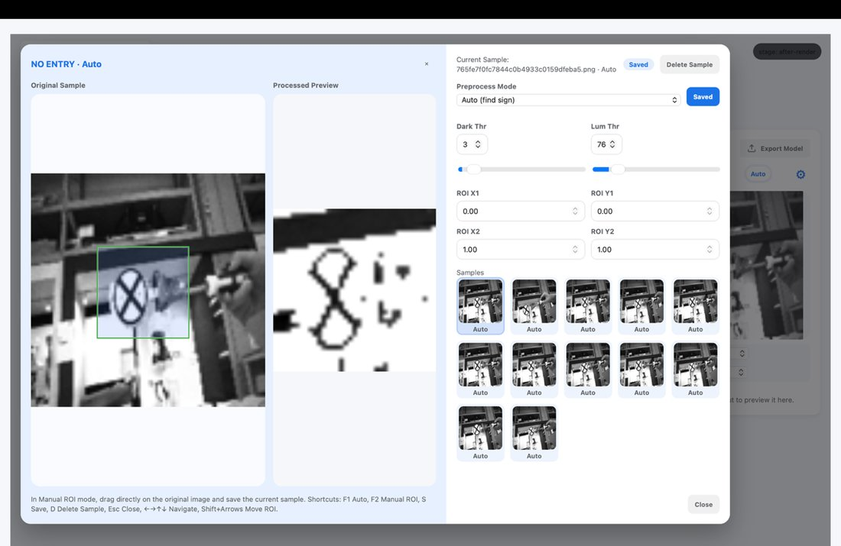
DATA PREPARATION 02
Preprocessing: cropping and thresholding
ROI — the crop box; only this region reaches the model
Dark Thr — darker pixels become pure white (removes shadows and background)
Lum Thr — brighter pixels become pure white (removes glare)
Auto mode crops the darkest region automatically; Manual ROI positions the crop box manually
Press S to save; unsaved preprocessing is discarded
EDIT PAGE · VIEWER + WORKTABLE
Rule of thumb — the sign appears black and the background white; everything else is noise.
AIOSCOUT · EDGE AI VISION WORKSHOP
09 / 22

Slide 10
DATA PREPARATION 03
Hyperparameters
Parameter | Default | Effect
Image size | 96 | Detail versus speed (96 / 160 / 384)
Batch size | 16 | Samples per update; larger values train faster and use more RAM
Epochs | 20 | Passes over the data; excessive values cause overfitting
Validation split | 0.25 | Fraction held out for validation
Learning rate | 0.001 | Step size; higher values converge faster but unstably
Conv1 / Conv2 filters | 8 / 16 | Feature detectors per layer
Dense units | 32 | Decision-layer neurons
START FROM DEFAULTS
Change one thing at a time
The defaults suit 96×96 grayscale input. In the project, the highest-leverage improvements come from the data, not from these values.
THE TRADE-OFF
Larger is not automatically better
More filters, units, or image size may add accuracy, but always at slower inference. On a microcontroller, inference speed is part of correctness.
AIOSCOUT · EDGE AI VISION WORKSHOP
10 / 22

Slide 11
CONCEPT 05
Overfitting and validation
HEALTHY
A model can score highly on every training image and still fail on the first new image it receives: it has memorized rather than learned — like a student who memorizes past papers but cannot answer a new question.
Training ≈ validation
Both scores track each other upward. The model generalizes.
Indicator: validation accuracy during training
Prevention: greater variety in samples (angles, lighting) and a moderate epoch count
Final test: images from outside the team — the method used in the project evaluation
OVERFIT
Validation stalls or drops
Training accuracy keeps rising while held-out performance falls. Stop training, collect more varied data, and retrain.
AIOSCOUT · EDGE AI VISION WORKSHOP
11 / 22

Slide 12
LIVE DEMONSTRATION · 15 MINUTES
Road-sign recognition, end to end.
1 · OPEN TEMPLATE
2 · CAPTURE SIGNS
3 · PREPROCESS
4 · TRAIN
5 · LIVE PREVIEW
6 · DEPLOY
The complete pipeline is demonstrated once; the project session repeats it with digits.
AIOSCOUT · EDGE AI VISION WORKSHOP
12 / 22

Slide 13
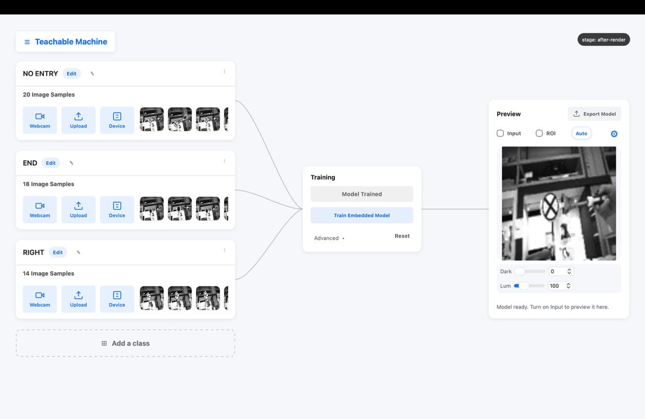
DEMONSTRATION 01
The workspace
Sample Area — collect and preprocess data
Train Area — hyperparameters and the Train button
Preview Area — live test against the camera
The demonstration opens template.tmproj — the same file the project starts from.
SAMPLE · TRAIN · PREVIEW
AIOSCOUT · EDGE AI VISION WORKSHOP
13 / 22

Slide 14
DEMONSTRATION 02
Capturing road-sign samples
Three classes: left arrow · right arrow · stop. Source set to Device — the board's own camera.
Gear settings stay at defaults: 96×96 · grayscale · 115200 · AA 55 AA
~40 samples per class, counts equal
The instructor varies angle and distance while capturing; reproduce this variation in the project
CAPTURE FROM THE BOARD'S CAMERA
AIOSCOUT · EDGE AI VISION WORKSHOP
14 / 22

Slide 15
DEMONSTRATION 03
Preprocessing the sign images
A Manual ROI boxed tightly around the sign
Dark Thr raised until the wall texture disappears
The arrow remains black and the background becomes white; verify several samples with the arrow keys
S to save, ESC to exit
Observation — this step takes two minutes and contributes more to accuracy than any hyperparameter change.
ROI + THRESHOLDS ON REAL SAMPLES
AIOSCOUT · EDGE AI VISION WORKSHOP
15 / 22

Slide 16
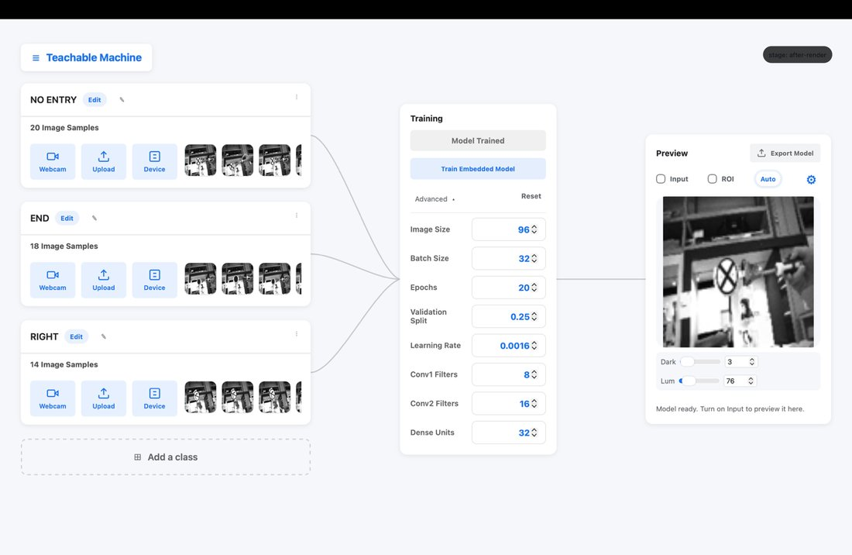
DEMONSTRATION 04
Training
Defaults everywhere: 96 · grayscale · batch 16 · 20 epochs · lr 0.001 · 8/16 filters · 32 dense
Click Train Embedded Model; on this dataset, training completes in under a minute
Observe the validation accuracy as it rises
ADVANCED PANEL → TRAIN EMBEDDED MODEL
AIOSCOUT · EDGE AI VISION WORKSHOP
16 / 22

Slide 17
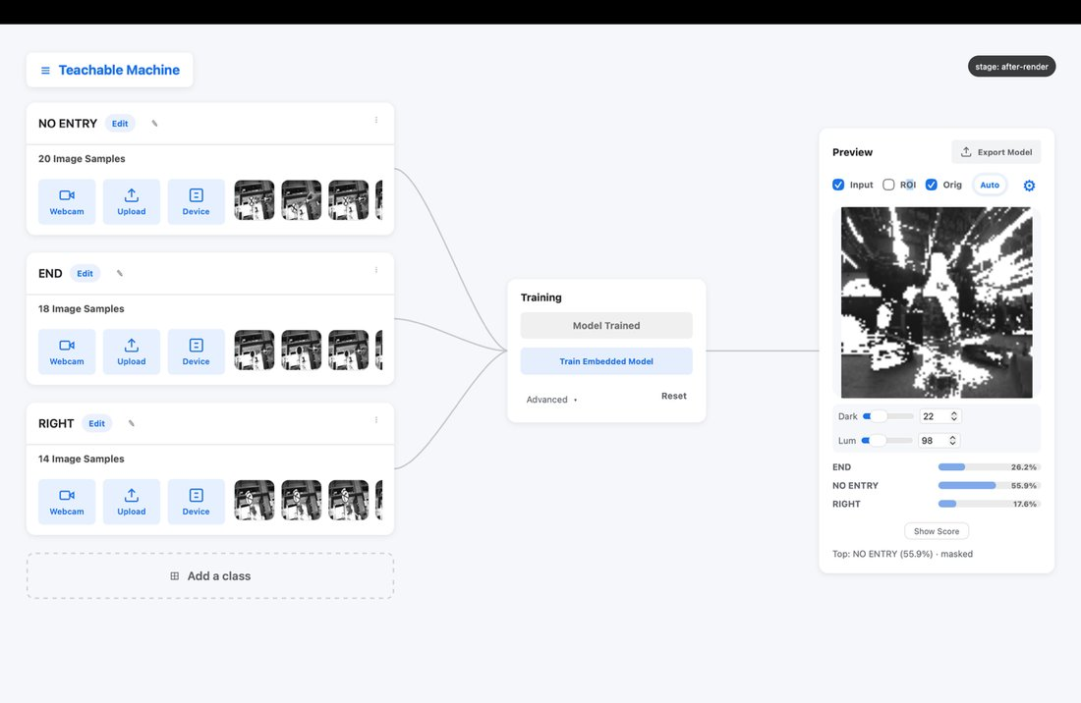
DEMONSTRATION 05
Live preview on unseen input
Gear → source Device + port
Toggle Input and present a sign
Read the confidence bar; toggle ROI to inspect exactly what the model receives
Present a tilted sign, a distant sign, and a partially covered sign; observe how the confidence responds
INTERPRETATION VIEW · LIVE CONFIDENCE
AIOSCOUT · EDGE AI VISION WORKSHOP
17 / 22

Slide 18
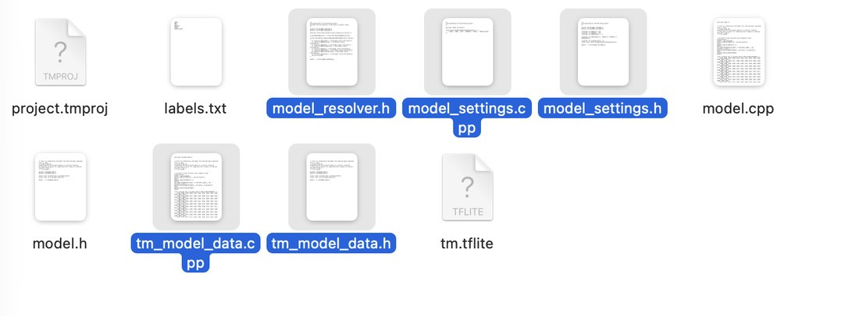
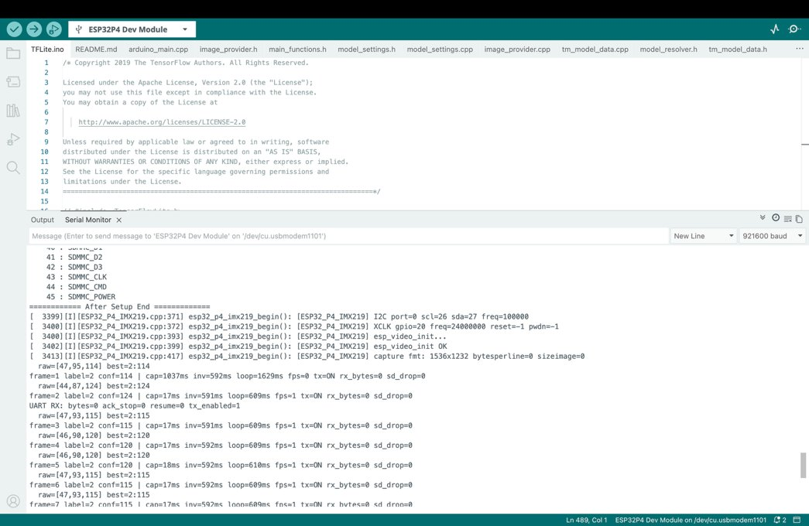
DEMONSTRATION 06
Export and deployment
Export model → five files: the quantized weights plus headers
Copy them into the TFLite.ino project folder
Check IMG_SIZE = 96 (must equal the app's image size)
Upload → Serial Monitor → the board classifies independently
FIVE FILES → PROJECT FOLDER
End of demonstration — every step required for the project has now been shown.
AIOSCOUT · EDGE AI VISION WORKSHOP
INFERENCE RUNNING ON THE ESP32-P4
18 / 22

Slide 19
RECAP · CONCEPTS AND WORKFLOW
Six concepts, six steps.
IDEAS
IDEAS
IDEAS
Learning from examples
CNN + confidence
Edge AI + int8
Labeled data in, learned rules out; training replaces hand-written rules.
A stack of feature detectors that ends in one score per class.
Quantized models run on-chip in real time via TensorFlow Lite Micro.
STEPS
STEPS
STEPS
Collect & preprocess
Train & preview
Export & deploy
Balanced, varied samples; ROI and thresholds clean the noise.
Defaults first; watch validation; test on unseen images.
Five files, IMG_SIZE match, upload — the model runs on the board.
AIOSCOUT · EDGE AI VISION WORKSHOP
19 / 22

Slide 20
PROJECT · 90 MINUTES
Project: a digit recognizer
The task: train a model that recognizes handwritten digits 0–9 presented on paper and runs live on the ESP32-P4.
PROVIDED MATERIALS
Kit and manual
Smart car (ESP32-P4 + camera), map, road-sign stand with 3 signs, USB-C cable, batteries ×2, markers and paper — and the lab manual (Parts A–H).
Requirement | Target
Deployed on the board | Live inference via Serial Monitor
Accuracy on unseen digits | ≥ 8 of 10 correct
Test set | Written by another team — never seen in training
One improvement | Be prepared to explain one change made and its observed effect
TIME MANAGEMENT
Start with four digits
Begin with digits 1, 2, 3 and 7 (the most confusable); four reliable classes outperform ten unreliable ones. Add classes if time allows.
AIOSCOUT · EDGE AI VISION WORKSHOP
20 / 22

Slide 21
PROJECT · DATA PREPARATION
Data-collection guidelines
TIP 01
TIP 02
TIP 03
TIP 04
Bold, large digits
Capture from the board
Equal counts
Independent test data
8–10 cm tall with bold strokes; thin pen lines disappear at 96×96 grayscale.
Use Device rather than the webcam; train on images from the camera that will run the model.
30–50 per class, balanced; an unbalanced dataset biases the model toward the largest class.
The evaluation uses another team's handwriting; include handwriting from every team member in the training data.
Tip 05 — iterate: train, test, correct the data, retrain. Two or three iterations are a normal part of the process.
AIOSCOUT · EDGE AI VISION WORKSHOP
21 / 22

Slide 22
BEGIN THE PROJECT
Open the lab manual and begin with Part A.
REFERENCE
REFERENCE
IF PROBLEMS OCCUR
Pre-lab manual
Lab manual
Troubleshooting table
Completed before the session.
Parts A–H: collect, preprocess, train, test, deploy, evaluate, extend.
Common failures — port busy, single-class collapse, upload errors — each with its remedy.
WORKSHOP MATERIALS · PRELAB.HTML · LABMANUAL.HTML ON THE WORKSHOP PAGE
AIOSCOUT · EDGE AI VISION WORKSHOP
22 / 22

