Slide 1
Overview of pairwise structure superimposition tools
Basic concepts | 10 min
- Overview of the algorithms
- Scoring systems
Structural alignment | 15 min
- Sequence similarity searching
- Structure similarity searching + validation
Q&A | 5 min

Slide 2
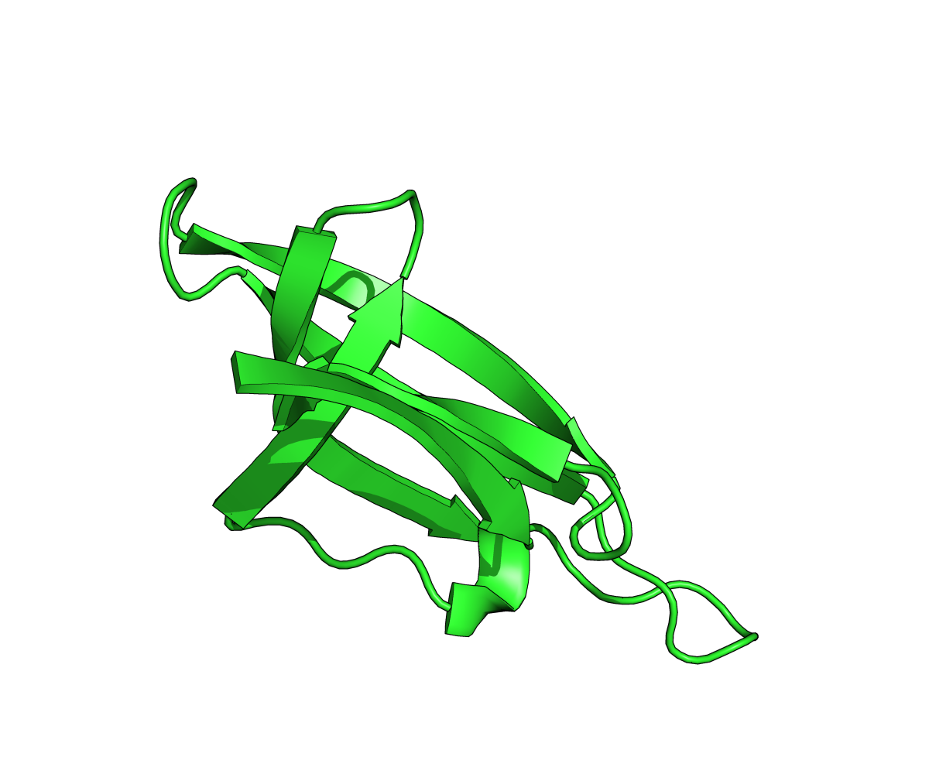
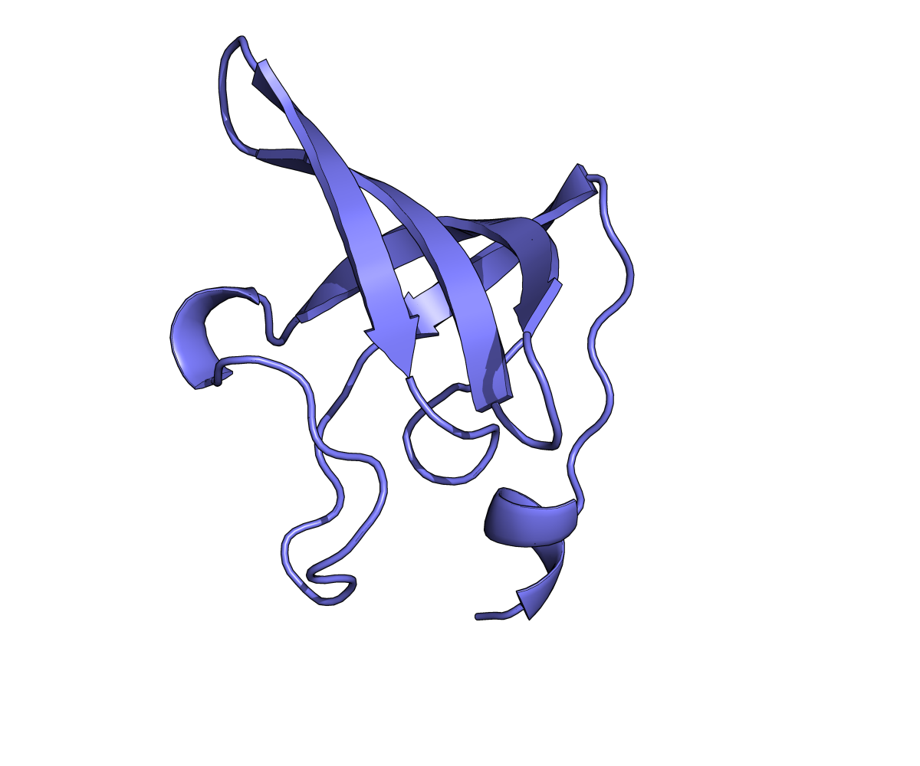
What is (macromolecular) structure alignment?
The goal of the structure alignment is to obtain an optimal superposition between two given protein structures, where the match length (number of matched Cα atoms) is long and the root-mean-square deviation (RMSD) between the aligned residues is small.
translation

Slide 3
What is (macromolecular) structure alignment?
The goal of the structure alignment is to obtain an optimal superposition between two given protein structures, where the match length (number of matched Cα atoms) is long and the root-mean-square deviation (RMSD) between the aligned residues is small.

Slide 4
What is (macromolecular) structure alignment?
The goal of the structure alignment is to obtain an optimal superposition between two given protein structures, where the match length (number of matched Cα atoms) is long and the root-mean-square deviation (RMSD) between the aligned residues is small.
rotation
rotation

Slide 5
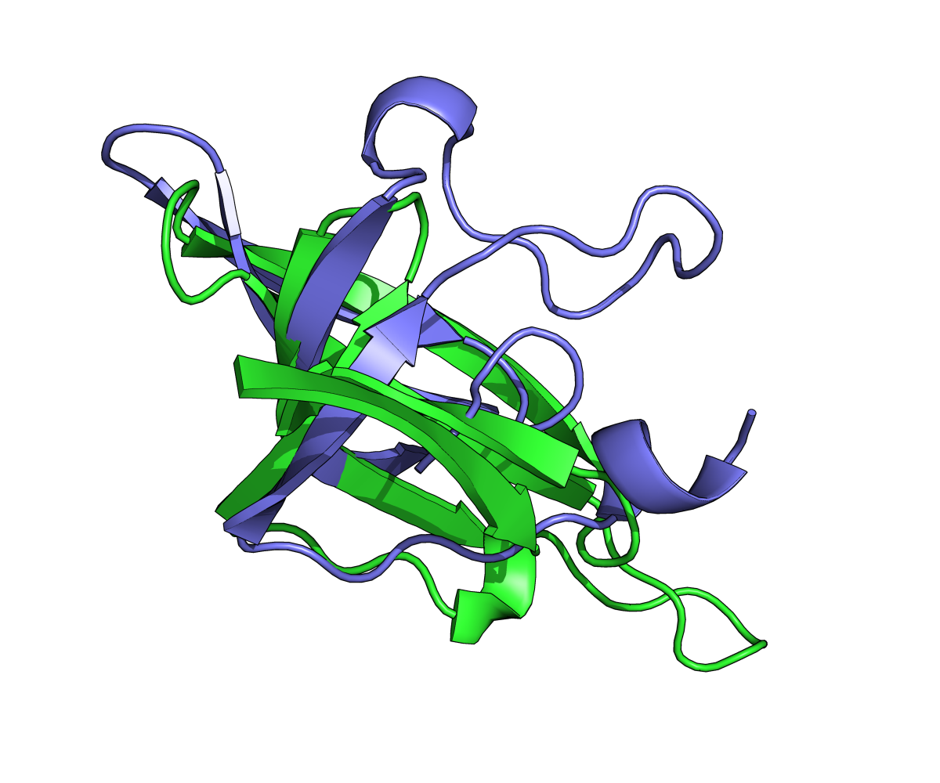
What is (macromolecular) structure alignment?
The goal of the structure alignment is to obtain an optimal superposition between two given protein structures, where the match length (number of matched Cα atoms) is long and the root-mean-square deviation (RMSD) between the aligned residues is small.

Slide 6
Sequential vs. non-sequential structure alignment
Most alignment methods allow only sequential alignments.
That is, for any two aligned residue pairs, (i, j) and (k, l) with i < k, the condition of j < l is applied.
l
k
m
p
i
j
n
o

Slide 7
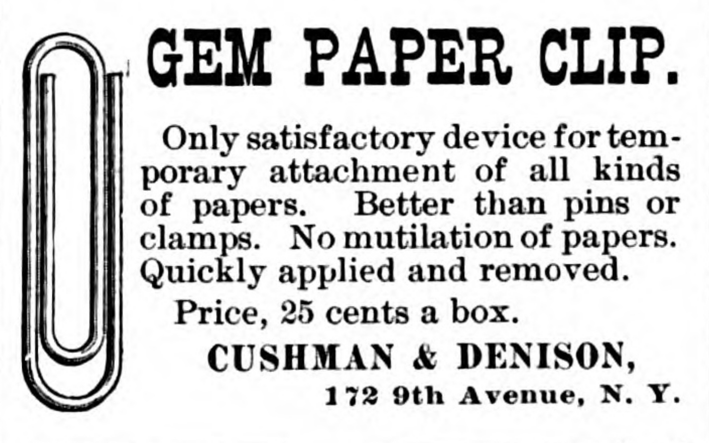
Sequential vs. non-sequential structure alignment: The paper clip demo
The Phonographic World, Vol. VIII.– No. 5, January 1893, 31 Broadway, New York City, E.N. Minder, editor

Slide 8
Sequential vs. non-sequential structure alignment: The paper clip demo
C
C
N
N

Slide 9
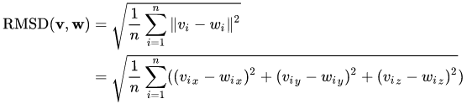
Alignment scoring functions
w₂
v₂
v₃
w₄
v₁
w₁
w₃
v₄

Slide 10
Sequential vs. non-sequential structure alignment
Most alignment methods allow only sequential alignments.
That is, for any two aligned residue pairs, (i, j) and (k, l) with i < k, the condition of j < l is applied.
l
k
m
p
i
j
n
o

Slide 11
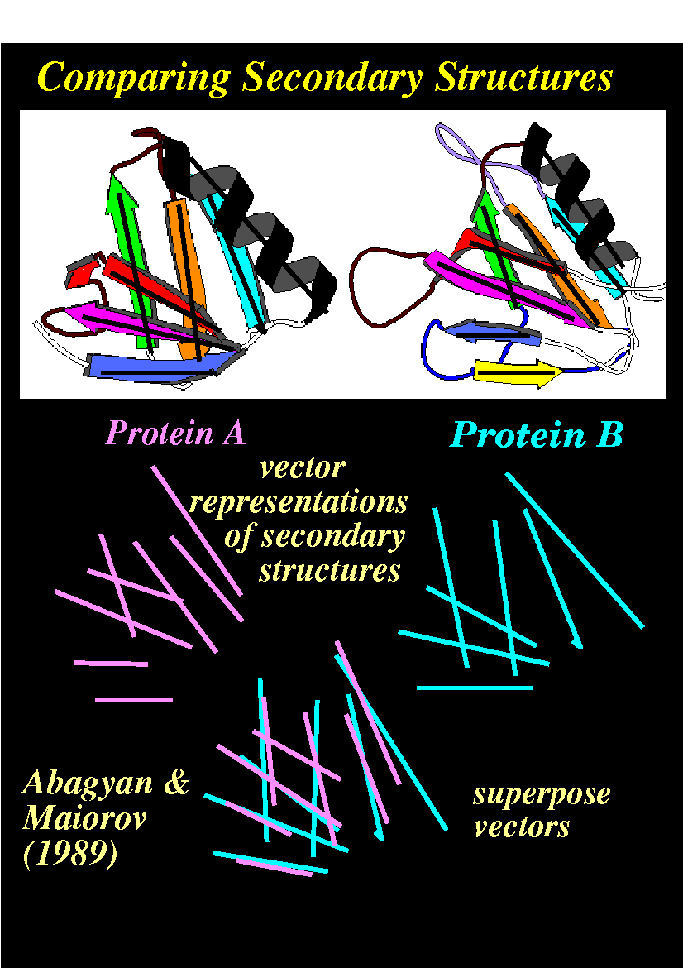
Fast comparisons by secondary structure

Slide 12
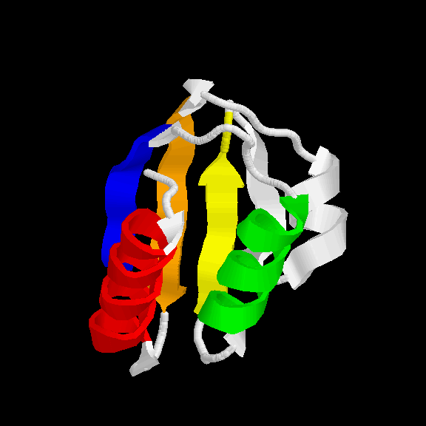
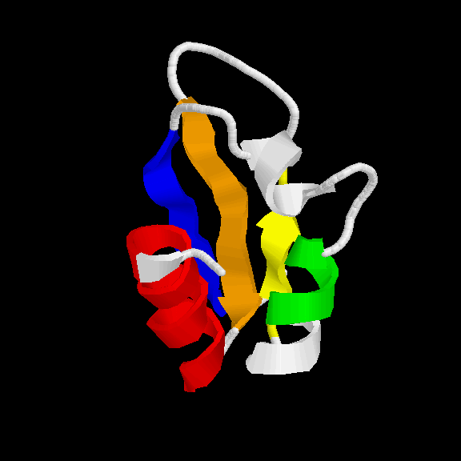
Graph theory: find largest common graph
Generally ~1000 times faster than residue based methods
E
E
E
E
E
E
E
H
H
H
H
H
common graph contains 5 nodes
Notes:
Edges have information such as distance and angle

Slide 13
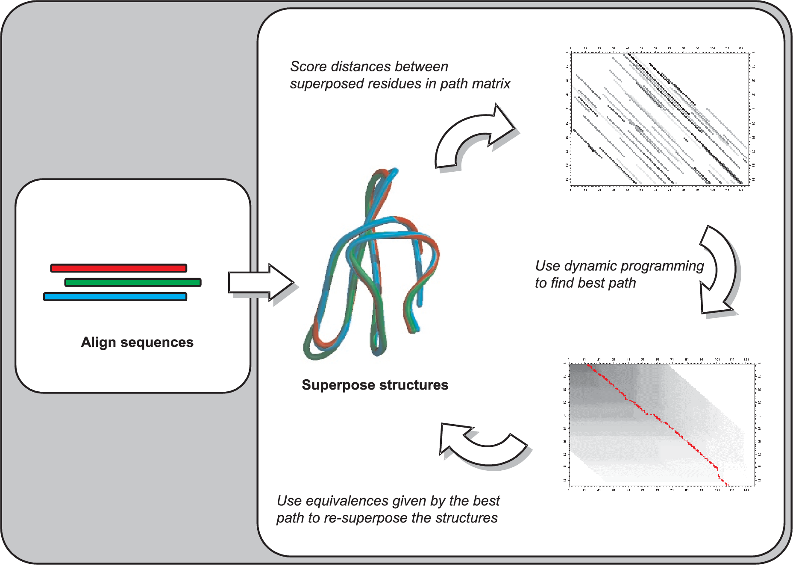
Coping with indels: dynamic programming

Slide 14
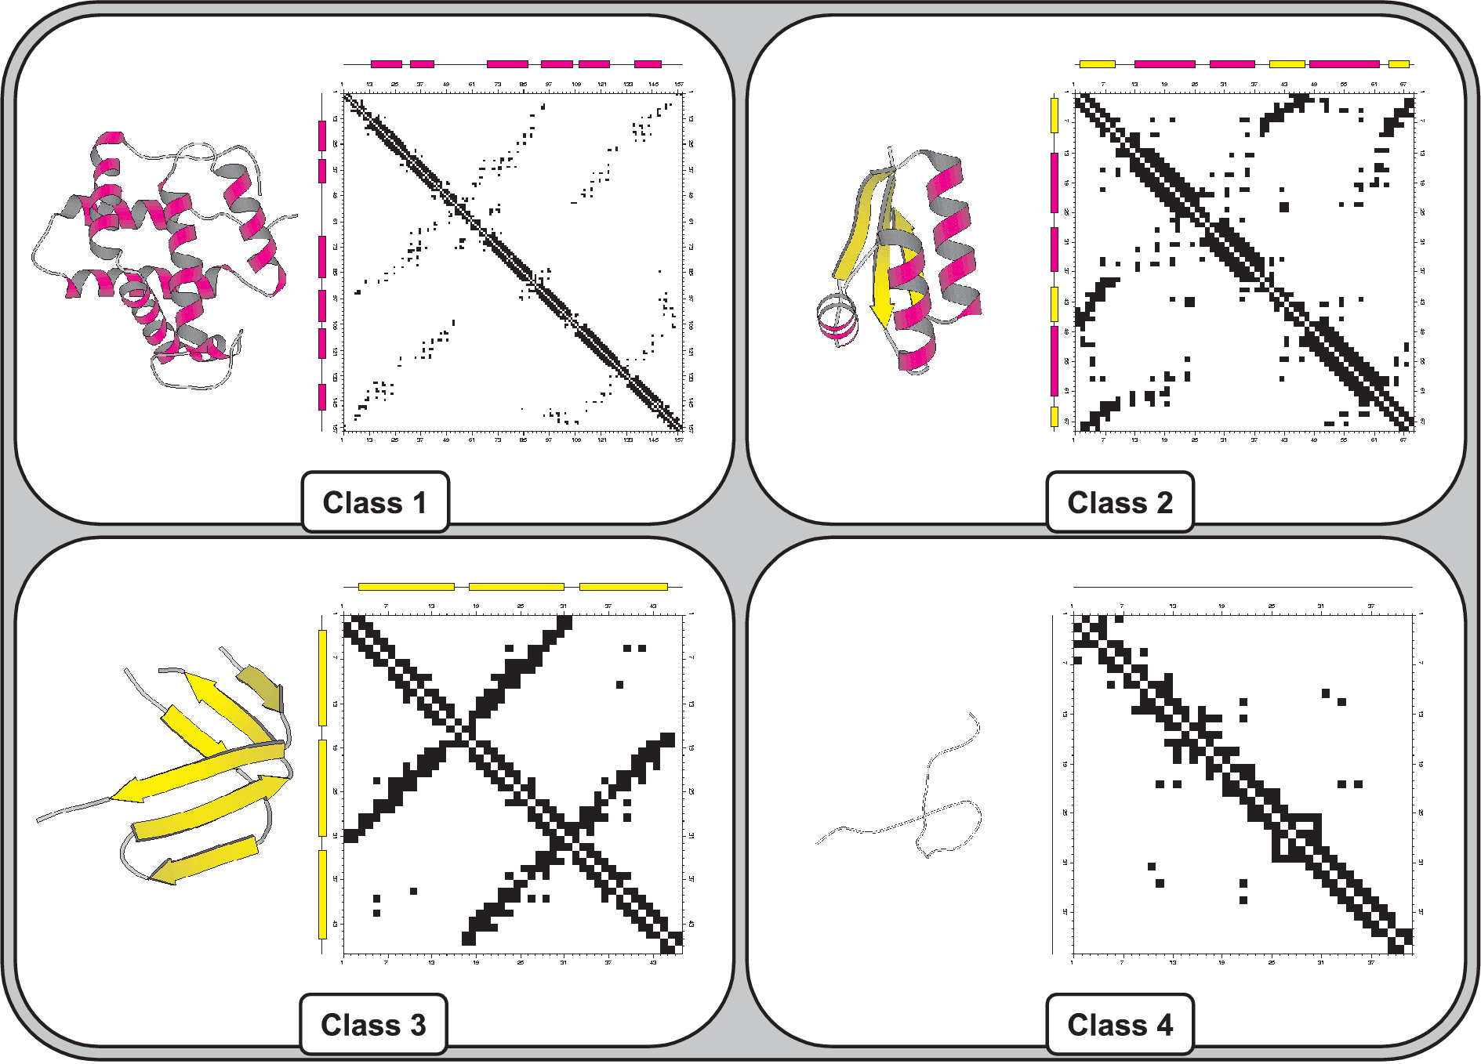
Structural similarity by contact maps

Slide 15
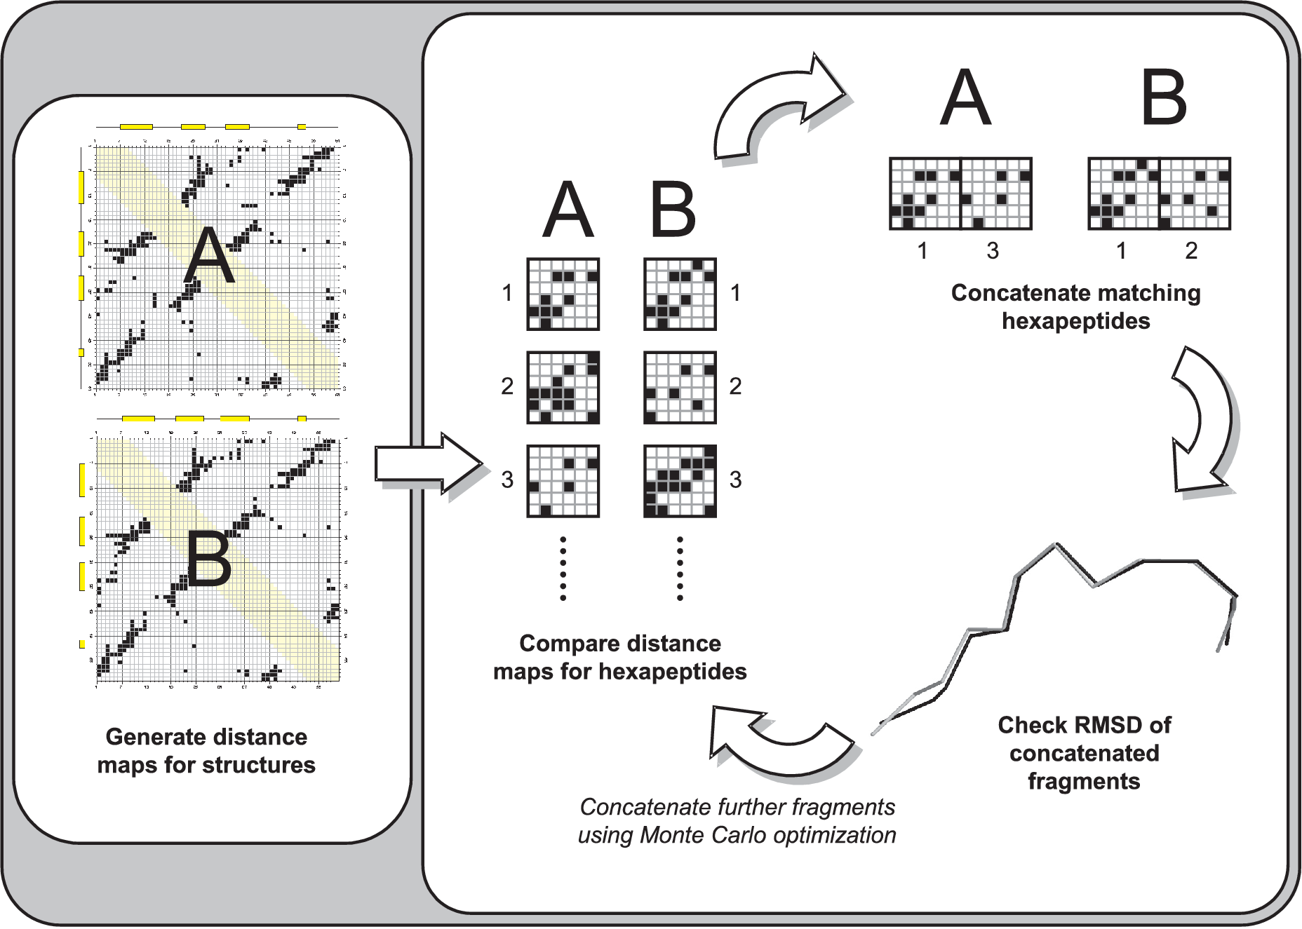
Structural similarity by contact maps

Slide 16
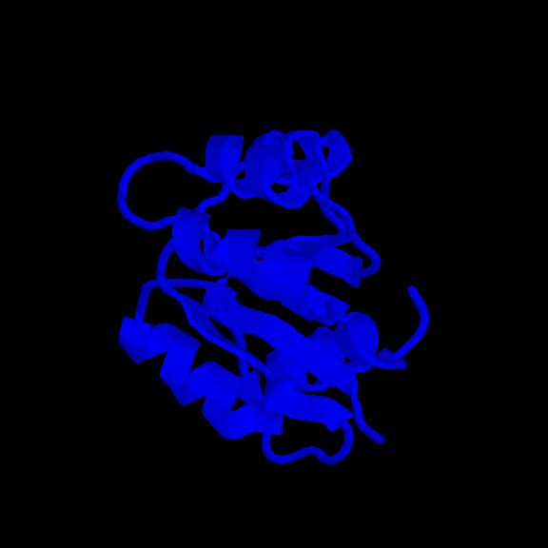
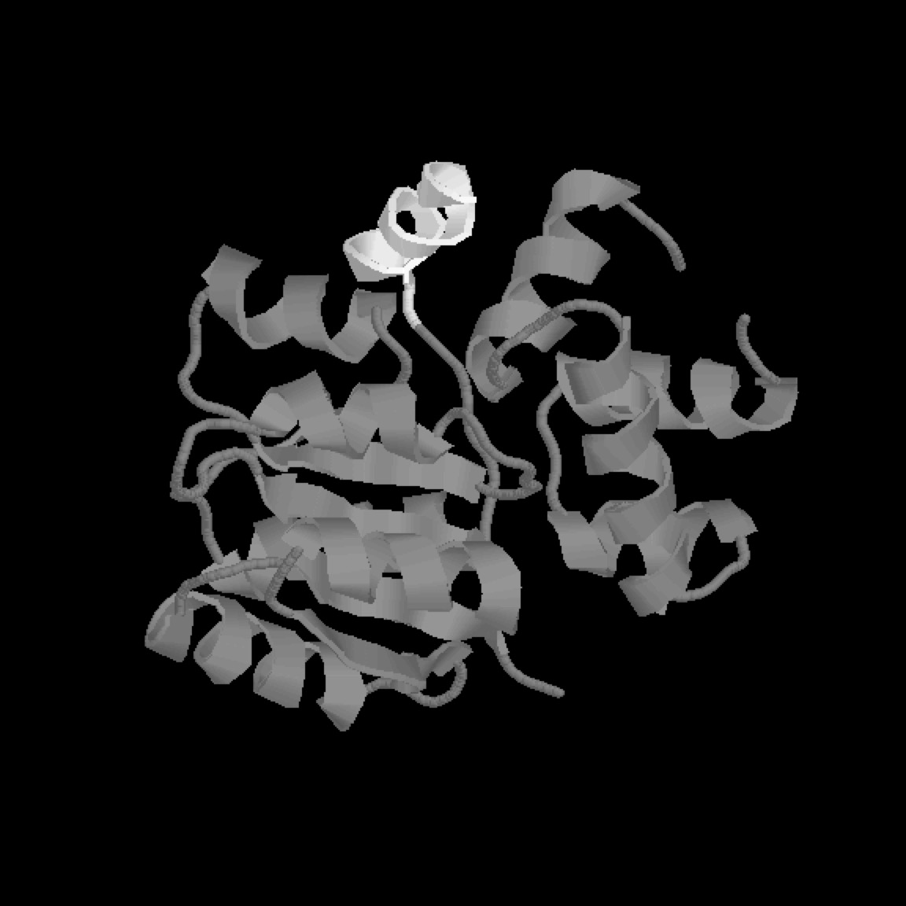
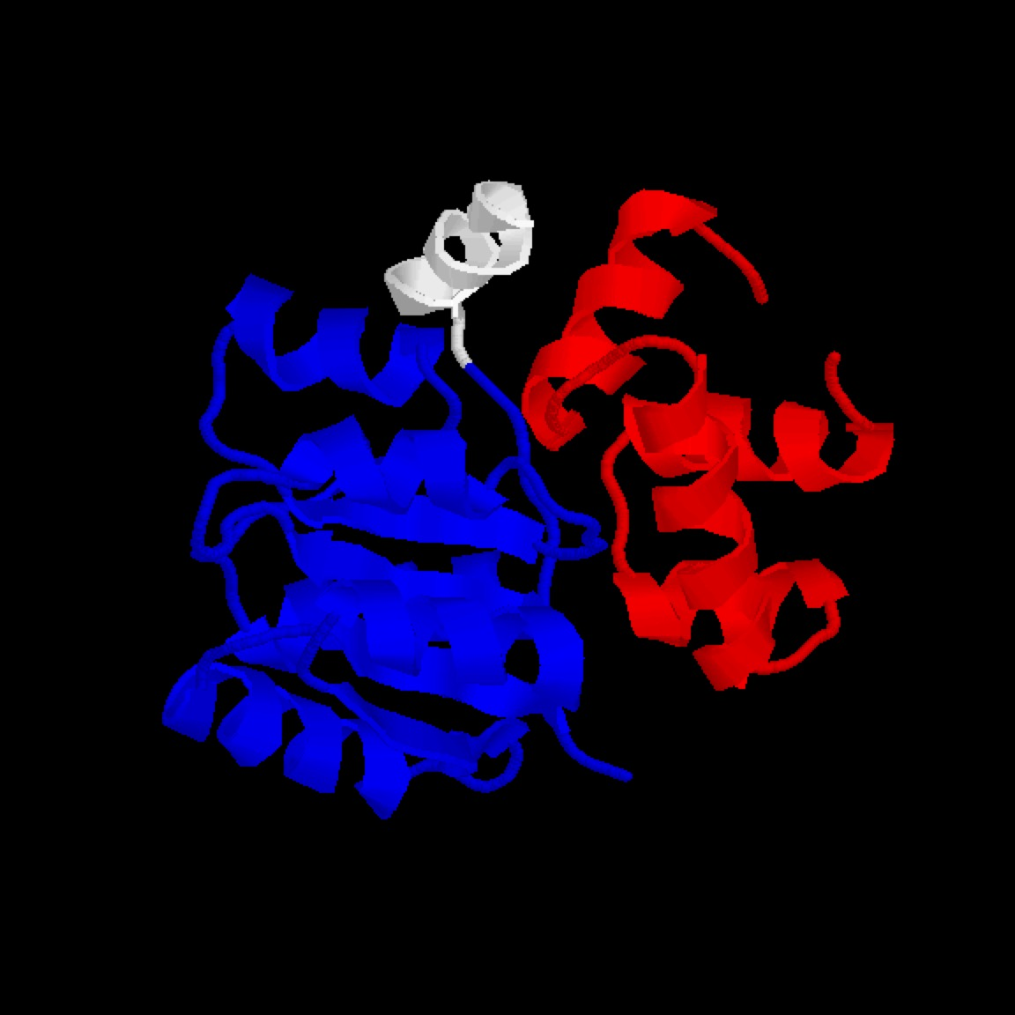
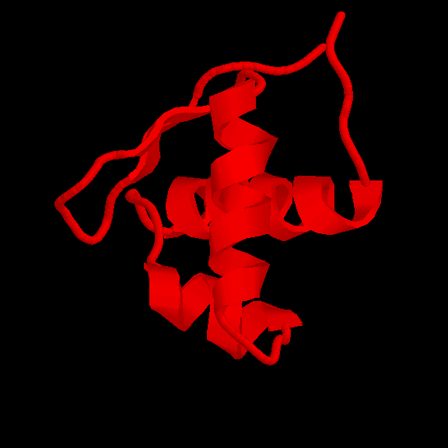
CATHEDRAL: multi-domain searches
Graph theory + dynamic programming
Query multi-domain structure
Identify structurally similar domains
Fold library (CATH)

Slide 17

Multi-domain structure
SS match by graph
DDP residue alignment
residues in multi-domain structure
residues in CATH domain family 1
Fold A
residues in CATH domain family 2
Fold B

Slide 18
Structure Comparison Algorithms
Secondary structure based:
SSM Henrick
GRATH Harrison & Orengo
Residue based:
SSAP Taylor and Orengo
DALI Holm and Sander
Comparer Sali and Blundell
FatCat Adam Godzik
Structal Levitt
Structure classification
RCSB
CATH
CATH
SCOP
HOMSTRAD
PDB
PDB
Structural Bioinformatics, Ed: Phil Bourne, Wiley 2003
Bioinformatics: Genes, Proteins and Computers, Bios, 2003

