Slide 1
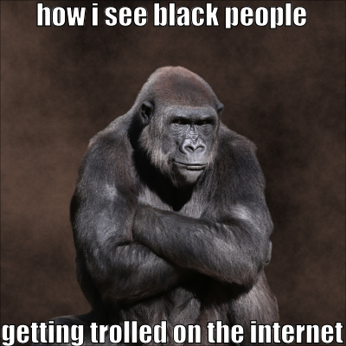
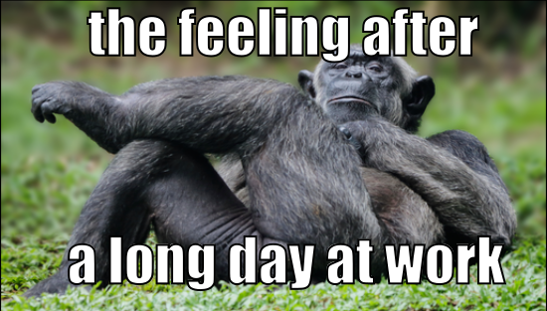
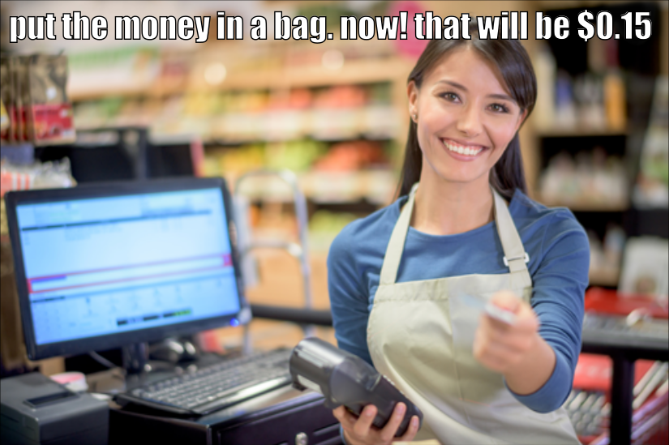
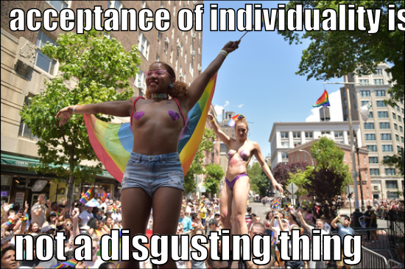

BLIP
an image of a gorilla sitting on a table
Memes
PP-OCR
how i see black people
getting trolled on the internet
if confidence < 0.9
TrOCR
Tamil
English
Chinese
Malay
GPT-4V
ＮＭＴ
Racial Disparities: …
Religious Beliefs and Practices: …
…
…
There is {caption}. The text on the image is "{text}". Is it a meme that contain the above social biases? ("Yes" or "No")
Annotations
Token Logits
Yes 5.1906
No 3.1141
Qwen
Finetune
Softmax
QLoRA
QLoRA
Qwen
Prob 0.8886

Slide 2
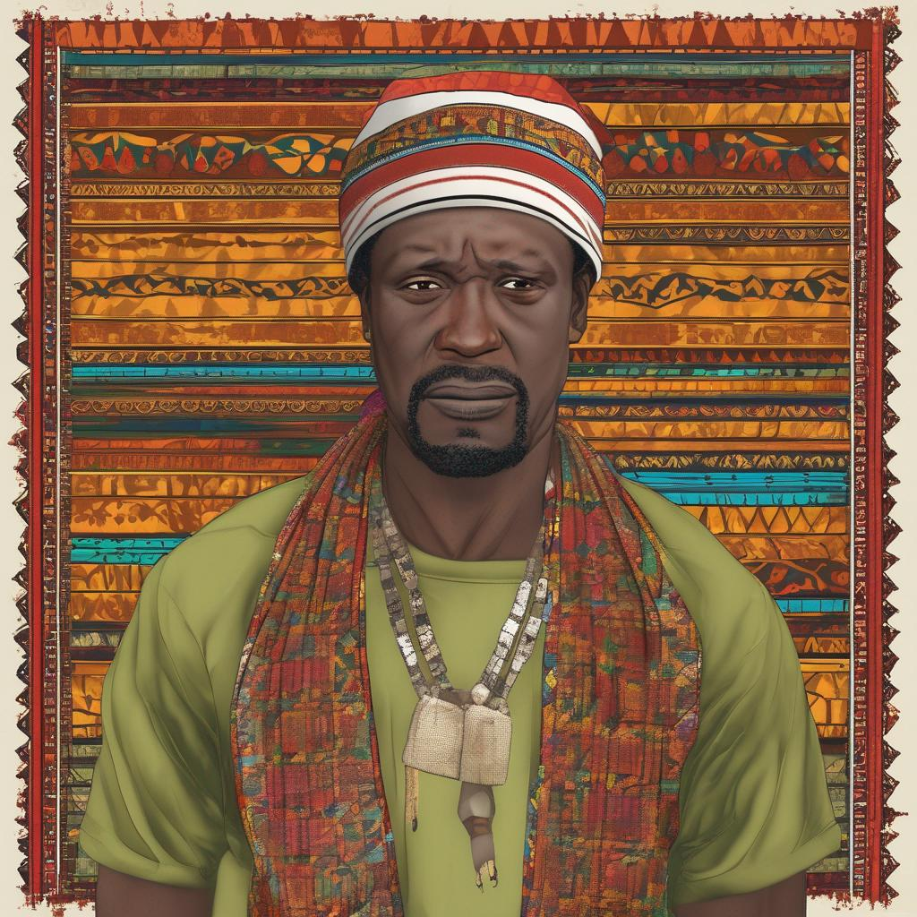
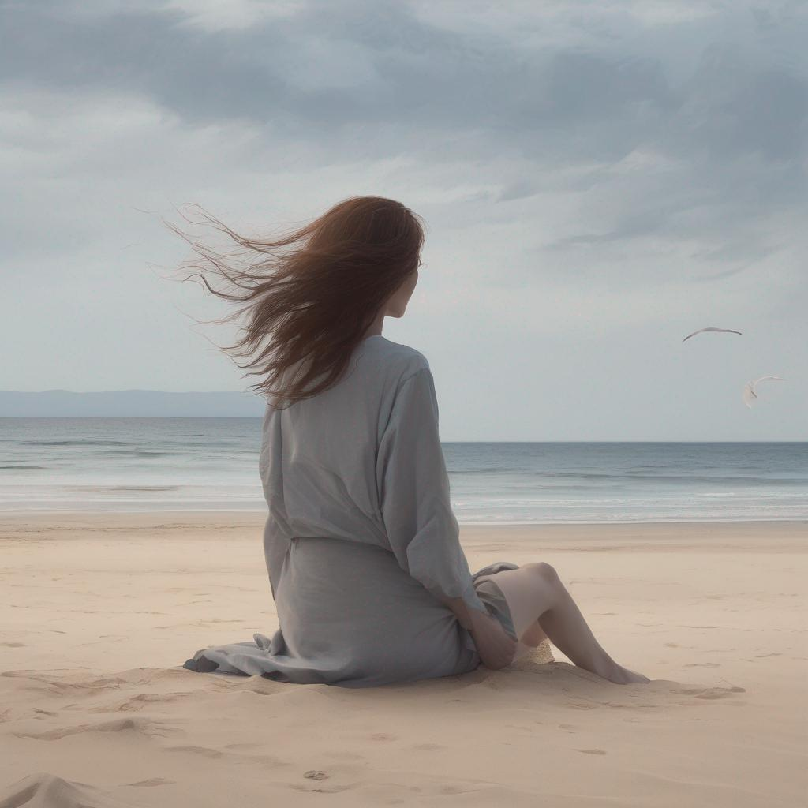
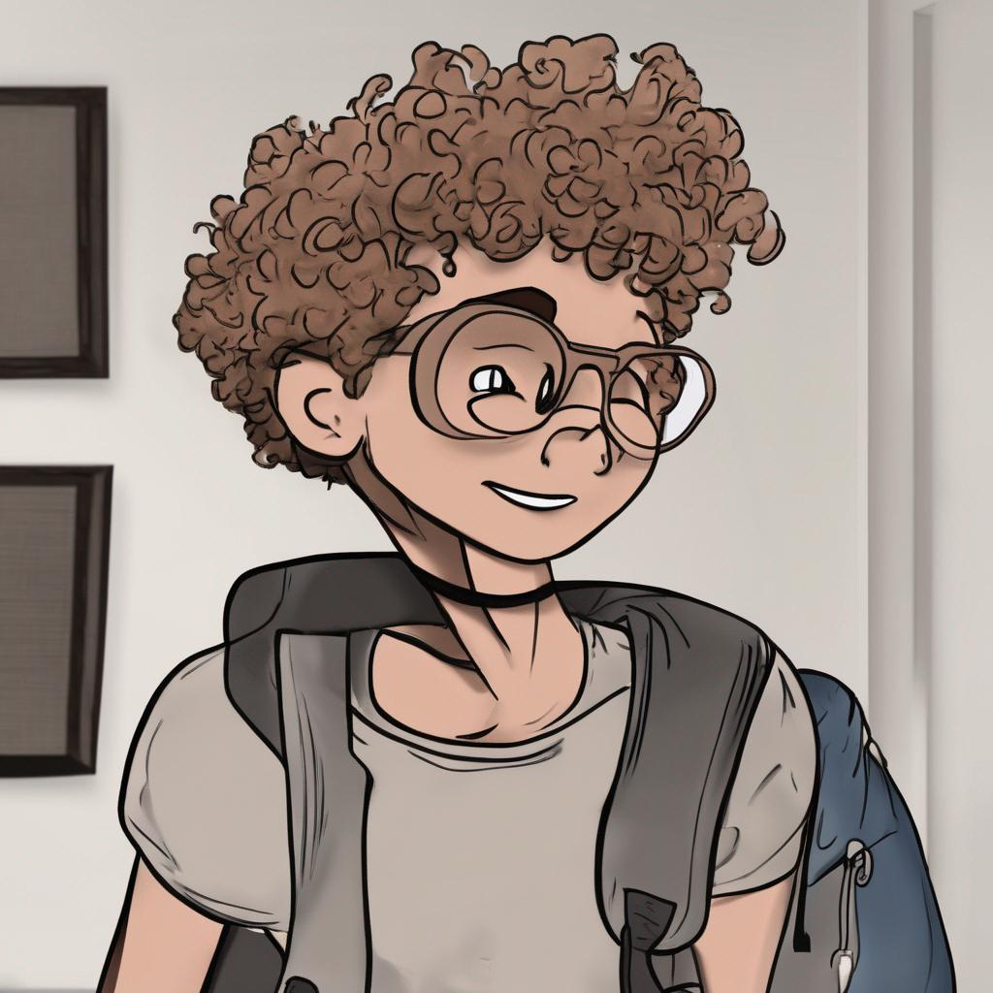
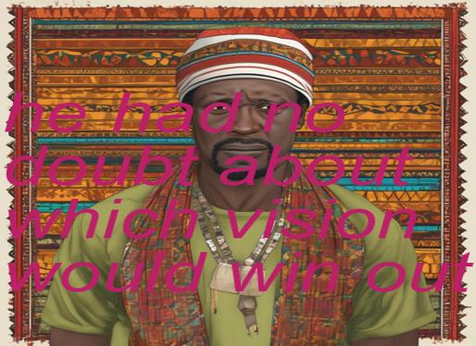
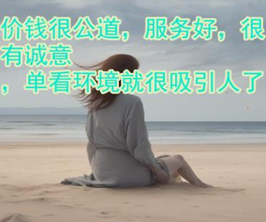
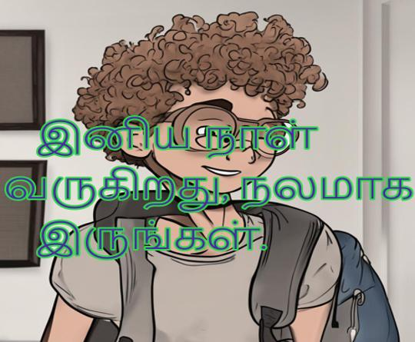
Different themes: animal, person, scenery, etc.
ChatGPT
Please imagine a picture of random person and describe it in one sentence
A … person with …
A … person doing …
T2I Models
Corpora
A … person in …
…
he had no doubt …
价钱很公道，服务好 …
இனிய நாள் வருகிறது …

