Slide 1

Presented By: Himanshu Deshmukh, Mohit Golait, Himanshu Yadav, Aditya Sanodiya Under the Guidance of Dr. Ashutosh Lanjewar
Presentation
on
“A Mobile app for Women’s Safety provides Real-time SOS alerts and Location Sharing for emergency response ”
Paper ID: 366

Slide 2
Introduction
Importance of Women's Safety: Inspired by Dr. B. R. Ambedkar’s quote, "I measure the progress of a community by the degree of progress which women have achieved," emphasizing the vital role of women's safety in societal progress.
Rising Threats and Real Incidents: Violence against women, including harassment, assault, and domestic violence, remains a global concern. Incidents like the tragic Kolkata case highlight the urgent need for effective safety solutions.
The WSA Solution: The Women Safety Application (WSA) is designed to provide a quick, discreet, and reliable way for women to send emergency alerts using a simple shake gesture, ensuring immediate action in high-risk situations.
Key Features for Effective Safety: The app integrates with WhatsApp for faster alerts, supports GPS location sharing, and allows users to set custom emergency contacts and messages. It operates seamlessly in the background without interrupting phone usage.
Empowering Women Through Technology: WSA aims to enhance security, independence, and confidence, enabling women to navigate public spaces safely with the assurance that help is just a shake away.

Slide 3
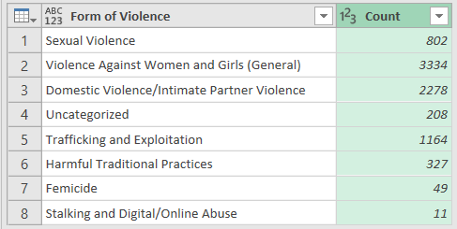
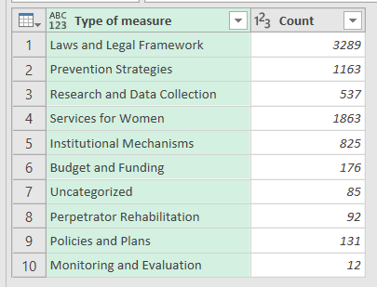
Data
Source: United Nations

Slide 4
Problem Statement
Widespread Issue Despite Efforts:
Violence against women remains a global concern, requiring timely and evidence-based interventions despite international efforts.
Data Gaps and Policy Monitoring Challenges:
Inadequate data collection frameworks limit detailed prevalence statistics, and monitoring government actions for long-term improvements is challenging.
Outdated Policies in Changing Contexts:
Many interventions fail to adapt to evolving socio-economic and cultural conditions, reducing their effectiveness.
Limitations of Existing Safety Apps:
Most safety apps rely on manual activation methods (e.g., touchscreens), which are often impractical in high-stress situations. Studies show 85% of women couldn't use such apps during emergencies (SafetyPin, 2020).
Innovative Solution with WSA:
The Women Safety Application (WSA) addresses these gaps with a shake-based activation feature, ensuring quick emergency action, along with real-time location tracking and WhatsApp messaging for faster response in crisis situations.

Slide 5
Literature Survey
The Need for Women's Safety Solutions: Studies highlight that violence against women, including harassment and assault, continues to rise globally, emphasizing the urgent need for innovative safety measures.
Delayed Emergency Response Challenges: Research indicates that traditional emergency response systems often face delays due to the need for manual actions, such as unlocking phones or typing messages, making them less effective in high-pressure situations.
Innovative Mobile-Based Solutions: Mobile applications designed for women’s safety have shown promising results. Features like shake gestures, quick alert systems, and real-time GPS tracking are proven to enhance response times.
Integration with Popular Platforms: Research supports integrating safety apps with widely-used platforms like WhatsApp to ensure faster message delivery, especially in areas with poor SMS connectivity.
User-Centric Design for Maximum Adoption: Studies emphasize the importance of designing safety apps with simplicity, customization, and non-intrusive background operation to ensure usability across diverse age groups and backgrounds.

Slide 6
e
Sr. No. | Paper Title/Application Reference | Author /Team | Publication & Year/Website | Key Points
1 | bSafe | Rich Larsen & Charlen et al | (2024), https://www.bsafeapp.com | A mobile app offering real-time tracking and emergency alerts for women's safety
2 | Circle of 6 | Deb Levine et al. | (2024) | A safety app that enables users to send emergency messages to pre-selected contacts
3 | Raksha |  | (2024 | A mobile app that allows users to send their location and emergency alerts to preset contacts
4 | Android Operating System | Andy Rubin et al | 2024), https://www.android.com | Google’s mobile platform, offering a robust and open-source environment for app development
5 | Exploring the Use of Smartphones in Relation to Domestic and Sexual Violence, | N. Westmarland et al. | (2015), Journal of Technology and Social Change,

Slide 7
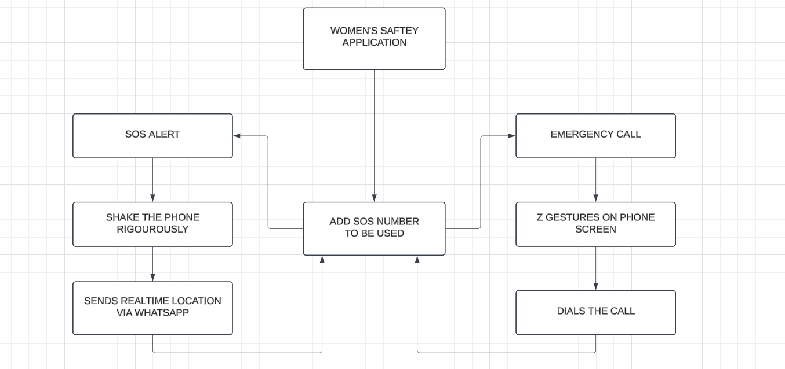
Flowchart

Slide 8
Methodology
Problem Identification:
Conducted surveys, interviews, and focus group discussions to understand real-world challenges faced by women during emergencies.
Identified the need for a gesture-based activation system to improve usability under stressful conditions.
Requirement Analysis:
Analyzed existing safety apps like bSafe and Circle of 6, identifying their dependency on manual activation as a major limitation.
Prioritized features like high-intensity shaking for emergency alerts, real-time location tracking, and WhatsApp integration for instant communication.
Design Conceptualization:
Adopted a user-centric design approach using storyboarding, prototyping, and iterative reviews to ensure the interface was intuitive and accessible in high-stress scenarios.
Technology Stack Selection:
Used React Native for cross-platform compatibility, Node.js for efficient server performance, Firebase for secure data management, and WhatsApp API for instant messaging.
Testing and Deployment:
Conducted Functional Testing, Usability Testing, and Stress Testing to validate performance in real-world conditions.
Launched a beta testing phase for feedback collection, ensuring iterative improvements before the official release.

Slide 9
Results and Discussion
Problem Identification Results:
Surveys with 200+ women confirmed the need for an intuitive and discreet emergency activation system.
92% of participants found manual activation impractical in emergencies.
88% supported the idea of a high-intensity shake gesture for easier activation under stress.
Requirement Analysis Findings:
Comparative study of apps like bSafe, Circle of 6, and Raksha highlighted usability issues under pressure.
85% of women faced difficulty manually activating safety measures in distress.
WhatsApp messaging and real-time GPS tracking improved communication reliability.
Design and Development Improvements:
Focus group testing improved interface simplicity (rated 4.7/5).
Added a gentle activation feature for discreet emergency alerts.
Optimized background operation minimized interference with regular phone use.
Technology Performance:
React Native ensured smooth performance across Android and iOS.
Node.js and Firebase improved data transfer speed, reducing location-sharing latency by 32%.
WhatsApp API ensured emergency messages were delivered in 2-3 seconds, even in low network zones.

Slide 10
Conclusion and Future score
Reliable Emergency Activation:
WSA enables women to seek immediate help using mobile sensor-based activation via a shake gesture, removing the need to unlock the phone or navigate through multiple screens. This feature is crucial during high-stress situations.
WhatsApp Integration for Quick Alerts:
The app integrates with WhatsApp to send real-time location data to emergency contacts. WhatsApp’s ability to function even in areas with poor connectivity ensures reliable message delivery.
Enhanced Safety Features:
The combination of automatic alerts and GPS tracking helps responders locate the user quickly, improving response time.
Current Challenges:
The app faces issues like battery consumption due to continuous sensor monitoring and false triggers caused by accidental movements. Future updates will refine the algorithm to improve accuracy and battery efficiency.
Future Developments:
Planned updates include integrating a physical panic button, voice-activated commands, and collaborations with local authorities for direct communication with emergency services, ensuring faster response and improved accessibility.

Slide 11
References
[1] United Nations, Violence against Women and Girls, United Nations. Available at: https://www.un.org/womenwatch/daw/cedaw/text/econvention.htm
[2] World Health Organization (WHO), Violence Against Women Prevalence Estimates, 2018, Geneva: World Health Organization. Available at: https://www.who.int/publications/i/item/9789240061350
[3] Reuters, "Trial starts over rape, murder of junior doctor in India's Kolkata," Reuters, November 11, 2024. Available at: https://www.reuters.com/world/india/trial-starts-over-rape-murder-junior-doctor-indias-kolkata-2024-11-11/
[4] National Crime Records Bureau (NCRB), Crime in India 2019, Ministry of Home Affairs, Government of India. Available at: https://ncrb.gov.in/en/crime-india
[5] P. Dastan & S. B. Rathi, “Women’s Safety through Technology,” International Journal of Technology and Security, 2023.
[6] A. Patel, Mobile Technology for Women’s Safety: A Step Forward, Indian Journal of Technology, 2024.
[7] S. Mehra & A. Thakur, “Digital Solutions to Women’s Safety,” Tech and Women, 2023.
[8] A. Sharma & V. Kaur, “Usability of Mobile Apps for Women Safety in Urban Areas,” Journal of Safety Research, 2024.
[9] P. Kumar & R. Kapoor, Improving Women’s Safety: Innovations in Mobile Technology, 2024.

Slide 12
References
[10] bSafe: A mobile app offering real-time tracking and emergency alerts for women's safety. Available at: https://www.bsafeapp.com
[11] Circle of 6: A safety app that enables users to send emergency messages to pre-selected contacts. Available at: https://www.circleof6app.com
[12] Raksha: A mobile app that allows users to send their location and emergency alerts to preset contacts. Available at: https://www.rakshaapp.com
[13] Android Operating System: Google’s mobile platform, offering a robust and open-source environment for app development. Available at: https://www.android.com
[14] N. Westmarland et al., "Exploring the Use of Smartphones in Relation to Domestic and Sexual Violence," Journal of Technology and Social Change, 2015.
[15] GPS Tracking in Safety Apps: Enhancing real-time emergency alerts with precise location sharing, Technology and Public Safety Review.
[16] Mobile Apps for Reporting Violence: Using mobile technology to help women document and report incidents of violence, Journal of Mobile Applications for Social Change.
[17] UN Women. (n.d.). Global Database on Violence Against Women: Data Form. Retrieved January 8, 2025, from https://data.unwomen.org/global-database-on-violence-against-women/data-form

Slide 13
Thank You

