Slide 1
CNN-Transformer Hybrid Model for Medical Image Classification
基于 CNN-Transformer 融合架构的胸部 X 光片肺炎智能诊断系统

Slide 2
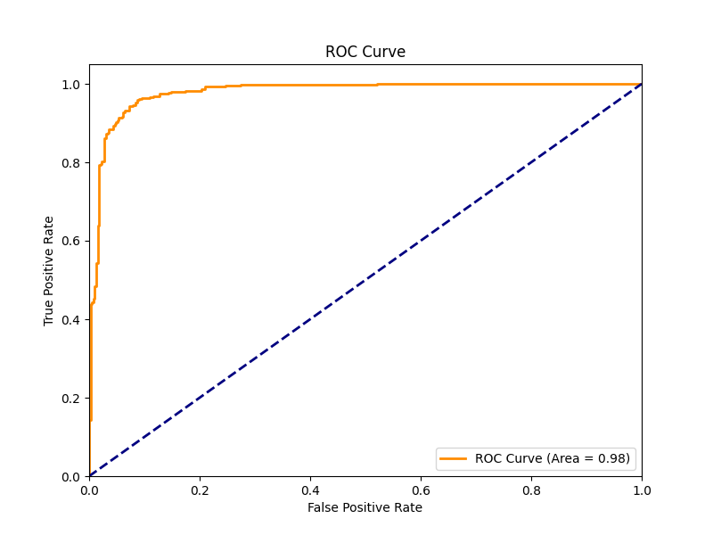

Slide 3
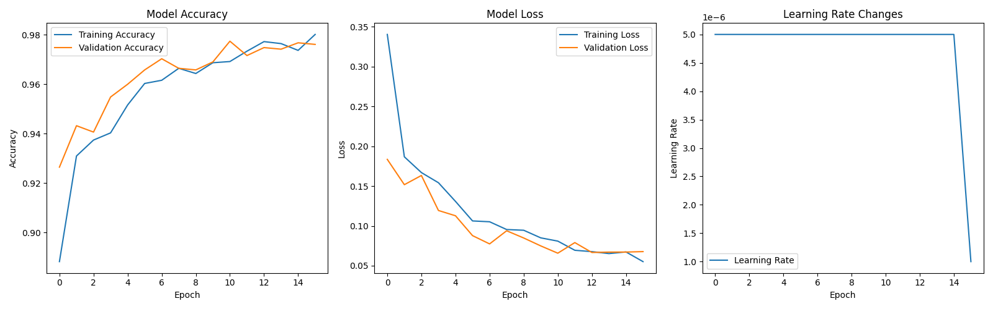

Slide 4
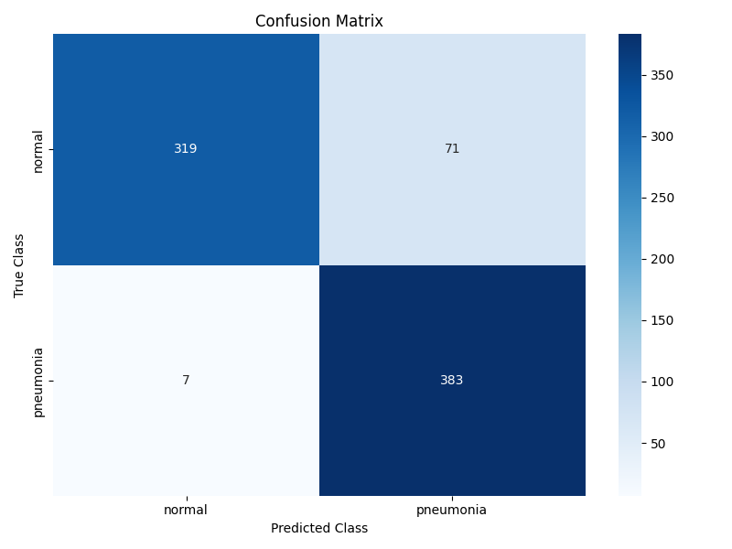

Slide 5
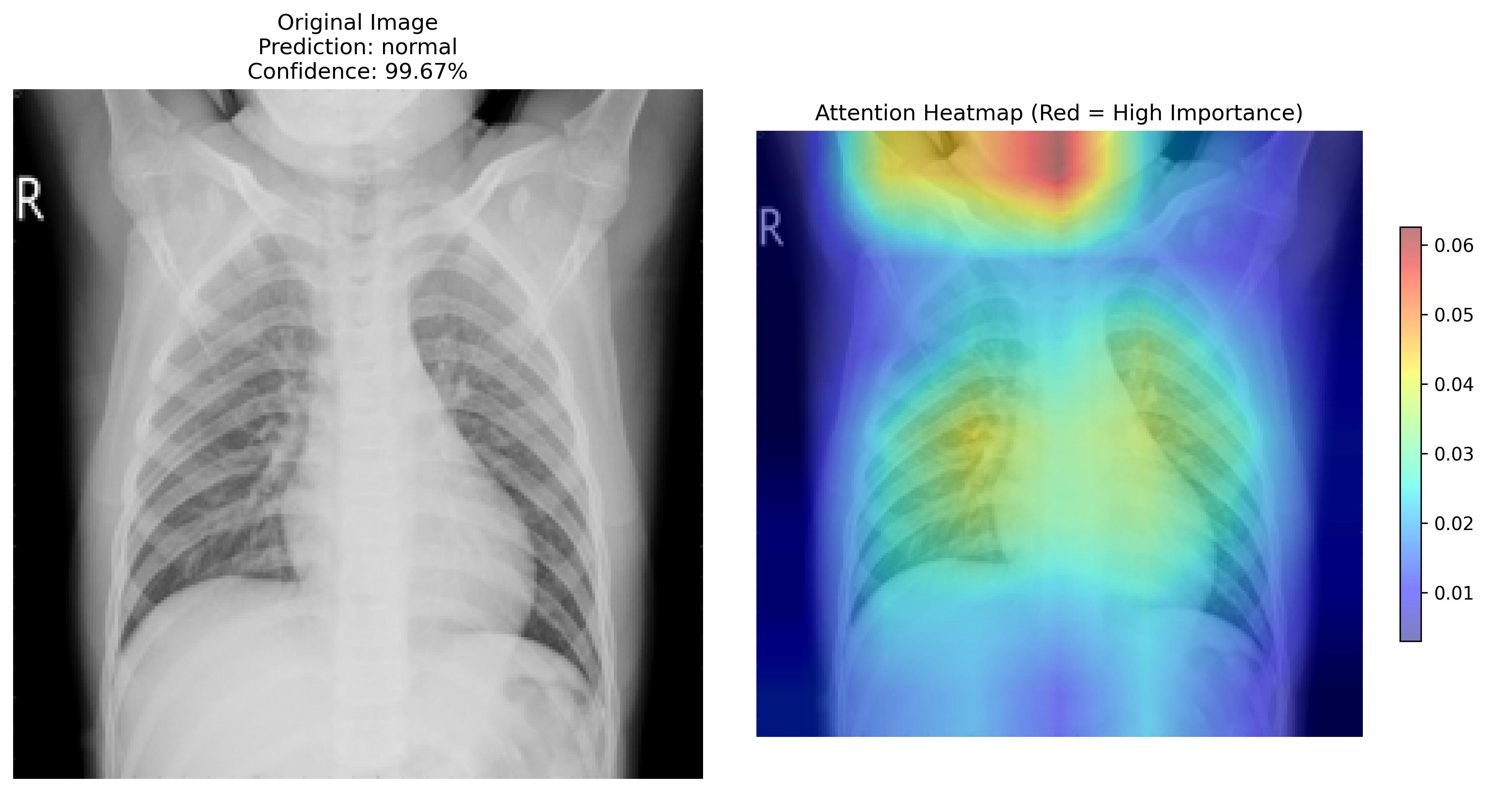

Slide 6
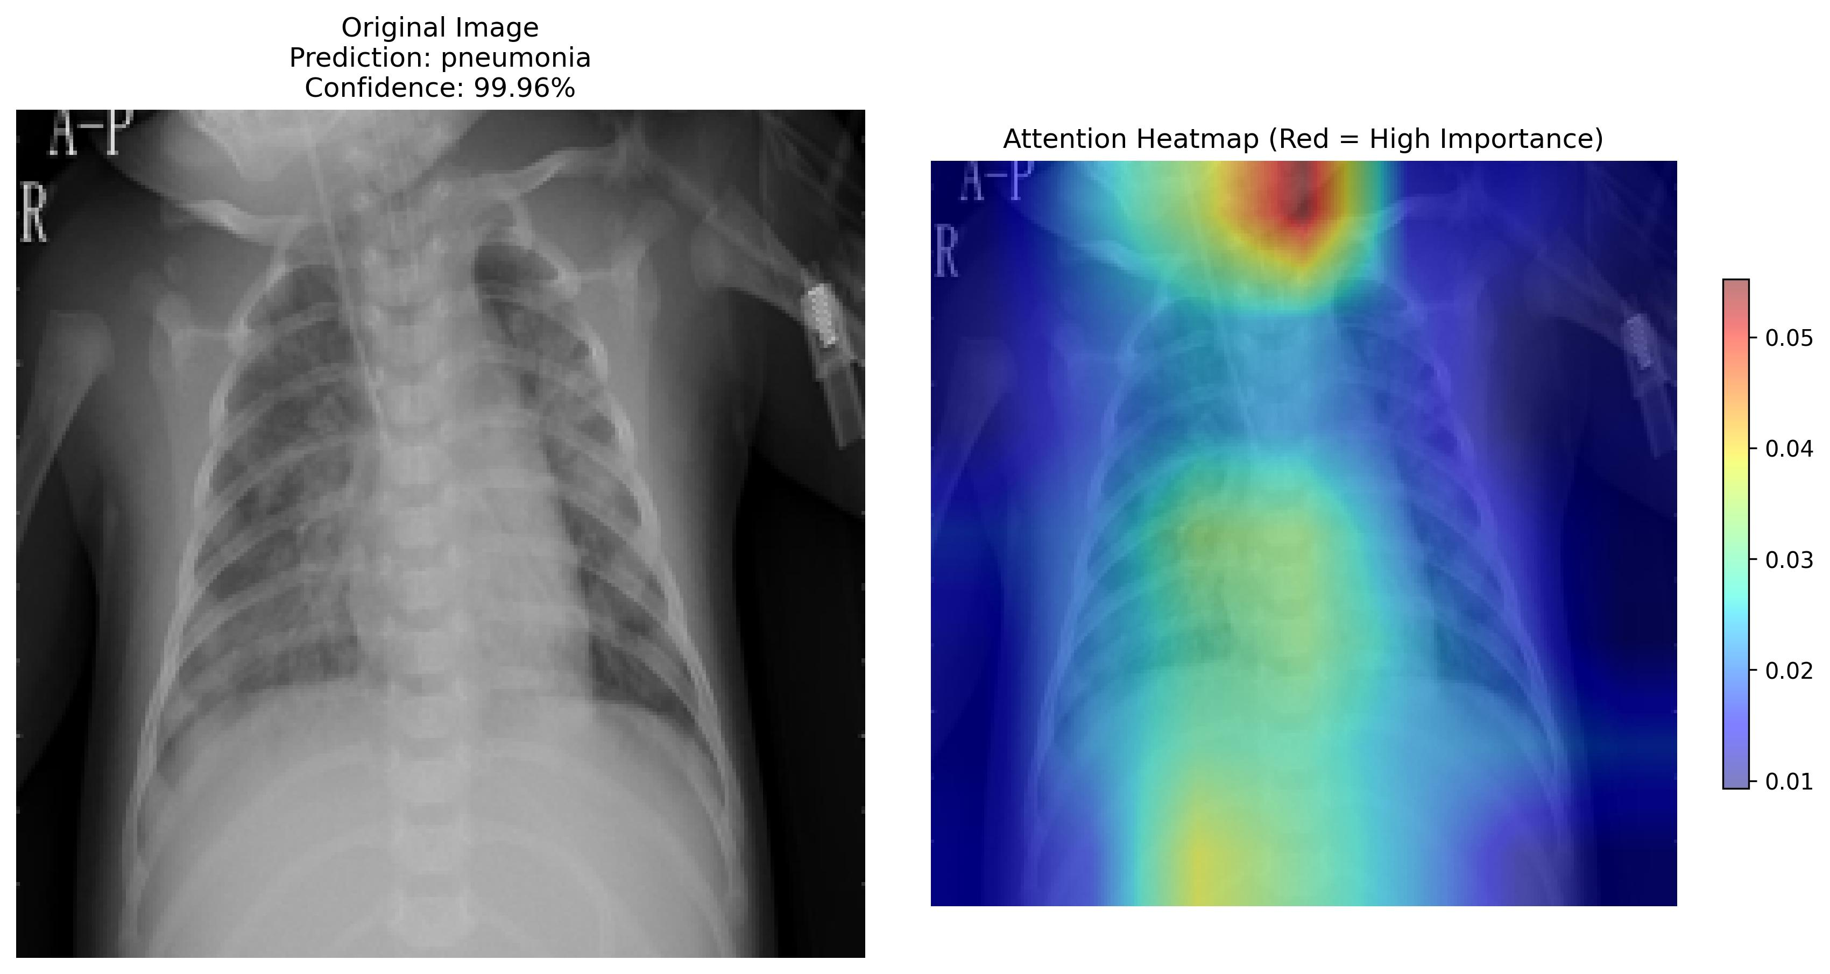

Slide 7


Slide 8


Slide 9
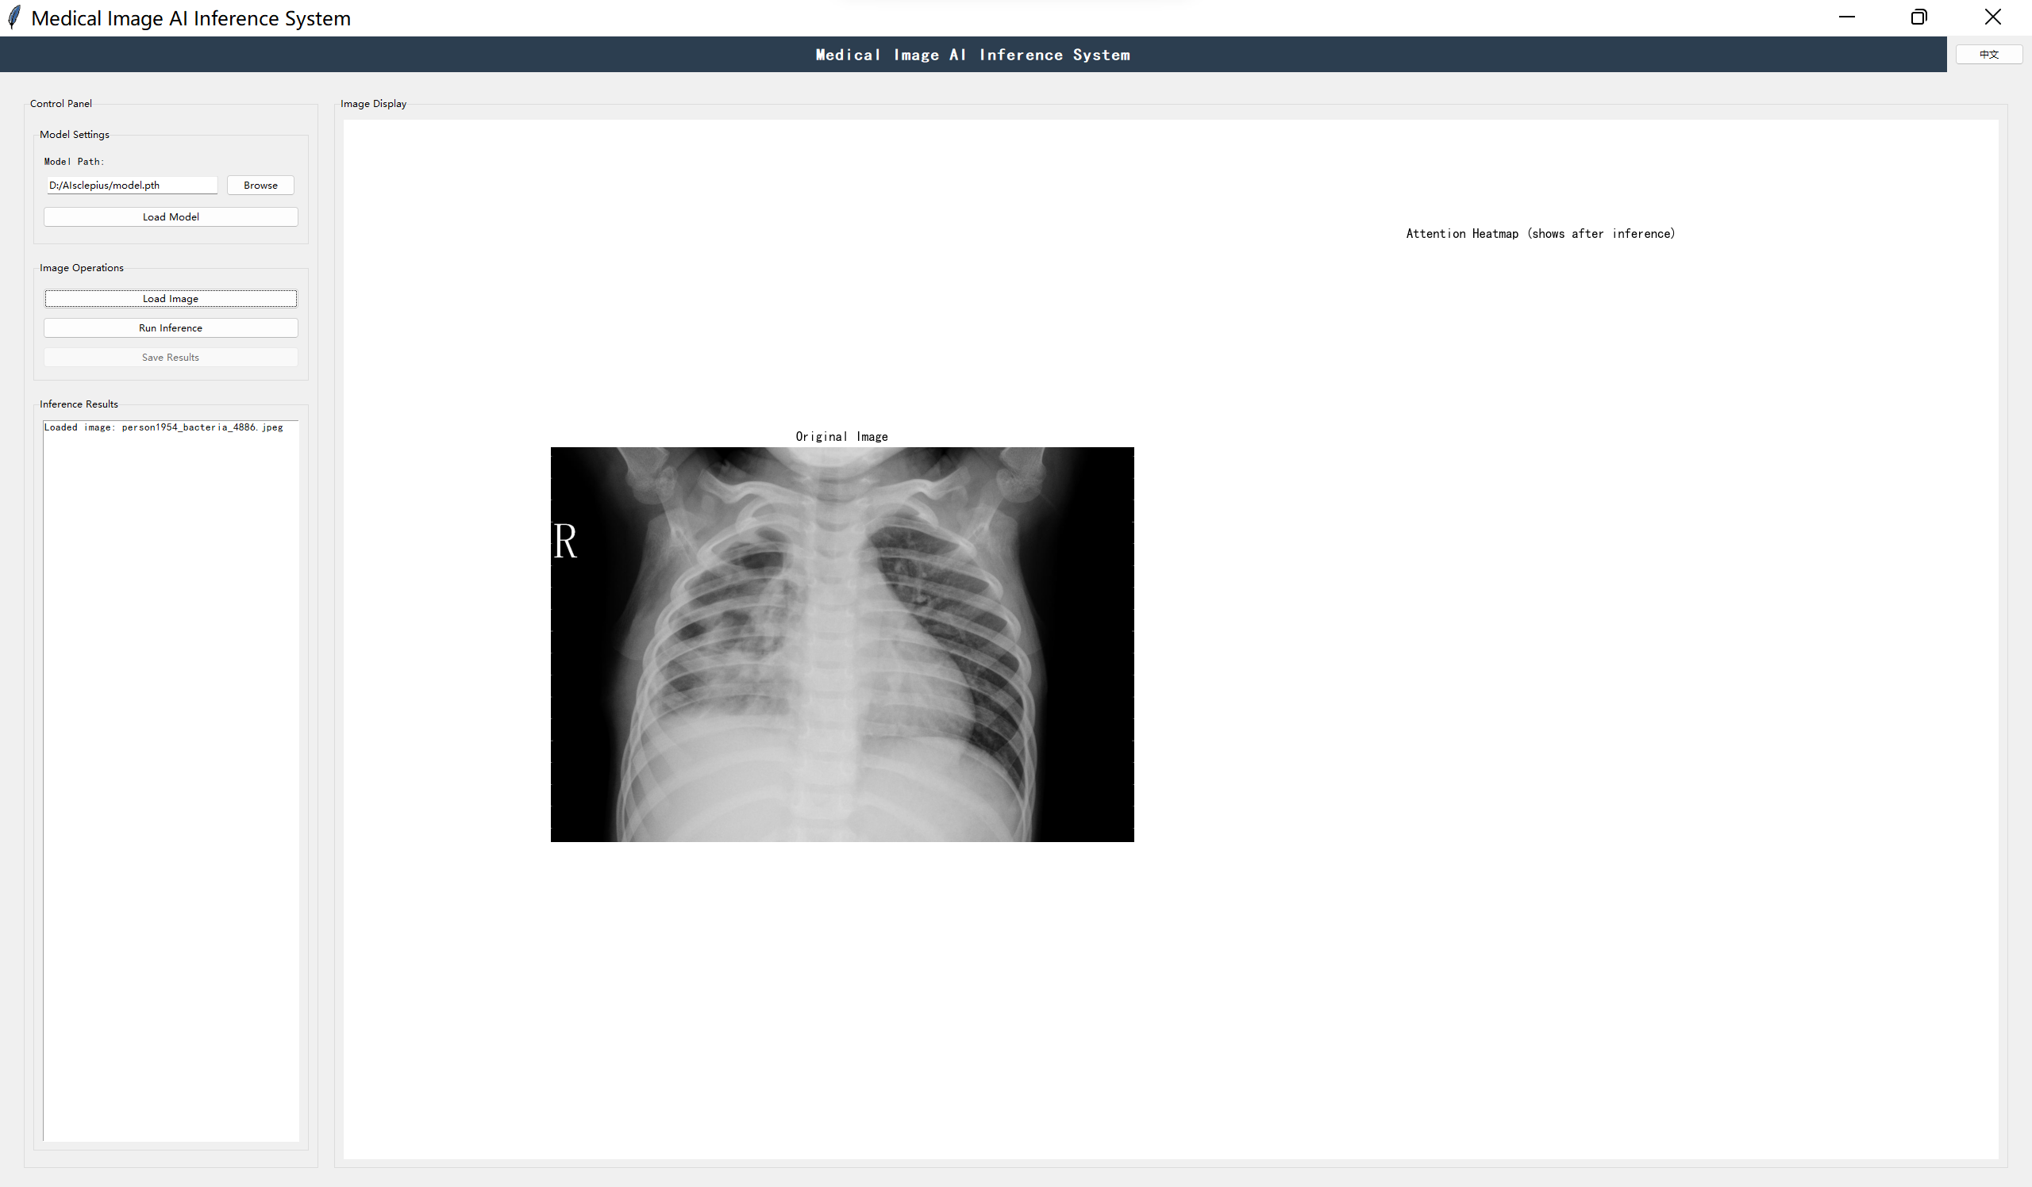

Slide 10
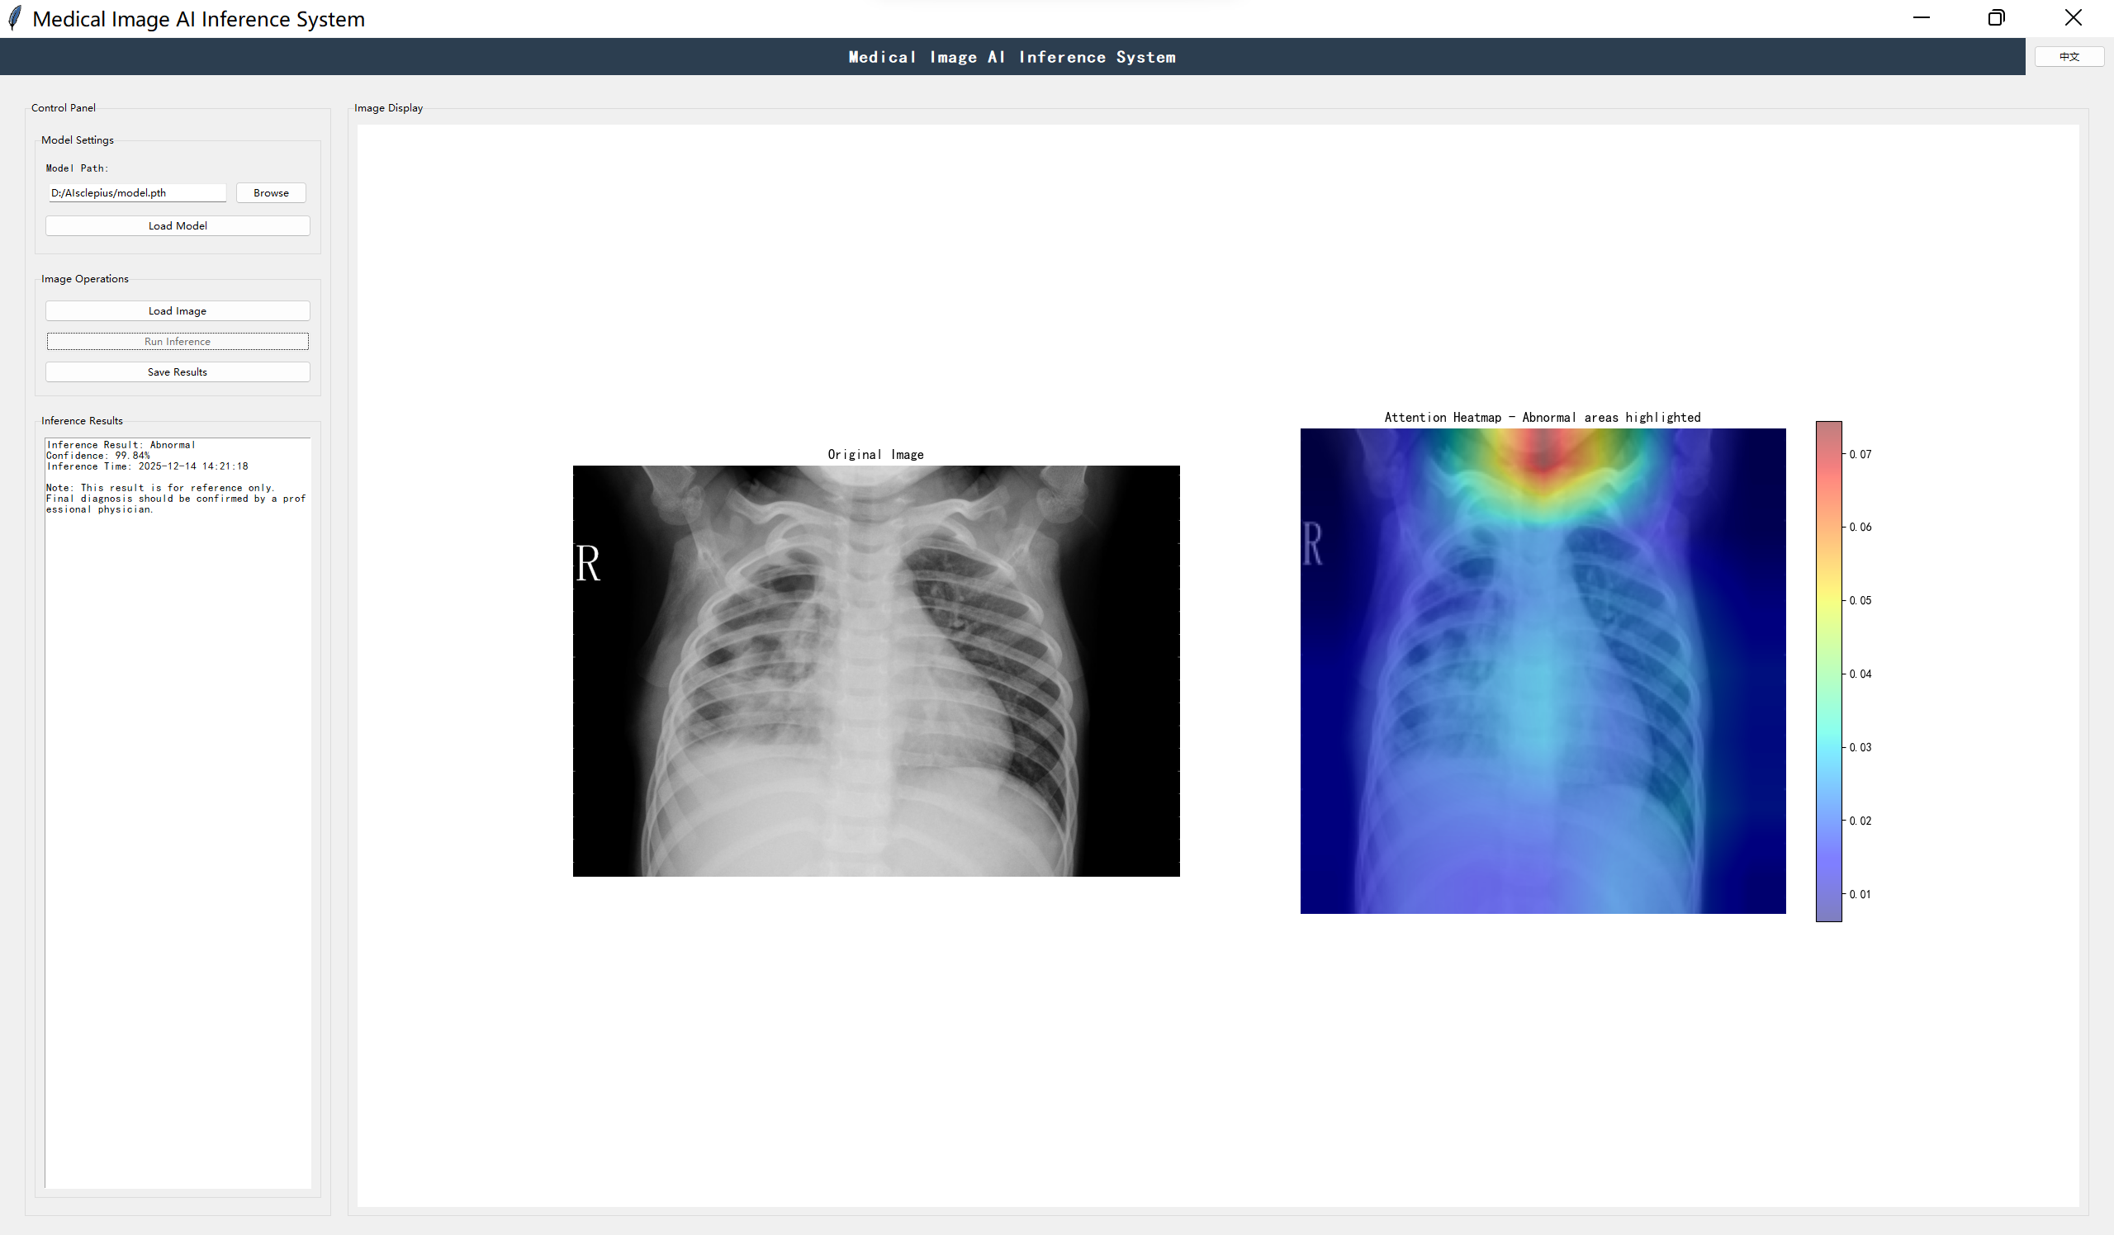

Slide 11
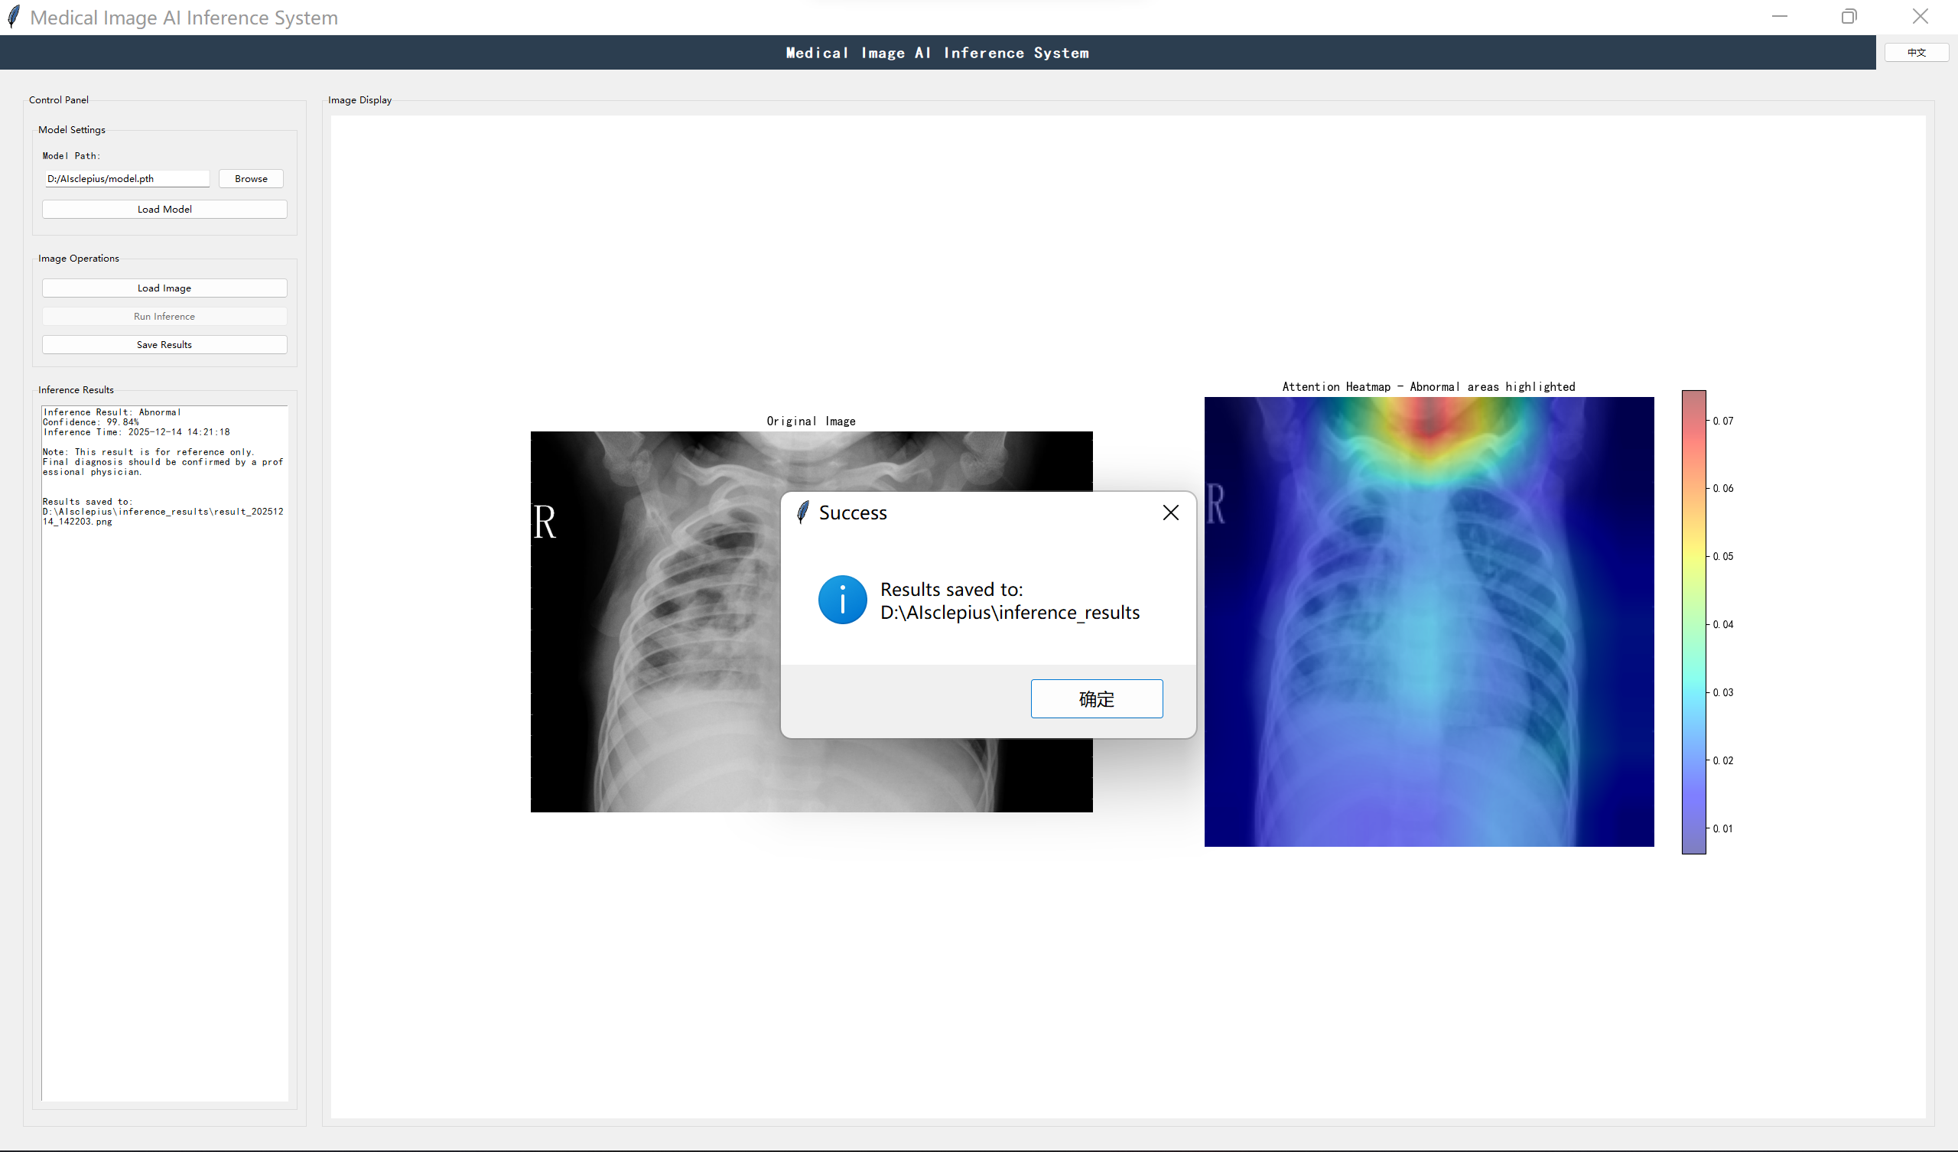

Slide 12
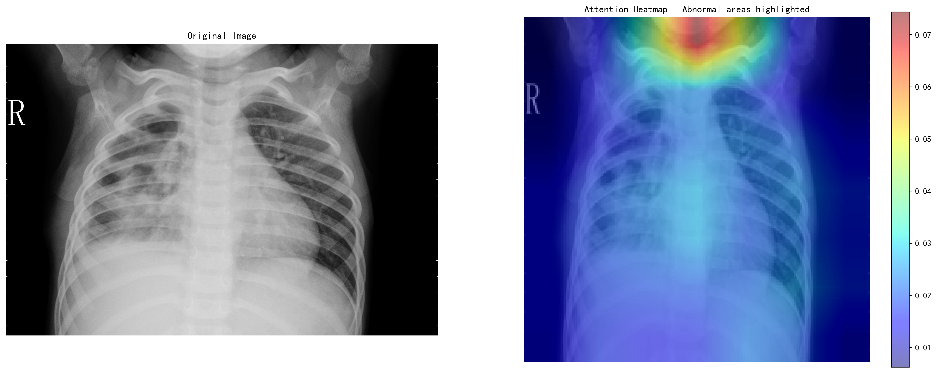
result_20251214_142203.png

Slide 13
result_20251214_142203.txt
Image Path:
D:/AIsclepius/pneumonia_classifier/data/val/PNEUMONIA/person1954_bacteria_4886.jpeg
Analysis Time: 2025-12-14 14:22:04
Inference Result: Abnormal
Confidence: 99.84%
Inference Time: 2025-12-14 14:21:18
Note: This result is for reference only.
Final diagnosis should be confirmed by a professional physician.

