Slide 1
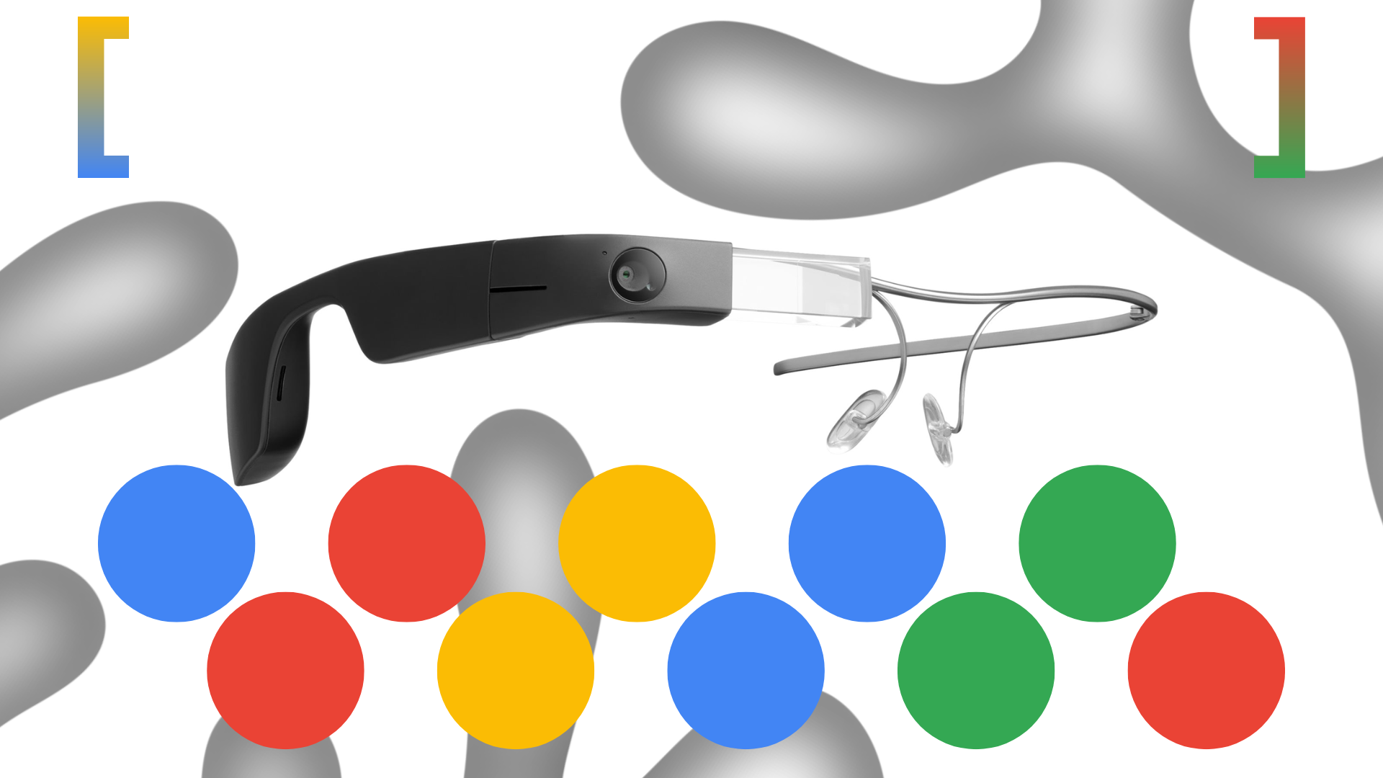
Why Google Glass Failed

