Slide 1


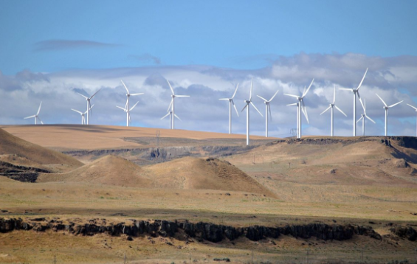
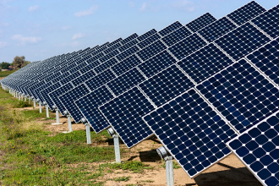
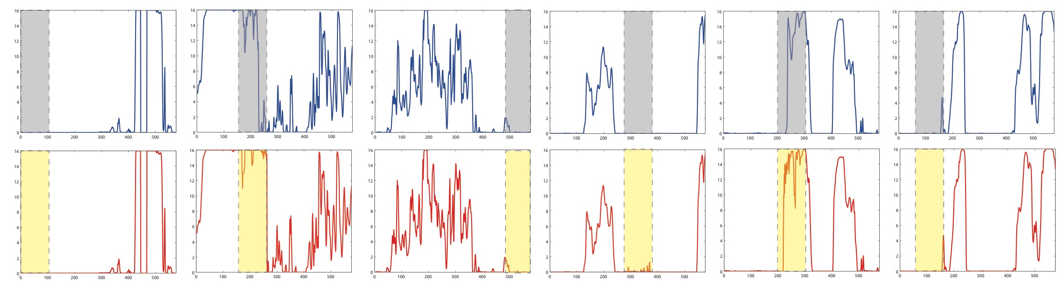




Final project for CSE547 Machine Learning for Big Data, Jun 2017
Renewable Scenarios Generation Using Generative Adversarial Networks
Yize Chen and Moke Mao
Department of Electrical Engineering and Department of Materials Science and Engineering
University of Washington, Seattle, WA
Introduction
Scenarios Generations
Introduction
Background:
Growing needs for analysis of renewables generation (e.g., wind, solar) scenarios; prediction of future power generation profile;
Existence of “big data”: historical generation profiles;
Previous research on scenario generation: complicated statistical methods; highly dependent on data volume and statistical assumption.
Objective:
Pre-process data for renewables generation;
Analyze, introduce, implement Generative Adversarial Networks(GANs)[3];
Realize GANs for renewables scenarios generation; future generation prediction; sensor data completion.
wind
solar
Data Description
Datasets: Wind Integration Dataset and Solar Integration Dataset by National Renewable Energy Laboratory (NREL). They recorded the wind and solar power generation nationwide.
Original datasets include power generation recorded every 5 minutes for 3 years from wind farms and large-scale solar panels (288 data points per day).
Data Processing:
Select wind farms and solar panels in WA
Rescale and resize each sample with total size 6188*576, 9484*576 respectively
For context conditional GANs, we add an extra testing set of 182*576.
Figure 2. Wind and solar power generation scenarios synthesized by GANs. X-axis is timestep while y-axis is power strength.
Figure 3. Data distribution in original and generated data scenario
Model-Free Scenarios Generations
The architecture in Fig.1 is used in all 3 models with some modifications. In naïve GAN, a uniform distribution between [-1,1] is used as $p_{noise}$. And random integers between [1, 10] was used as y vector. The model was trained for 100 epochs and the training was switching between 2 steps of optimizing D and 1 step of optimizing G.
After training for 100 epochs, z drawn from $p_{noise}$ were passed into G to synthesize samples. Generated samples are shown in Fig.2. Images in the bottom row are generated by G, images in the top row are selected from original dataset to compare with synthesized sample.
* Generated samples exhibit diversity and possibility of future operations.
* Sample value distribution of the original data and generated data are compared in Fig.3, which are well resembled.
Conditional GANs for Class Generations
The solar/wind datasets were separated into 3/5 classes based on the mean/maximum values of time-series and assign with labels Y. These labels were passed into generator as y vector along with z to generate scenarios resembles to specific class.
Fig.4 shows generated samples from conditional GAN and selected images from the correspondent class in the original data. Corresponding autocorrelation plot is shown to depict time-series dependency.
Methods
GANs with Wasserstein distance
*Generator G: trained to synthesize images G(z) resembling to a given distribution X;
*Discriminator D: trained to distinguish between sample from X and G(z).
*Let $𝒳=\left\{x^{1},…,x^{n}\right\}$ be a dataset of time-series samples.
*D(x): the discriminative function that for $x∈ℝ^{d}$ outputs probability of $x$ being a real sample.
*G(z): the generative function that takes a random vector $z∈ℝ^{d}$ sampled from a prior noise $p_{noise}$ and outputs a synthesized image G(z). GANs objective is given with Wasserstein distance [4] by:
Conditional GANs^{[3]}
As an extension of naïve GANs, conditional GANs gives extra input vector y and is trained to generate sample resembles to certain renewable class.
The objective is given by:
Context-Conditional GANs[5]
Let $m∈ℝ^{d}$denote to a binary mask that will be used to drop out a specified portion of an image. The generator receives as input an image with a randomly masked out patch, denoted as input $m⨀x$. The generator outputs $x_{G}=G\left(m⨀x,z\right)$ , which will be processed for D.
D(G(Z))
(a) Solar
(b) Wind
G(Z)
h3(1024)
Figure 4. Wind and solar power generation scenarios by conditional GAN along with autocorrelation plot (x-axis the lag and y-axis the autocorrelation value)
h4(1*24*24, 2*2)
h2(128*6*6)
h3(64*12*12, 2*2)
h1(64*12*12)
h2(128*6*6, 2*2)
Missing Data Completion and Renewables Prediction
Conclusions & Future Work
h1(1024)
G(Z)
X_ori
Context-Conditional Generative Adversarial Networks
Time-series completion: incomplete sensor data; analysis for historical scenarios;
Renewables prediction: Model-free predictions based on past data records
Masked data $m⨀x$were passed into G to condition the output.
In the first experiment (Fig.5), the tail end of the time series data with various length were “cut off” (blue dash line). CC-GANs is implemented to “predict” the future data based on the history. From Fig.5, we can see the tail generated by CC-GANs are continuous and similar to the original data. Images on the right with fewer data points “cut off” has better prediction.
In the ”patching” experiment (Fig.6), time windows in random position were masked and CC-GANs is implemented to retrieve the missing part. It is shown that the patches are continuous to both side and resemble the original power records.
GAN can be readily applied for scenarios generations for renewables sitting and design;
Incorporating labels and sample in-painting would find applications in conditional time-series; generations, data completion and future prediction;
Full evaluation and comparison of generated samples will be listed in final reports;
More applications: temporal-spatial correlation, ...
(Optional)
Class label Y
/Conditional Context
Historical data
Z
Figure 5. “Prediction experiment” Time series prediction by CC-GAN. The red line is the original scenario, the region after dash line was dropped out. The blue line is scenario generated by CC-GAN.
Figure 1. Architecture of our GANs/CC-GAN.s h2(128*6*6,2*2) denotes the second hidden layer is a convolutional layer with 128 channels, 6*6 kernels, and stride 2*2. h1(1024) denotes a normal layer with 1028 nodes. Each convolutional layer is followed by a batch normalization and relu layer [1].
References
We fill the missing patch in $m⨀x$ with the patch in $x_{G}$ and pass into the discriminator. The in-painted image $x_{I}$ is given by:
$$x_{I}=\left(1−m\right)⨀x_{G}+m⨀x$$
CC-GANs objective:
[1] Radford, Alec, Luke Metz, and Soumith Chintala. Unsupervised representation learning with deep convolutional generative adversarial networks. arXiv preprint arXiv:1511.06434 (2015).
[2] Morales J M, Minguez R, Conejo A J. A methodology to generate statistically dependent wind speed scenarios[J]. Applied Energy, 2010, 87(3): 843-855.
[3] Goodfellow I, Pouget-Abadie J, Mirza M, et al. Generative adversarial nets[C] Advances in neural information processing systems. 2014: 2672-2680.
[4] Arjovsky M, Chintala S, Bottou L. Wasserstein gan[J]. arXiv preprint arXiv:1701.07875, 2017.
[5] Denton E, Gross S, Fergus R. Semi-Supervised Learning with Context-Conditional Generative Adversarial Networks[J]. arXiv preprint arXiv:1611.06430, 2016.
*We would like to thank Prof. Baosen Zhang, Yishen Wang for precious advice and discussions.
Figure 6. “Patching experiment” Wind power scenario in-painted by CC-GAN. The top row is the original scenario, the grey region is randomly dropped. The bottom row is the same scenario with the dropped patch filled by CC-GAN.

