Slide 1


Introduction to Robotics AI 407 Spring 2025
University of Prince Mugrin
College of Computer and Cyber Sciences
Artificial Intelligence Department
Robot Operating System
ROS

Slide 2

Robot Operating System (ROS)
Robot Operating System is a framework for building robot applications and writing robot software. It provides tools, libraries, and conventions that make it easier to develop, test, and deploy robotic applications.

Slide 3
Robotics, before ROS
Lack of standards
Little code reusability
Keeping reinventing (or rewriting) device drivers,
access to robot’s interfaces, management of on-board processes, inter-process communication protocols, …
Keeping re-coding standard algorithms
New robot in the lab (or in the factory)
start re-coding (mostly) from scratch

Slide 4
WHAT IS ROS?
ROS is an open-source robot operating system
A set of software libraries and tools that help you build robot applications that work across a wide variety of robotic platforms
Originally developed in 2007 at the Stanford Artificial Intelligence Laboratory and development continued at Willow Garage
Since 2013 managed by OSRF (Open-Source Robotics Foundation)

Slide 5
ROS MAIN FEATURES
ROS has two "sides"
The operating system side, which provides standard
operating system services such as:
hardware abstraction
low-level device control
implementation of commonly used functionality
message-passing between processes
package management
A suite of user contributed packages that implement common robot functionality such as SLAM, planning, perception, vision, manipulation, etc.
Notes:
1. Hardware Abstraction
Windows: When you plug in a printer, keyboard, or mouse, Windows has drivers that allow it to work with the hardware, no matter the brand. You don’t need to worry about how the devices work internally.
ROS: ROS provides an abstraction layer for sensors, motors, and other robot hardware (like a LiDAR or robotic arm). Developers can write code without worrying about the hardware's exact specifications.
Example:
Windows: When you print a document, the OS handles the connection to the printer for you.
ROS: If your robot has a LiDAR sensor, ROS provides tools to easily read its data, regardless of the sensor’s manufacturer.
2. Low-Level Device Control
Windows: Windows lets you control devices directly, like adjusting your speaker volume or managing your hard drive through system settings.
ROS: Similarly, ROS allows direct control of robot components like wheels, arms, or cameras using software commands.
Example:
Windows: You can adjust a mouse’s sensitivity in the settings.
ROS: You can send commands to a robot's motor to change its speed or direction.
3. Implementation of Commonly Used Functionality
Windows: Windows provides built-in tools like the Task Manager for managing processes or File Explorer for browsing files.
ROS: ROS includes tools for starting, stopping, and monitoring different robot processes (like navigation or mapping).
Example:
Windows: Task Manager shows all the programs running on your computer.
ROS: ROS has a tool called rosnode that shows all the processes (nodes) running on your robot.
4. Message-Passing Between Processes
Windows: When you copy something to the clipboard in one program (e.g., Word), it communicates with another program (e.g., Paint) so you can paste the copied content.
ROS: Different parts of the robot (e.g., the camera and the navigation system) exchange information through a message-passing system.
Example:
Windows: You copy an image from Chrome and paste it into Photoshop—Windows handles the communication.
ROS: The camera sends images to the navigation system so the robot can avoid obstacles.
5. Package Management
Windows: Windows has a feature called Windows Update that installs new drivers or software updates. You can also download apps from app stores or the web.
ROS: ROS has a system to install and manage reusable software components (called packages) for specific robot tasks like controlling a drone or detecting objects.
Example:
Windows: You download and install Spotify or a game.
ROS: You install a navigation package to make your robot find its way around a room.

Slide 6
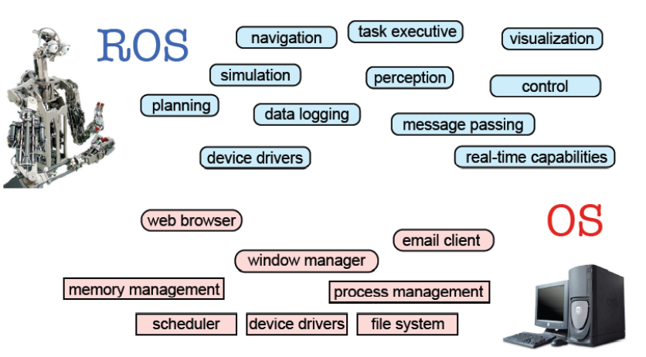
ROS MAIN FEATURES

Slide 7
WHY ROS?
Notes:
Saves Time: No need to build everything from scratch.
Easy Communication: Components can share data seamlessly.
Hardware Flexibility: Works with any sensor or motor.
Strong Community: Access to tutorials, packages, and support.
Simulation First: Test in a virtual world before real-world deployment.
In short, ROS speeds up robotics development by providing a powerful, flexible, and reusable framework.

Slide 8
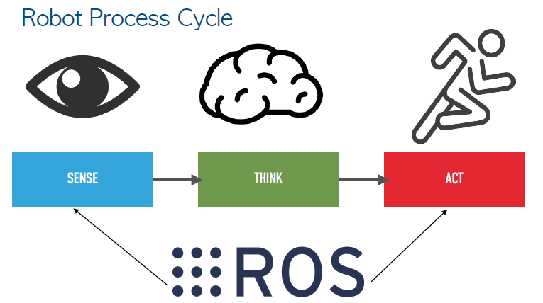
Robot Process Cycle

Slide 9
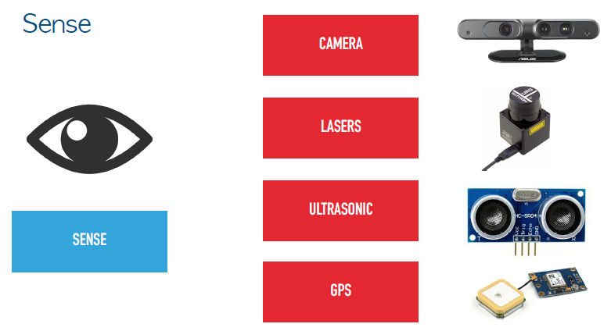

Slide 10
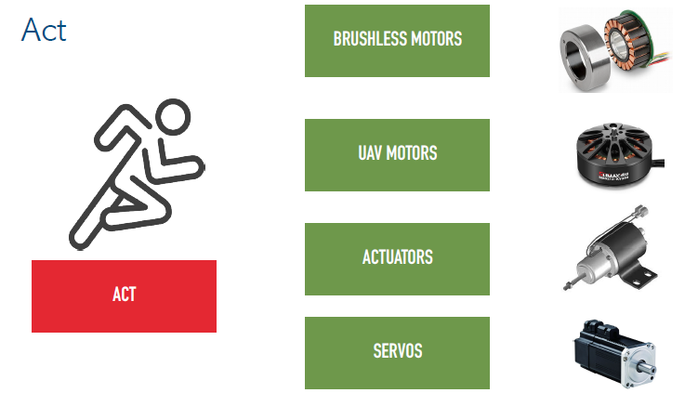

Slide 11
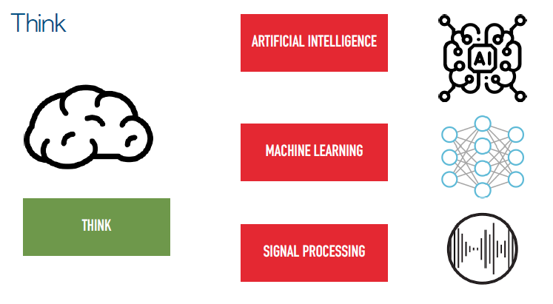

Slide 12
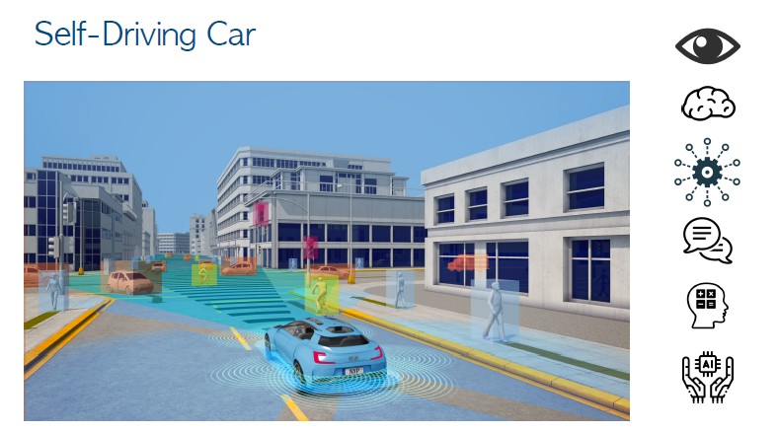

Slide 13
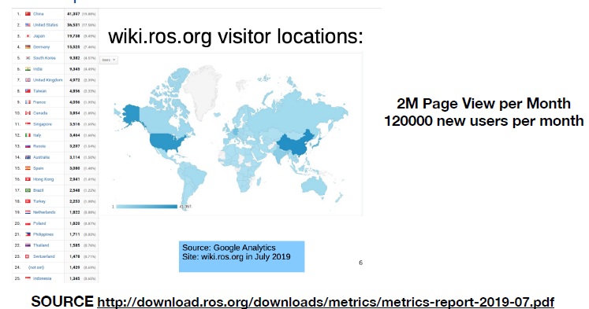
ROS Impact

Slide 14
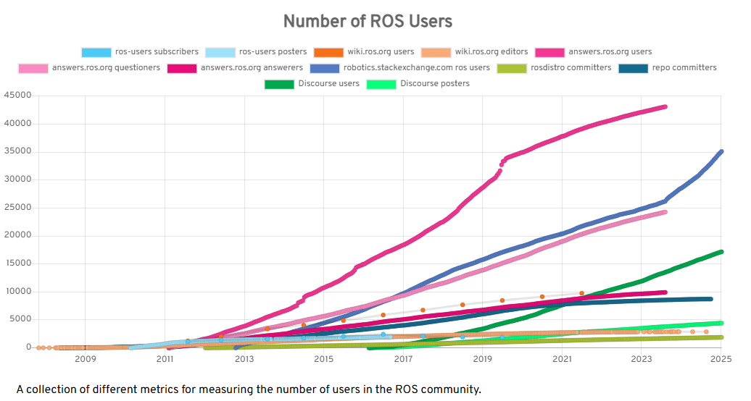
ROS Impact
Notes:
Source: Users - ROS Metrics

Slide 15
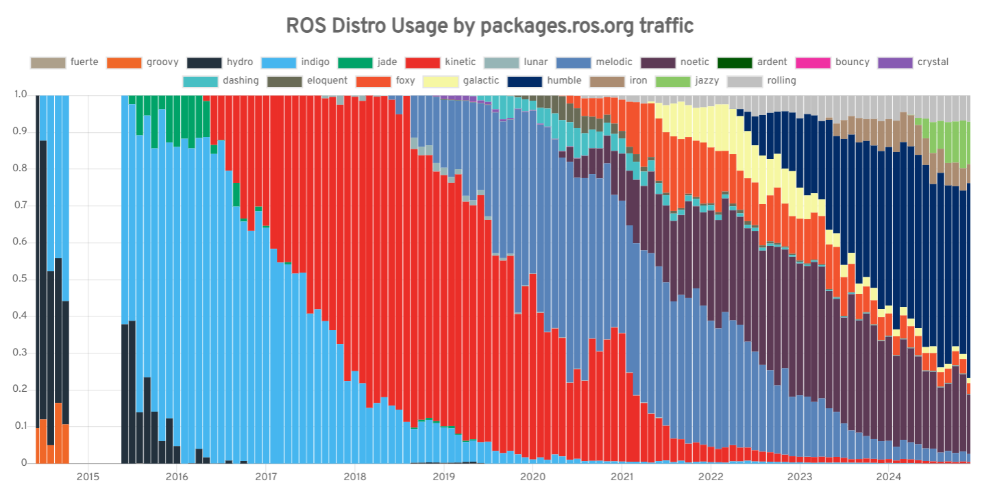
ROS Impact
Notes:
Source: Users - ROS Metrics

Slide 16
ROS Components

Slide 17

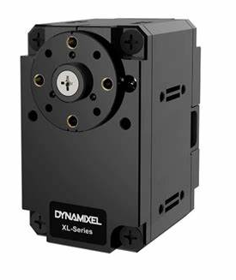
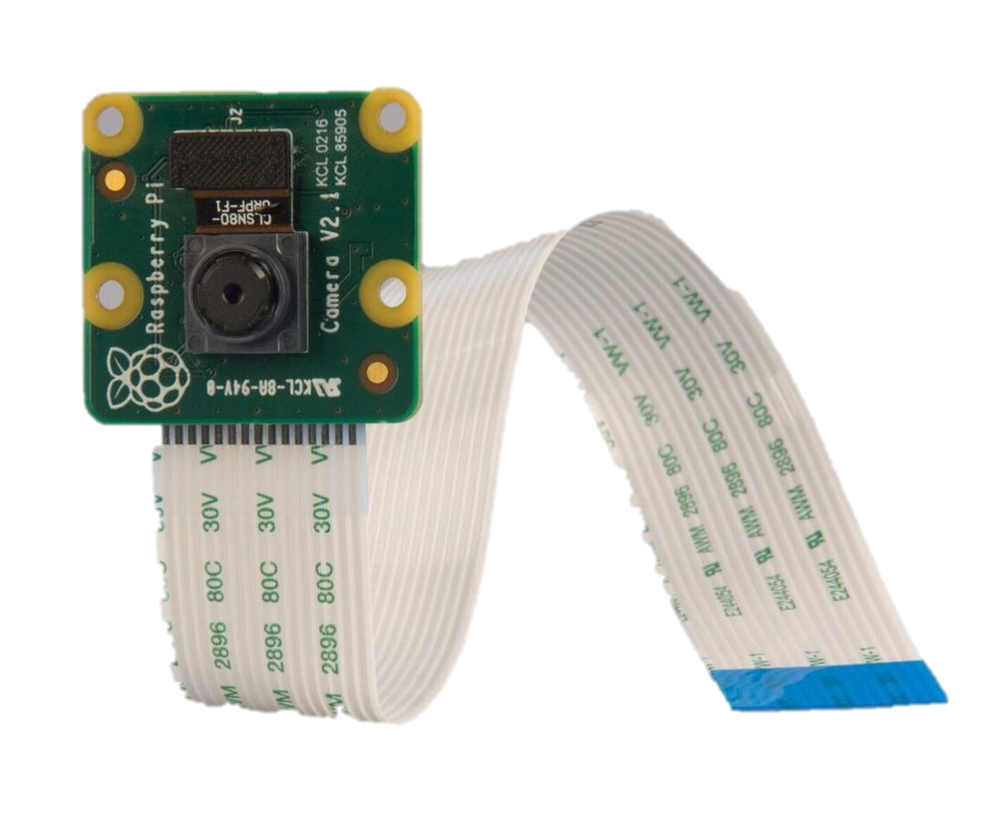
1. Nodes
A node is like a small program or unit that runs in your robot's system. It performs a specific task.
Example: Think of a robot that has two tasks: one to read data from a sensor (like a camera) and another to move the robot. Each task runs in its own node.
Notes:
In ROS: A robot can have multiple nodes that work together to perform complex tasks.
Example: sensor_node: Reads data from a camera.
movement_node: Controls the robot’s movement based on inputs

Slide 18
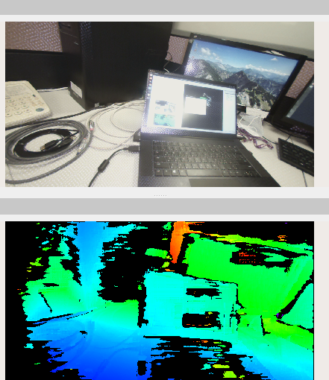
2. Topics
A topic is like a communication channel that nodes use to send and receive information. Nodes can publish (send) data to a topic or subscribe (listen) to a topic.
Example: A node publishes the robot's sensor data on a topic like /camera/image. Another node subscribes to /camera/image to get the camera data and process it.
Notes:
In ROS2: Topics are used for continuous, stream-like communication, like sending sensor data or robot position updates.

Slide 19
3. Messages
Messages are the actual data that gets exchanged through topics. A message defines the structure of the data being sent.
Example: If you're sending camera data, the message might include the image pixels. If you're sending robot position, the message might contain x, y, z coordinates and orientation.
Header:
seq: 1
stamp: {secs: 123456, nsecs: 789000}
frame_id: "camera_frame"
height: 720
width: 1280
encoding: "rgb8"
data: [0, 255, 255, 0, ...] # Pixel data

Slide 20
ROS Communication Methods

Slide 21
1. ROS Publisher/Subscriber
It is the way how nodes interact with topics.
Publishing means a node is sending data to a topic.
Subscribing means a node is receiving data from a topic.
Example:
Publisher: sensor_node → /camera/image
Subscriber: processing_node ← /camera/image

Slide 22
1. ROS Publisher/Subscriber

Slide 23
2. ROS Services

Slide 24
3. ROS ActionLib

Slide 25
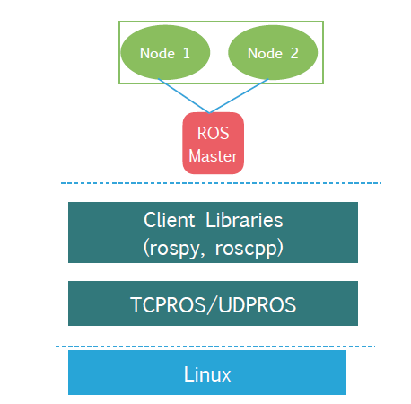
ROS Architecture

Slide 26
ROS Concepts
Reference Book: ROS Robot Programming (in English). Authors: Yoonseok Pyo, Hancheol Cho, Leon Jung, Darby Lim

Slide 27
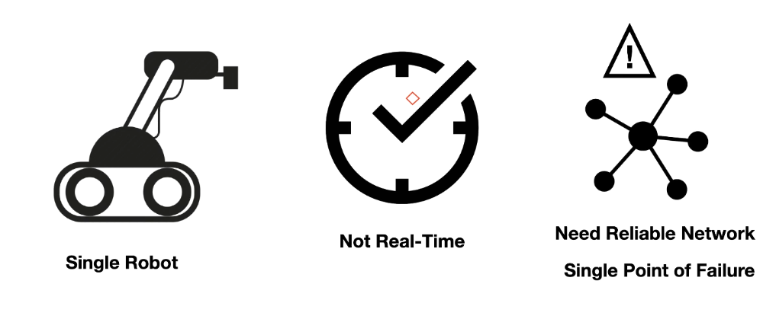
ROS 1 Limitations

Slide 28
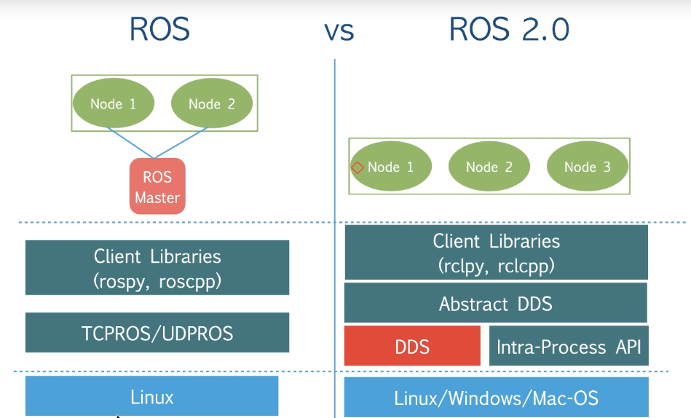
ROS vs ROS 2

Slide 29
Key Features of ROS 2
Real-Time Performance - Suitable for time-critical applications like self-driving cars & industrial robots.
Multi-Robot Support – Enables coordination between multiple robots in a system.
Better Security & Reliability – Uses DDS (Data Distribution Service) for reliable communication.
Cross-Platform Compatibility – Works on Linux, Windows, and macOS.
Scalability – Can be used in small robots (e.g., drones) and large systems (e.g., automated factories).
Flexibility – Supports multiple programming languages (C++, Python, etc.).

Slide 30
Install ROS
STEP01: Get a fresh installation of Ubuntu 22.04 Desktop on a physical machine from https://ubuntu.com/download/desktop
STEP02: Install ROS 2 Humble by simply following the steps here https://docs.ros.org/en/humble/Installation/Ubuntu-Install-Debs.html
STEP03: Running a simple demo Talker/Listener node to demonstrate communication between ROS 2 nodes.
STEO04: Running Basic ROS 2 Commands

Slide 31
Step 1 : Get a fresh installation of Ubuntu 22.04 Desktop
Ubuntu 22.04.5 LTS (Jammy Jellyfish)
Step 2 : Install ROS 2 Humble by simply following the steps here:
https://docs.ros.org/en/humble/Installation/Ubuntu-Install-Debs.html

Slide 32
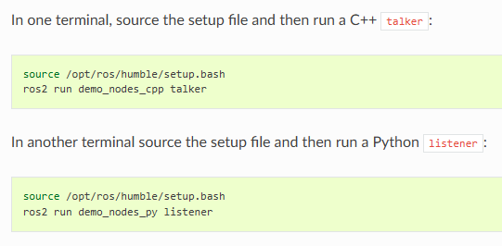
Step 3 : Running a simple demo Talker/Listener to demonstrate communication between ROS 2 nodes.

Slide 33
Basic Linux Ubuntu Commands:
ls – Lists files and directories in the current directory.
cd directory_name – Changes the current directory to directory_name.
clear – Clears the terminal screen.
pwd – Displays the present working directory.
mkdir directory_name – Creates a new directory called directory_name.

Slide 34
Understanding sudo apt install package_name
sudo – Runs the command as a superuser (administrator privileges).
apt – The package management tool for Ubuntu/Debian-based distributions.
install/update/remove – The action to install a package.
package_name – The name of the software package to be installed.

Slide 35
Run ROS 2 Commands
List all nodes
ros2 node list
Get information about a specific node
ros2 node info /node_name
List all topics
ros2 topic list
Print messages to console
ros2 topic echo /topic_name
Find which nodes are publishing to a topic
ros2 topic info /topic_name
List all message types
ros2 interface list | grep "msg/"

Slide 36
Run ROS 2 Commands
List all services
ros2 service list
List all actions
ros2 action list
Run a publisher node
ros2 run demo_nodes_py talker
Run a subscriber node
ros2 run demo_nodes_py listener

