Slide 1


Introduction to Robotics AI 407 Spring 2025
University of Prince Mugrin
College of Computer and Cyber Sciences
Artificial Intelligence Department
Robot Operating System
ROS – Part 2

Slide 2
Checking if ROS 2 is Installed
To verify that ROS 2 is installed, open a new terminal and run: ros2
If you see an output, ROS 2 is correctly installed.
If you get "command not found", even after installation, it means ROS 2 is not sourced.
Fix: Source ROS 2 in .bashrc
To ensure ROS 2 is sourced automatically, follow these steps:
1. Open the .bashrc file: gedit ~/.bashrc
2. Add the following line at the end: source /opt/ros/humble/setup.bash
3. Save the file and apply changes: source ~/.bashrc
Now, every new terminal will recognize ROS 2 automatically.

Slide 3
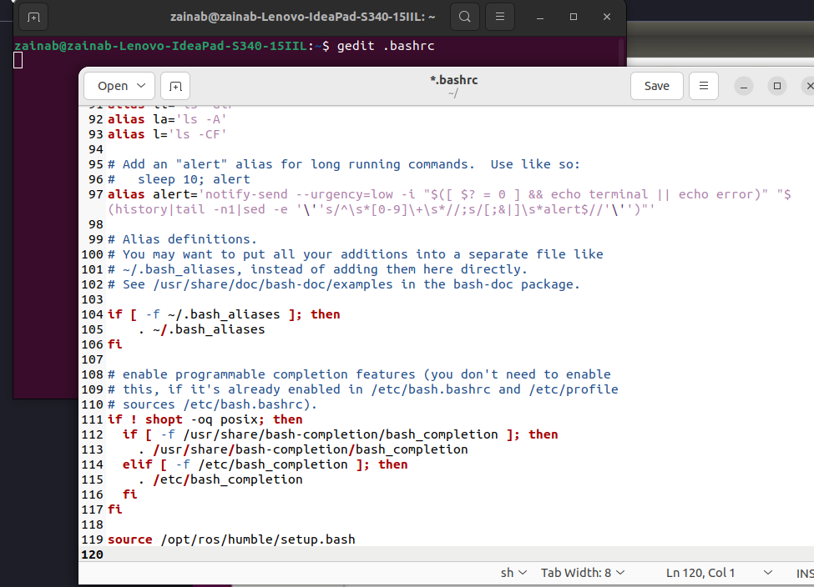
Source ROS 2

Slide 4

Ros 2 Basic Commands Demo

Slide 5
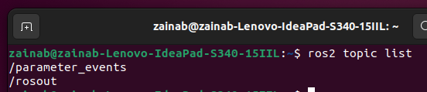
Ros2 Topic Commands
Open a new Terminal, and type in ros2 topic
This will give you a list of all the options that the ros2 topic command can do.
Type in ros2 topic list (And press enter).
This should give you a window like the following:
The two entries listed above are ROS’s built in way of reporting and aggregating debug messages in the system.
What we want to do is publish and subscribe to a message.

Slide 6
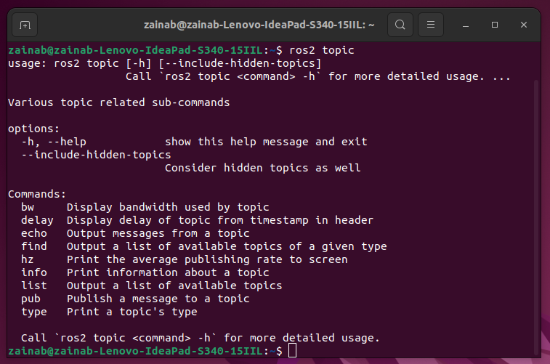
Output of ros2 topic command

Slide 7
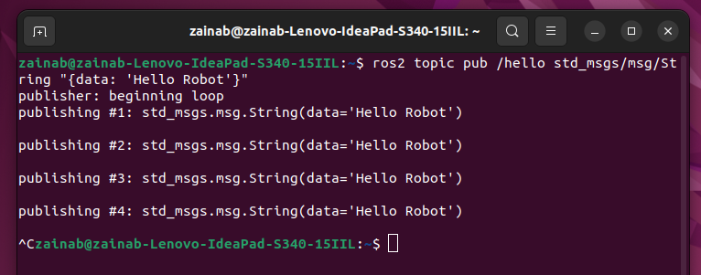
Publishing Messages to a Topic
Open an new terminal and write:
ros2 topic pub /hello std_msgs/msg/String “{data: 'Hello Robot'}“
ros2 topic pub → Publishes a message to a topic.
/hello → The topic name (It can be whatever you want).
std_msgs/msg/String → The message type (in this case String).
{data: 'Hello Robot'} → The correct YAML format for the String message in ROS 2

Slide 8
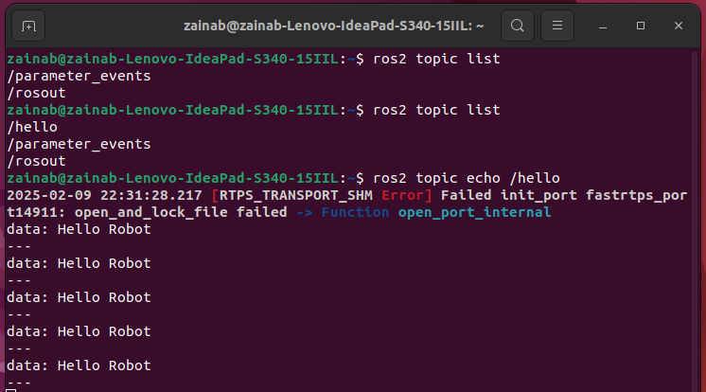
Going back to the previous Terminal, we can execute ros2 topic list again.
We now have a new topic listed!
We can also echo the topic to see the message by entering ros2 topic echo /hello

Slide 9

We have now successfully published a topic with a message,
Type Ctrl + C to stop echoing the /hello topic.
We can get info on our topic by typing:
ros2 topic info /hello
The output will be:
Type: std_msgs/msg/String
Publisher count: 1
Subscription count: 0

Slide 10
Programming with ROS
What does programming with ROS mean?
It means that ROS provides some built-in functions to implement ROS capabilities.
For example, if we want to implement a new ROS topic, or a new ROS message, or a ROS service
we can simply call these ROS built-in functions to create it.
We don’t need to implement ROS features from scratch.
The programs that use ROS built-in functions/APIs (application program interface) are called ROS nodes.

Slide 11
Next Contents
The slides covers:
Creating a ROS workspace
Creating a ROS package
Creating ROS nodes

Slide 12
ROS 2 Workspace

Slide 13
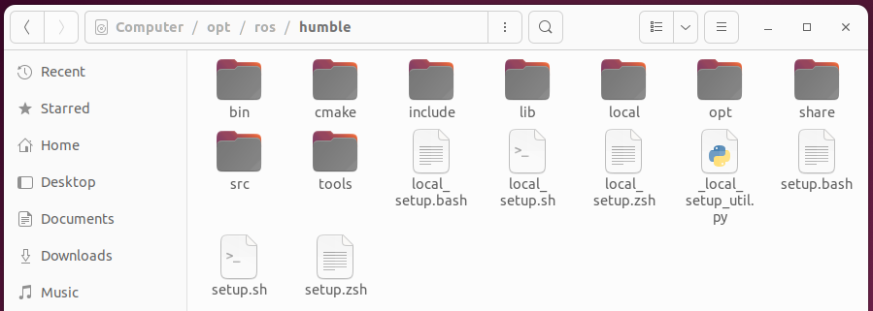
ROS Workspace
A ROS workspace serves as the working environment where all development and execution take place. It includes essential configuration files that must be sourced to enable ROS functionality within a terminal.

Slide 14
Creating a ROS Workspace and Package
The first step in ROS development is the creation of the ROS workspace,
which is a directory where ROS packages are kept.
We can create new packages, install existing packages, and build and create new executables.
You must first create a ROS workspace folder.
You can give it any name, and you can create it in any location.
Normally, this is in the Ubuntu home folder.

Slide 15
ROS Build System
To build ros workspace we will need to install colcon
Colcon is the official build tool for ROS 2. It replaces catkin (used in ROS 1) and provides an efficient way to build, test, and package multiple ROS 2 packages at once.
Colcon Features:
Supports multiple packages – Builds all packages in a workspace efficiently.
Parallel processing – Builds packages faster by using multiple CPU cores.
Flexible – Works with different build systems like CMake, Python, and Gradle.
Automatic dependency handling – Ensures packages are built in the correct
Install colcon
sudo apt install python3-colcon-common-extensions

Slide 16
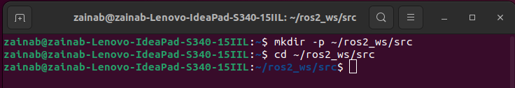
1. Create the Workspace Directory
At a new terminal, enter the following command. This creates a folder called ros2_ws, inside of which is another folder called src.
$ mkdir -p ~/ros2_ws/src
The name of the src folder shouldn’t be changed. You can change the workspace folder name if you want. After entering the command, switch to the src folder by using the cd command:
$ cd ros2_ws/src
ros2_ws is the workspace name.
The src folder will contain ROS 2 packages. (currently empty)

Slide 17

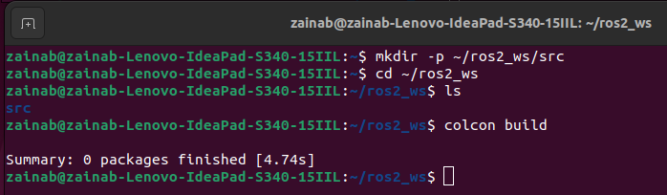
2. Build the Workspace using colcon
After initializing the colcon workspace, you can build it, even if no packages are present.
To build the workspace, navigate from the ros2_ws/src folder to the ros2_ws root directory:
_{$ cd ~/ros2_ws}
The command to build a ROS 2 workspace is:
_{$ colcon build}

Slide 18
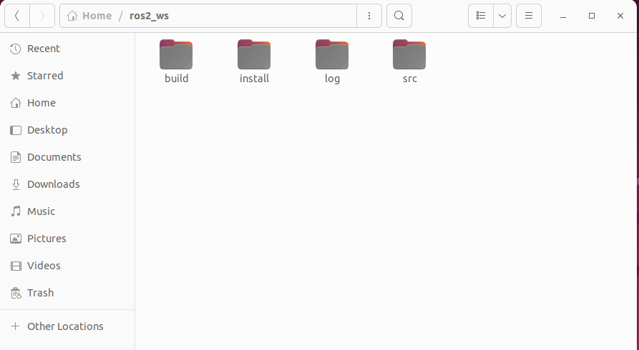
ros2_ws Result: Now you can see a few folders in addition to the src folder

Slide 19
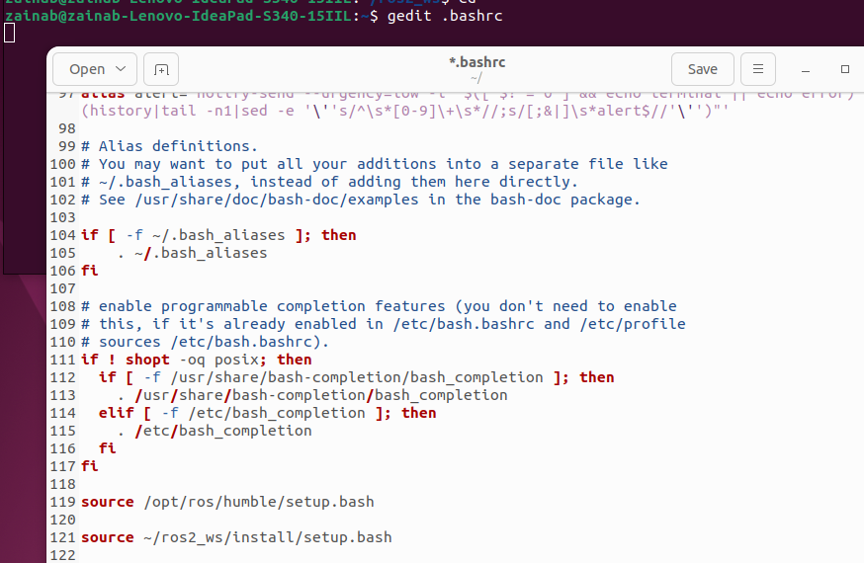
3. Source the Workspace in .bashrc
source ~/ros2_ws/install/setup.bash
the .bashrc script in the home folder executes when a new terminal session starts. So, the command inserted in the
.bashrc file also executes.

Slide 20
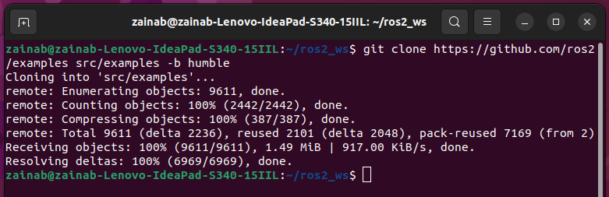
Let’s clone the examples repository into the src directory of the workspace to install the package.: - we shall be at the root of the workspace cd ~/ros2_ws _{- then run the command} git clone https://github.com/ros2/examples src/examples -b humble
If git not found, then install it using the command _{sudo apt install git}

Slide 21
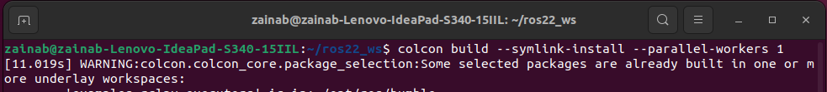
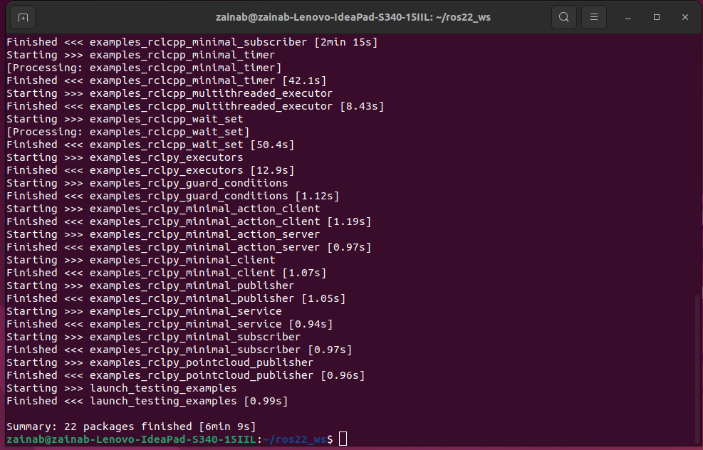

Slide 22
ROS Workspace
Follow the instruction on the documentaion
https://docs.ros.org/en/humble/Tutorials/Beginner-Client-Libraries/Colcon-Tutorial.html

Slide 23
To create our own workspace with installed packages
Step 1 install colcon:
sudo apt install python3-colcon-common-extensions
Step 2 create the workspace (create the directory)
mkdir -p ~/ros2_ws/src cd ~/ros2_ws
.
└── src
1 directory, 0 files

Slide 24
To create our own workspace
step 3 add some examples
git clone https://github.com/ros2/examples src/examples -b humble
If git not found, run (sudo apt install git)
.
└── src
└── examples
├── CONTRIBUTING.md
├── LICENSE
├── rclcpp
├── rclpy
└── README.md
4 directories, 3 files

Slide 25
To create our own workspace
step 4 build the workspace
colcon build --symlink-install
Or colcon build --symlink-install --parallel-workers 1
Step 5 source the workspace
source ~/ros2_ws/install/setup.bash

Slide 26
ros2_ws Result: Now you can see a few folders in addition to the src folder
.
├── build
├── install
├── log
└── src
4 directories, 0 files

Slide 27
ROS 2 Workspace
src/ (Source) → Contains your packages (code, launch files, etc.). You write and store all your ROS 2 packages here.
build/ → Stores compiled files and intermediate build artifacts generated by colcon build.
install/ → Contains the final built packages, executables, and libraries. You need to source this (source install/setup.bash) to use your packages.
log/ → Stores logs and debugging information from builds and executions, useful for troubleshooting.

Slide 28
Try a Demo
With the environment sourced, we can run executables built by colcon. Let’s run a subscriber node from the examples:
ros2 run examples_rclcpp_minimal_subscriber subscriber_member_function
In another terminal, let’s run a publisher node (don’t forget to source the setup script):
ros2 run examples_rclcpp_minimal_publisher publisher_member_function
You should see messages from the publisher and subscriber with numbers incrementing.

Slide 29
Exercise 1: Create a workspace with your name and clone the following repository in it git clone https://github.com/ros/ros_tutorials.git -b humble
Creating a workspace — ROS 2 Documentation: Humble documentation

Slide 30
After creating the workspace, it is an important thing to add the workspace environment.
This means you have to set the workspace path
so that the packages inside the workspace become accessible and visible.
To do this, you have to do the following steps.
Open the .bashrc file in the home folder, and add the following line at the end of the file.
source ~/ros2_ws/install/setup.bash

Slide 31
ROS 2 Workspace

Slide 32
ROS 2 Packages & Nodes

Slide 33
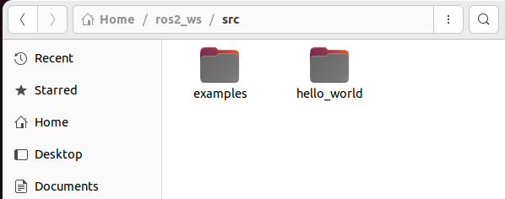
ROS Package
A ROS 2 package is a structured directory that contains everything needed to run a ROS 2 project. This includes: Code (Python or C++), Configuration files, Dependencies, ..etc

Slide 34
ROS 2 Packages
_{Steps to Create a Package}
1. Navigate to Your Workspace source
_{cd ~/ros2_ws/src}
_{2. Create the Package}
Run this command to create a simple Python-based ROS 2 package:
ros2 pkg create --build-type ament_python hello_world --dependencies rclpy std_msgs This will: Create a folder hello_world/ and Set up necessary files Include dependencies (rclpy for ROS 2, std_msgs for messages)

Slide 35
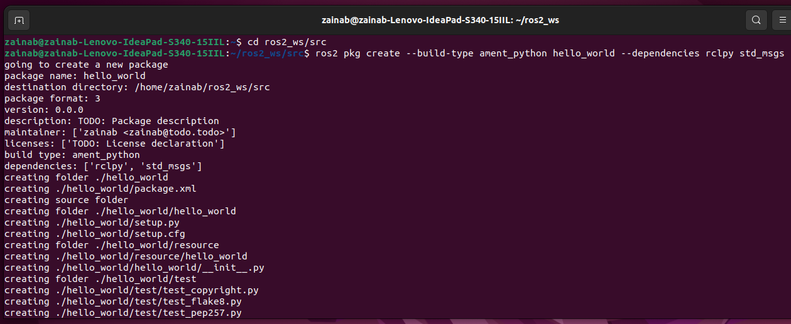
1. Navigate to Your Workspace source 2. Create the package named hello_world

Slide 36
ROS Nodes
Navigate to hello_world folder using the command
_{cd hello_world/hello_world}
Create a file named hello_world_publisher.py using the following command:
_{gedit hello_world_publisher.py}
Open the file then write the code in the next slide (Publisher Node):
(make sure to save your code ctrl+s)
Then do the same for the hello_world_subscriber.py:
gedit hello_world_subscriber.py
Open the file then write the code in the next slide of (Subscriber Node):
(make sure to save your code ctrl+s)

Slide 37
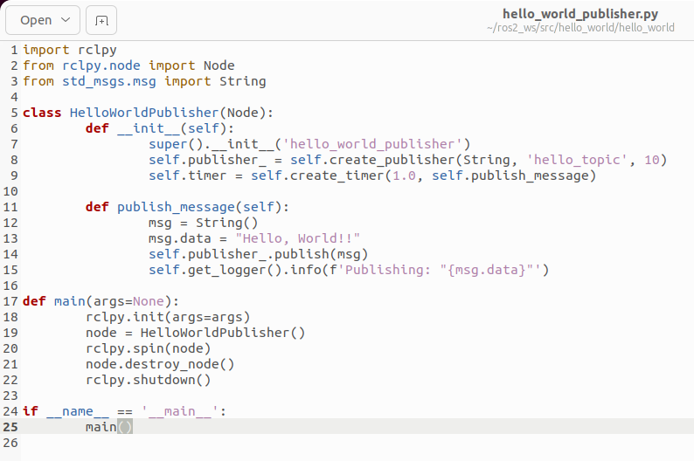
Publisher Node

Slide 38
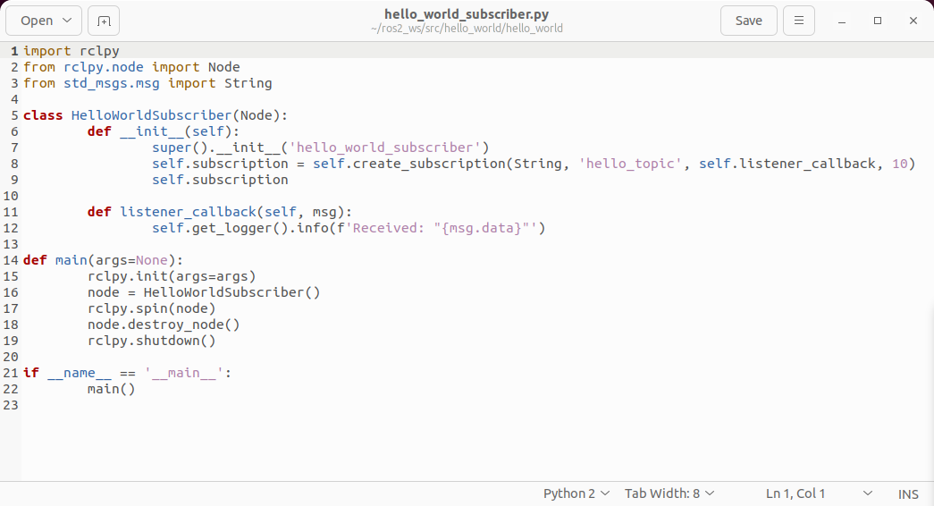
Subscriber Node
Open the hello_world_subscriber.py file, write the following code:

Slide 39
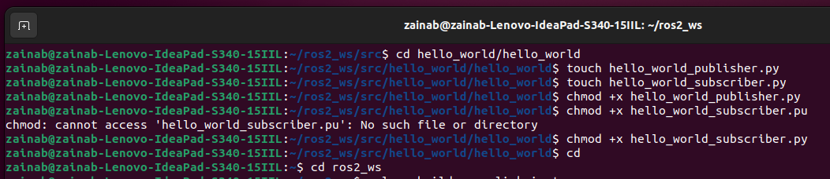
5. Make Python Files Executable
Run this inside your hello_world package:
chmod +x hello_world_publisher.py
chmod +x hello_world_ subscriber.py

Slide 40
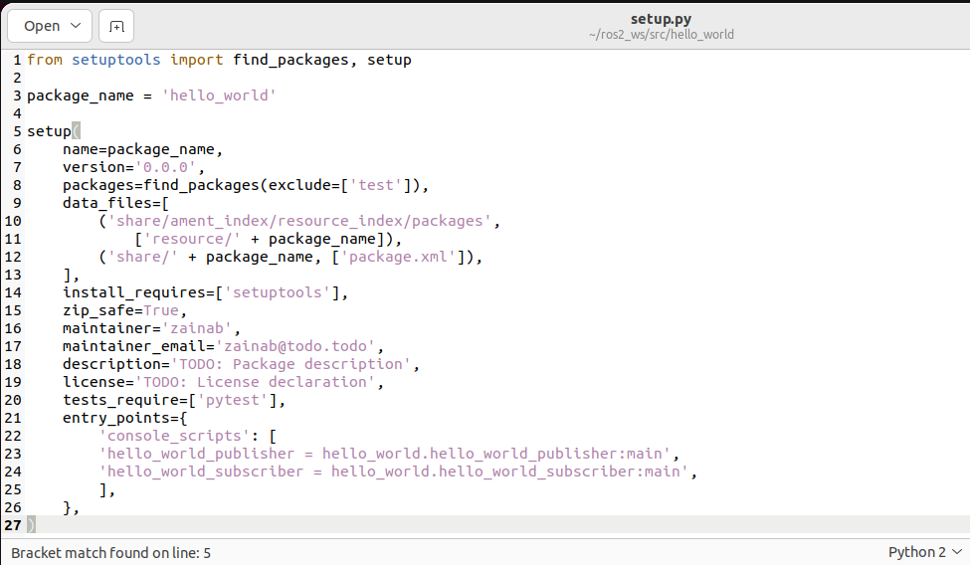
6. Register the Nodes in setup.py
Open setup.py and find entry_points. Modify it to include both scripts:
entry_points={ 'console_scripts': [ ubscriber.py:ubscriber.py:ubscriber.py:ubscriber.py: ], },

Slide 41
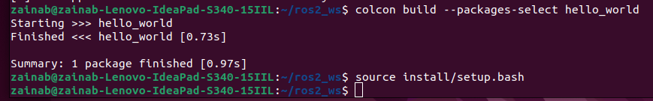
_{7. Build the package}
_{cd}
_{cd ros2_ws}
colcon build --packages-select hello_world
_{source install/setup.bash}

Slide 42
Running ROS 2 Nodes
To run a code using ros2 use the command:
ros2 run package_name executable_file_name
In our case to run the publisher open a new terminal and write
Terminal #1: ros2 run hello_world hello_world_publisher
And open another terminal to run the subscriber code
Terminal #2: ros2 run hello_world hello_world_subscriber
Terminal #3: Then try some of basic commands to explore the system
_{ros2 node list}
_{ros2 topic list}
rqt_graph # to visualize the node connections

Slide 43
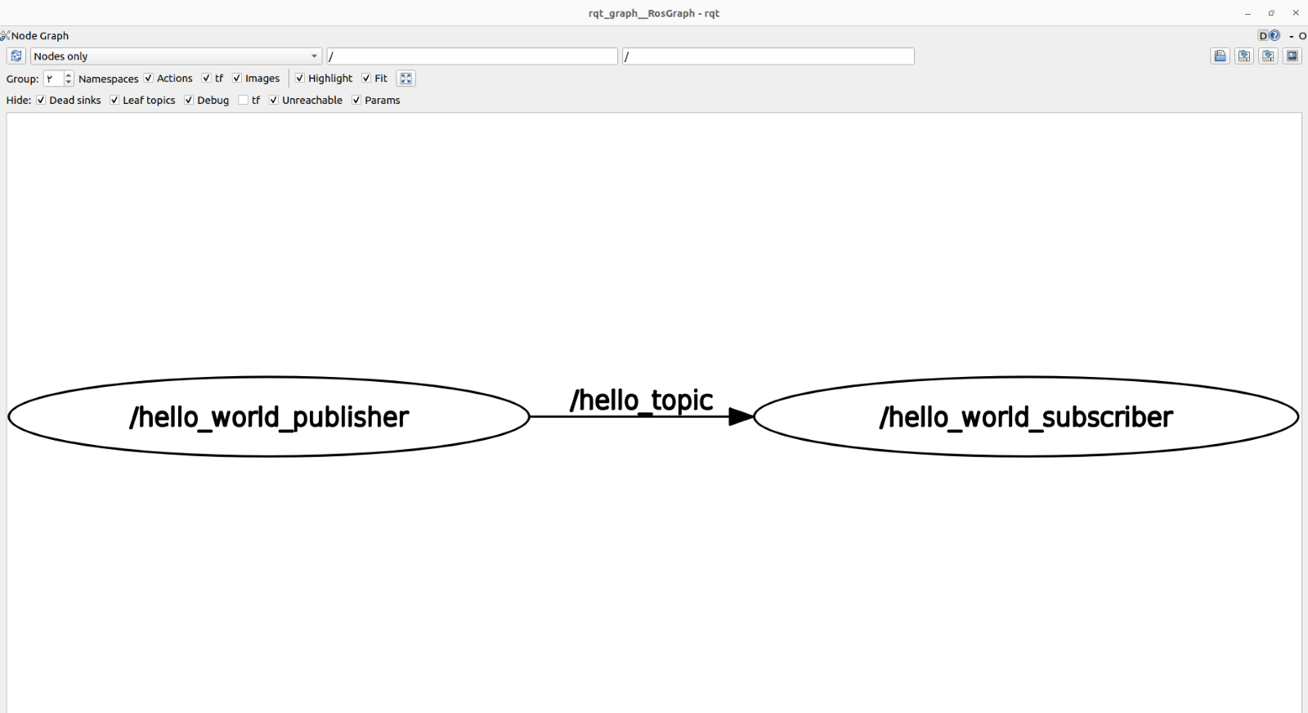
Visualizing a Computing Graph
Do you want to see what’s happening when the files are executing?
The rqt_graph GUI tool visualizes the ROS computation graph.
In another terminal run the command:
_{rqt_graph}

Slide 44
Exercise 2: The Hello World Example Using ROS 2 (Create package + nodes)
Creating a hello_world Package
to send and receive a “Hello World” string message.
Creating Python Nodes
publisher node
subscriber node
Executing Python Nodes
Visualizing a Computing Graph

