Slide 1
Cardiac Wellness System
(Heart Risk Predictor)
A Comprehensive Machine Learning Health Checkup
Name
Surana vinaya kumar 240301370055
Om Prakash jena 240301370054
Biswojit Mohapatra 240301370051

Slide 2
Contents
Introduction
Project Objectives
Technology Used
Health Input Features
Machine Learning Methodology
User Interface and Design Strategy
Diagnostic Reporting Mechanics
Key System Advantages
Conclusion
Future Scope And Expansion

Slide 3
Introduction
Cardiovascular diseases are a leading cause of global mortality.
Early detection using predictive modeling is potentially life-saving.
Purpose: Develop an ML-based web application to predict heart disease likelihood based on user health metrics.
Approach: A streamlined, user-friendly interface providing self-assessment using an underlying trained model.

Slide 4
Project Objectives
Create an intuitive, single-page user interface for quick health checkups.
Utilize key biometric data (Age, Sex, BMI, Blood Temp, etc.) to assess risk.
Implement a Deep Random Forest Classification model for high-accuracy predictions.
Provide users with meaningful interactive, animated diagnostic reports.

Slide 5
Technologies Used
Programming Language: Python (Core Logic & ML)
Frontend Framework: Streamlit (Web Interface)
UI/UX Design: Custom HTML/CSS with Glassmorphism & Animated Gradients
Machine Learning: Scikit-Learn (RandomForestClassifier)
Data Processing: Pandas & NumPy

Slide 6
Health Input Features
The model analyzes 6 critical health indicators:
Demographic: Age & Biological Sex
Body Metrics: Height and Weight (Real-time BMI calculation)
Vital Sign: Resting Blood Pressure (mmHg)
Lab Metric: Total Cholesterol (mg/dl)
Symptoms: Chest Pain Level (Asymptomatic to Severe Angina)

Slide 7
Machine Learning Methodology
Algorithm: Random Forest Classifier (100 estimators, max depth 7)
Data Source: Synthetically generated robust dataset of 4,000 medical profiles covering diverse cases.
Data Split: 80% Training Data, 20% Testing Data with balanced class weights.
Performance: Achieves high predictive accuracy on the simulated test evaluation data.

Slide 8
User Interface & Design Strategy
Modern "Glassmorphism" UI with clean light/dark visually striking cards.
Dynamic background gradients via custom CSS continuous flow animations.
Single-page architecture for an "all-in-one-screen" seamless experience.
Immediate visual feedback as users adjust health input sliders.

Slide 9
Diagnostic Reporting Mechanics
Dynamic Results Processing:
- Optimal Health: Displays a comforting heartbeat animation (Green visual theme).
- Elevated Risk: Displays a flashing warning animation (Red visual theme).
Custom Medical Advisory Plans generated based on the specific prediction.
Includes a custom UI Pie Chart visualizing Risk vs. Safe probabilistic percentages.

Slide 10
Key System Advantages
Real-time Assessment: Instant feedback with near zero-latency predictions.
Privacy-Centric: Localized data processing containing no external cloud data storage.
Exportable Summaries: Users can securely download a .txt summary of their medical report.
Educational Impact: Promotes awareness regarding fundamental cardiovascular trackers.

Slide 11
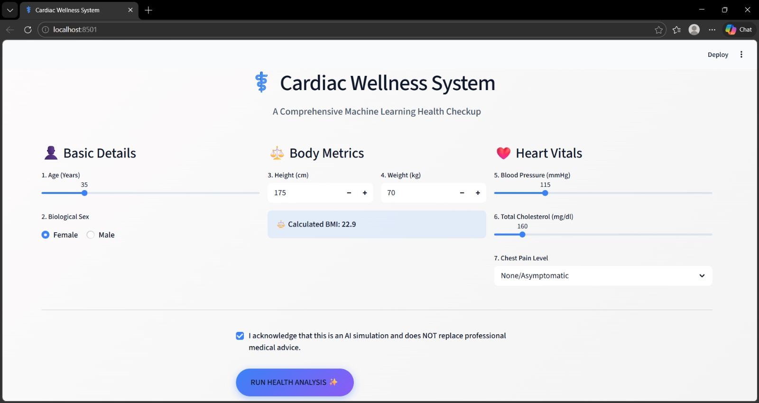
Conclusion
The Cardiac Wellness System effectively combines aesthetic modern web design with powerful machine learning capabilities.
It successfully demonstrates the potential of AI in personal healthcare monitoring systems.
Delivers an intuitive, accessible experience without sacrificing depth or analytical rigidity.

Slide 12
Future Scope & Expansion
Integration with Wearable Technology (Smartwatches/Fitness trackers) for automated data scraping.
Expand backend connectivity to incorporate Electronic Health Records (EHR).
Incorporate advanced deep learning neural networks utilizing significantly larger, real-world clinical datasets.

Slide 13


