Slide 1
Cardiac Wellness System
(Heart Risk Predictor)
A Comprehensive Machine Learning Health Checkup
Developed By: Vinay, Om, and Biswojit

Slide 2

1. Introduction
Cardiovascular diseases are a leading cause of global mortality.
Early detection using predictive modeling is potentially life-saving.
Purpose: Develop an ML web application to predict heart disease likelihood.
Approach: A streamlined interface providing self-assessment using an underlying trained ML model.

Slide 3
2. Project Objectives
Create an intuitive, single-page user interface for quick health checkups.
Utilize key biometric data (Age, Sex, BMI, Blood Temp, etc.) to assess risk.
Implement a Deep Random Forest Classification model for high accuracy.
Provide users with meaningful interactive, animated diagnostic reports.

Slide 4
3. Technologies Used
Programming Language: Python (Core Logic & ML)
Frontend Framework: Streamlit (Web Interface)
UI/UX Design: Custom HTML/CSS with Glassmorphism & Animated Gradients
Machine Learning: Scikit-Learn (RandomForestClassifier)
Data Processing: Pandas & NumPy

Slide 5
4. Health Input Features
The model analyzes 6 critical health indicators:
1. Demographic: Age & Biological Sex
2. Body Metrics: Height and Weight (Real-time BMI calculation)
3. Vital Sign: Resting Blood Pressure (mmHg)
4. Lab Metric: Total Cholesterol (mg/dl)
5. Symptoms: Chest Pain Level (Asymptomatic to Severe Angina)

Slide 6
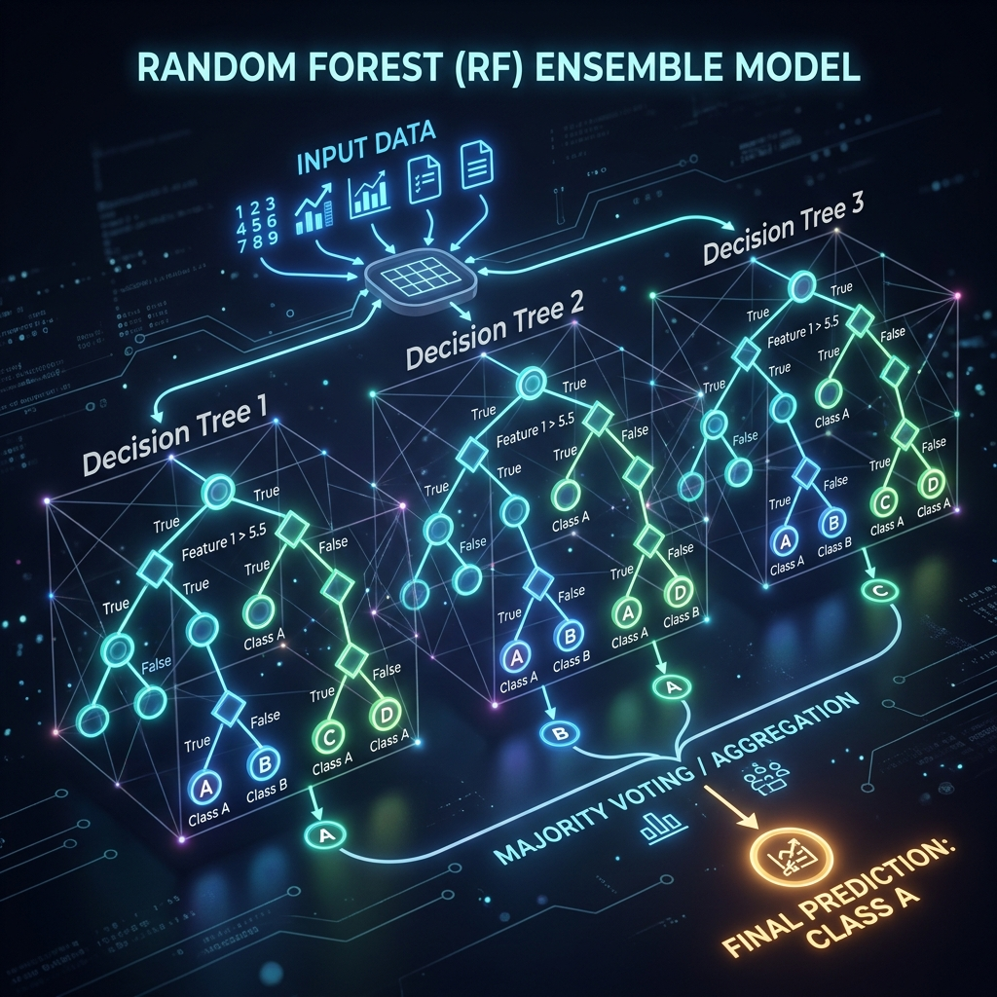
5. Machine Learning Methodology
Algorithm: Random Forest Classifier (100 estimators, max depth 7)
Data Source: Synthetically generated robust dataset of 4,000 cases.
Data Split: 80% Training Data, 20% Testing Data with balanced class weights.
Performance: Achieves high predictive accuracy on the evaluation data.

Slide 7
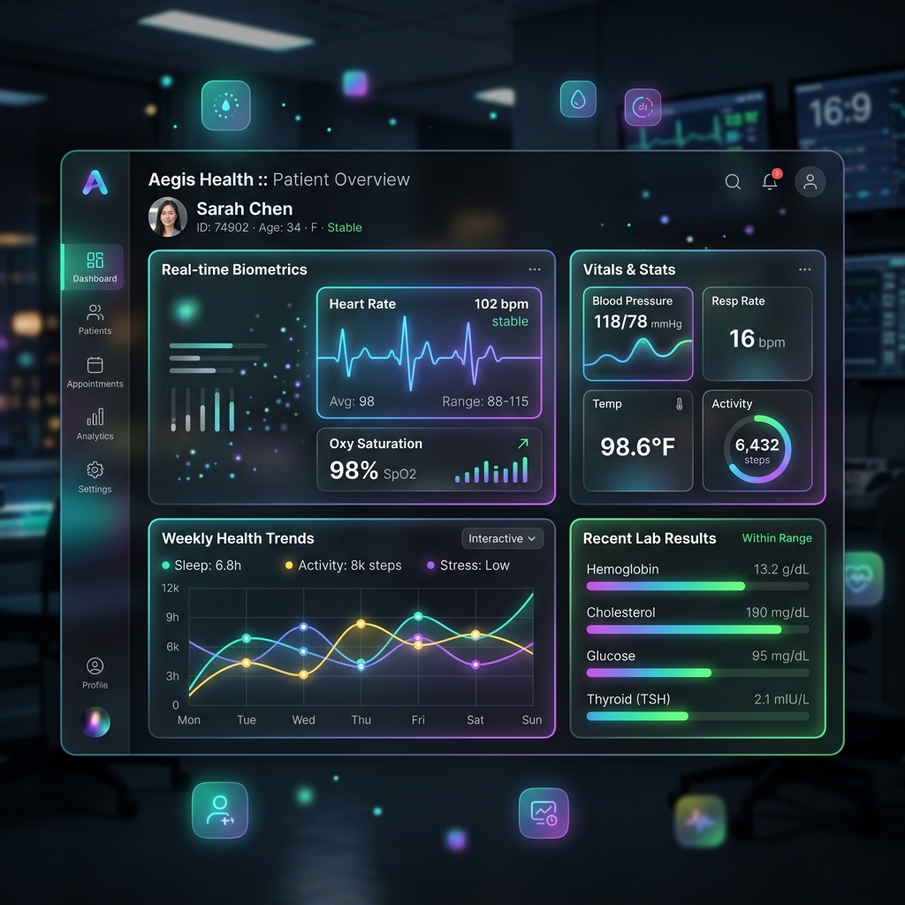
6. User Interface & Design Strategy
Modern "Glassmorphism" UI with clean light/dark visually cards.
Dynamic background gradients via custom CSS flow animations.
Single-page architecture for an "all-in-one-screen" experience.
Immediate visual feedback as users adjust health input sliders.

Slide 8
7. Diagnostic Reporting Mechanics
Dynamic Results Processing:
- Optimal Health: Displays comforting heartbeat animation (Green).
- Elevated Risk: Displays flashing warning animation (Red).
Custom Medical Advisory Plans based on the specific prediction.
Includes a UI Pie Chart visualizing Risk vs. Safe percentages.

Slide 9
8. Key System Advantages
Real-time Assessment: Instant feedback with near zero-latency.
Privacy-Centric: Localized data processing; no external cloud storage.
Exportable Summaries: Users can download a .txt medical report.
Educational Impact: Promotes awareness of fundamental health trackers.

Slide 10
9. Conclusion
The Cardiac Wellness System effectively combines aesthetic modern web design with powerful machine learning.
It successfully demonstrates the potential of AI in personal healthcare monitoring systems.
Delivers an intuitive, accessible experience without sacrificing depth.

Slide 11
10. Future Scope & Expansion
Integration with Wearable Technology (Smartwatches/Fitness trackers) for automated data extraction.
Expand backend connectivity to incorporate Electronic Health Records (EHR).
Incorporate advanced deep learning neural networks utilizing significantly larger, real-world clinical datasets.

