Slide 1
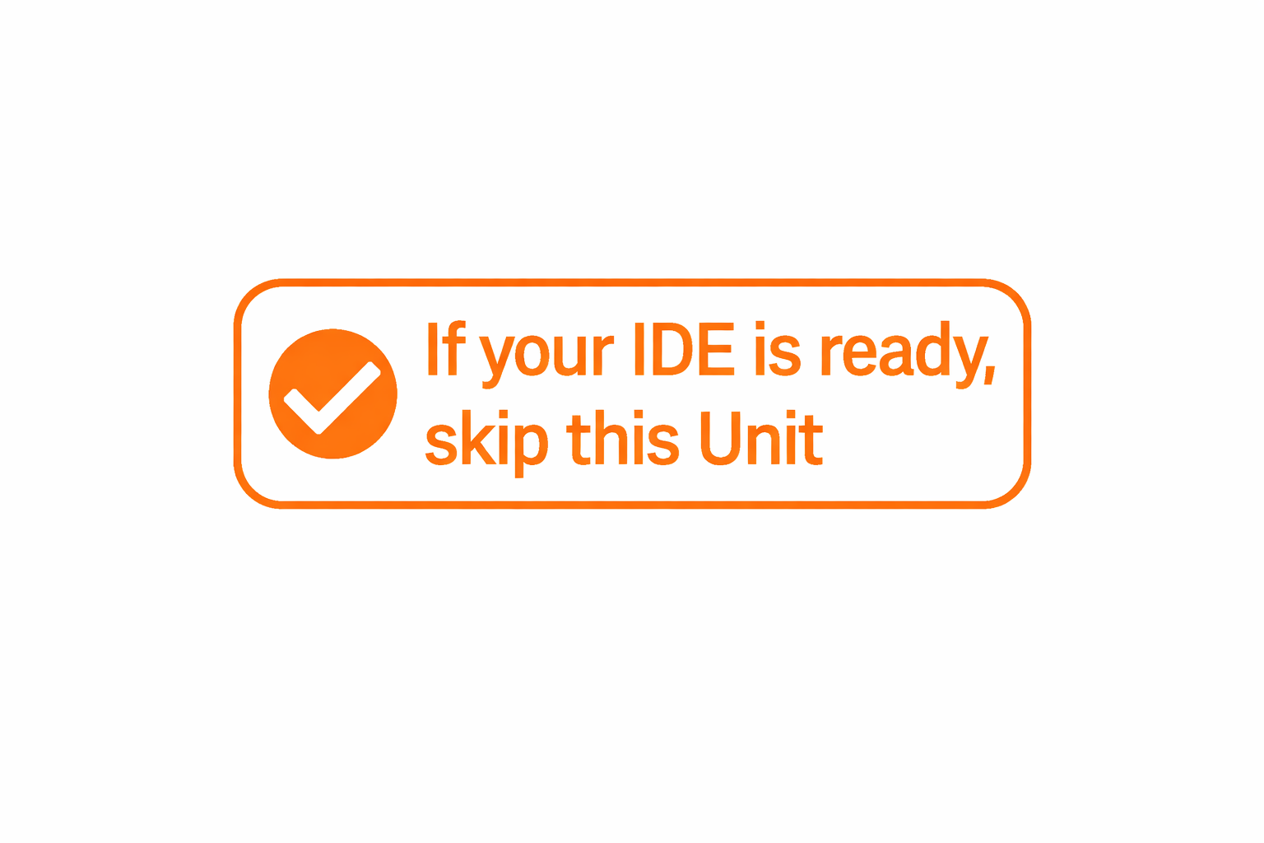


AI Decoded using only open-source tools
Unit 0: Setup
IDE – Visual Studio Code
Code Assistant – Continue.Dev
GitHub Copilot
© 2026 Asim Munawar
Released under the MIT License
https://github.com/AIxorDie/ai-decoded

Slide 2
AI Decoded using only open-source tools
Unit 01: Tokenization
What is Tokenization?
Using a modern Tokenizer
Byte-Pair Encoding
© 2026 Asim Munawar
Released under the MIT License
https://github.com/AIxorDie/ai-decoded

Slide 3
AI Decoded using only open-source tools
Unit 02: Embeddings
Why Embeddings?
Cosine Similarity
Learnable Embeddings
Input vs. Contextual Embeddings
© 2026 Asim Munawar
Released under the MIT License
https://github.com/AIxorDie/ai-decoded

Slide 4
AI Decoded using only open-source tools
Unit 03: Self Attention
Positional Embeddings
Scaled Dot-Product Self-Attention
Multi-Head Attention
Transformer Block
© 2026 Asim Munawar
Released under the MIT License
https://github.com/AIxorDie/ai-decoded

Slide 5
Appendix

Slide 6
Course Journey
Core AI & LLM fundamentals → Advanced topics like agents, tool-use.
Built using open-source technologies whenever possible.
In rare cases, if paid services are needed, I will prioritize options with free tiers.
Who This Is For
Beginners — build strong foundations
Intermediate learners — deepen understanding
Advanced practitioners — connect concepts and go further

Slide 7


AI xor Die
AI Decoded
Explaining AI using only open-source tools
Asim Munawar
https://github.com/AIxorDie/ai-decoded
© 2025 Asim Munawar
Released under the MIT License
https://opensource.org/licenses/MIT

