Slide 1


AI Decoded Learn AI the Right Way
❌ Overwhelmed by tutorials
❌ Not sure what actually works
❌ “Vibe coding” only gets you so far
❌ Confused by videos claiming to
“Train an LLM in 1-Click”
✅ Open-Source Only — No locked tools
✅ Clear explanations
✅ Real code you can run
✅ Practical & useful — from beginner to expert
If you want real AI skills — This is for you
© 2026 Asim Munawar
Released under the MIT License
https://github.com/AIxorDie/ai-decoded

Slide 2
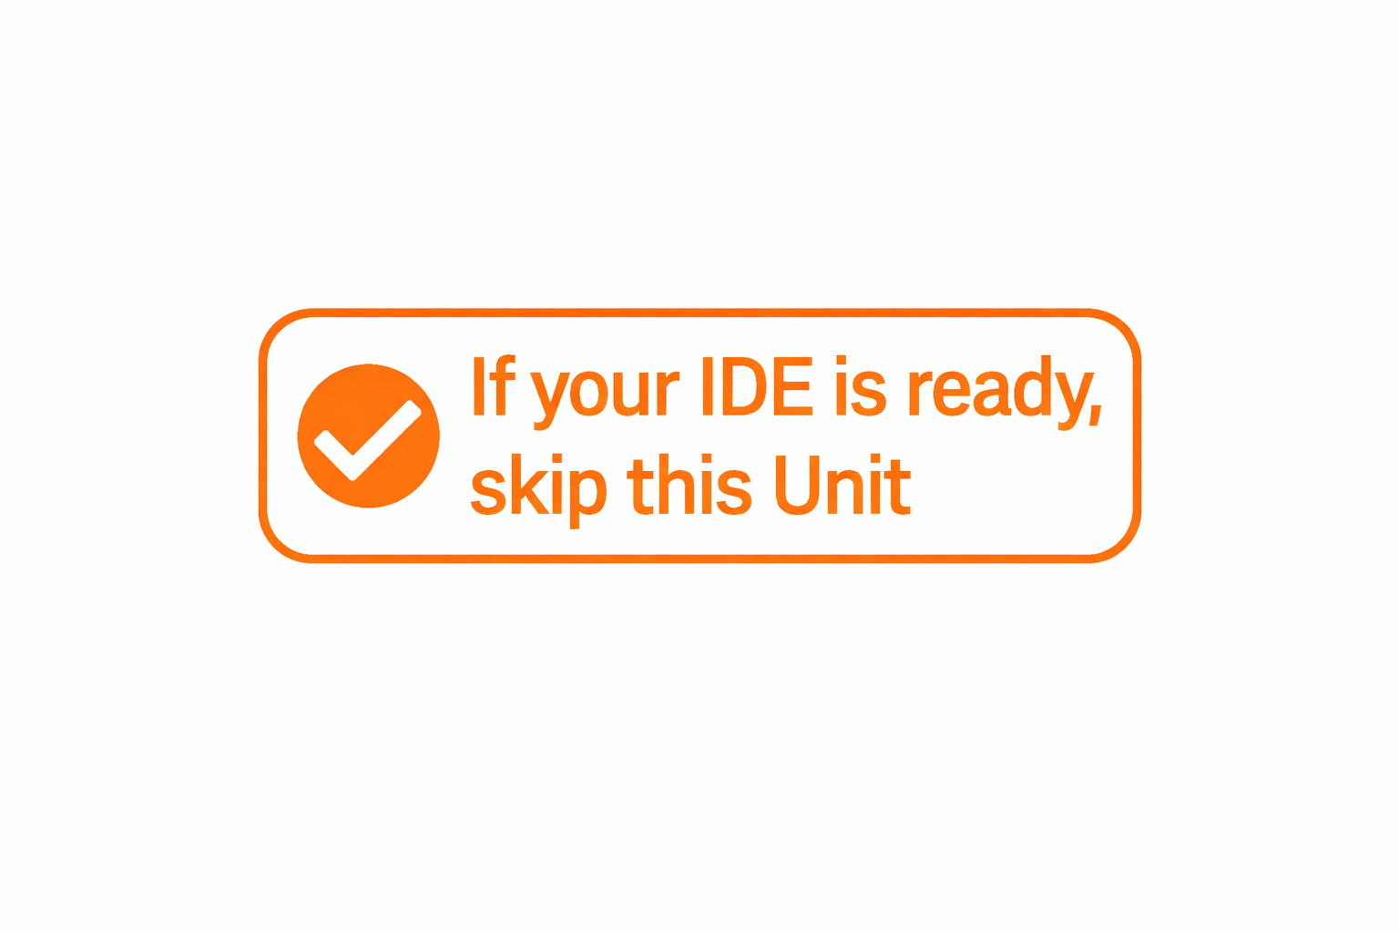
AI Decoded Powered entirely by open-source
Unit 0: Setup
IDE – Visual Studio Code
Code Assistant – Continue.Dev
GitHub Copilot
© 2026 Asim Munawar
Released under the MIT License
https://github.com/AIxorDie/ai-decoded

Slide 3
AI Decoded: LLM Basics Powered entirely by open-source
Unit 1: Tokenization
What is Tokenization?
Using a modern Tokenizer
Byte-Pair Encoding
© 2026 Asim Munawar
Released under the MIT License
https://github.com/AIxorDie/ai-decoded

Slide 4
AI Decoded: LLM Basics Powered entirely by open-source
Unit 2: Embeddings
Why Embeddings?
Cosine Similarity
Learnable Embeddings
Input vs. Contextual Embeddings
© 2026 Asim Munawar
Released under the MIT License
https://github.com/AIxorDie/ai-decoded

Slide 5
AI Decoded: LLM Basics Powered entirely by open-source
Unit 3: Self Attention
Positional Embeddings
Scaled Dot-Product Self-Attention
Multi-Head Attention
Transformer Block
© 2026 Asim Munawar
Released under the MIT License
https://github.com/AIxorDie/ai-decoded

Slide 6
AI Decoded: LLM Basics Powered entirely by open-source
Unit 4: Transformer Decoder & Sampling
Encoder - Decoder
Causal Masking
Logits to Probabilities
Decoding & Sampling
© 2026 Asim Munawar
Released under the MIT License
https://github.com/AIxorDie/ai-decoded

Slide 7
AI Decoded: LLM Basics Powered entirely by open-source
Unit 5: How LLMs Generate Text Efficiently?
What is KV Cache?
Why naive generation is inefficient?
What Q, K, and V really do in attention?
How KV cache reduces compute & latency
© 2026 Asim Munawar
Released under the MIT License
https://github.com/AIxorDie/ai-decoded

Slide 8
AI Decoded: LLM Basics Powered entirely by open-source
Unit 6: Playing with Real LLMs (HF)
Tokenization | Embeddings
Attention
Decoder + Sampling
KV Cache
© 2026 Asim Munawar
Released under the MIT License
https://github.com/AIxorDie/ai-decoded

Slide 9
AI Decoded: LLM Training Powered entirely by open-source
Reward Model: Training and Using
What is Reward Model (RM)?
Human Preference Data
Training an RM
Using an RM
© 2026 Asim Munawar
Released under the MIT License
https://github.com/AIxorDie/ai-decoded

Slide 10
AI Decoded: LLM Training Powered entirely by open-source
RLHF using GRPO with Multiple Rewards
What is RLHF?
What is GRPOTraining an RM?
Symbolic and Trained Reward Functions
Similar to DeepSeek RLHF
© 2026 Asim Munawar
Released under the MIT License
https://github.com/AIxorDie/ai-decoded

Slide 11
AI Decoded: Neuro-Symbolic AI Powered entirely by open-source
Unit 1: Neuro-Symbolic Reasoning with LLMs
What is Neuro-Symbolic AI?
LLM + Rule Engine
LLM + Knowledge Graphs
Program-of-Thought (LLM + Python Code)
© 2026 Asim Munawar
Released under the MIT License
https://github.com/AIxorDie/ai-decoded

Slide 12
AI Decoded: Neuro-Symbolic AI Powered entirely by open-source
Unit 2: Real LLM + Symbolic Planner
Build a Smart Home Chores Application
Local Huggingface LLM + Planner
Pyperplan as Symbolic Planner
© 2026 Asim Munawar
Released under the MIT License
https://github.com/AIxorDie/ai-decoded

Slide 13
Symbolic AI Concepts Part 1
Propositional Logic
First-Order Logic
Horn Clauses
Rule-based reasoning
Asim Munawar

Slide 14
Symbolic AI Concepts Part 2
Logic programming intuition
Forward Chaining
Backward chaining
Asim Munawar

Slide 15
Symbolic AI Concepts Part 3
Knowledge representation
Closed‑world vs open‑world assumptions
Knowledge graphs & ontologies
CSPs, SAT & SMT
Determinism, soundness, completeness
Asim Munawar

Slide 16
AI Decoded: Agents Powered entirely by open-source
Unit 1: Tools + LLM
How to use tools with LLMs?
Running local LLM with Ollama
Prereq for building Agents with LangChain
© 2026 Asim Munawar
Released under the MIT License
https://github.com/AIxorDie/ai-decoded

Slide 17
AI Decoded: Agents Powered entirely by open-source
Unit 2: MCP Server & Client
What is Model Context Protocol?
MCP Server with Different Transport Layers
An MCP Client
Tool use the MCP way
© 2026 Asim Munawar
Released under the MIT License
https://github.com/AIxorDie/ai-decoded

Slide 18


Build a Free Web Search Agent Powered by Open-Source
Runs Locally
Simple Code
https://github.com/AIxorDie/ai-decoded

Slide 19
How AI Thinks? What Modern AI Can (and Can’t) Do?
https://github.com/AIxorDie/ai-decoded

Slide 20


Slide 21

Build a Web Agent Powered entirely by open-source
© 2026 Asim Munawar
Released under the MIT License
https://github.com/AIxorDie/ai-decoded

Slide 22
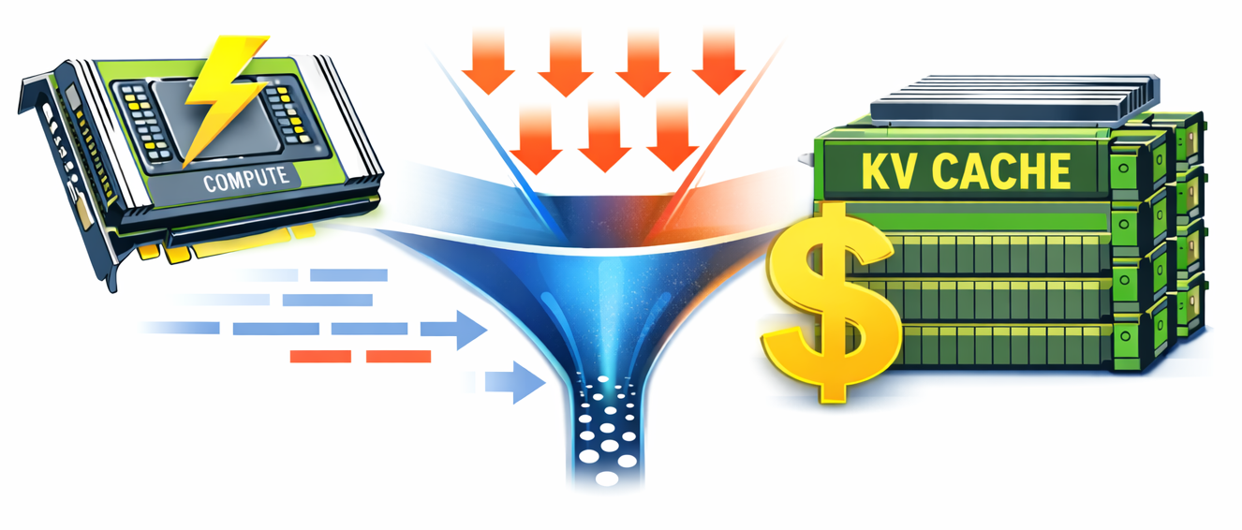
Blog Walkthrough
LLM Inference: The Real Bottleneck

Slide 23
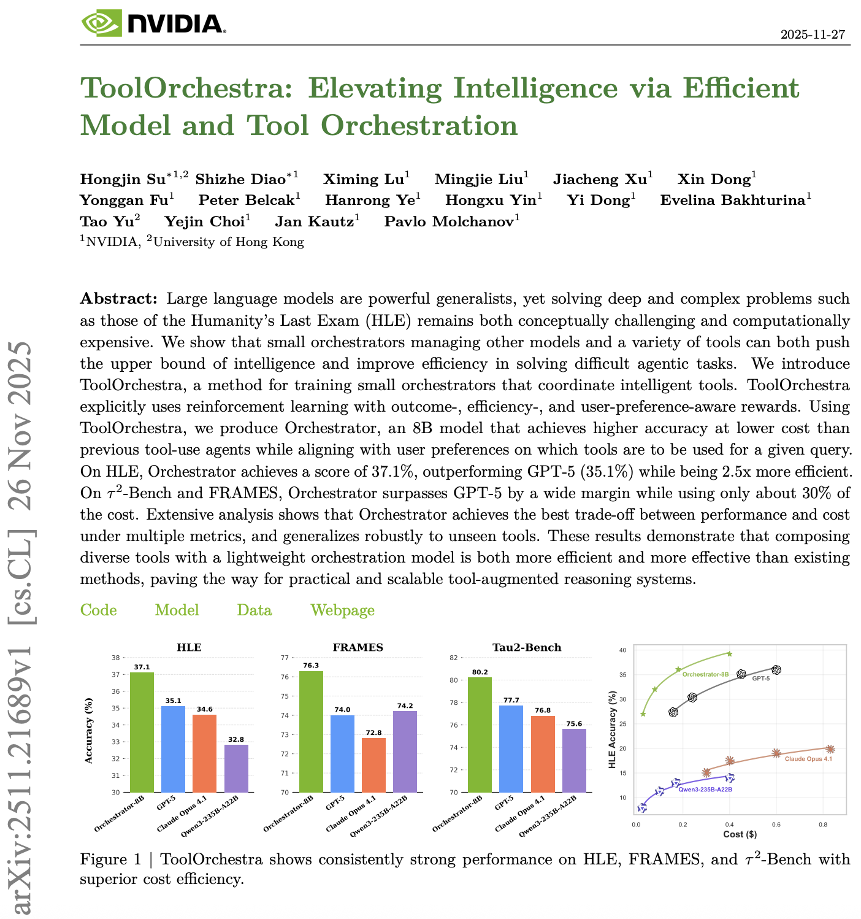
Paper Walkthrough

Slide 24
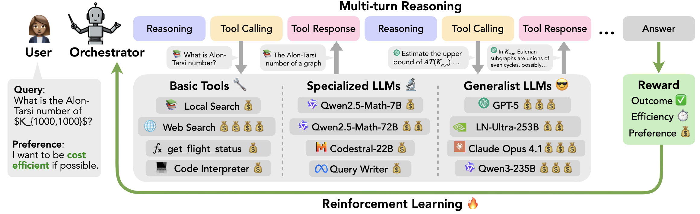
Paper Walkthrough
ToolOrchestra

Slide 25


Slide 26
Build a Web Agent Powered entirely by open-source
Free Web Agent

Slide 27
Course Journey
Core AI & LLM fundamentals → Advanced topics like agents, tool-use.
Built using open-source technologies whenever possible.
In rare cases, if paid services are needed, I will prioritize options with free tiers.
Who This Is For
Beginners — build strong foundations
Intermediate learners — deepen understanding
Advanced practitioners — connect concepts and go further

Slide 28


AI xor Die
AI Decoded Explaining AI using only open-source tools
Asim Munawar
https://github.com/AIxorDie/ai-decoded
© 2025 Asim Munawar
Released under the MIT License
https://opensource.org/licenses/MIT

