Slide 1

Notes:
Cover — Abasiono Mbat

Slide 2
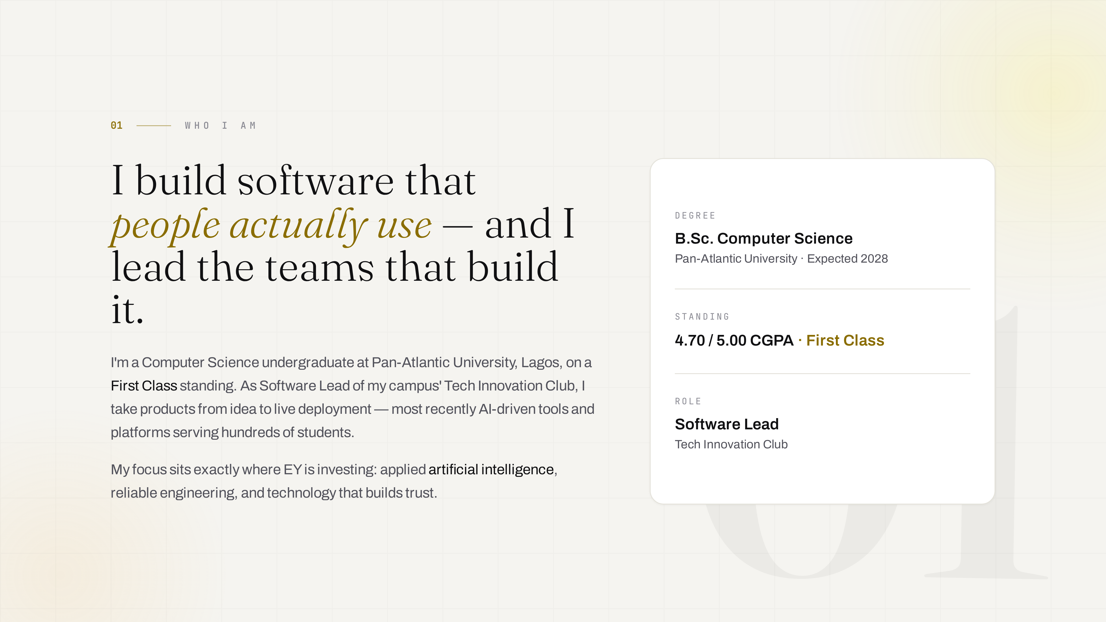
Notes:
Who I am

Slide 3
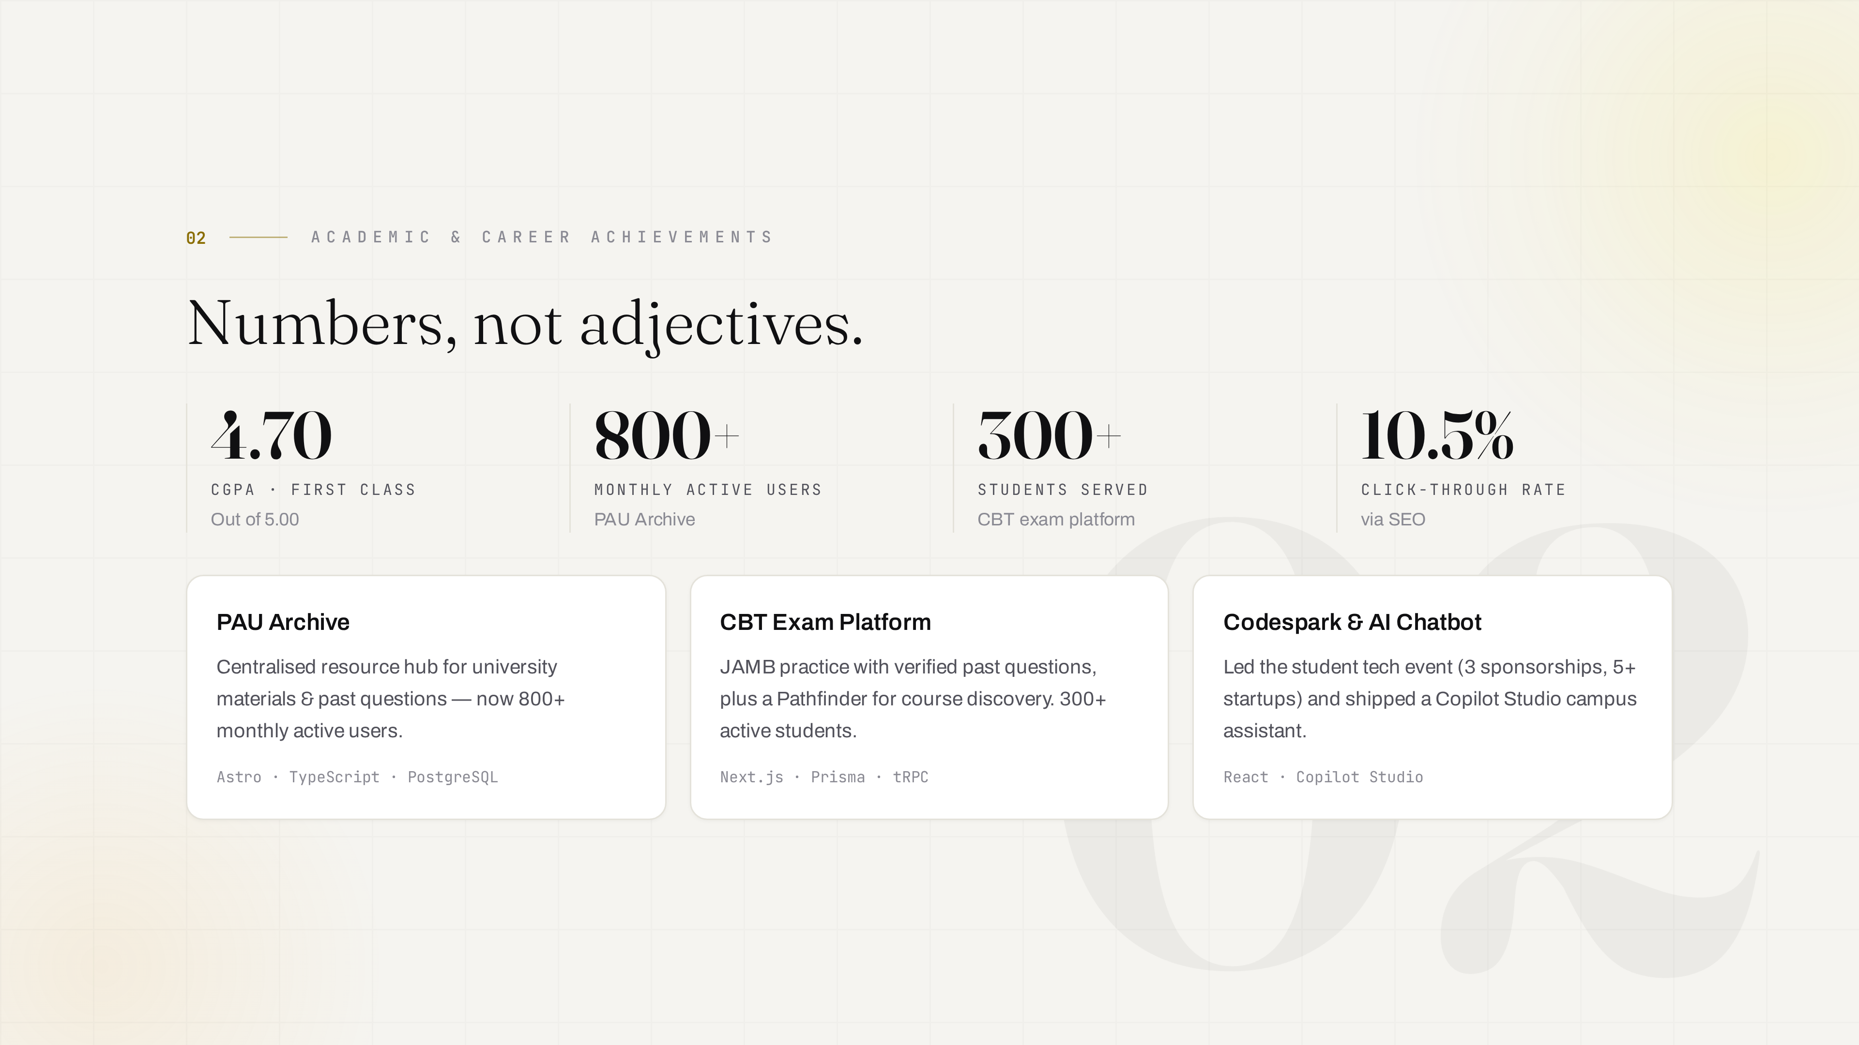
Notes:
Academic & career achievements

Slide 4
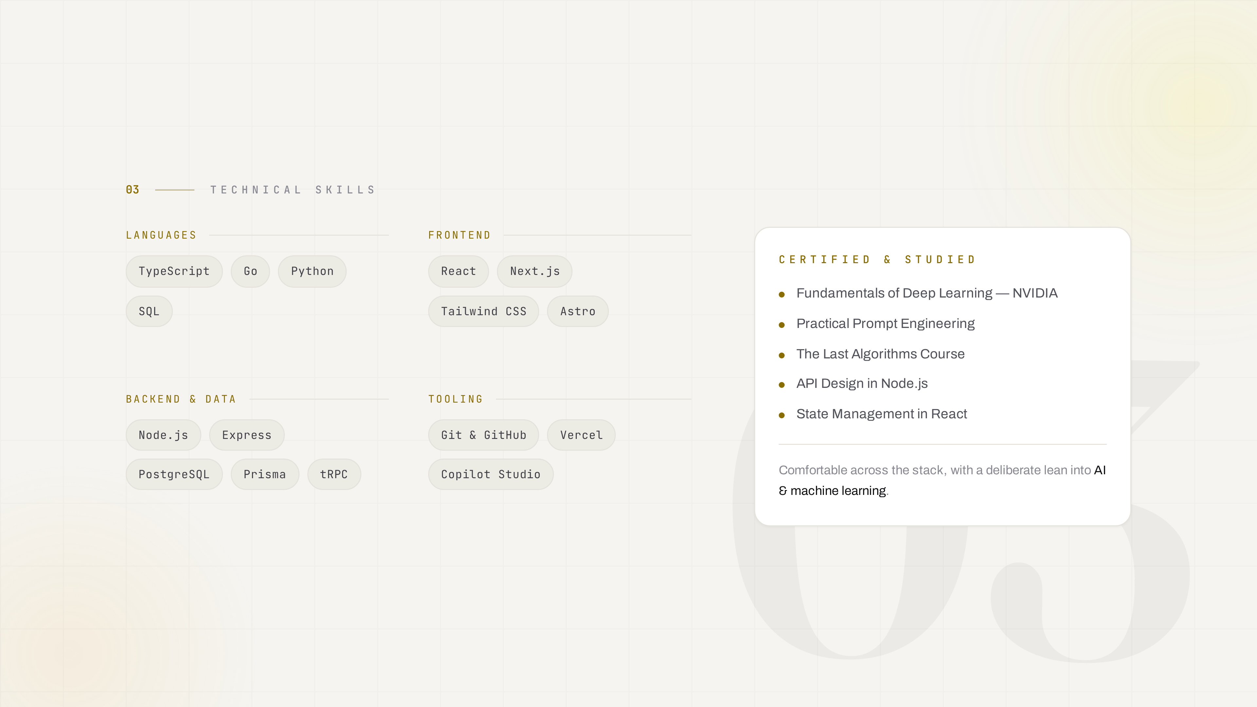
Notes:
Technical skills

Slide 5
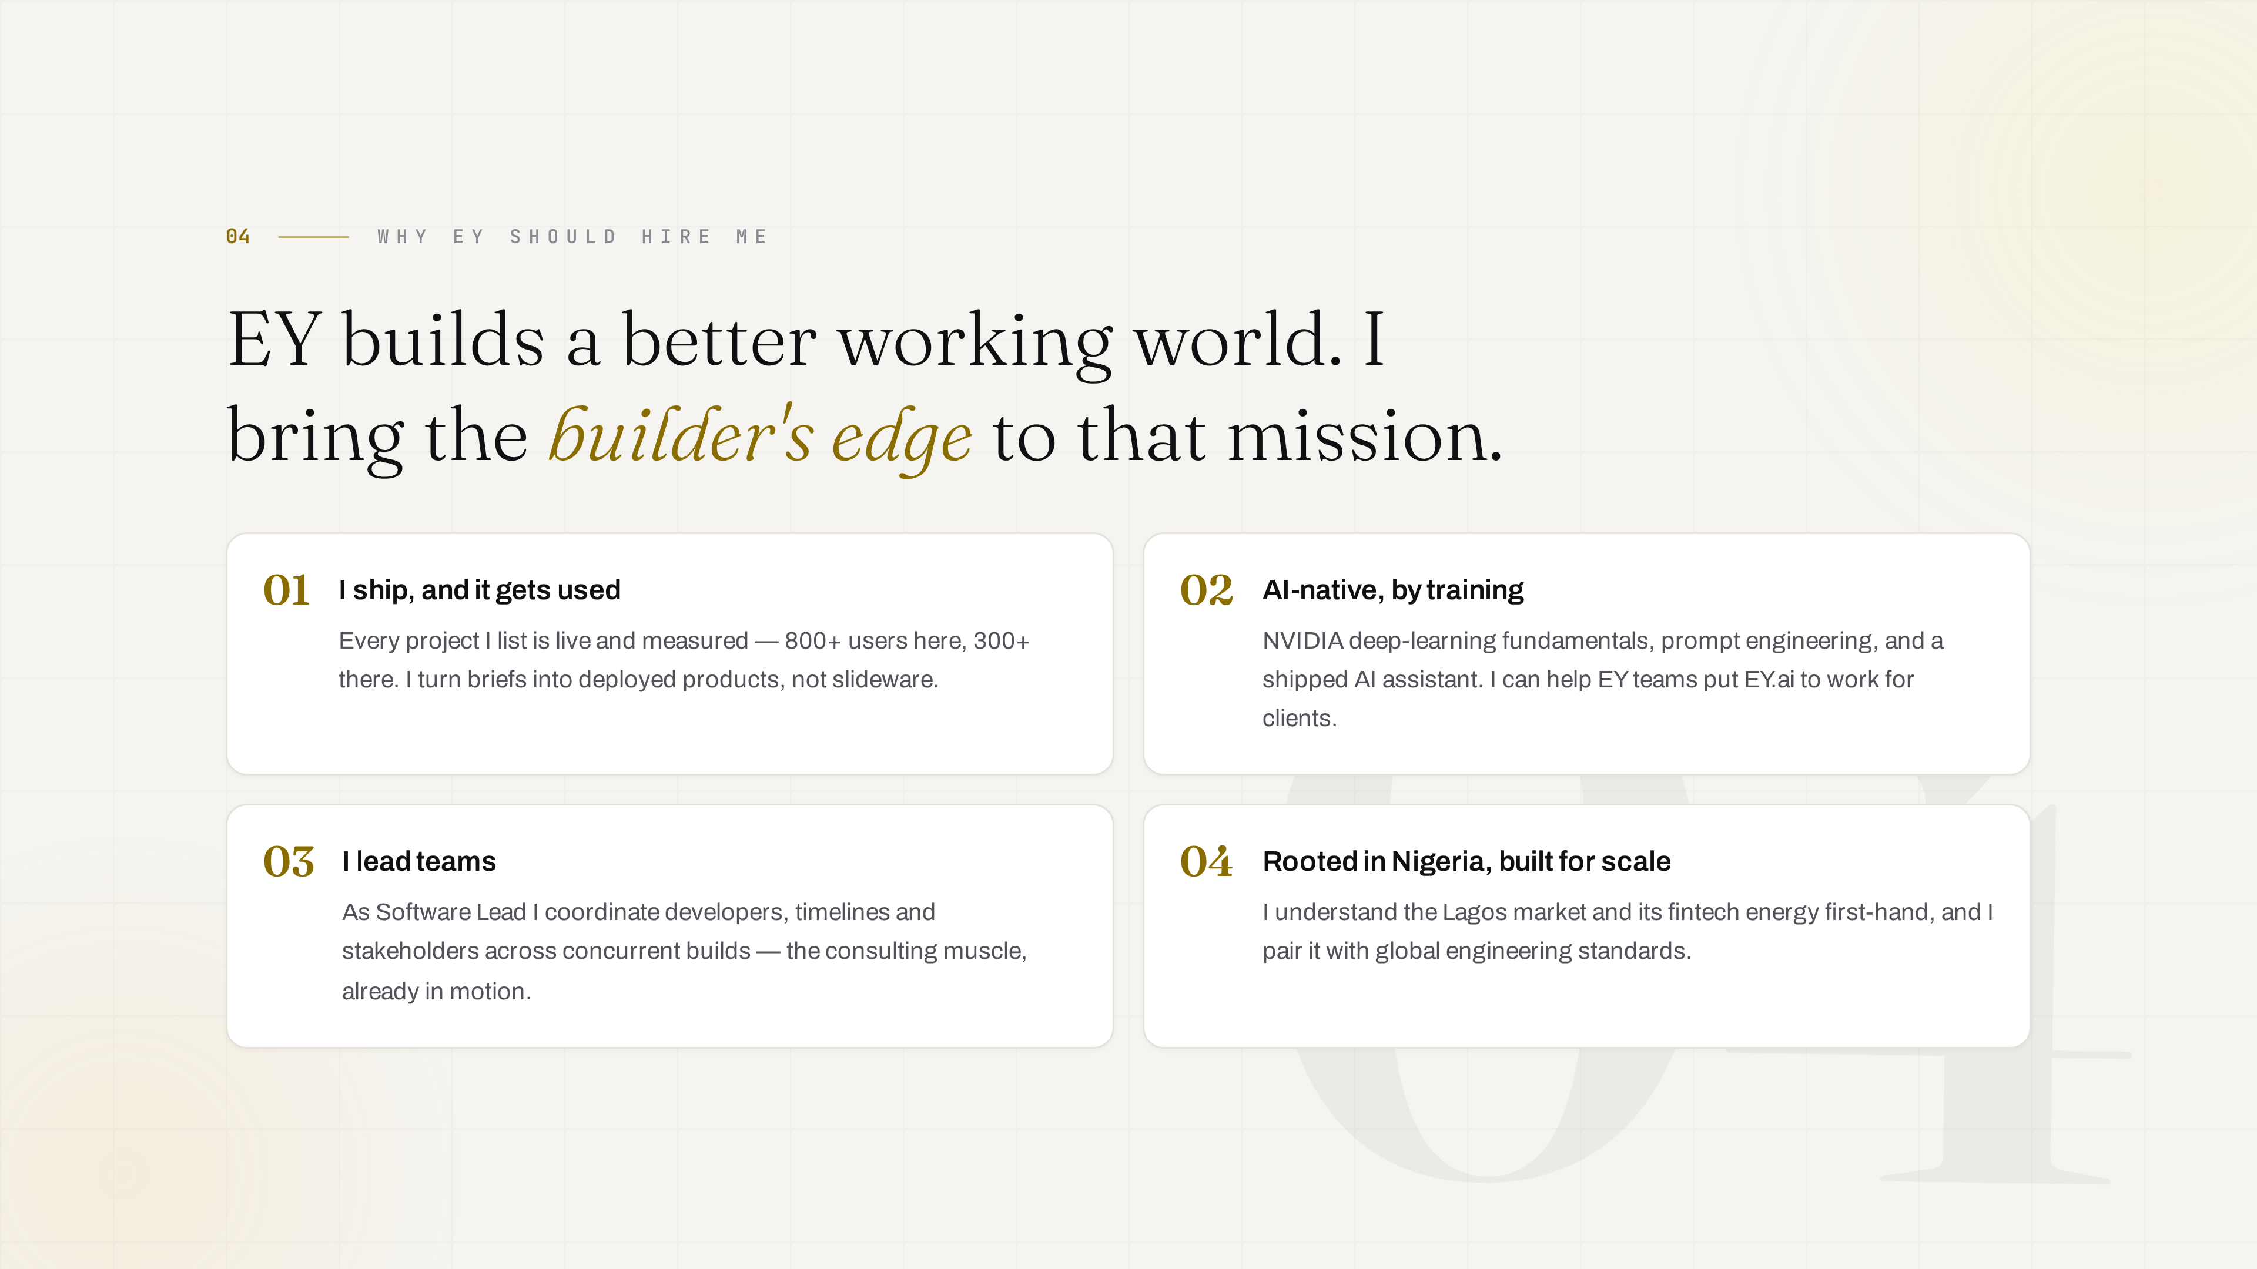
Notes:
Why EY should hire me

Slide 6

Notes:
Emerging technology trends

Slide 7
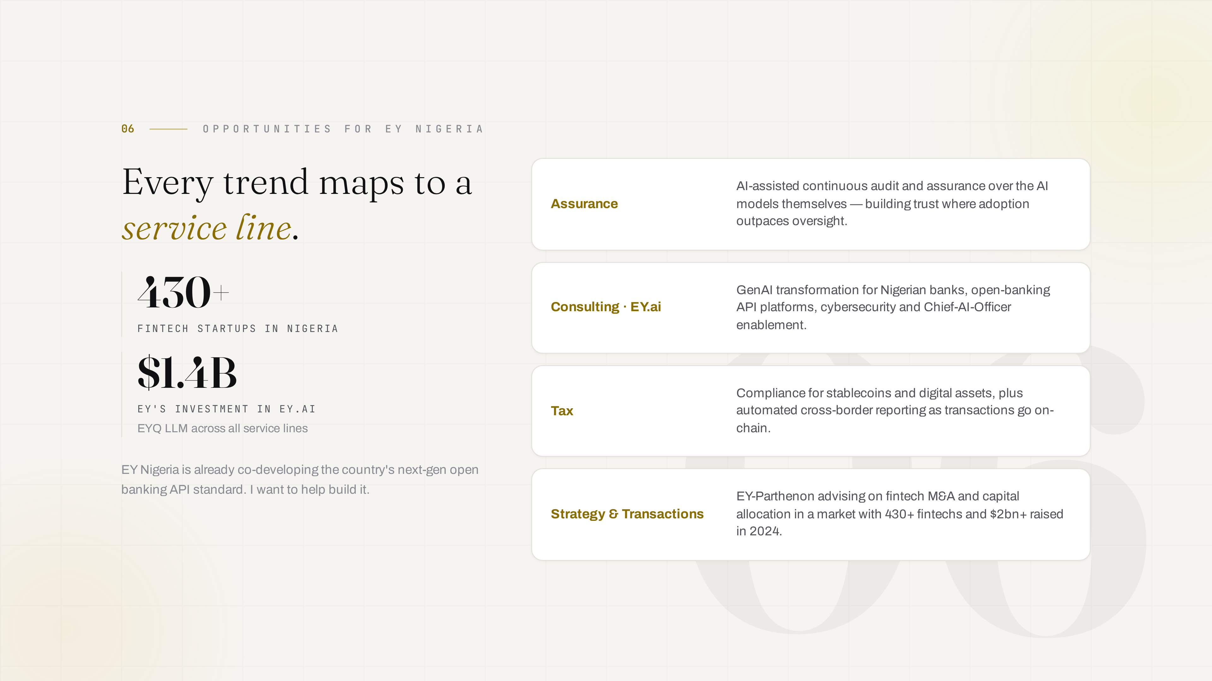
Notes:
Opportunities for EY Nigeria

Slide 8

Notes:
Thank you

