Slide 1

Battle of The Neighbourhoods
The Caribbean Flavour Edition!
By Aaron Beckford
Prepared for IBM Data Science Professional Capstone Project Submission
August 26, 2019

Slide 2

Introduction – Where do We go?
The Good, Regular & Weird News!
WMFD is the holding company for a group of quick-service West Indian Restaurant Franchises
They are eyeing an expansion into an a new North American major market city, and have chosen Toronto, Ontario
They are tasking us to select the best neighbourhood for their 1^{st.} new location
But no project managers from WMFD have ever visited Toronto
What We Need to Figure Out Is...
Which neighbourhood would be the best for their first new location?
What would the competitive landscape look like for them in Toronto?
What would be the best way to communicate these findings to WMFD?

Slide 3

Data Collection & Cleaning
Foursquare API - our endpoint to retrieve lists of venues and their types within given neighbourhoods and Postal Code Forward Service Areas (FSAs) listed on Foursquare
Wikipedia - for the data required to form a table of all M-prefixed Canadian Postal codes and the neighbourhoods within them (M-prefixed postal codes in Canada are nearly exclusively used for addresses in Toronto city limits)
Statistics Canada – for the .GeoJSON file we will use to detail the boundary lines of each FSA within Toronto’s city limits
After we combine, filter & pre-process everything to fit our needs...
Our dataset consists of 7,869 unique venues across Toronto, retrieved from Foursquare, with their respective neighborhood names and FSA codes appended
A total of 347 unique types of venues are included in our results dataset. But, we’re only interested in one kind...

Slide 4
Processing & Modeling
We need to decide which Machine Learning model we will employ to analyze our finished datasets. A few aspects we need to keep in mind:
  Our data is mostly categorical, not continuous
  Geophysical coordinates are relevant
  We are trying to determine characteristics of the venues that are not immediately apparent in the dataset
Given what we’ve learned about Machine Learning models so far...
We are trying to discover new attributes in our data (3); Unsupervised Learning
We are categorizing venues by their distance from other similar venues (2); Clustering
Since we’re not trying to predict the coordinate values of the next location...
  We’ll be using the K-Means Unsupervised Clustering model!

Slide 5
Results
We are returned a list of each of the 103 FSAs in Toronto city limits, and each is attributed a cluster label by our K-Means model
Each neighbourhood is labeled according to the returned density of Caribbean Restaurants within the neighbourhood’s boundaries
Our cluster labels are integer values, from 0 to 3 inclusive
  For example. Cluster 0 contains zero Caribbean restaurants, Cluster 1 has one, Cluster 2 with two, and Cluster 3 has three.
We prepared a map of Toronto, with the FSA boundaries defined and each shaded in a linear color scale to represent their respective cluster label, to visually communicate our K-Means model’s result

Slide 6
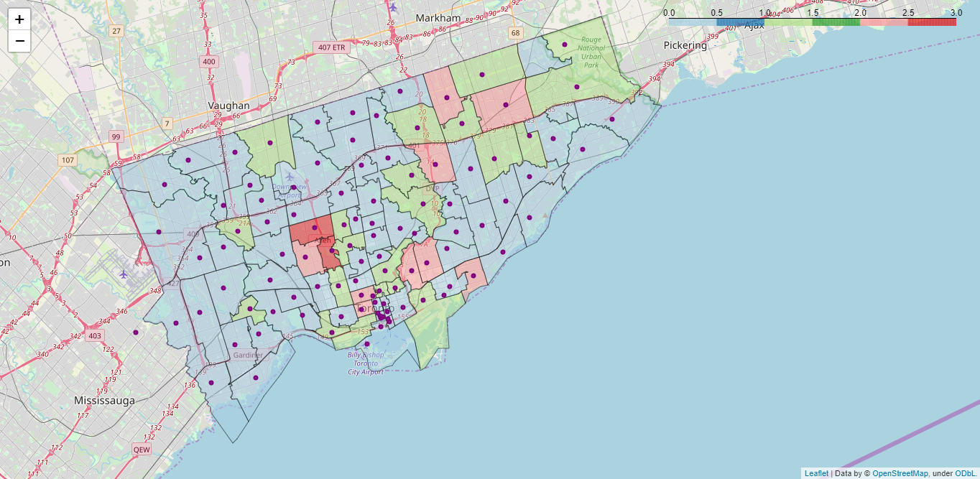
Our Results, Mapped!

Slide 7
Let’s Discuss The Results!
Our Cluster pattern shows to us some visually significant aspects of the distribution of Caribbean Restaurants within Toronto’s city limits:
  There is a noticeable constant presence of Caribbean restaurants heading Northeast outward from the Downtown core
  The highest concentration of Caribbean restaurants seems to be in the Midtown - Eglinton West areas, with two Cluster 3 neighbourhoods
  The majority of Caribbean restaurants are located south of Highway 401, a major highway route that runs East-West through Toronto
In light of these three distinguishable patterns of distribution on the Choropleth map we’ve developed, we would recommend to WMFD to focus your location planning on commercial real estate in the Weston (M9N) neighbourhood.
  We recommend Weston as the best neighbourhood for WMFD’s expansion due to it reflecting the three major aspects discovered from our analysis:
  There is already present, but not yet saturated, demand for Caribbean restaurants in the area
  It is located South of Highway 401
  It is outside of the aforementioned northeasterly distribution of Caribbean restaurants in Toronto, reducing the risk of over-competition

Slide 8
Reflections & Conclusion
In order to make a more accurate, granular analysis of the best neighbourhood, we would have made the following changes:
  Include a population distribution plot to also communicate potential target market sizes per neighbourhood
  Include a Median income distribution plot to allow WMFD to determine appropriate item pricing
  Overlay Mean & Median values of Toronto commercial property listings closed within the last 2yrs-3yrs onto plot so that WMFD can develop better sense of expected returns & return timelines on financial outlays for real estate purchases and/or leases

Slide 9
Thank You!
By Aaron Beckford

