Slide 1
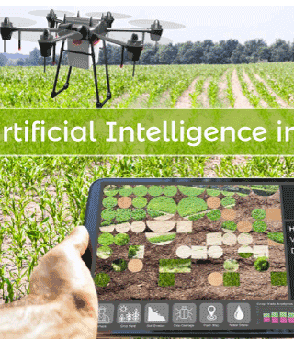
Agricultural Detection
Double A projects
This Photo by Unknown Author is licensed under CC BY-ND

Slide 2

Introduction
hi this is the Double A project
the program is meant to assist in agriculture, our aims or goal of this project is to create an AI application that will be used for farming.
AN innovative AI-powered farming solution that leverages machine learning and computer vision to optimize crop yields, reduce waste, and promote sustainable farming practices. Our mission is to empower farmers with data-driven insights, enabling them to make informed decisions and increase their productivity.

Slide 3
Problem Statement:
Traditional farming methods rely on manual observations, leading to inaccurate predictions and inefficient resource allocation.
Climate change, soil degradation, and pests/diseases pose significant threats to global food security.
Farmers lack access to timely and accurate data, hindering their ability to respond to changing conditions.

Slide 4
Solution:
Our AI-powered farming application aims to:
Crop Monitoring: Utilizing computer vision and machine learning algorithms to analyse satellite and drone imagery, detecting early signs of stress, disease, and pests.
Predictive Analytics: Providing farmers with accurate forecasts of weather patterns, soil moisture, and crop yields, enabling data-driven decision-making.

Slide 5
Target market:
Small-scale farmers
Large-scale commercial farms
Agricultural cooperatives
Government agencies and research institutions

Slide 6
Competitive Advantage:
Increased crop yields and reduced waste
Improved resource allocation and reduced labour costs
Enhanced decision-making capabilities for farmers
Promotion of sustainable farming practices and reduced environmental impact

Slide 7
Design
Application design, we went with a simple design, we used flutter on android studio, to program an object detection application which we then programmed to detect things using live camera visuals. with the help of teachable machine, we created a tflite model to test the application to see if it meets our requirements. we gathered videos and images of different types of crops and weeds from different sources.

Slide 8
unfortunately, we couldn't load our trained model to our project, due to some technical issues that we faced and time-slot, our devices were not compatible with certain IDE plugins which delayed us a lot and our project was 80-90% done.

